Slide 1

Recursion
By Alex Joslin

Slide 2
What is Recursion?
In computer science, recursion is when a function calls itself.
Example
def func():
// code
func()
func()

Slide 3
How do functions work behind the scenes
def d(): pass def c(): d() def b(): c() def a(): b() c() a()

Slide 4
How do functions work behind the scenes
def d(): pass def c(): d() def b(): c() def a(): b() c() a()

Slide 5
How do functions work behind the scenes
a()
def d(): pass def c(): d() def b(): c() def a(): b() c() a()

Slide 6
How do functions work behind the scenes
a()
def d(): pass def c(): d() def b(): c() def a(): b() c() a()

Slide 7
How do functions work behind the scenes
b()
a()
def d(): pass def c(): d() def b(): c() def a(): b() c() a()

Slide 8
How do functions work behind the scenes
b()
a()
def d(): pass def c(): d() def b(): c() def a(): b() c() a()

Slide 9
How do functions work behind the scenes
c()
b()
a()
def d(): pass def c(): d() def b(): c() def a(): b() c() a()

Slide 10
How do functions work behind the scenes
c()
b()
a()
def d(): pass def c(): d() def b(): c() def a(): b() c() a()

Slide 11
How do functions work behind the scenes
d()
c()
b()
a()
def d(): pass def c(): d() def b(): c() def a(): b() c() a()

Slide 12
How do functions work behind the scenes
d()
c()
b()
a()
def d(): pass def c(): d() def b(): c() def a(): b() c() a()

Slide 13
How do functions work behind the scenes
c()
b()
a()
def d(): pass def c(): d() def b(): c() def a(): b() c() a()

Slide 14
How do functions work behind the scenes
b()
a()
def d(): pass def c(): d() def b(): c() def a(): b() c() a()

Slide 15
How do functions work behind the scenes
a()
def d(): pass def c(): d() def b(): c() def a(): b() c() a()

Slide 16
How do functions work behind the scenes
a()
def d(): pass def c(): d() def b(): c() def a(): b() c() a()

Slide 17
How do functions work behind the scenes
c()
a()
def d(): pass def c(): d() def b(): c() def a(): b() c() a()

Slide 18
How do functions work behind the scenes
c()
a()
def d(): pass def c(): d() def b(): c() def a(): b() c() a()

Slide 19
How do functions work behind the scenes
d()
c()
a()
def d(): pass def c(): d() def b(): c() def a(): b() c() a()

Slide 20
How do functions work behind the scenes
d()
c()
a()
def d(): pass def c(): d() def b(): c() def a(): b() c() a()

Slide 21
How do functions work behind the scenes
c()
a()
def d(): pass def c(): d() def b(): c() def a(): b() c() a()

Slide 22
How do functions work behind the scenes
a()
def d(): pass def c(): d() def b(): c() def a(): b() c() a()

Slide 23
How do functions work behind the scenes
def d(): pass def c(): d() def b(): c() def a(): b() c() a()

Slide 24
Recursion
def a(): a() a()

Slide 25
Recursion
a()
def a(): a() a()

Slide 26
Recursion
a()
def a(): a() a()

Slide 27
Recursion
a()
a()
def a(): a() a()

Slide 28
Recursion
a()
a()
def a(): a() a()

Slide 29
Recursion
a()
a()
a()
def a(): a() a()

Slide 30
Recursion
a()
a()
a()
def a(): a() a()

Slide 31
Recursion
a()
a()
a()
a()
def a(): a() a()

Slide 32
Recursion
a()
a()
a()
a()
def a(): a() a()

Slide 33
Recursion
a()
a()
a()
a()
a()
a()
a()
a()
def a(): a() a()

Slide 34
Recursion
a()
a()
a()
a()
a()
a()
a()
a()
STACK OVERFLOW
def a(): a() a()

Slide 35
Recursion – With Base Case
def a(i): if i == 3: return a(i+1) a(1)
Base Case
( A condition used to
terminate recursive calls )

Slide 36
Recursion – With Base Case
def a(i): if i == 3: return a(i+1) a(1)

Slide 37
Recursion – With Base Case
a(1)
def a(i): if i == 3: return a(i+1) a(1)

Slide 38
Recursion – With Base Case
a(1)
def a(i): if i == 3: return a(i+1) a(1)

Slide 39
Recursion – With Base Case
a(1)
def a(i): if i == 3: return a(i+1) a(1)

Slide 40
Recursion – With Base Case
a(2)
a(1)
def a(i): if i == 3: return a(i+1) a(1)

Slide 41
Recursion – With Base Case
a(2)
a(1)
def a(i): if i == 3: return a(i+1) a(1)

Slide 42
Recursion – With Base Case
a(2)
a(1)
def a(i): if i == 3: return a(i+1) a(1)

Slide 43
Recursion – With Base Case
a(3)
a(2)
a(1)
def a(i): if i == 3: return a(i+1) a(1)

Slide 44
Recursion – With Base Case
a(3)
a(2)
a(1)
def a(i): if i == 3: return a(i+1) a(1)

Slide 45
Recursion – With Base Case
a(3)
a(2)
a(1)
def a(i): if i == 3: return a(i+1) a(1)

Slide 46
Recursion – With Base Case
a(2)
a(1)
def a(i): if i == 3: return a(i+1) a(1)

Slide 47
Recursion – With Base Case
a(1)
def a(i): if i == 3: return a(i+1) a(1)

Slide 48
Recursion – With Base Case
def a(i): if i == 3: return a(i+1) a(1)

Slide 49

Recursion - Factorial Example

Slide 50
Recursion – Factorial
fib(4) ---> 24
4 * 3 * 2 * 1 = 24
fib(6) ---> 720
6 * 5 * 4 * 3 * 2 * 1 = 720

Slide 51
Recursion – Factorial
def fac(n): if n == 1: # base case return 1 else:
return n * fac(n-1) print(fac(4)) # 24

Slide 52
Recursion – Factorial
fac(4)
def fac(n): if n == 1: # base case return 1 else:
return n * fac(n-1) print(fac(4)) # 24

Slide 53
Recursion – Factorial
fac(4)
def fac(n): if n == 1: # base case return 1 else:
return n * fac(n-1) print(fac(4)) # 24

Slide 54
Recursion – Factorial
4 * fac(3)
fac(4)
def fac(n): if n == 1: # base case return 1 else:
return n * fac(n-1) print(fac(4)) # 24

Slide 55
Recursion – Factorial
4 * fac(3)
fac(4)
def fac(n): if n == 1: # base case return 1 else:
return n * fac(n-1) print(fac(4)) # 24

Slide 56
Recursion – Factorial
4 * fac(3)
fac(4)
def fac(n): if n == 1: # base case return 1 else:
return n * fac(n-1) print(fac(4)) # 24

Slide 57
Recursion – Factorial
3 * fac(2)
4 * fac(3)
fac(4)
def fac(n): if n == 1: # base case return 1 else:
return n * fac(n-1) print(fac(4)) # 24

Slide 58
Recursion – Factorial
3 * fac(2)
4 * fac(3)
fac(4)
def fac(n): if n == 1: # base case return 1 else:
return n * fac(n-1) print(fac(4)) # 24

Slide 59
Recursion – Factorial
3 * fac(2)
4 * fac(3)
fac(4)
def fac(n): if n == 1: # base case return 1 else:
return n * fac(n-1) print(fac(4)) # 24

Slide 60
Recursion – Factorial
2 * fac(1)
3 * fac(2)
4 * fac(3)
fac(4)
def fac(n): if n == 1: # base case return 1 else:
return n * fac(n-1) print(fac(4)) # 24

Slide 61
Recursion – Factorial
2 * fac(1)
3 * fac(2)
4 * fac(3)
fac(4)
def fac(n): if n == 1: # base case return 1 else:
return n * fac(n-1) print(fac(4)) # 24

Slide 62
Recursion – Factorial
2 * fac(1)
3 * fac(2)
4 * fac(3)
fac(4)
def fac(n): if n == 1: # base case return 1 else:
return n * fac(n-1) print(fac(4)) # 24

Slide 63
Recursion – Factorial
2 * fac(1)
3 * fac(2)
4 * fac(3)
fac(4)
def fac(n): if n == 1: # base case return 1 else:
return n * fac(n-1) print(fac(4)) # 24

Slide 64
Recursion – Factorial
2 * 1
3 * fac(2)
4 * fac(3)
fac(4)
def fac(n): if n == 1: # base case return 1 else:
return n * fac(n-1) print(fac(4)) # 24

Slide 65
Recursion – Factorial
3 * 2
4 * fac(3)
fac(4)
def fac(n): if n == 1: # base case return 1 else:
return n * fac(n-1) print(fac(4)) # 24

Slide 66
Recursion – Factorial
4 * 6
fac(4)
def fac(n): if n == 1: # base case return 1 else:
return n * fac(n-1) print(fac(4)) # 24

Slide 67
Recursion – Factorial
24
def fac(n): if n == 1: # base case return 1 else:
return n * fac(n-1) print(fac(4)) # 24

Slide 68
Recursion - Fibonacci Example

Slide 69
Recursion – Fibonacci Sequence
0, 1, 1, 2, 3, 5, 8, 13, 21, 34, ...
fib(4) ---> 3
fib(6) ---> 8
fib(9) ---> 34

Slide 70
Recursion – Fibonacci Sequence
def fib(n): if n == 1: # base case return 1
elif n == 0:
return 0 else:
return fib(n-1) + fib(n-2) print(fib(4)) # 3

Slide 71
Recursion – Fibonacci Sequence
def fib(n): if n == 1: # base case return 1
elif n == 0:
return 0 else:
return fib(n-1) + fib(n-2) print(fib(4)) # 3

Slide 72
Recursion – Fibonacci Sequence
fib(4)
fib(3)
fib(2)
def fib(n): if n == 1: # base case return 1
elif n == 0:
return 0 else:
return fib(n-1) + fib(n-2) print(fib(4)) # 3
fib(2)
fib(1)
fib(1)
fib(0)
1
1
0
fib(1)
fib(0)
1
0

Slide 73
Recursion Fibonacci Sequence
fib(4)
fib(3)
fib(2)
fib(2)
fib(1)
fib(1)
fib(0)
1
1
0
fib(1)
fib(0)
def fib(n): if n == 1: return 1
elif n == 0:
return 0 else:
return fib(n-1) + fib(n-2) print(fib(4))
1
0

Slide 74
Recursion Fibonacci Sequence
fib(4)
fib(3)
fib(2)
fib(4)
fib(2)
fib(1)
fib(1)
fib(0)
1
1
0
fib(1)
fib(0)
def fib(n): if n == 1: return 1
elif n == 0:
return 0 else:
return fib(n-1) + fib(n-2) print(fib(4))
1
0

Slide 75
Recursion Fibonacci Sequence
fib(4)
fib(3)
fib(2)
fib(4)
fib(2)
fib(1)
fib(1)
fib(0)
1
1
0
fib(1)
fib(0)
def fib(n): if n == 1: return 1
elif n == 0:
return 0 else:
return fib(n-1) + fib(n-2) print(fib(4))
1
0

Slide 76
Recursion Fibonacci Sequence
fib(4)
fib(3)
fib(2)
fib(3)
fib(4)
fib(2)
fib(1)
fib(1)
fib(0)
1
1
0
fib(1)
fib(0)
def fib(n): if n == 1: return 1
elif n == 0:
return 0 else:
return fib(n-1) + fib(n-2) print(fib(4))
1
0

Slide 77
Recursion Fibonacci Sequence
fib(4)
fib(3)
fib(2)
fib(3)
fib(4)
fib(2)
fib(1)
fib(1)
fib(0)
1
1
0
fib(1)
fib(0)
def fib(n): if n == 1: return 1
elif n == 0:
return 0 else:
return fib(n-1) + fib(n-2) print(fib(4))
1
0

Slide 78
Recursion Fibonacci Sequence
fib(4)
fib(3)
fib(2)
fib(2)
fib(3)
fib(4)
fib(2)
fib(1)
fib(1)
fib(0)
1
1
0
fib(1)
fib(0)
def fib(n): if n == 1: return 1
elif n == 0:
return 0 else:
return fib(n-1) + fib(n-2) print(fib(4))
1
0

Slide 79
Recursion Fibonacci Sequence
fib(4)
fib(3)
fib(2)
fib(2)
fib(3)
fib(4)
fib(2)
fib(1)
fib(1)
fib(0)
1
1
0
fib(1)
fib(0)
def fib(n): if n == 1: return 1
elif n == 0:
return 0 else:
return fib(n-1) + fib(n-2) print(fib(4))
1
0

Slide 80
Recursion Fibonacci Sequence
fib(4)
fib(3)
fib(2)
fib(1)
fib(2)
fib(3)
fib(4)
fib(2)
fib(1)
fib(1)
fib(0)
1
1
0
fib(1)
fib(0)
def fib(n): if n == 1: return 1
elif n == 0:
return 0 else:
return fib(n-1) + fib(n-2) print(fib(4))
1
0

Slide 81
Recursion Fibonacci Sequence
fib(4)
fib(3)
fib(2)
fib(1)
fib(2)
fib(3)
fib(4)
fib(2)
fib(1)
fib(1)
fib(0)
1
1
0
fib(1)
fib(0)
def fib(n): if n == 1: return 1
elif n == 0:
return 0 else:
return fib(n-1) + fib(n-2) print(fib(4))
1
0

Slide 82
Recursion Fibonacci Sequence
fib(4)
fib(3)
fib(2)
1
fib(2)
fib(3)
fib(4)
fib(2)
fib(1)
fib(1)
fib(0)
1
1
0
fib(1)
fib(0)
def fib(n): if n == 1: return 1
elif n == 0:
return 0 else:
return fib(n-1) + fib(n-2) print(fib(4))
1
0

Slide 83
Recursion Fibonacci Sequence
fib(4)
fib(3)
fib(2)
1 + fib(2)
fib(3)
fib(4)
fib(2)
fib(1)
fib(1)
fib(0)
1 +
1
1
0
fib(1)
fib(0)
def fib(n): if n == 1: return 1
elif n == 0:
return 0 else:
return fib(n-1) + fib(n-2) print(fib(4))
1
0

Slide 84
Recursion Fibonacci Sequence
fib(4)
fib(3)
fib(2)
fib(0)
1 + fib(2)
fib(3)
fib(4)
fib(2)
fib(1)
fib(1)
fib(0)
1 +
1
1
0
fib(1)
fib(0)
def fib(n): if n == 1: return 1
elif n == 0:
return 0 else:
return fib(n-1) + fib(n-2) print(fib(4))
1
0

Slide 85
Recursion Fibonacci Sequence
fib(4)
fib(3)
fib(2)
fib(0)
1 + fib(2)
fib(3)
fib(4)
fib(2)
fib(1)
fib(1)
fib(0)
1 +
1
1
0
fib(1)
fib(0)
def fib(n): if n == 1: return 1
elif n == 0:
return 0 else:
return fib(n-1) + fib(n-2) print(fib(4))
1
0

Slide 86
Recursion Fibonacci Sequence
fib(4)
fib(3)
fib(2)
0
1 + fib(2)
fib(3)
fib(4)
fib(2)
fib(1)
fib(1)
fib(0)
1 +
1
1
0
fib(1)
fib(0)
def fib(n): if n == 1: return 1
elif n == 0:
return 0 else:
return fib(n-1) + fib(n-2) print(fib(4))
1
0

Slide 87
Recursion Fibonacci Sequence
fib(4)
fib(3)
fib(2)
1 + 0
fib(3)
fib(4)
fib(2)
fib(1)
fib(1)
fib(0)
1 + 0
1
1
0
fib(1)
fib(0)
def fib(n): if n == 1: return 1
elif n == 0:
return 0 else:
return fib(n-1) + fib(n-2) print(fib(4))
1
0

Slide 88
Recursion Fibonacci Sequence
fib(4)
fib(3)
fib(2)
1 +
1 + fib(3)
fib(4)
fib(2)
fib(1)
fib(1)
fib(0)
1 + 0
1
1
0
fib(1)
fib(0)
def fib(n): if n == 1: return 1
elif n == 0:
return 0 else:
return fib(n-1) + fib(n-2) print(fib(4))
1
0

Slide 89
Recursion Fibonacci Sequence
fib(4)
fib(3)
fib(2)
1 +
fib(1)
1 + fib(3)
fib(4)
fib(2)
fib(1)
fib(1)
fib(0)
1 + 0
1
1
0
fib(1)
fib(0)
def fib(n): if n == 1: return 1
elif n == 0:
return 0 else:
return fib(n-1) + fib(n-2) print(fib(4))
1
0

Slide 90
Recursion Fibonacci Sequence
fib(4)
fib(3)
fib(2)
1 +
fib(1)
1 + fib(3)
fib(4)
fib(2)
fib(1)
fib(1)
fib(0)
1 + 0
1
1
0
fib(1)
fib(0)
def fib(n): if n == 1: return 1
elif n == 0:
return 0 else:
return fib(n-1) + fib(n-2) print(fib(4))
1
0

Slide 91
Recursion Fibonacci Sequence
fib(4)
fib(3)
fib(2)
1 +
1
1 + fib(3)
fib(4)
fib(2)
fib(1)
fib(1)
fib(0)
1 + 0
1
1
0
fib(1)
fib(0)
def fib(n): if n == 1: return 1
elif n == 0:
return 0 else:
return fib(n-1) + fib(n-2) print(fib(4))
1
0

Slide 92
Recursion Fibonacci Sequence
fib(4)
fib(3)
fib(2)
1 + 1
1 + 1
fib(4)
fib(2)
fib(1)
fib(1)
fib(0)
1 + 0
1
1
0
fib(1)
fib(0)
def fib(n): if n == 1: return 1
elif n == 0:
return 0 else:
return fib(n-1) + fib(n-2) print(fib(4))
1
0

Slide 93
Recursion Fibonacci Sequence
fib(4)
2 +
fib(3)
fib(2)
1 + 1
2 + fib(4)
fib(2)
fib(1)
fib(1)
fib(0)
1 + 0
1
1
0
fib(1)
fib(0)
def fib(n): if n == 1: return 1
elif n == 0:
return 0 else:
return fib(n-1) + fib(n-2) print(fib(4))
1
0

Slide 94
Recursion Fibonacci Sequence
fib(4)
2 +
fib(3)
fib(2)
1 + 1
fib(2)
2 + fib(4)
fib(2)
fib(1)
fib(1)
fib(0)
1 + 0
1
1
0
fib(1)
fib(0)
def fib(n): if n == 1: return 1
elif n == 0:
return 0 else:
return fib(n-1) + fib(n-2) print(fib(4))
1
0

Slide 95
Recursion Fibonacci Sequence
fib(4)
2 +
fib(3)
fib(2)
1 + 1
fib(2)
2 + fib(4)
fib(2)
fib(1)
fib(1)
fib(0)
1 + 0
1
1
0
fib(1)
fib(0)
def fib(n): if n == 1: return 1
elif n == 0:
return 0 else:
return fib(n-1) + fib(n-2) print(fib(4))
1
0

Slide 96
Recursion Fibonacci Sequence
fib(4)
2 +
fib(3)
fib(2)
1 + 1
fib(1)
fib(2)
2 + fib(4)
fib(2)
fib(1)
fib(1)
fib(0)
1 + 0
1
1
0
fib(1)
fib(0)
def fib(n): if n == 1: return 1
elif n == 0:
return 0 else:
return fib(n-1) + fib(n-2) print(fib(4))
1
0

Slide 97
Recursion Fibonacci Sequence
fib(4)
2 +
fib(3)
fib(2)
1 + 1
fib(1)
fib(2)
2 + fib(4)
fib(2)
fib(1)
fib(1)
fib(0)
1 + 0
1
1
0
fib(1)
fib(0)
def fib(n): if n == 1: return 1
elif n == 0:
return 0 else:
return fib(n-1) + fib(n-2) print(fib(4))
1
0

Slide 98
Recursion Fibonacci Sequence
fib(4)
2 +
fib(3)
fib(2)
1 + 1
1
fib(2)
2 + fib(4)
fib(2)
fib(1)
fib(1)
fib(0)
1 + 0
1
1
0
fib(1)
fib(0)
def fib(n): if n == 1: return 1
elif n == 0:
return 0 else:
return fib(n-1) + fib(n-2) print(fib(4))
1
0

Slide 99
Recursion Fibonacci Sequence
fib(4)
2 +
fib(3)
fib(2)
1 + 1
1 +
1 + fib(2)
2 + fib(4)
fib(2)
fib(1)
fib(1)
fib(0)
1 + 0
1
1
0
fib(1)
fib(0)
def fib(n): if n == 1: return 1
elif n == 0:
return 0 else:
return fib(n-1) + fib(n-2) print(fib(4))
1
0

Slide 100
Recursion Fibonacci Sequence
fib(4)
2 +
fib(3)
fib(2)
1 + 1
1 +
fib(0)
1 + fib(2)
2 + fib(4)
fib(2)
fib(1)
fib(1)
fib(0)
1 + 0
1
1
0
fib(1)
fib(0)
def fib(n): if n == 1: return 1
elif n == 0:
return 0 else:
return fib(n-1) + fib(n-2) print(fib(4))
1
0

Slide 101
Recursion Fibonacci Sequence
fib(4)
2 +
fib(3)
fib(2)
1 + 1
1 +
fib(0)
1 + fib(2)
2 + fib(4)
fib(2)
fib(1)
fib(1)
fib(0)
1 + 0
1
1
0
fib(1)
fib(0)
def fib(n): if n == 1: return 1
elif n == 0:
return 0 else:
return fib(n-1) + fib(n-2) print(fib(4))
1
0

Slide 102
Recursion Fibonacci Sequence
fib(4)
2 +
fib(3)
fib(2)
1 + 1
1 +
0
1 + fib(2)
2 + fib(4)
fib(2)
fib(1)
fib(1)
fib(0)
1 + 0
1
1
0
fib(1)
fib(0)
def fib(n): if n == 1: return 1
elif n == 0:
return 0 else:
return fib(n-1) + fib(n-2) print(fib(4))
1
0

Slide 103
Recursion Fibonacci Sequence
fib(4)
2 +
fib(3)
fib(2)
1 + 1
1 + 0
1 + 0
2 + fib(4)
fib(2)
fib(1)
fib(1)
fib(0)
1 + 0
1
1
0
fib(1)
fib(0)
def fib(n): if n == 1: return 1
elif n == 0:
return 0 else:
return fib(n-1) + fib(n-2) print(fib(4))
1
0

Slide 104
Recursion Fibonacci Sequence
fib(4)
2 + 1
fib(3)
fib(2)
1 + 1
1 + 0
2 + 1
fib(2)
fib(1)
fib(1)
fib(0)
1 + 0
1
1
0
fib(1)
fib(0)
def fib(n): if n == 1: return 1
elif n == 0:
return 0 else:
return fib(n-1) + fib(n-2) print(fib(4))
1
0

Slide 105
Recursion Fibonacci Sequence
3
fib(4)
2 + 1
fib(3)
fib(2)
1 + 1
1 + 0
3
fib(2)
fib(1)
fib(1)
fib(0)
1 + 0
1
1
0
fib(1)
fib(0)
def fib(n): if n == 1: return 1
elif n == 0:
return 0 else:
return fib(n-1) + fib(n-2) print(fib(4))
1
0

Slide 106
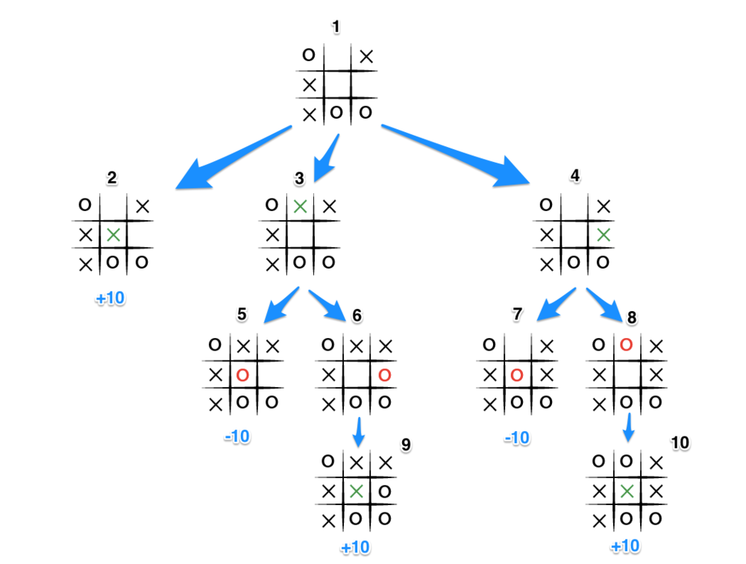
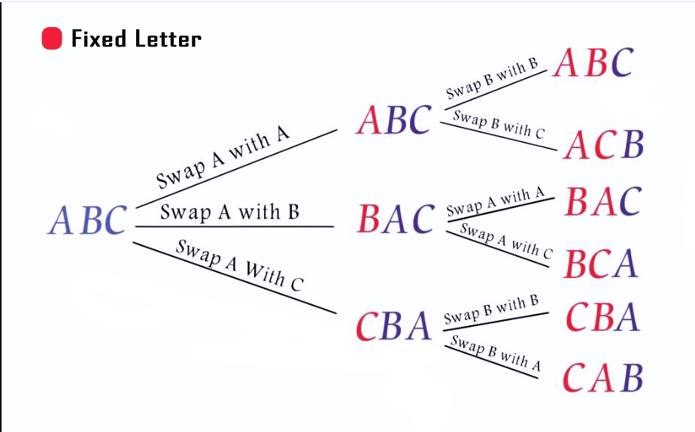
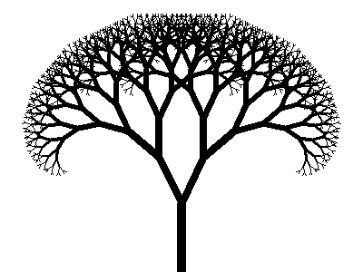
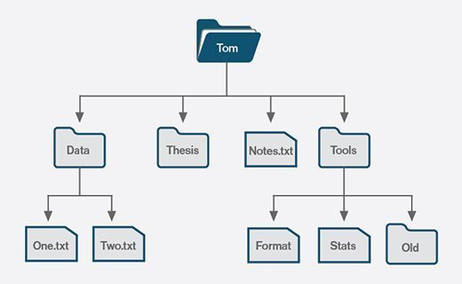

What is Recursion used for?
You typically see recursion used to solve problems that are difficult to solve iteratively.
Permutations
File search in a tree-based
files system
Determining all the possible
moves in a game with AI
Fractals

Slide 107
Can anything done iteratively be done recursively?
Can anything done recursively be done iteratively?
YES! (In theory)
Church-Turning Thesis Proved this.
In practice, not so much. You may run into memory and time constraints. Not so easy to do.

Slide 108
Exercise Challenge
Create a recursive algorithm that returns True or False if there exists a combination of x and/or y numbers that add up to a limit.
addup(11, 2, 3) # True (2 + 2 + 2 + 2 + 3 == 11)
addup(10, 5, 3) # True (5 + 5 = 10)
addup(8, 3, 6) # False (No combination exists)
addup(19, 5, 7) # True (5 + 7 + 7)
addup(13, 4, 2) # False (No combination exists)

