Slide 1
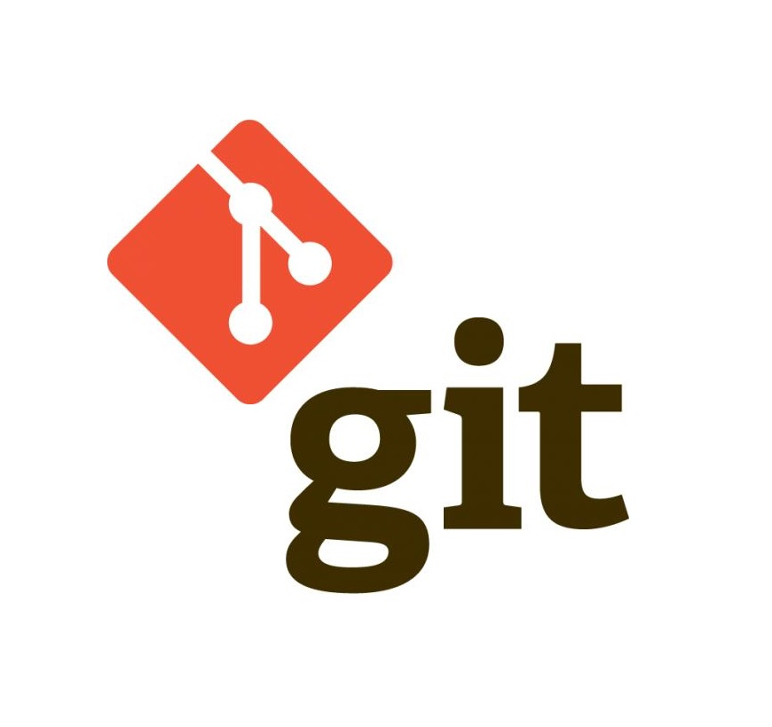
Version Control with Git
by Alex Joslin

Slide 2
How do people calibrate together on coding project?
They uses a version control system such as
git
perforce
subversion
bitbucket
Git is the most popular version control system

Slide 3

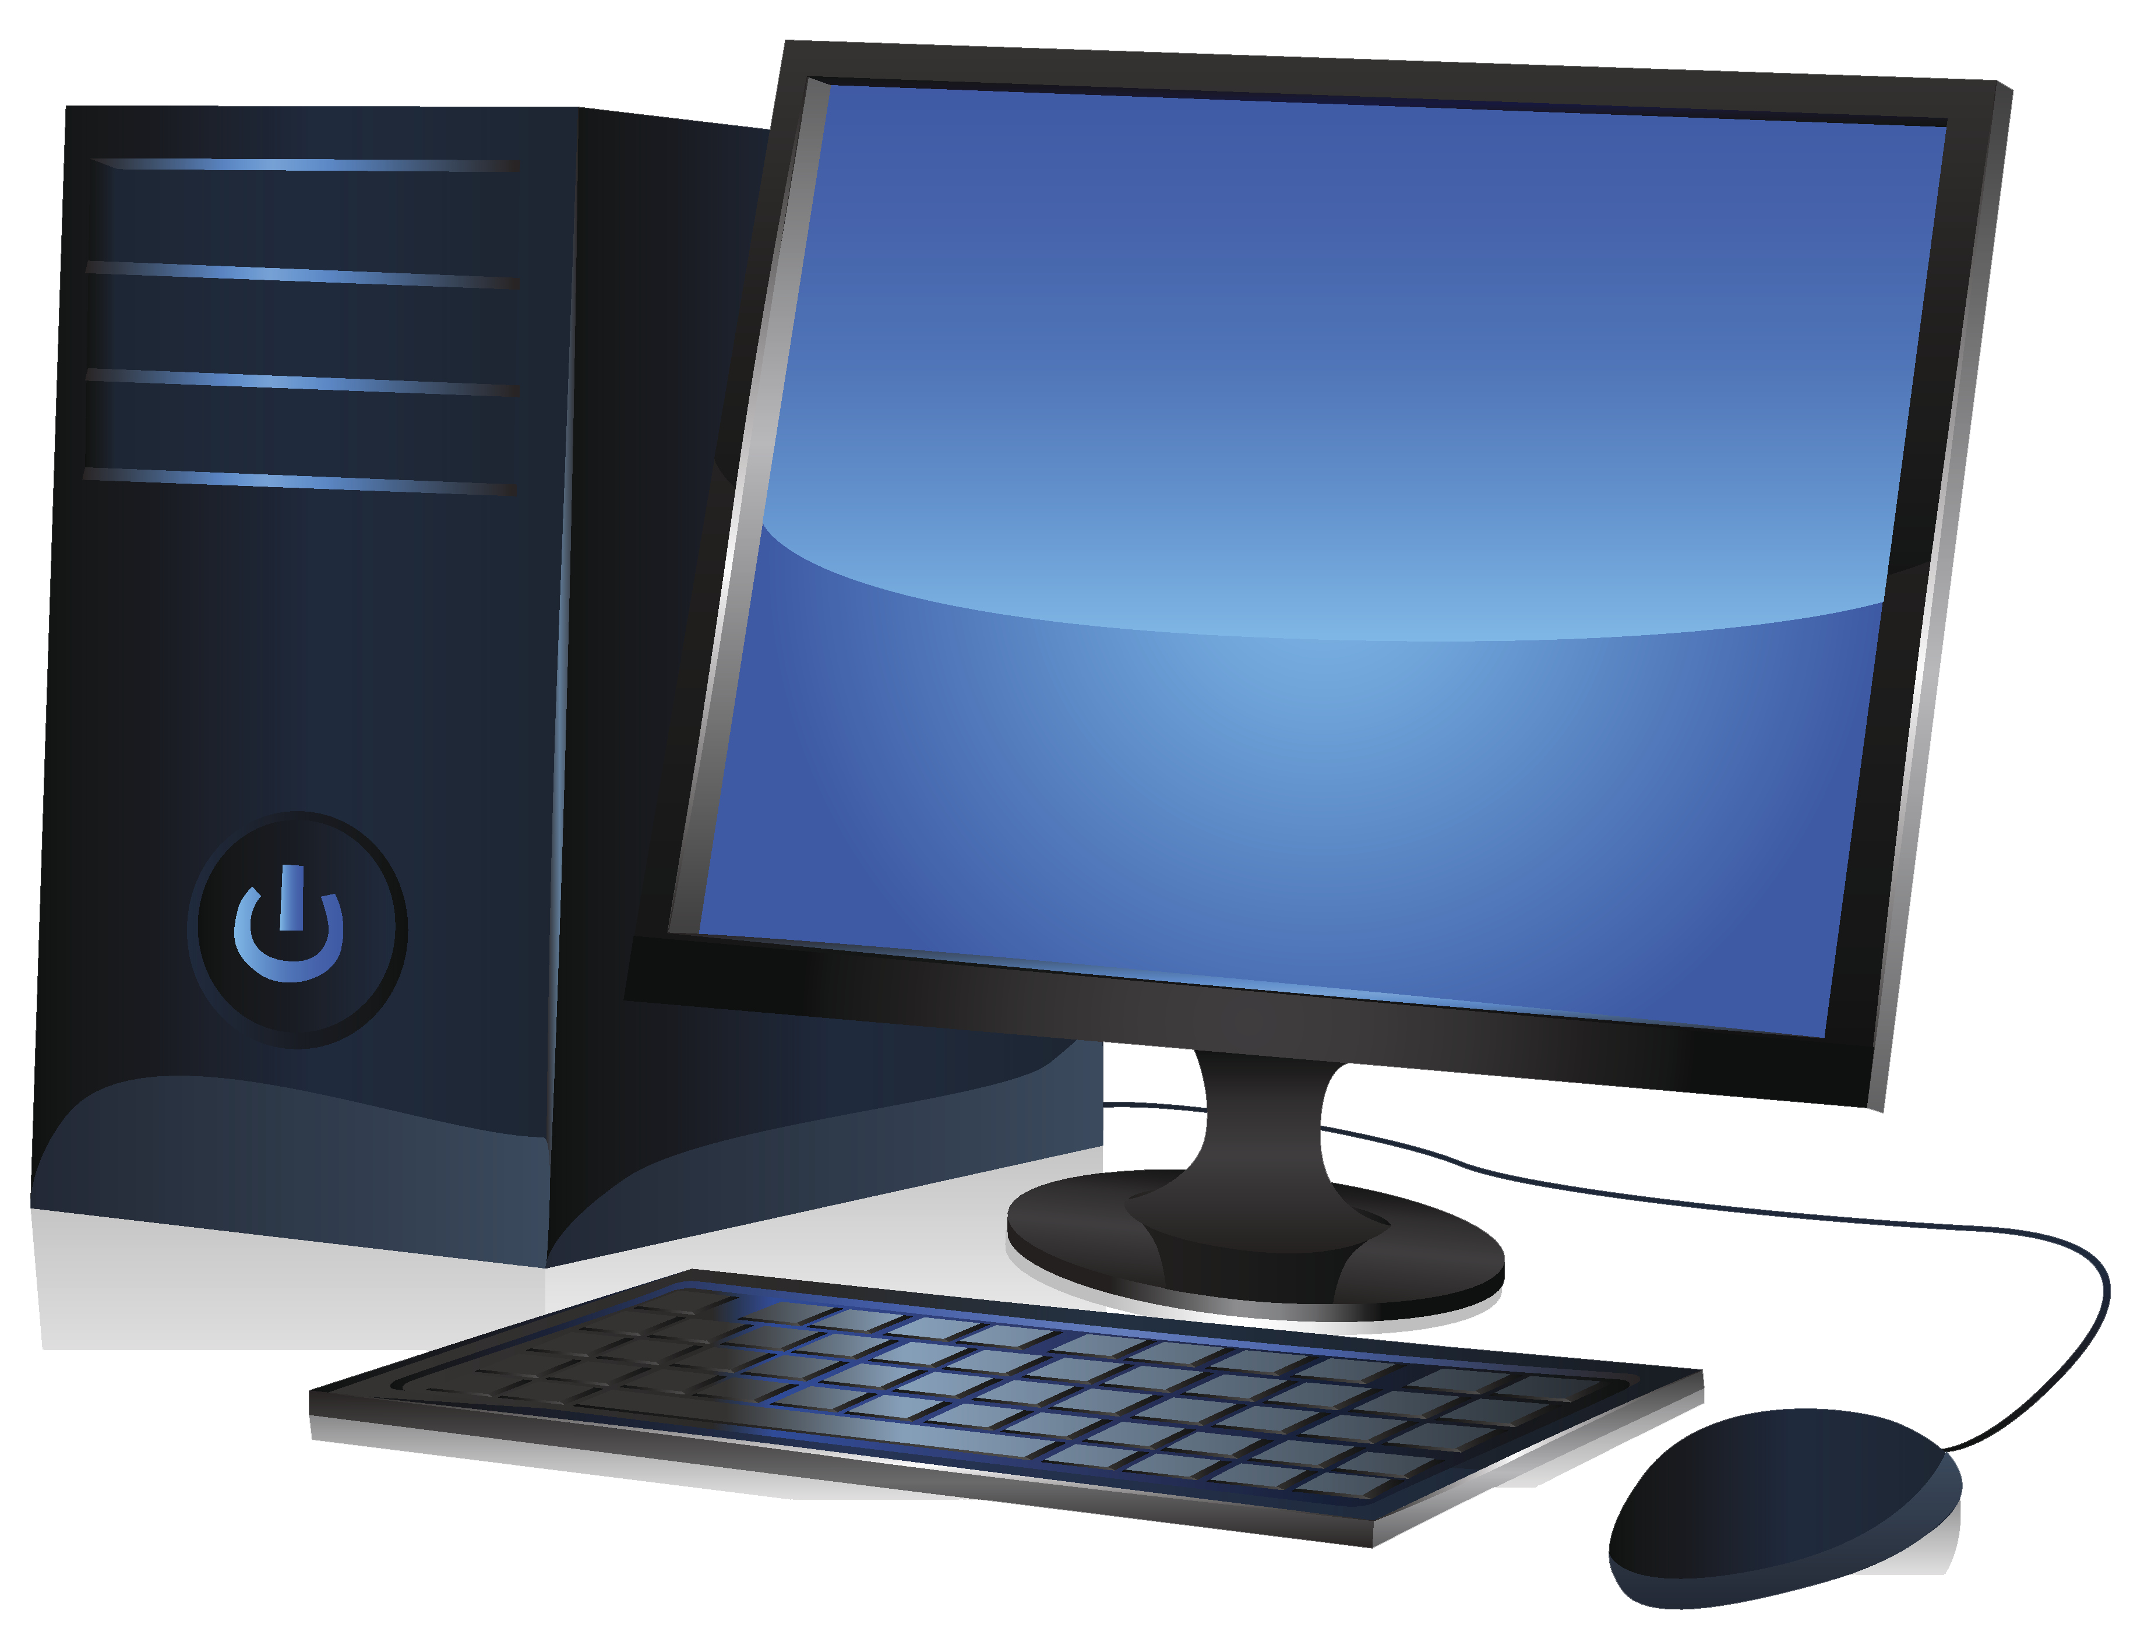
github.com
Concepts
Remote Repo
Local Repo
Working Directory
Log
Commands
Push
Pull
Commit
Clone
Alex
Marcel

Slide 4
Commands
clone / init
add
commit
push
pull
github.com
Remote Repo
Alex
Marcel
Working Directory
Working Directory
Local Repo
Local Repo
Staging Area
Staging Area
tower.py
enemy.py

Slide 5
Commands
clone / init
add
commit
push
pull
github.com
Remote Repo
Alex
Marcel
Working Directory
Working Directory
Local Repo
Local Repo
git commit
git commit
Staging Area
Staging Area
git add
git add
tower.py
enemy.py

Slide 6
Commands
clone / init
add
commit
push
pull
github.com
Remote Repo
Alex
Marcel
Working Directory
Working Directory
Local Repo
Local Repo
git commit
git commit
Staging Area
Staging Area
git add
git add
tower.py
enemy.py

