Slide 1

Heaps
By Alex Joslin

Slide 2
What is a Heap?
Oxford Dictionary: A disorderly collection of objects placed haphazardly on top of each other.
Computer Science: It is a complete binary tree that is used to rank items in a low time complexity.

Slide 3
Min Heap
Max Heap
2
25
4
5
19
23
9
7
10
9
15
14
16
11
15
11
18
6
3
8

Slide 4
Insertion
2
h.insert(20)
h.insert(3)
4
5
9
7
10
9
15
11
18
20
3

Slide 5
Insertion
2
h.insert(20)
h.insert(3)
4
5
9
7
3
9
15
11
18
20
10

Slide 6
Insertion
2
h.insert(20)
h.insert(3)
4
3
h.insert(1)
9
7
5
9
15
11
18
20
10
1

Slide 7
Insertion
2
h.insert(20)
h.insert(3)
4
3
h.insert(1)
9
7
1
9
15
11
18
20
10
5

Slide 8
Insertion
2
h.insert(20)
h.insert(3)
4
1
h.insert(1)
9
7
3
9
15
11
18
20
10
5

Slide 9
Insertion
1
h.insert(20)
h.insert(3)
4
2
h.insert(1)
h.insert(31)
h.insert(6)
9
7
3
9
15
11
18
20
10
5
31
6

Slide 10
Insertion
1
h.insert(20)
h.insert(3)
4
2
h.insert(1)
h.insert(31)
h.insert(6)
9
7
3
6
15
11
18
20
10
5
31
9

Slide 11
Deletion
1
h.delete()
4
2
9
7
3
6
15
11
18
20
10
5
31
9

Slide 12
Deletion
9
h.delete()
4
2
9
7
3
6
15
11
18
20
10
5
31
9

Slide 13
Deletion
2
h.delete()
4
9
9
7
3
6
15
11
18
20
10
5
31

Slide 14
Deletion
2
h.delete()
4
3
9
7
9
6
15
11
18
20
10
5
31

Slide 15
Deletion
2
h.delete()
h.delete()
4
3
9
7
5
6
15
11
18
20
10
9
31

Slide 16
Deletion
31
h.delete()
h.delete()
4
3
9
7
5
6
15
11
18
20
10
9
31

Slide 17
Deletion
3
h.delete()
h.delete()
4
31
9
7
5
6
15
11
18
20
10
9

Slide 18
Deletion
3
h.delete()
h.delete()
4
5
9
7
31
6
15
11
18
20
10
9

Slide 19
Deletion
3
h.delete()
h.delete()
4
5
h.delete()
9
7
9
6
15
11
18
20
10
31

Slide 20
Deletion
31
h.delete()
h.delete()
4
5
h.delete()
9
7
9
6
15
11
18
20
10
31

Slide 21
Deletion
4
h.delete()
h.delete()
31
5
h.delete()
9
7
9
6
15
11
18
20
10

Slide 22
Deletion
4
h.delete()
h.delete()
7
5
h.delete()
9
31
9
6
15
11
18
20
10

Slide 23
Deletion
4
h.delete()
h.delete()
7
5
h.delete()
h.delete()
9
18
9
6
15
11
31
20
10

Slide 24
Deletion
10
h.delete()
h.delete()
7
5
h.delete()
h.delete()
9
18
9
6
15
11
31
20
10

Slide 25
Deletion
5
h.delete()
h.delete()
7
10
h.delete()
h.delete()
9
18
9
6
15
11
31
20

Slide 26
Deletion
5
h.delete()
h.delete()
7
9
h.delete()
h.delete()
h.delete()
9
18
10
6
15
11
31
20

Slide 27
Deletion
20
h.delete()
h.delete()
7
9
h.delete()
h.delete()
h.delete()
9
18
10
6
15
11
31
20

Slide 28
Deletion
7
h.delete()
h.delete()
20
9
h.delete()
h.delete()
h.delete()
9
18
10
6
15
11
31

Slide 29
Deletion
7
h.delete()
h.delete()
9
9
h.delete()
h.delete()
h.delete()
20
18
10
6
15
11
31

Slide 30
Deletion
7
h.delete()
h.delete()
9
9
h.delete()
h.delete()
h.delete()
11
18
10
6
15
20
31

Slide 31
Time Complexity
Single operation
N operations
(building heap)
 | Average Case | Worst Case
Insert | O(log(n)) | O(n)
Delete | O(log(n)) | O(n)
Peek | O(1) | O(1)

Slide 32
O(log(n)) insertion on average
for a single node.
But since we are inserting
n nodes, we can’t treat
each insertion the same.
1
2
3
4
5
6
7
8
9
10
11
12
13
14
15

Slide 33
Nodes on different
levels have different
time complexities.
1
O(1)
2
-3
4
5
6
7
8
9
10
-11
12
13
14
15
O(3)

Slide 34
Nodes on different
levels have different
time complexities.
There for each node
has a time complexity
of O(h).
1
O(h)
2
-3
4
5
6
7
8
9
10
-11
12
13
14
15
O(h)

Slide 35




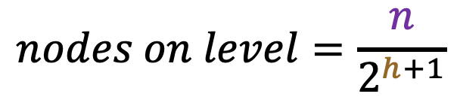





Height
$$n=15$$
nodes on level
$$h=3$$
1
$$1 \sim \frac{n}{16}$$
2
3
$$2 \sim \frac{n}{8}$$
$$h=2$$
4
5
6
7
$$4 \sim \frac{n}{4}$$
$$h=1$$
8
9
10
11
12
13
14
15
$$8 \sim \frac{n}{2}$$
$$h=0$$
$$nodes on level=\frac{n}{2^{h+1}}$$

Slide 36
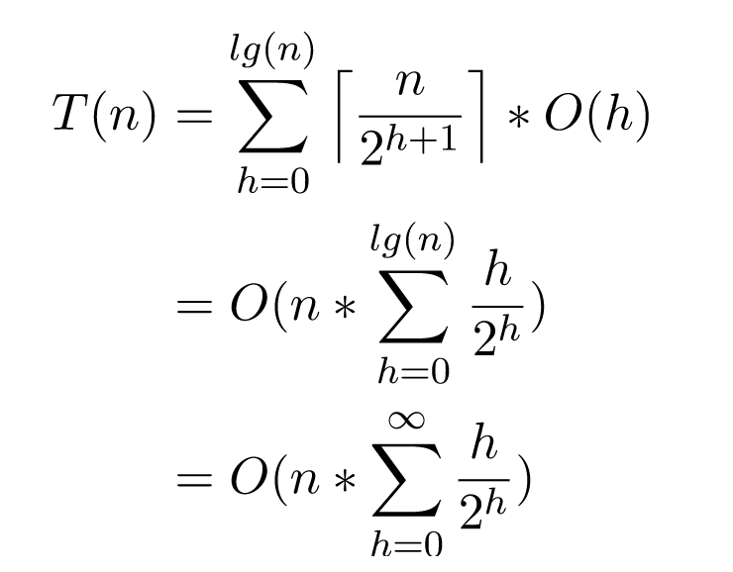
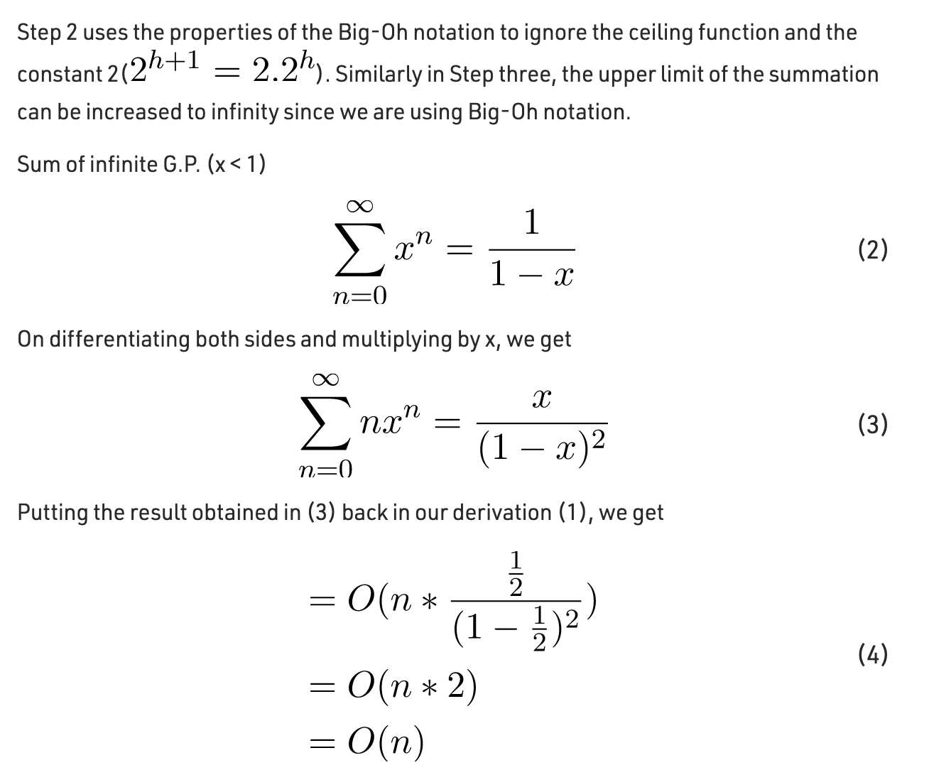

Slide 37
Implementation
1
2
3
4
5
6
7
8
9
10
11
12
13
14
15
1 | 2 | 3 | 4 | 5 | 6 | 7 | 8 | 9 | 10 | 11 | 12 | 13 | 14 | 15

