Slide 1

Perceptron
By Alex Joslin

Slide 2
Problem Set
INPUTS |  |  | OUTPUTS
0 | 0 | 1 | 0
1 | 1 | 1 | 1
1 | 0 | 1 | 1
0 | 1 | 1 | 0
1 | 0 | 0 | ?
Predict the expected output

Slide 3
Perceptron
A perceptron is a neural network with no hidden layers.
Inputs
Synapses
Neuron
Output

Slide 4







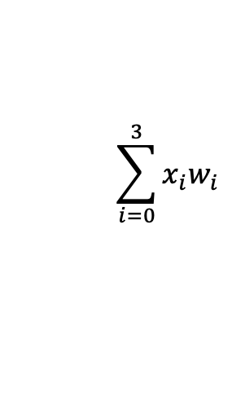



Perceptron
A perceptron is a neural network with no hidden layers.
Inputs
Synapses
Neuron
Output
$$x_{1}$$
$$w_{1}$$
$$w_{2}$$
$$\sum_{i=0}^{3}{x_{i}w_{i}}$$
$$∅\left(x\right)=\frac{1}{1+e^{−x}}$$
$$x_{2}$$
$$\hat{p}$$
$$nomalize data$$
$$w_{3}$$
$$x_{3}$$
$$summation of$$
$$inputs ∗ weights$$

Slide 5

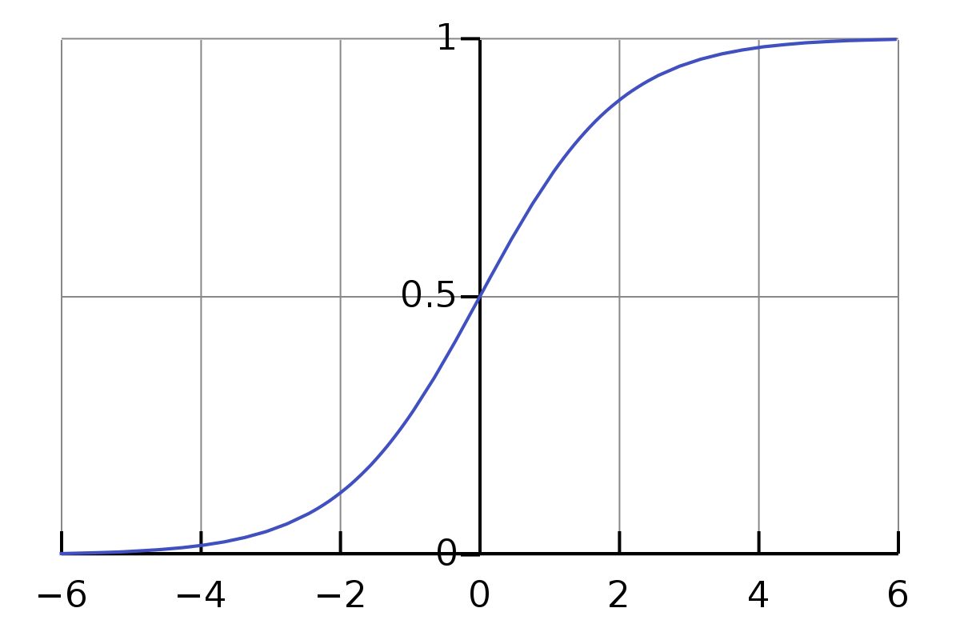

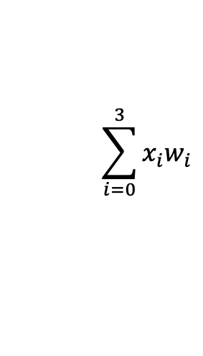



















Example
$$x_{1}$$
$$w_{1}$$
$$w_{2}$$
$$\sum_{i=0}^{3}{x_{i}w_{i}}$$
$$normalize data$$
$$x_{2}$$
$$\hat{p}$$
$$w_{3}$$
$$x_{3}$$
Sum of weighted inputs
Function
Sigmoid Normalizing
Function
Prediction
Inputs
Weights
$$\sum_{i=0}^{3}{x_{i}w_{i}=x_{1}w_{1}+x_{2}w_{2}+x_{3}w_{3}}$$
$$x_{1}=0$$
$$w_{1}=−0.165$$
$$φ\left(Sum\right)=\frac{1}{1+e^{−Sum}}$$
$$\hat{p}=0.268$$
$$x_{2}=0$$
$$w_{2}=0.440$$
$$x_{3}=1$$
$$w_{3}=−0.999$$
$$Sum=0∗−0.156+0∗0.440+1∗−0.999$$
$$φ\left(−0.999\right)=\frac{1}{1+e^{−(−0.999)}}$$
$$Sum=−0.999$$
$$φ\left(−0.999\right)=0.268$$

Slide 6
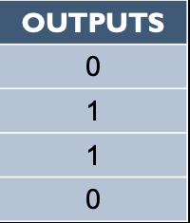
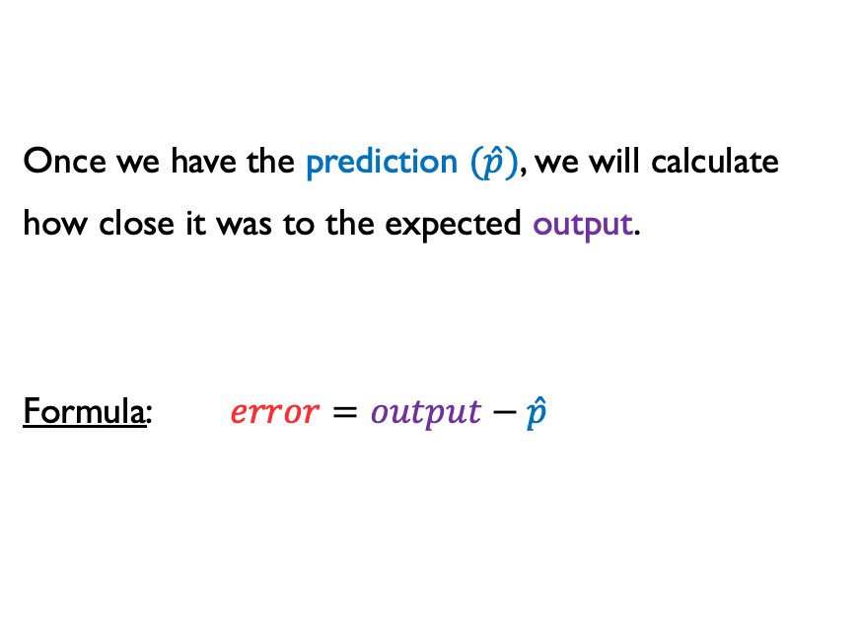


Error Weighted Derivative
Once we have the prediction $(\hat{p})$, we will calculate
how close it was to the expected output.
Formula: $error=output−\hat{p}$
$$error=0−0.268$$
$$error=−0.268$$

Slide 7



Adjusting the weights
Now we must train our neural network. We will be looping through our neural network 20,000 times.
With every pass, our neural network will get smarter.
To make it smarter, we must adjust the weights with every pass.
How do we adjust the weights accordingly? Answer: with another formula
$$φ^{′}\left(\hat{p}\right)=\hat{p}∗(1−\hat{p})$$
← Sigmoid Normalizing Derivative
$$snd=\hat{p}∗(1−\hat{p})$$
$$adjustment=error ∗{inputs}^{transposed} ∗snd$$
$$w_{i}+=adjustment$$
(new weights = previous weights + adjustment)

Slide 8
Now let’s try it with the entire input matrix
INPUTS |  |  | OUTPUTS
0 | 0 | 1 | 0
1 | 1 | 1 | 1
1 | 0 | 1 | 1
0 | 1 | 1 | 0

Slide 9
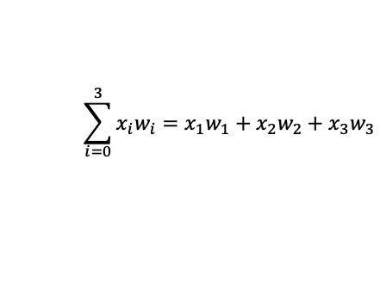

Inputs
Weights
Sum of weighted inputs
Sigmoid Normalized
Prediction
$$\sum_{i=0}^{3}{x_{i}w_{i}=x_{1}w_{1}+x_{2}w_{2}+x_{3}w_{3}}$$
$$φ\left(Sum\right)=\frac{1}{1+e^{−Sum}}$$
0 | 0 | 1
1 | 1 | 1
1 | 0 | 1
0 | 1 | 1
-0.999
-0.725
-1.165
-0.559
0.268
0.326
0.237
0.367
0.268
0.326
0.237
0.367
-0.165
0.440
-0.999
*
=
→

Slide 10




$$error$$
$$error=output−\hat{p}$$
$$outputs$$
Prediction
0
1
1
0
0.268
0.326
0.237
0.367
-0.268
0.673
0.762
-0.367
$$−$$
=

Slide 11



Sigmoid Normalizing Derivative ($snd$)
$$φ^{′}\left(\hat{p}\right)=\hat{p}∗(1−\hat{p})$$
Prediction
Prediction
0.268
0.326
0.237
0.367
1
1
1
1
0.268
0.326
0.237
0.367
0.196
0.219
0.181
0.231
*
$$−$$
=

Slide 12




adjustments
$$adjustment=error ∗{inputs}^{transposed} ∗snd$$
$$error$$
$$snd$$
$${inputs}^{transposed}$$
-0.268
0.673
0.762
-0.367
0.196
0.219
0.181
0.231
0 | 1 | 1 | 0
0 | 1 | 0 | 1
1 | 1 | 1 | 1
0.286
0.063
0.149
*
$$∗$$
=

Slide 13




$$New Adjusted weights$$
$$w_{i}+=adjustment$$
New Weights
Previous Weights
$$adjustment$$
0.120
0.504
-0.850
-0.165
0.440
-0.999
0.286
0.063
0.149
=
+

Slide 14
Repeat this process 20,000 times
Congratulations! You have just completed your first neural network!

