Slide 1

Threading
By Alex Joslin

Slide 2
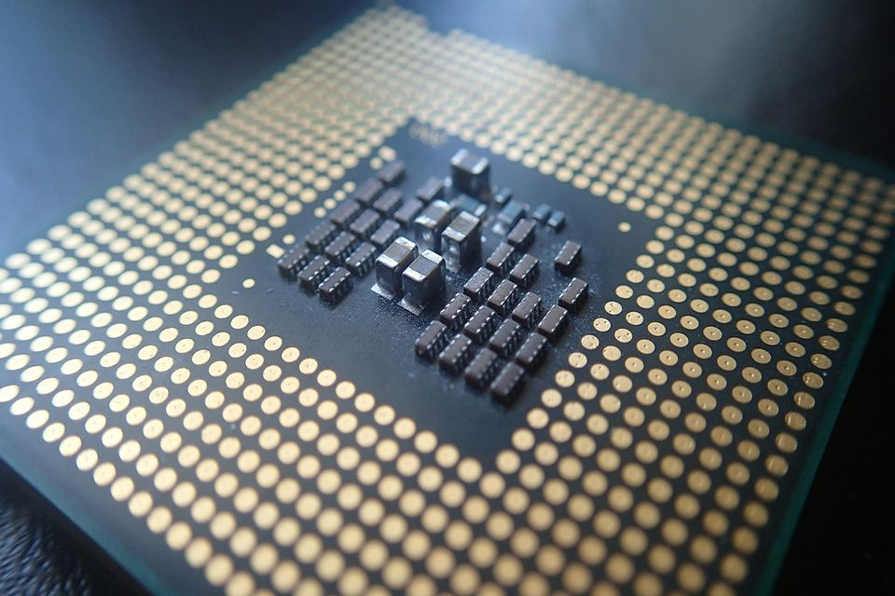
CPU Terminology
A CPU (central processing unit) also called
a processor is an electrical circuit that
executes instructions and performs basic
logical, mathematical, and I/O operations.
Cors
CPU
CPU’s have many components such as schedulers, ALU’s, clock, buses, cache, cors and many more.
A CPU cor can handle one task at a time

Slide 3
What is a process?
A process is basically a program an execution.
Example: Running word, email app, photoshop on your computer.
What is a thread?
A thread is a sequence of instructions in execution
Example: You are running word and 1 thread is saving the page every 5 seconds, a 2nd thread checking grammatical errors, a 3rd thread is displaying the content on screen.

Slide 4
What is multiprocessing?
When a CPU executes multiple processes at the same time among its multiple cors. This is referred to as Parallelism.
What is multithreading?
When a CPU Cor executes multiple threads independently by switching back and forth between each other. This is referred to as Concurrency.

