Slide 1

Protocols
By Alex Joslin

Slide 2
What is a Protocol
A set of rules that dictate how data is communicated across a network.
Many different networking protocols.
Each protocol have their own dedicated port number.

Slide 3

Examples of Protocols

Slide 4
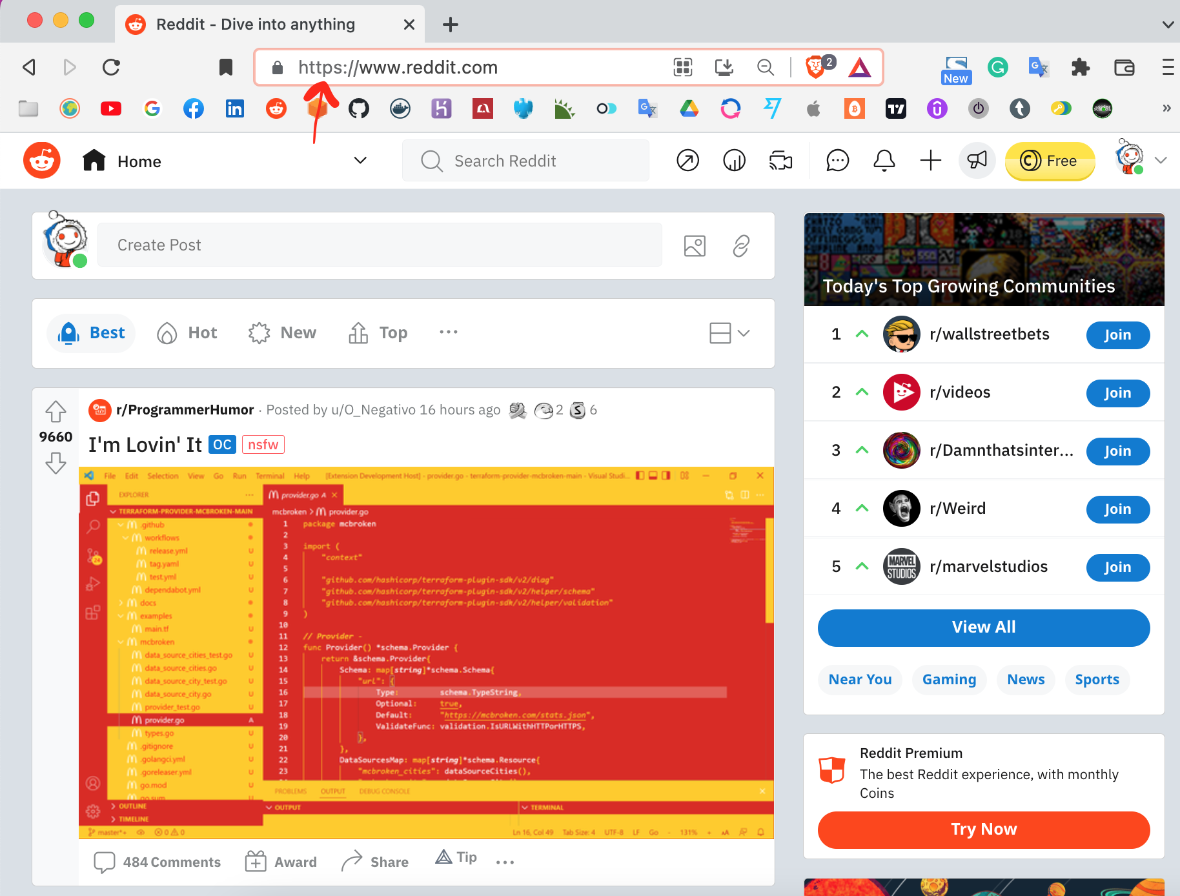
HTTP & HTTPS
Hypertext Transfer Protocol (Secure)
You open a web browser and navigate to https://www.reddit.com
Your browser sends a request to a server that is hosting that web page.
This request is sent through a protocol called http.

Slide 5

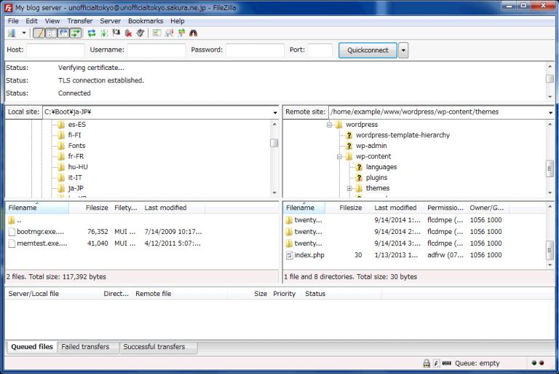
FTP
File Transfer Protocol
A way for computers to transfer files between one another through the internet. (Without a Web Browser)
Example: FileZilla
Notes:
What is the difference between Internet and World Wide Web?
You can also transfer files through HTTP.

