Slide 1
COMPARATIVE ANALYSIS OF MODERN TABULAR ML For
Network Intrusion Detection
Evaluating gradient boosting models for detecting cyber attacks in network traffic.
CSE-CIC-IDS2018
3 Models + SMOTE
<15 min
Main dataset
Models compared
Talk target
Farman H. Sayem · Jace C. Rea · Kunle S. Oguntoye
Group 5
Notes:
Opening: Introduce the project as a practical evaluation framework. We are not proposing a new algorithm; we are asking which tabular ML model is most useful for intrusion detection when we account for imbalance, calibration, thresholds, and drift. Time: about 40 seconds.

Slide 2
PROJECT OVERVIEW
Project overview: what we set out to build
Core purpose
What makes this more than a basic model comparison?
A reproducible evaluation framework for network intrusion detection models.
• Uses metrics that matter for cybersecurity, not just accuracy.
• Tests calibration because risk scores must be trustworthy.
• Tests drift because traffic changes across time and datasets.
• Classify network flows as benign or attack.
• Compare LightGBM, XGBoost, CatBoost, and SMOTE variant.
• Evaluate performance, probability reliability, and drift robustness.
Takeaway: The project is about making model evaluation more realistic for security use.
Group 5 · Network Intrusion Detection
2
Notes:
Explain the full project in one sentence: we built a reproducible Colab framework to test gradient boosting models for intrusion detection. Emphasize that the scope includes performance, calibration, thresholds, and drift. Time: about 50 seconds.

Slide 3
MOTIVATION
Motivation and relevance: why accuracy is not enough
Intrusion detection is a high-cost imbalance problem.
Missed attack
False alarm
Risk score
A false negative can mean an intrusion slips through.
A false positive adds analyst workload and alert fatigue.
A probability only helps if it is calibrated and actionable.
Metrics used: recall, precision, F1, PR-AUC, FPR, Brier score, and drift performance.
Takeaway: A useful detector has to catch attacks, avoid alert fatigue, and produce reliable risk scores.
Group 5 · Network Intrusion Detection
3
Notes:
Explain why accuracy is misleading: if attacks are rare, a model can be accurate while missing attacks. Introduce the central tradeoff: recall catches attacks; false positives create analyst fatigue; calibration helps risk scoring. Time: about 55 seconds.

Slide 4
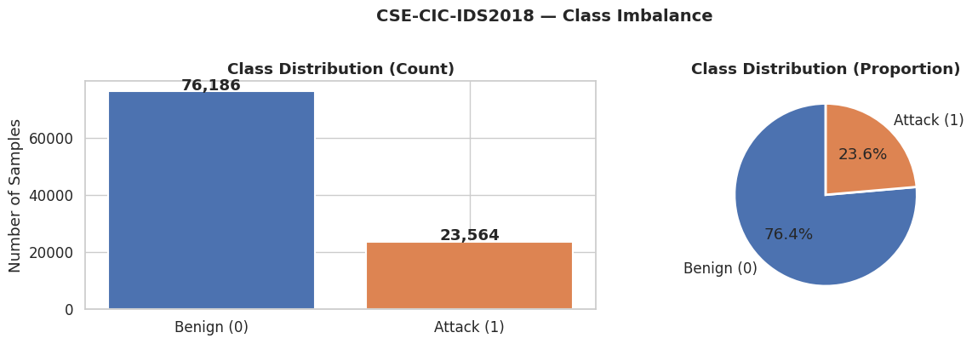
DATASET OVERVIEW
Dataset overview: class imbalance in the final 2018 sample
Final data used
• Primary dataset: CSE-CIC-IDS2018.
• Drift dataset: CIC-IDS2017.
• 2018 cleaned set: 99,750 rows.
• 2017 cleaned set: 48,902 rows.
Why it matters
The class split is not extreme, but attacks are still the minority class. PR-AUC and recall are more informative than accuracy.
Takeaway: The model must learn attack behavior from a smaller attack class, so imbalance-aware evaluation matters.
Group 5 · Network Intrusion Detection
4
Notes:
Walk through the class imbalance figure. The final 2018 sample has 76,186 benign and 23,564 attack samples, or about 23.6 percent attacks. This supports the decision to focus on PR-AUC and recall. Time: about 50 seconds.

Slide 5
IMPLEMENTATION
Project setup and Colab code stack
Environment
Pipeline layout
• Google Colab + Google Drive-mounted datasets.
• Fixed random seed: 42 for reproducibility.
• Large CSVs streamed and sampled to stay within Colab memory.
Load → Clean → Align features → Split → Train → Evaluate → Calibrate → Threshold → Drift test
Python libraries
• pandas / NumPy for data handling.
• scikit-learn for splitting, pipelines, metrics, calibration.
• imbalanced-learn for SMOTE.
• LightGBM, XGBoost, CatBoost for model training.
Challenges with real data
Design goal: every transformation is reusable and fitted only where appropriate to avoid leakage.
• Streamed multi-GB CSVs in chunks to avoid crashes.
• Stripped inconsistent column whitespace and bad rows.
• Binarized labels: Benign = 0, all attacks = 1.
• Aligned only shared usable features across 2018 and 2017.
Takeaway: The notebook was built as a reproducible pipeline for a reliable system rather than a one-off model script.
Group 5 · Network Intrusion Detection
5
Notes:
Describe the implementation stack so the audience understands this was a real end-to-end Colab workflow. Mention the fixed seed and pipeline structure. Time: about 50 seconds.

Slide 6
MODEL SETUP
Preprocessing and split design
Cleaning choices
Final modeling setup
• Replaced infinite values with missing values.
• Removed duplicate rows.
• Dropped identifiers like IPs, ports, timestamps, and flow IDs.
• Clipped extreme outliers at the 99.9th percentile.
• 23 shared numeric features after 2018/2017 alignment.
• 70/15/15 stratified train/validation/test split.
• Preprocessor fit only on training data.
• 2017 drift set transformed with the 2018-fitted preprocessor.
69,824
14,963
14,963
23
~23.6%
Train rows
Validation rows
Test rows
Features
Attack rate
Takeaway: The split and preprocessing choices were designed to reduce leakage and keep comparisons fair.
Group 5 · Network Intrusion Detection
6
Notes:
Emphasize leakage control: fit transformations on training data only and never use test data during training or calibration. Mention the split sizes. Time: about 55 seconds.

Slide 7
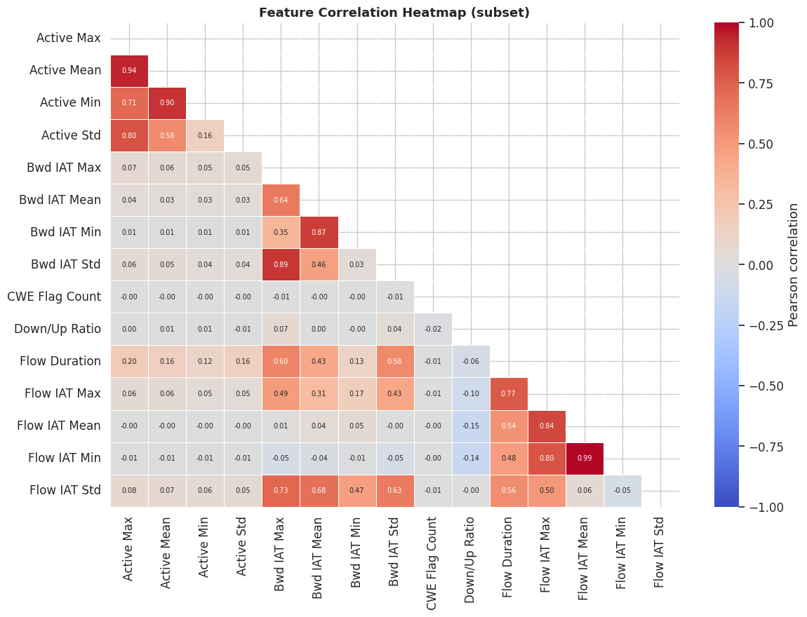
FEATURE UNDERSTANDING
EDA: timing features were strongly related
What to notice
• Several IAT timing features are highly correlated.
• Flow IAT Min and Flow IAT Mean are nearly redundant.
• Active Mean and Active Max also move together strongly.
Why it matters
The model is likely learning groups of related timing behavior rather than one isolated feature at a time.
Takeaway: The EDA suggested timing behavior would be a major signal for intrusion detection.
Group 5 · Network Intrusion Detection
7
Notes:
Use this slide to bridge from raw data to model behavior. The correlation heatmap shows relationships among features, especially timing/IAT variables. This will later connect to feature importance and drift. Time: about 50 seconds.

Slide 8
MODEL DESIGN
Model design: baseline comparison plus evaluation layers
Baseline model comparison
What we added beyond baseline
• LightGBM: fast gradient boosting for tabular data.
• XGBoost: strong regularized boosting baseline.
• CatBoost: robust out-of-box boosting comparison.
• LightGBM + SMOTE: oversampling test against class weighting.
• Class weighting to penalize missed attacks more heavily.
• RandomizedSearchCV attempted with PR-AUC objective.
• Calibration with Platt and Isotonic methods.
• Threshold sweep and cross-year drift testing.
Because the tuning cell reported nan CV PR-AUC, avoid overclaiming “tuning improved the model.” Treat the final models as final evaluated / search-selected versions.
Takeaway: The project compared baseline models, then tested the choices that matter in real intrusion detection.
Group 5 · Network Intrusion Detection
8
Notes:
Explain baseline versus added layers. Baseline is the model comparison under a shared pipeline. Added layers are imbalance handling, attempted tuning, calibration, thresholding, and drift. Be honest that tuning produced nan CV PR-AUC, so we should avoid claiming tuning success. Time: about 65 seconds.

Slide 9
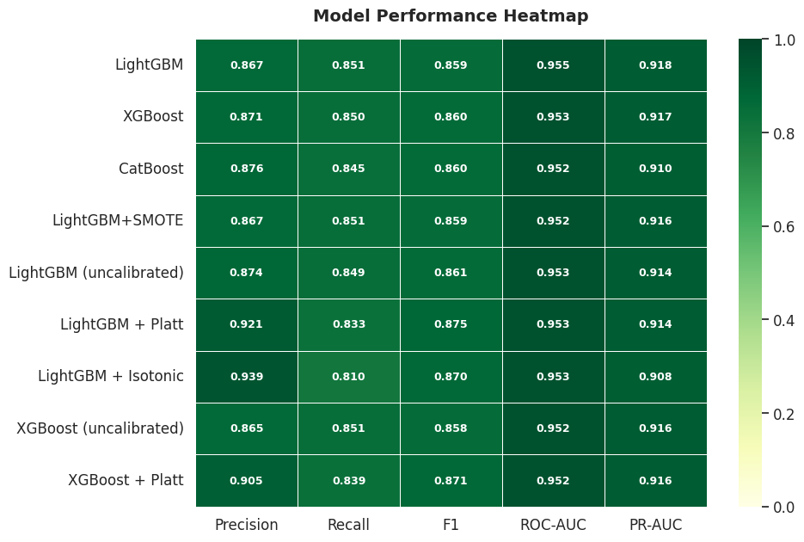
RESULTS
Results: overall model performance on 2018 test data
Main comparison
• LightGBM base: best PR-AUC at 0.918 and recall at 0.851.
• XGBoost was nearly tied: PR-AUC 0.917 and recall 0.850.
• CatBoost was competitive but slightly lower PR-AUC.
• SMOTE did not clearly outperform class weighting.
Takeaway: LightGBM was the strongest same-year base model, but XGBoost was extremely close.
Group 5 · Network Intrusion Detection
9
Notes:
This is the best summary slide for same-year performance. Emphasize that LightGBM wins narrowly on PR-AUC and recall, and it trains faster. Also clarify that the top models are close, so operational criteria matter. Time: about 60 seconds.

Slide 10
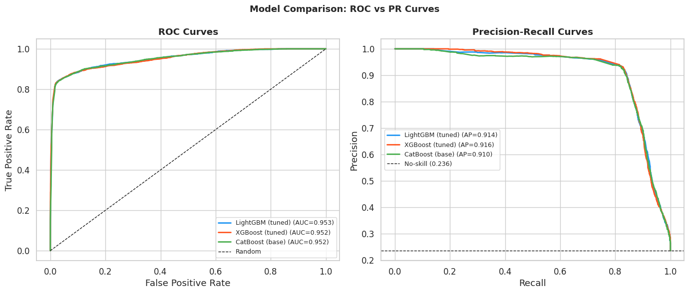
RESULTS
Results: ROC and PR curves show strong but similar ranking
How to read this
• ROC-AUC is high for all models, around 0.952–0.953.
• PR-AUC is more important because attacks are the minority class.
• Curves are close, so model choice alone is not the full story.
Why PR-AUC matters
It focuses on how well the model finds attacks while controlling false alarms.
Takeaway: The models rank attacks well on 2018 data, but calibration and thresholds determine practical usefulness.
Group 5 · Network Intrusion Detection
10
Notes:
Explain ROC vs PR at a high level. ROC looks strong, but PR is a better lens for imbalanced attack detection. The models are close, so the next slides focus on operational outcomes. Time: about 55 seconds.

Slide 11
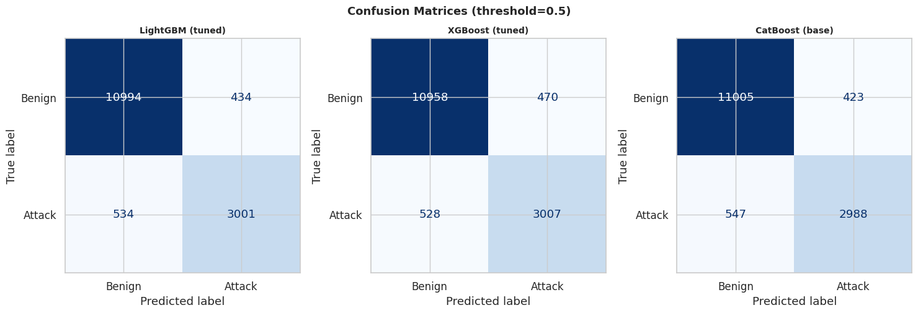
RESULTS
Results: operational impact at the default 0.5 threshold
At threshold = 0.5
534
LightGBM missed attacks
528
XGBoost missed attacks
547
CatBoost missed attacks
XGBoost caught slightly more attacks; CatBoost created slightly fewer false positives.
Takeaway: Confusion matrices translate metrics into missed attacks and analyst workload.
Group 5 · Network Intrusion Detection
11
Notes:
Use the confusion matrices to explain actual consequences. False negatives are missed attacks. False positives are analyst alerts. XGBoost missed the fewest attacks but had more false positives. Time: about 60 seconds.

Slide 12
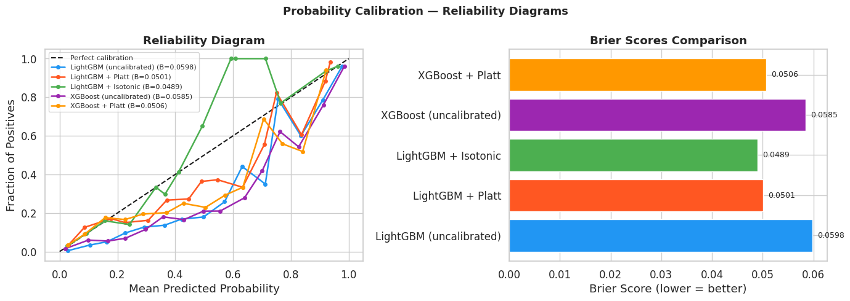
RESULTS
Results: calibration made risk scores more reliable
What changed?
• Brier score measures probability error; lower is better.
• LightGBM + Isotonic had the best Brier score: 0.0489.
• Calibration improved risk-score reliability.
Tradeoff
Calibration can make the model more conservative at the same 0.5 threshold, which may reduce recall.
Takeaway: Calibration helps when probabilities are used for risk scoring, not just yes/no classification.
Group 5 · Network Intrusion Detection
12
Notes:
Explain calibration with a simple example: if the model says 80 percent attack probability, it should be right about 80 percent of the time. Brier score improved after calibration. Time: about 55 seconds.

Slide 13
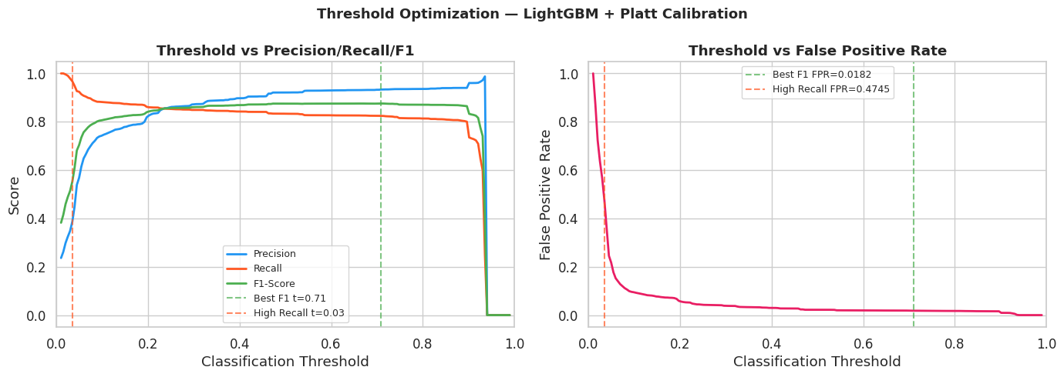
RESULTS
Results: threshold tuning controls the recall vs false-alarm tradeoff
Two operating points
Max F1
t ≈ 0.709
F1 = 0.8755
Precision = 0.9334
Recall = 0.8243
High recall
t ≈ 0.035
Recall = 0.9675
FPR = 0.4745
Interpretation: high recall catches more attacks, but creates far more false alarms.
Takeaway: The best threshold depends on risk tolerance and analyst capacity.
Group 5 · Network Intrusion Detection
13
Notes:
Explain that a threshold is not a model property; it is an operational setting. Low threshold catches more attacks but floods analysts. High threshold reduces alerts but misses more attacks. Time: about 60 seconds.

Slide 14
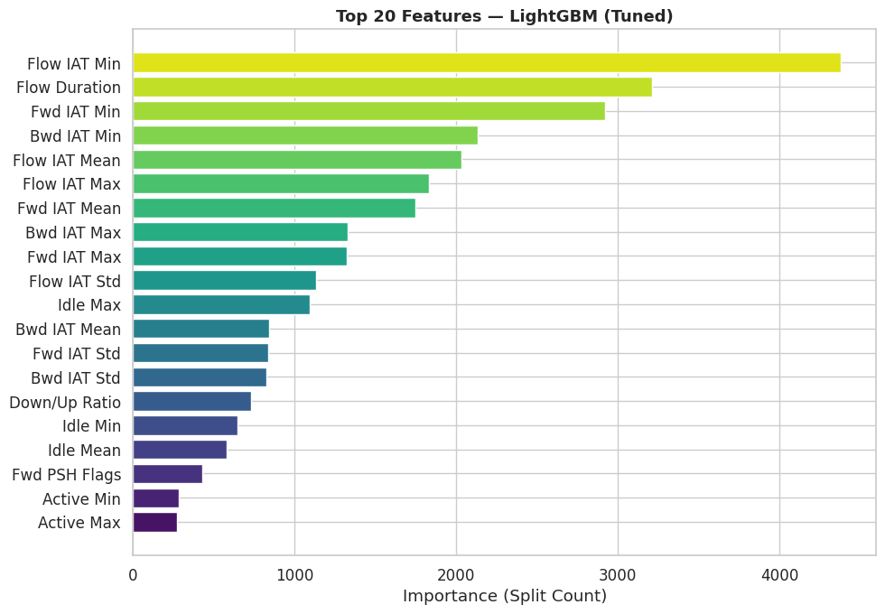
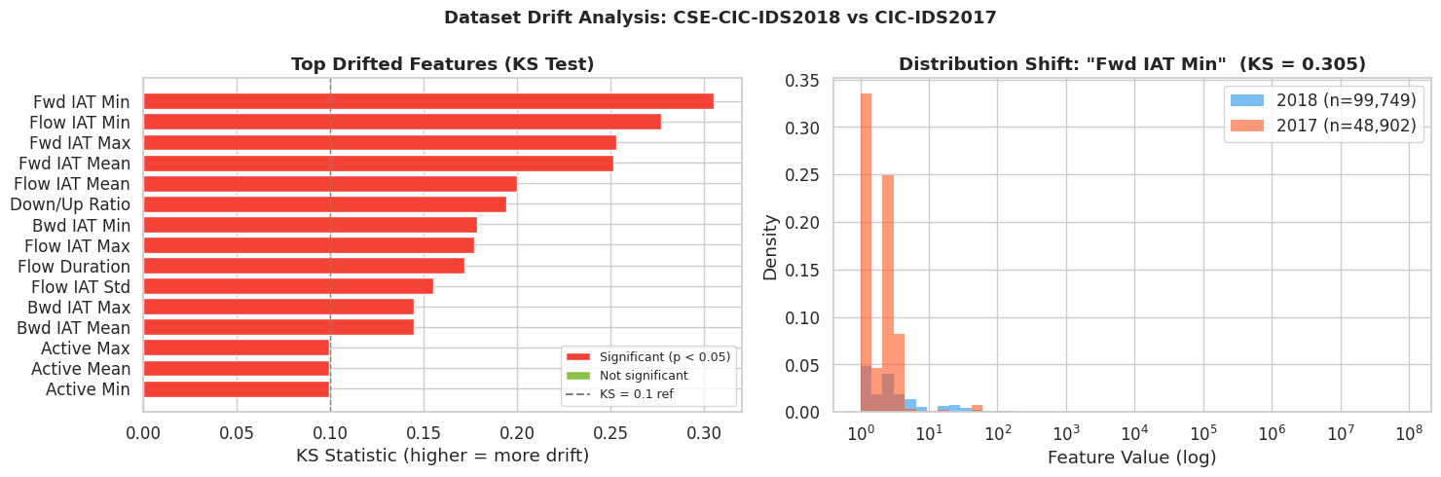
RESULTS
Results: drift exposed the biggest weakness
Connection
The model relied heavily on IAT/timing features. Those same features shifted most between 2018 and 2017, which helps explain the severe cross-year drop.
PR-AUC under drift
LightGBM: 0.914 → 0.260
XGBoost: 0.916 → 0.335
CatBoost: 0.910 → 0.255
Takeaway: Strong same-year results did not guarantee cross-year robustness; XGBoost degraded least, but all models degraded.
Group 5 · Network Intrusion Detection
14
Notes:
This is one of the most important slides. Connect feature importance to drift. The model learned timing patterns; those patterns changed across years. XGBoost was most robust but still dropped sharply. Time: about 70 seconds.

Slide 15
WRAP-UP
Challenges, limitations, and future work
Challenges / limitations
Future work
• Dataset size required sampling and chunked loading.
• 2018 and 2017 feature formats did not align perfectly.
• Binary labels hide differences between attack types.
• Random split is less realistic than a time-based deployment split.
• Tuning output had nan CV PR-AUC, so tuning claims should be cautious.
• Fix and rerun hyperparameter tuning.
• Test temporal train/test splits (train on earlier dates, test on later)
• Expand from binary to multi-class attack classification.
• Add live drift monitoring and retraining triggers.
• Evaluate thresholds based on analyst workload constraints.
Final answer
LightGBM was the best same-year speed/performance choice; XGBoost was most robust under drift; calibration and threshold tuning are essential before operational use.
Takeaway: Practical intrusion detection needs model selection, calibration, thresholding, and drift monitoring together.
Group 5 · Network Intrusion Detection
15
Notes:
Close with the balanced conclusion: LightGBM is strongest same-year, XGBoost best under drift, and calibration/thresholding are essential. Then discuss limitations and future work. Time: about 80 seconds.

Slide 16
Any Questions?
Notes:
Open up to audience for any questions.

