Slide 1
MSP430FR6628 GRIFFIN C Setup
Jacky Fang
08/15/2017

Slide 2
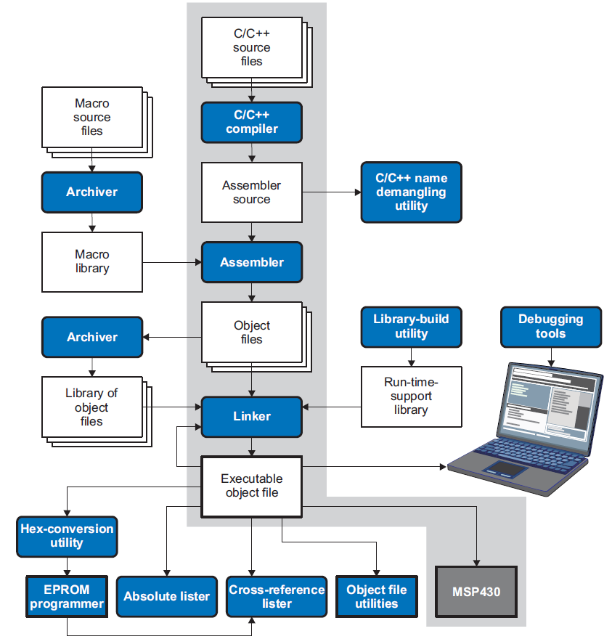
MSP430 Software Flow
The main product of this development process is an executable object file that can be executed on a MSP430 device.
The C/C++ compiler accepts C/C++ source code and produces MSP430 machine code object modules. The program enables you to compile, assemble, and link source modules in one step.
The assembler translates assembly language source files into machine language objects modules. Source files can contain instructions, assembler directives, and macro directives.
The linker combines object files into a single executable object module. It performs symbolic relocation and resolves external references. The linker accepts relocatable object modules (created by the assembler) as input. It also accepts archiver library members and output modules created by a previous linker run. Link directives allow you to combine object file sections, bind sections or symbols to addresses or within memory ranges, and define global symbols.
The hex conversion utility converts object files to TI-Tagged, ASCII-Hex, Intel, Motorola-S, or Tektronix object format. The cross-reference lister uses object files to produce a cross-reference listing showing symbols, their definition, and their references in the linked source files.

Slide 3
Link
The linker combines object files, and performs the following tasks:
Allocates sections into the target system's configured memory
Relocates symbols and sections to assign them to final addresses
Resolves undefined external references between input files
The linker command language controls memory configuration, output section definition, and address binding. Two powerful directives, MEMORY and SECTIONS could be found from asm.cmd.
More specific options in lnk_msp430fr2522.cmd and msp430fr2522.cmd could be fetched from toplevel/swsupport/include.
Setting for choose specific link file
$settings{make_based_tests}{defines}{LDFLAGS} = '-z $(DSYNC_WORKSPACE)/project/test_framctrl/framctrl_nano_retention.cmd';
This line will make the compiler use the new linker command file to replace the default linker command file.

Slide 4
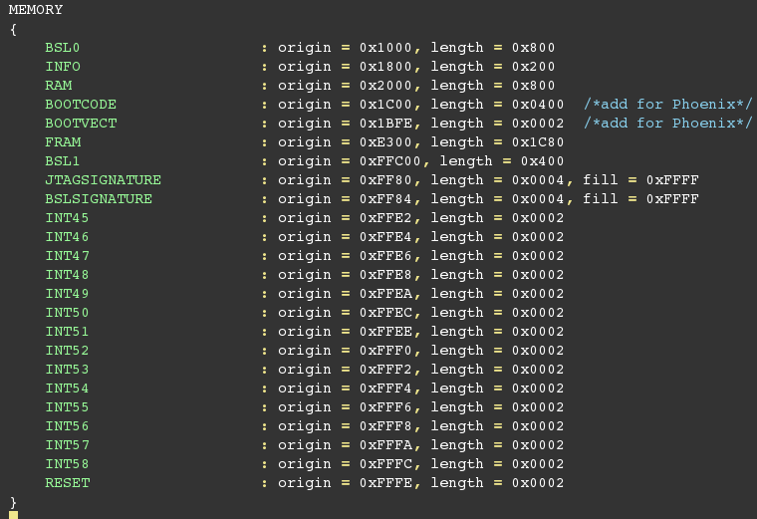
Link File MEMORY
Lnk_Msp430fr2522.cmd

Slide 5
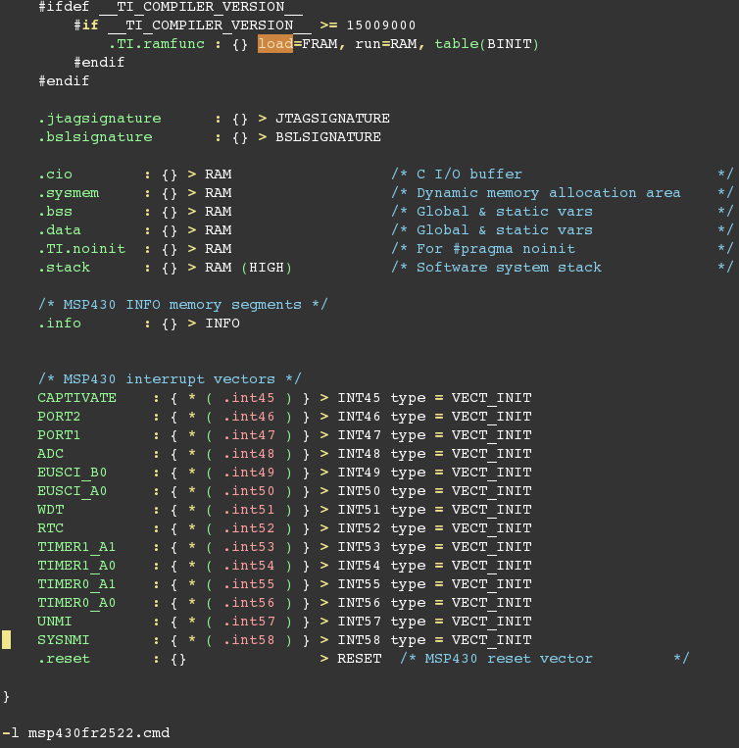
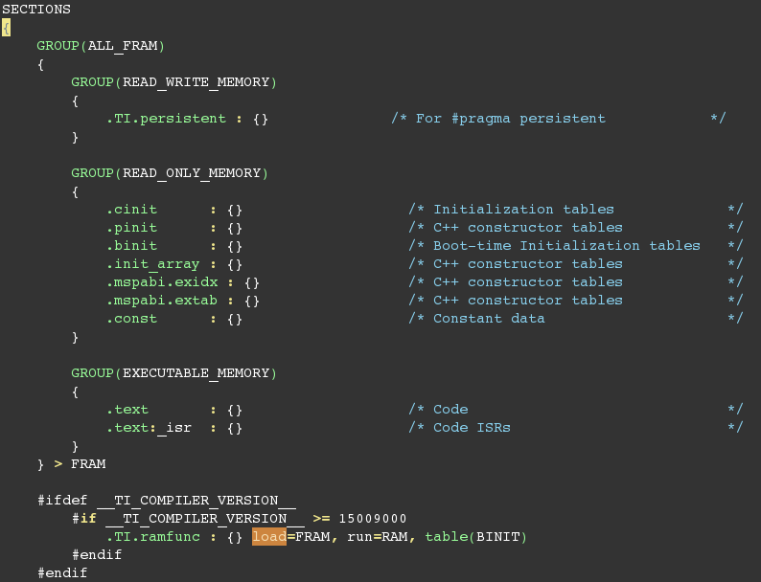
Link File SECTION
Lnk_Msp430fr2522.cmd

Slide 6
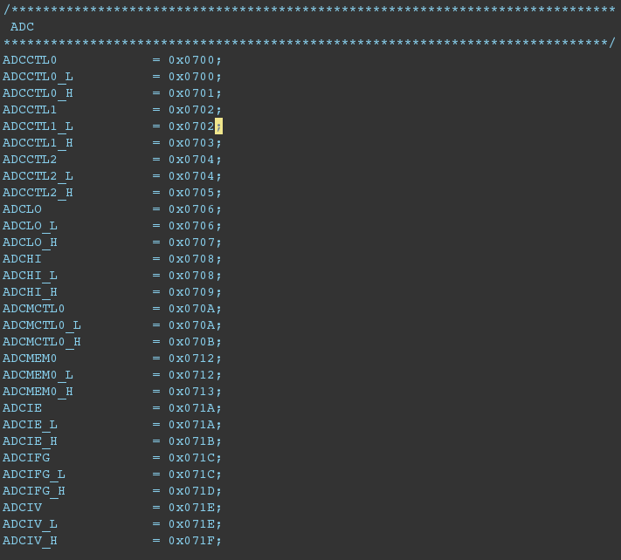
Link File Register
Msp430fr2522.cmd

Slide 7
Header File
Containing declarations and prototypes
The head file was checked into toplevel/swsupport/include/
NOT modified
Plan to use local workaround lnk_msp430fr2522.cmd and msp430fr2522.cmd from project/software

Slide 8
Header File Call
Project/software
Retain test_support.h, Separate test_support.h to header file and C file
Delete device.h and msp430.h
Retain general_support.h
Setup project/driverlib, link all IP header file and IP C file, link to IP prefer
Move hh_map.h to project/software
Toplevel/software
Retain msp430fr2522.h, msp430_internal.h
Link command file

Slide 9
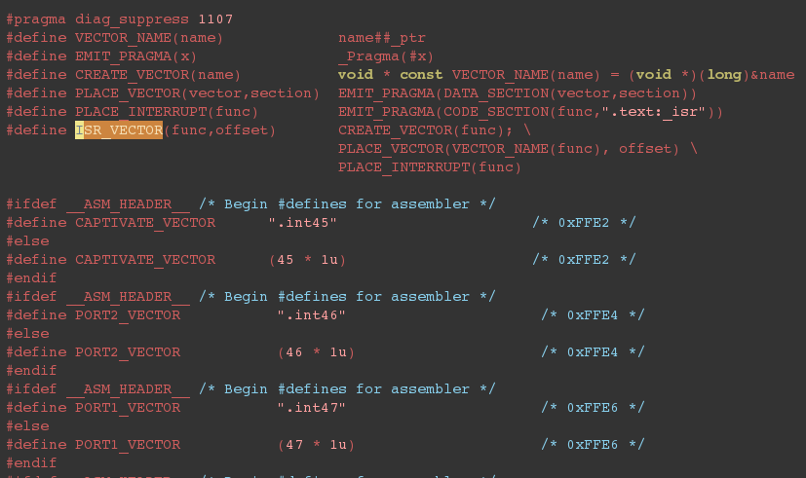
Header File Interrupt
Msp430fr2522.h

Slide 10
Test_support.h
Header file entrance
Instance extern part as API functions in c_test_support.h file and the instance some functions often used in ASM:
TB_success(); TB_error();
TB_send(); TB_end();
TB_setPortAllHigh/Low/Tri();
TB_initialize(); TB_watchdogDiable();
_system_pre_init(); → compiler boot hook function

Slide 11
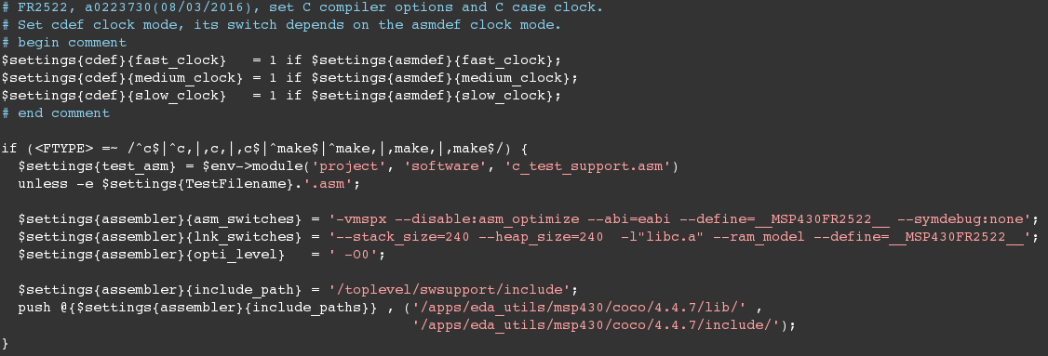
Compiler Option Device Specific
Project/setting/all_test.set
Plan delete the common/makefile/ content "-I$(COCOINCPATH)", it is redundant

Slide 12
Make-based Simulation Flow
The concept is to use a Makefile instead of the present solution of a dynamically generated Shell script. The flow consist the following steps:
Determination of the Makefile to use and the target to use.
copying the Makefile to the <SIMDIR>/SW folder, replacing placeholders
copy of the source code to the <SIMDIR>/SW folder
running "make <target>" in the <SIMDIR>/SW folder
creation of additional files (msp430 linker command file, a makefile with variable definition etc)
Post processing (i.e. generation of the mem initial file)
The Makefile name is composed of $settings {make_based_tests} followed by "_" followed by "c" in case of "c" test cases. Example: given is the line “$settings{make_based_tests}{Makefile} = "Makefile_msp16"” and the test case is of type "c", then the Makefile to be used is "Makefile_msp16_c".
The Makefile will be searched in the folders project/makefiles or common/makefiles(default). The first matching Makefile will be used.
This Makefile can contain several targets, e.g. one target for the regular compile procedure (let's say "test"), another target (dependent on the target above) for creation of additional files for memory initialization (let's say "meminit"), etc.
Plan to Griffin specific makefile project/software/Makefile_griffin_c

Slide 13
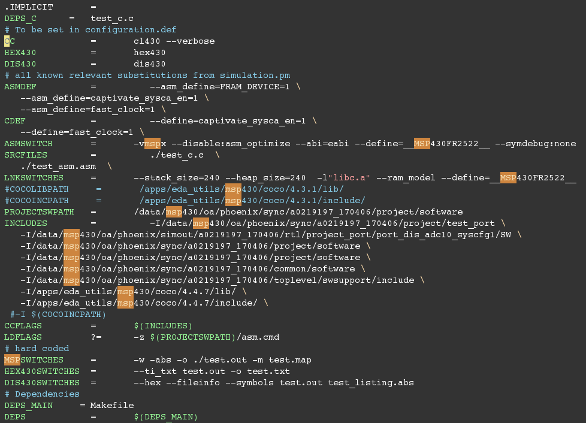
Variable in Phoenix C Makefile

Slide 14
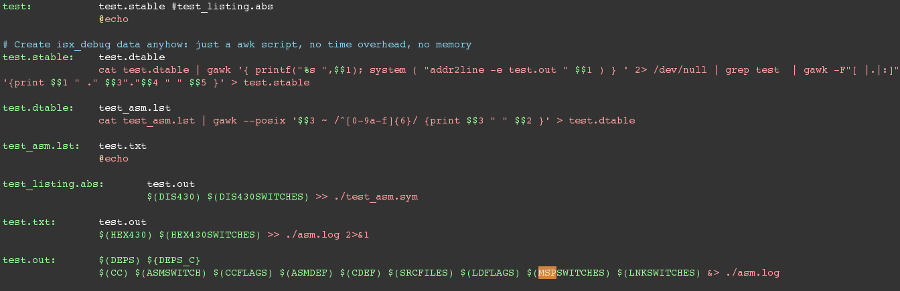
Target in Phoenix C Makefile

Slide 15
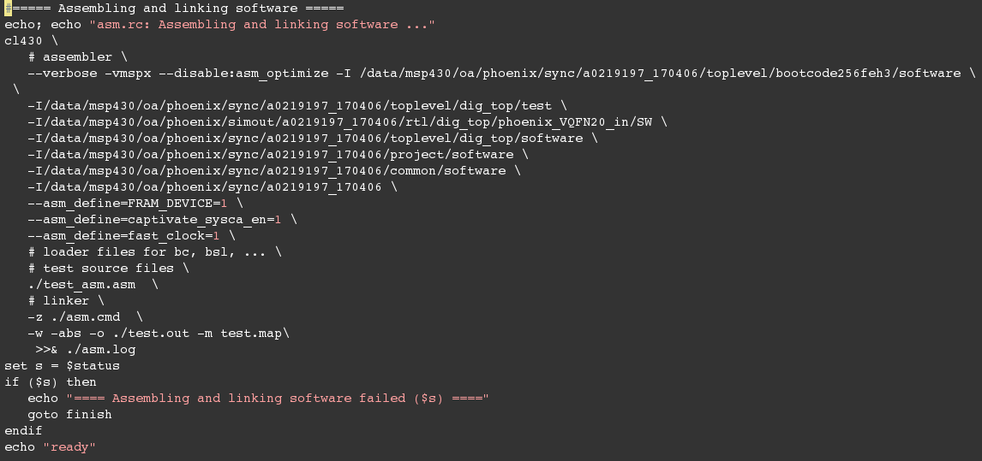
ASM Case Compile Flow

Slide 16
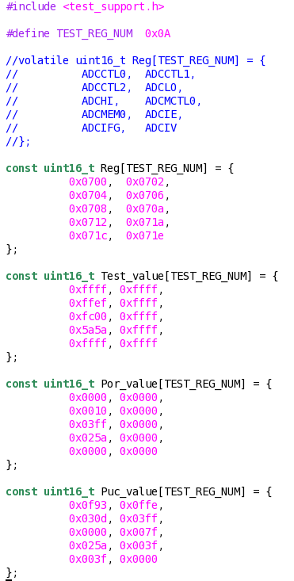
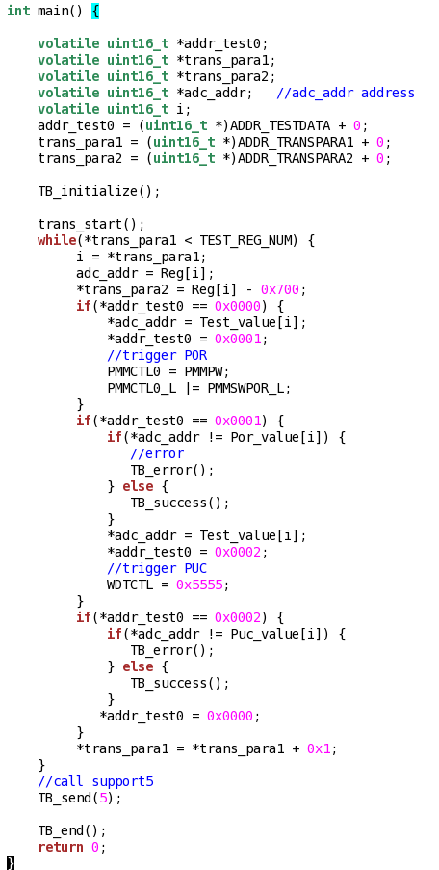
Case1:
This page is from Gavin’s PPT

Slide 17
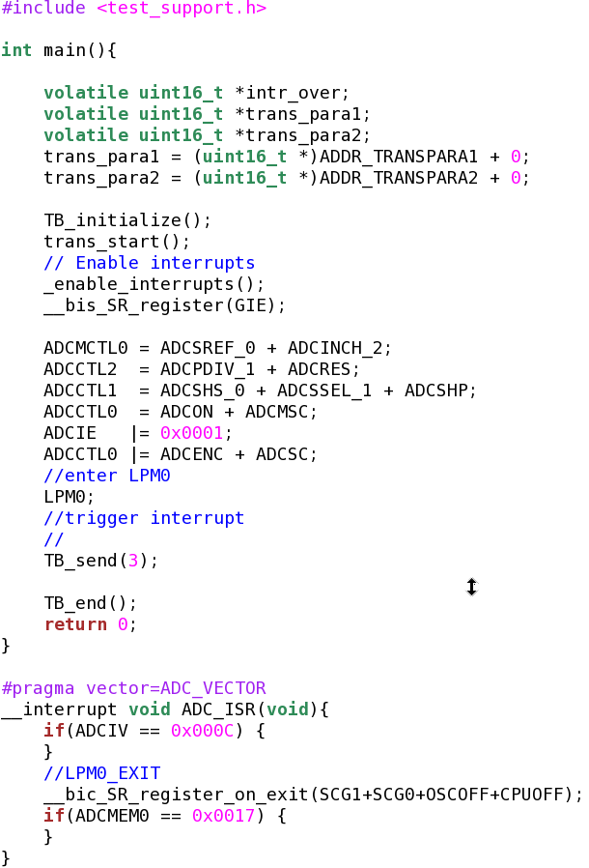
Case2:
This case trigger the ADC Interrupt, here is a interrupt example code.
#pragma vector = ADC_VECTOR is a must
__interrupt is key word.
Interrupt code
This page is from Gavin’s PPT

Slide 18
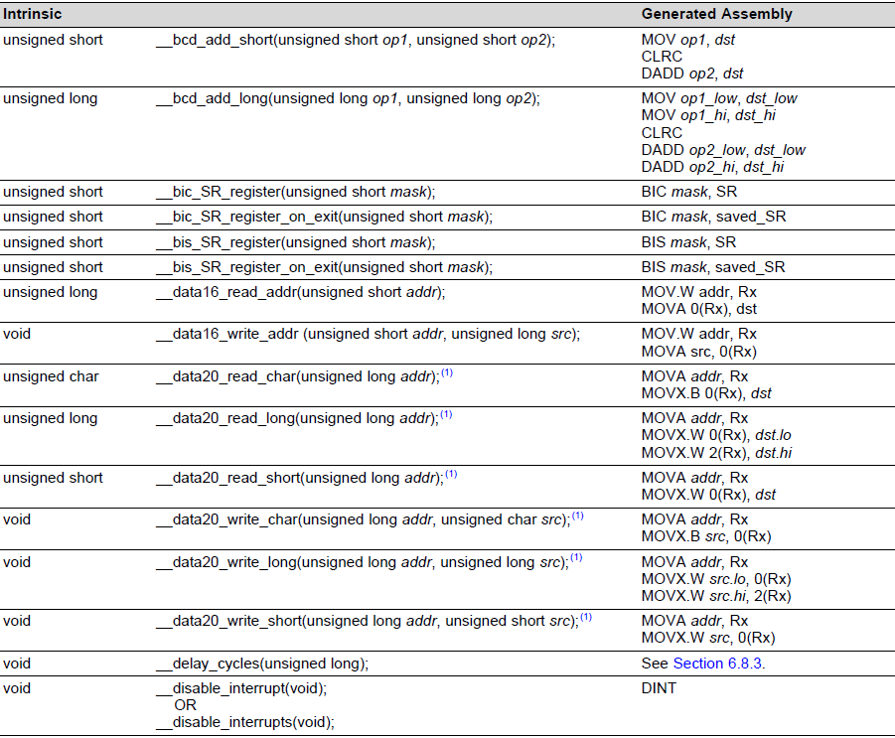
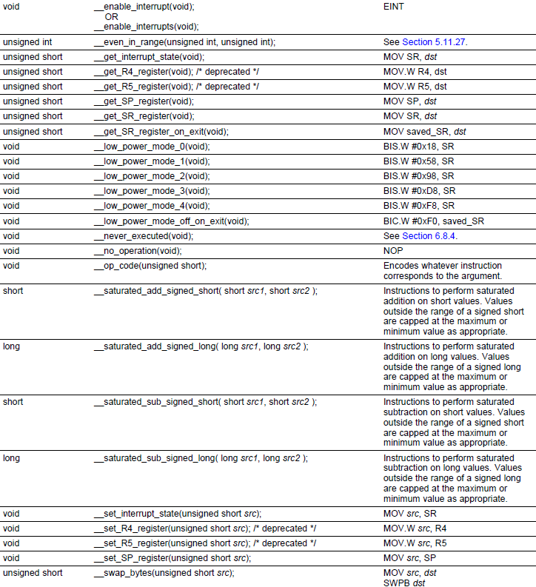
MSP430 Intrinsic
The compiler recognizes a number of intrinsic operators. Intrinsics are used like functions and produce assembly language statements that would otherwise be inexpressible in C/C++.

Slide 19
Reference
MSP430 Assembly Language Tools v15.12.0.LTS UG
MSP430 Optimizing C/C++ Compiler v15.9.0.STS UG
MCU C Test Coding Guidelines

