Slide 1
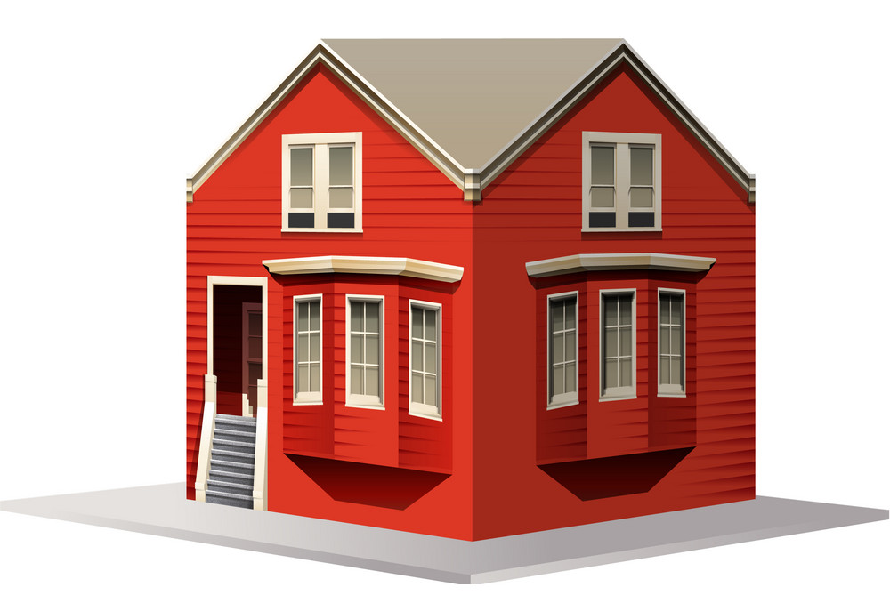




Voxels
$$δ=1$$
$$δ=0$$
$$Rx$$
$$Tx$$

Slide 2
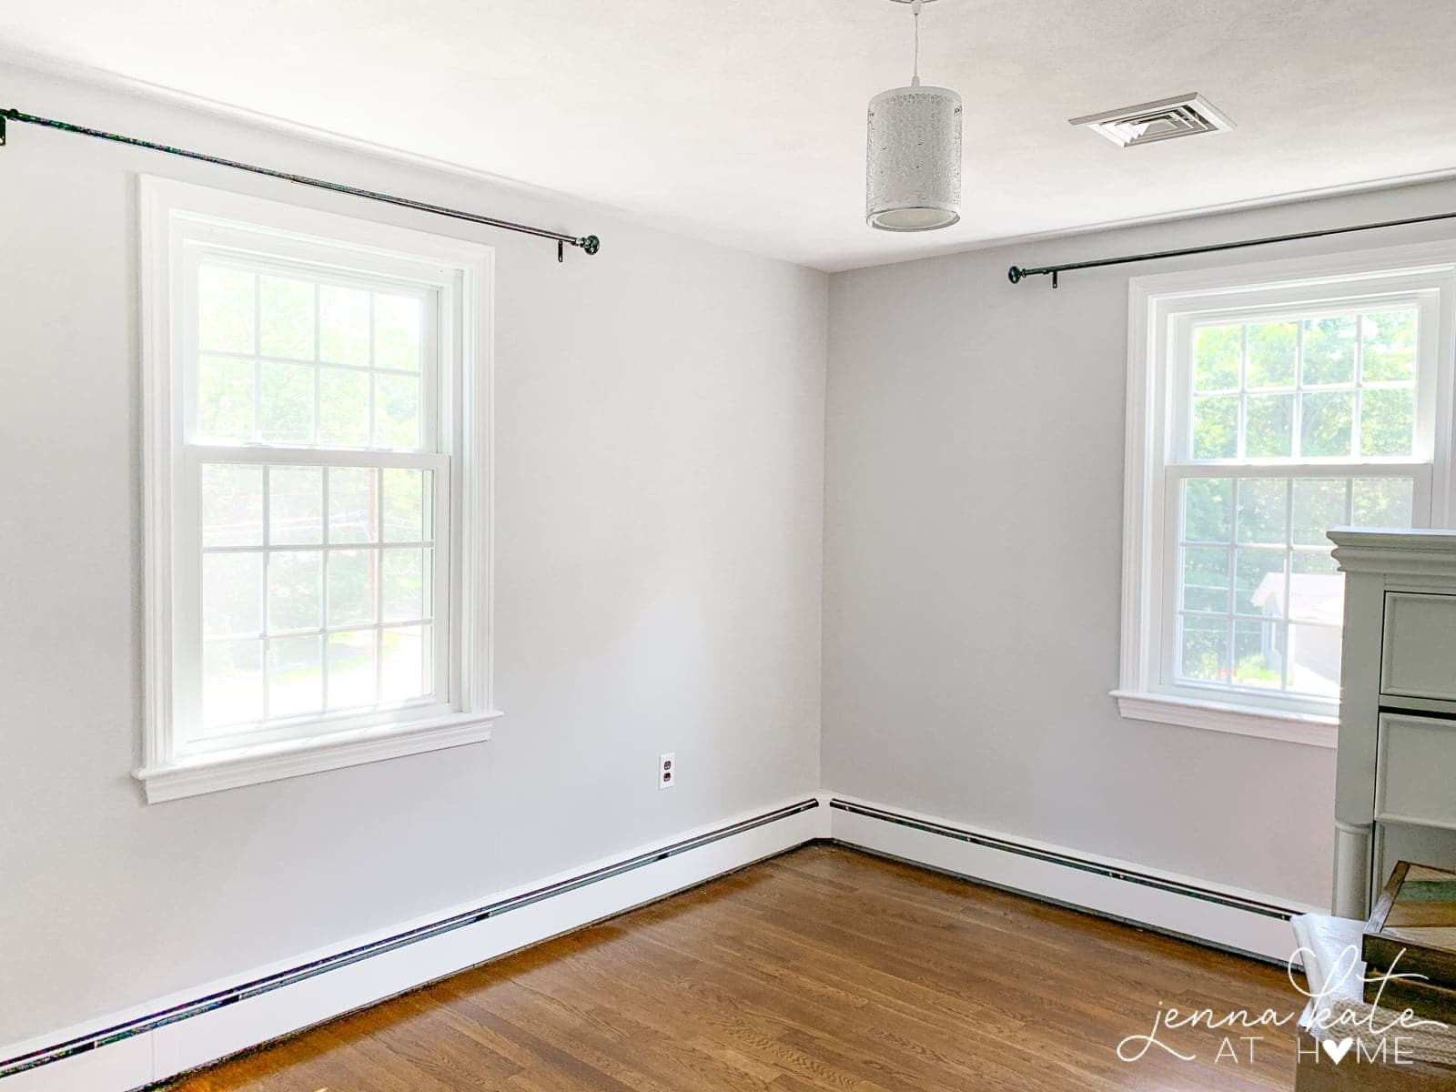
Voxels
$$δ=1$$
$$δ=0$$
$$Rx$$
$$Tx$$

Slide 3


$$Rx$$
$$Tx$$

Slide 4



Slide 5
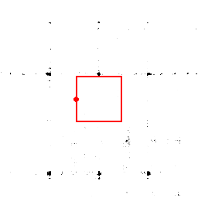
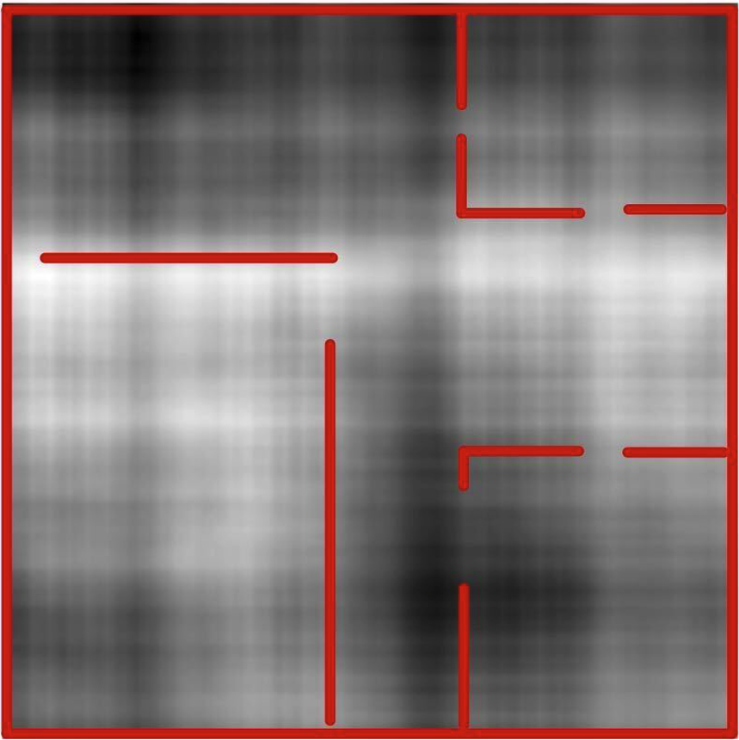
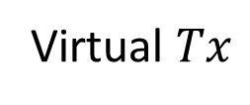




(a)
(b)
(c)
(d)
$$Tx$$
$$Tx$$
$$Rx$$
$$Rx$$
Virtual $Tx$
Walls
LoS rays

Slide 6
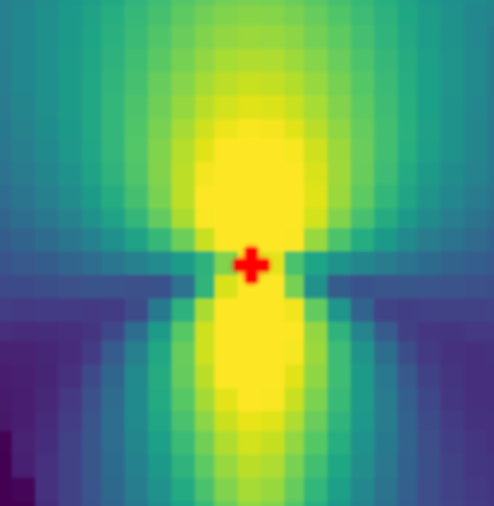
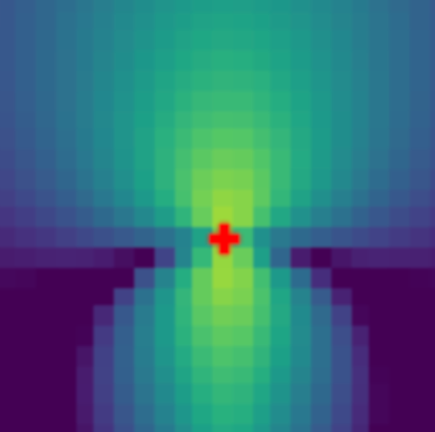
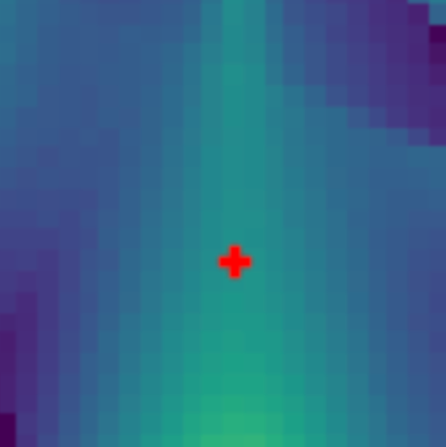













Stage 1
$$ψ_{LoS}$$
$$Eq. (1)$$
$$ψ^{∗}$$
$$(x,y)$$
~
MLP
$$(δ,ω)$$
$$ℒ_{stage1}\left(ψ^{∗},ψ_{LoS}\right)$$
$Tx, Rx$ locations
Copy weights
to stage 2
Stage 2
$$ψ_{ref1}$$
$${\tilde{ψ}}_{LoS}$$
$$Eq. (2)$$
$$ψ^{∗}$$
~
$Tx, Rx$ locations
$$ℒ_{stage2}\left(ψ^{∗},{\tilde{ψ}}_{LoS},ψ_{ref1}\right)$$

Slide 7

Stage 1
$$ψ_{LoS}$$
$$Eq. (1)$$
$$ψ^{∗}$$
$$(x,y)$$
~
MLP
$$(δ,ω)$$
$$ℒ_{stage1}\left(ψ^{∗},ψ_{LoS}\right)$$
$Tx, Rx$ locations
Copy weights
to stage 2
Stage 2
$$ψ_{ref1}$$
$${\tilde{ψ}}_{LoS}$$
$$Eq. (2)$$
$$ψ^{∗}$$
~
$Tx, Rx$ locations
$$ℒ_{stage2}\left(ψ^{∗},{\tilde{ψ}}_{LoS},ψ_{ref1}\right)$$

Slide 8


$$(x,y)$$
Stage 1
MLP
$$(δ,ω)$$
$$ψ_{LoS}$$
$$Eq. (1)$$
$$ψ^{∗}$$
~
Copy weights
to stage 2
$Tx, Rx$ locations
$$ℒ_{stage1}\left(ψ^{∗},ψ_{LoS}\right)$$
Stage 2
$$ψ_{ref1}$$
$${\tilde{ψ}}_{LoS}$$
$$Eq. (2)$$
$$ψ^{∗}$$
~
$Tx, Rx$ locations
$$ℒ_{stage2}\left(ψ^{∗},{\tilde{ψ}}_{LoS},ψ_{ref1}\right)$$

Slide 9














Stage 1
$$(x,y)$$
MLP
$$ψ^{∗}$$
$$(δ,ω)$$
$$ψ_{LoS}$$
$$Eq. (1)$$
~
$Tx, Rx$ locations
$$ℒ_{stage1}\left(ψ^{∗},ψ_{LoS}\right)$$
Copy weights to stage 2
Stage 2
$$(x,y)$$
$$ψ^{∗}$$
MLP
$$(δ,ω)$$
$$ψ_{ref1}$$
$$Eq. (2)$$
~
$Tx, Rx$ locations
$$ℒ_{stage2}\left(ψ^{∗},{\tilde{ψ}}_{LoS},ψ_{ref1}\right)$$

Slide 10

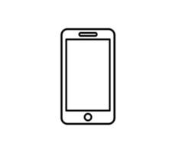














Stage 1
Stage 2
Freeze
Forward
$$(x,y)$$
$$(δ,ω)$$
$$(x,y)$$
$$(δ,ω)$$
MLP
$$ψ^{∗}$$
MLP
$$ψ_{ref1}$$
$$ψ^{∗}$$
$$Rx$$
$$ψ_{LoS}$$
$$Rx$$
$$ℒ_{stage2}\left(ψ^{∗},{\tilde{ψ}}_{LoS},ψ_{ref1}\right)$$
$$ℒ_{stage1}\left(ψ^{∗},ψ_{LoS}\right)$$
$$Tx$$
$$Tx$$
$$Tx$$
$$Rx$$
Copy model to Stage 2

Slide 11


