Slide 1
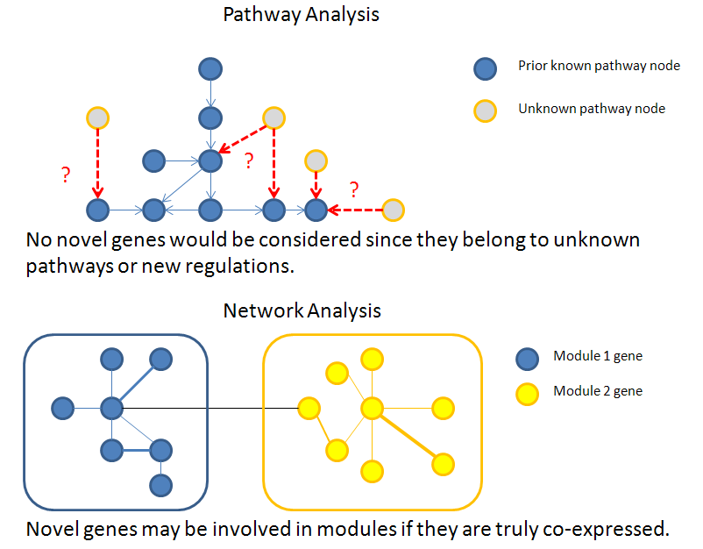
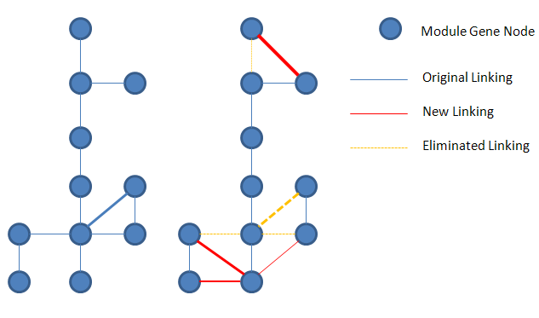
Introduction & Specific Aims
Though there are the same genes among cancers, different interactions might result in their variations.

Slide 2
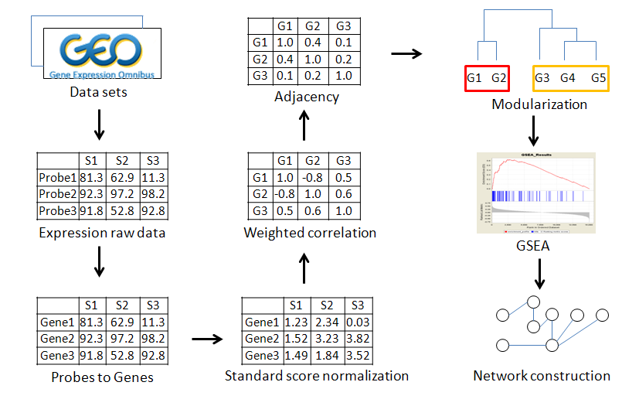
Materials & Methods

Slide 3
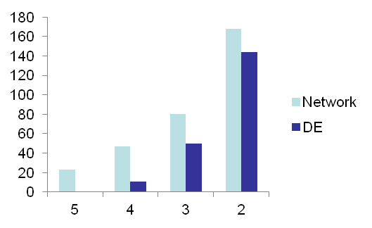
Results
Modulator Stability
Candidate genes overlapped among lung cancer datasets perform rather similar in different samples.
Those genes perform significantly since their connectivity rank p-values are small enough (p-value < 0.05).
Samples | Rank p-value
Dataset 1 | 3.40E-02
Dataset 2 | 1.57E-04
Dataset 3 | 5.74E-05
Dataset 4 | 5.00E-05
Statistical differential expressed (DE) gene selections vary across different samples.
Network analysis could perform far better to maintain its stability and reproducibility.
Gene Number
Data set overlapped

Slide 4
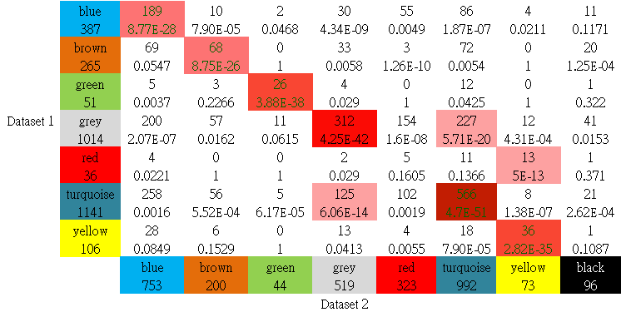

Results
Modulator Reproducibility
Modules separated among datasets are highly consistent.
With higher intensity expresses higher similarity.
The diagonal of the image implies the related overlapped genes.
Lung cancer reproducibility evaluation

Slide 5
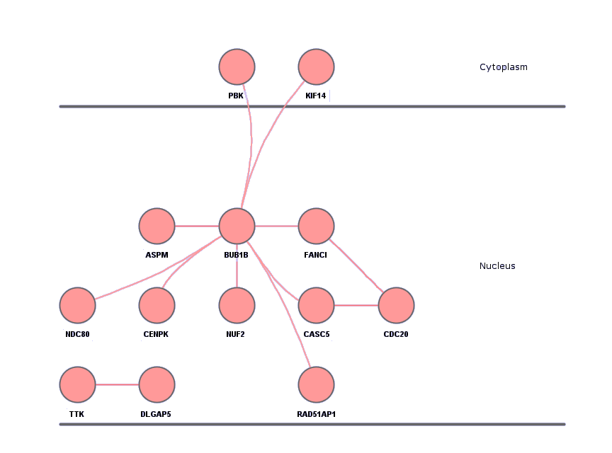
Results
Pathway Comparison & Functional Annotation
Biological comparison among identified modules and significant pathways in GSEA imply high similarity with some differences.
Significant on
  Leukocyte transendothelial migration
  Cell adhesion molecules (CAMs)
  Cell cycle regulation

Slide 6

Conclusion
Several novel signaling networks are identified for cytoskeletal rearrangement and cell proliferation functions across cancer datasets.
Similarities among datasets are calculated and these constructed networks may reveal possible enrichment of current pathways.
Further researches would be focused on these novel gene-gene interactions among different cancers in order to identify their potential regulators leading to the distinct pathogenic processes.

