Slide 1

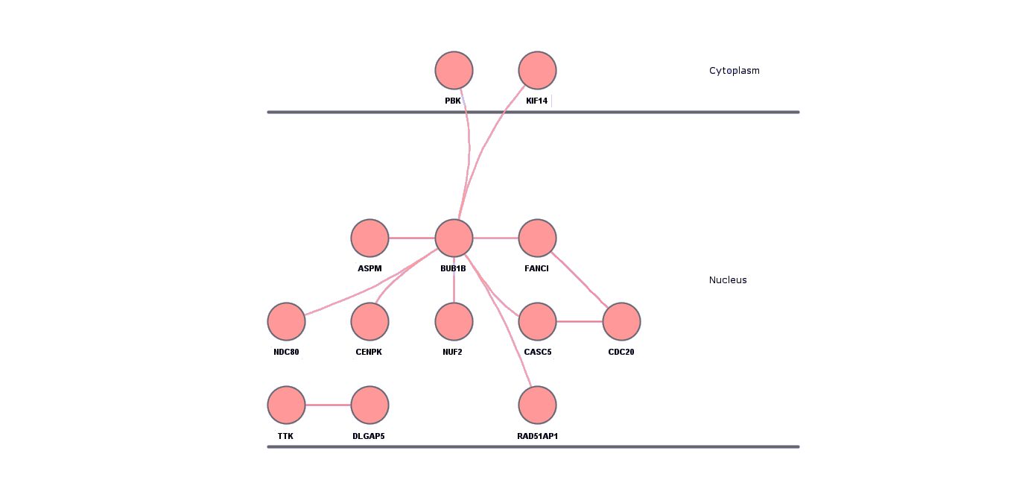
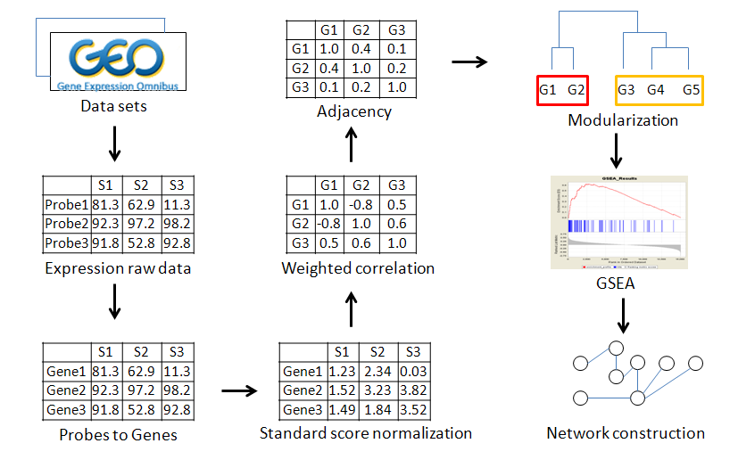
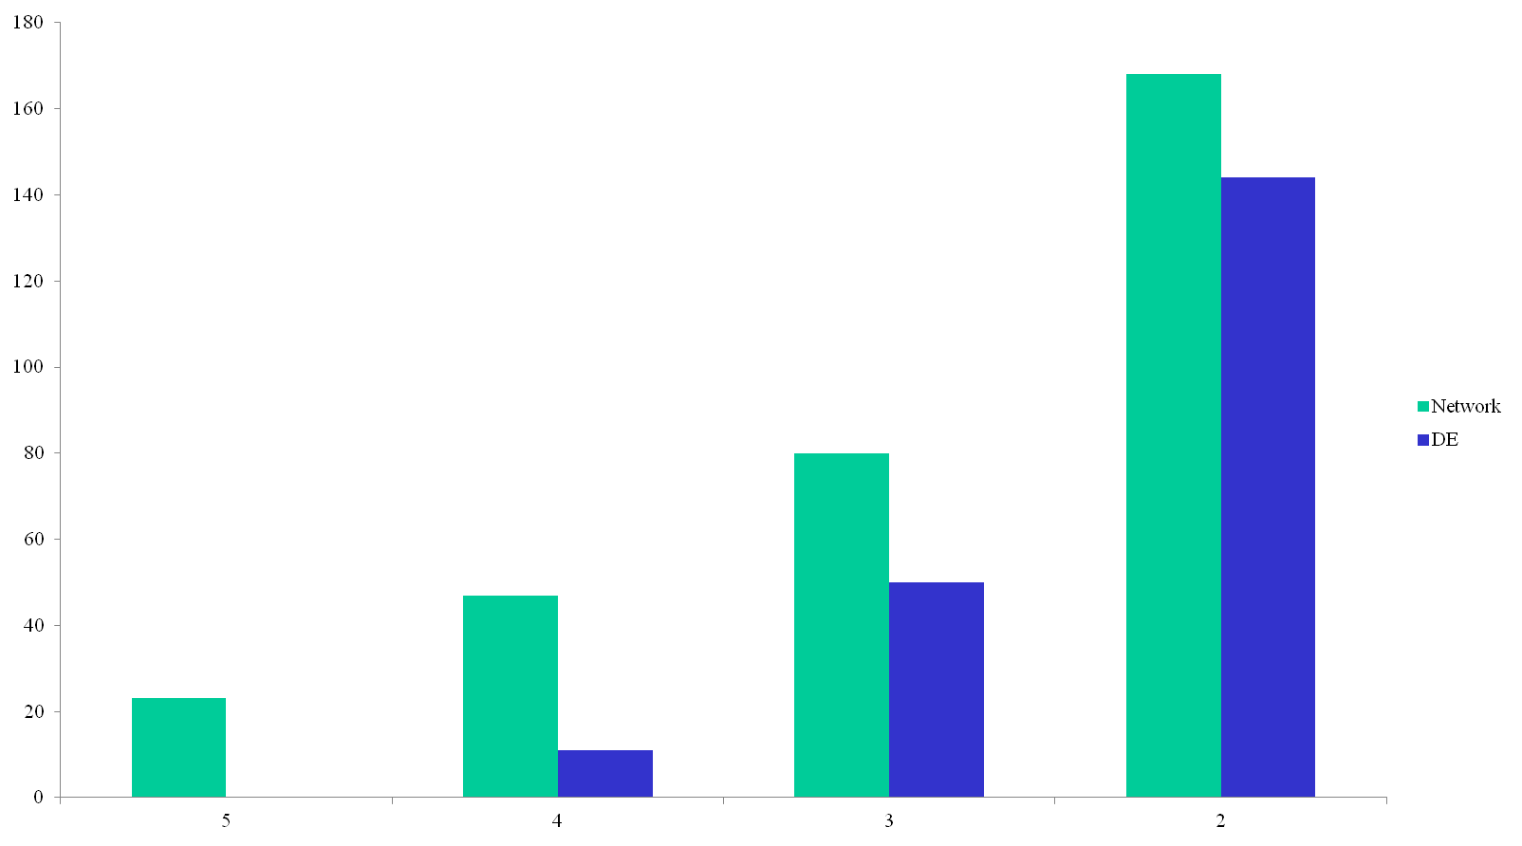
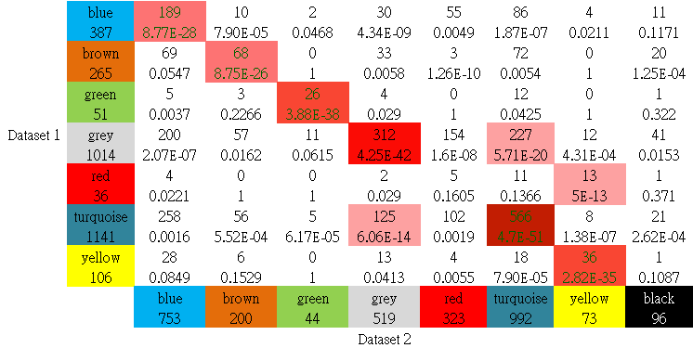

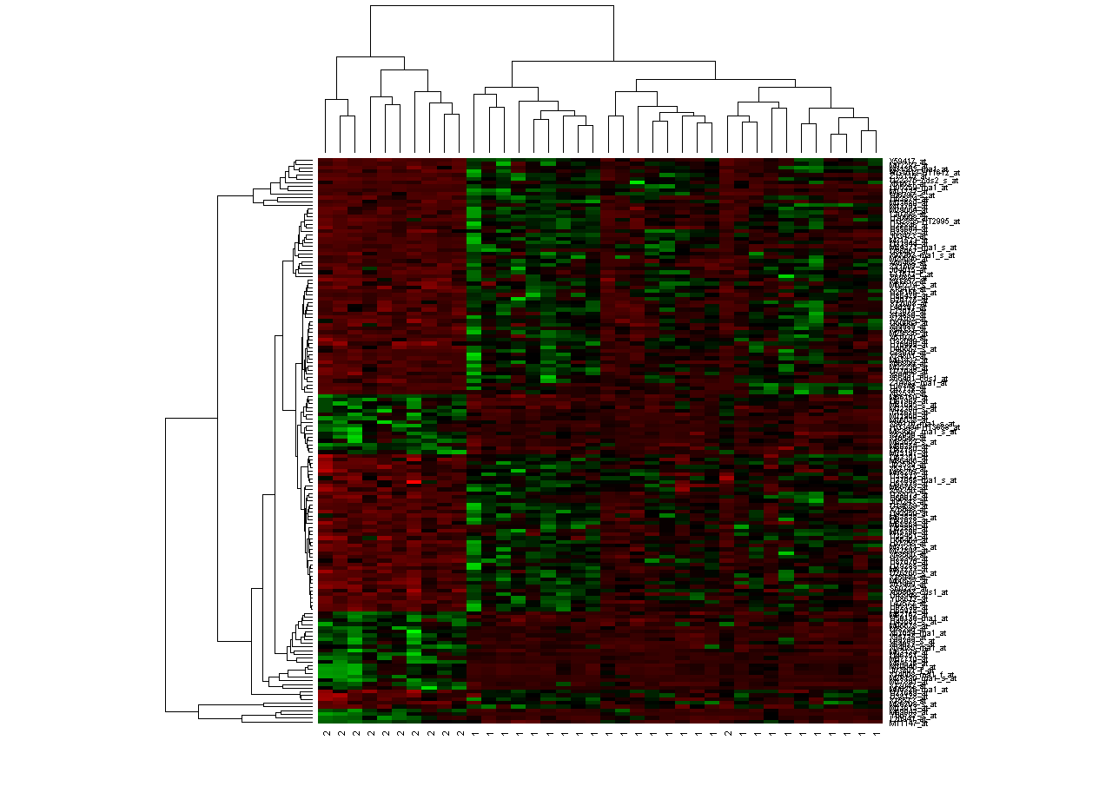
Signaling Network for Exploring the Novel Regulatory Mechanisms among Cancers
Chia-Chuan Ho, Tzu-Pin Lu, Liang-Chuan Lai, Mong-Hsun Tsai , and Eric Y. Chuang
National Taiwan University, Taipei, Taiwan
Abstract
Materials and Methods
Because current researches with respect to the gene expr-essions of microarrays are almost based on the prior kno-wledge, such as pathway analysis, some novel regulatory signaling mechanisms couldn’t be observed and realized. Studies comparing transcription among different cancers may result in various signalings while highly differentially expressed genes gives us no consistent reason why they are dissimilar. To better characterize transcriptional regu-lations, we try a systematic approach by weighted gene coexpression network analysis on various sorts of cancer datasets. We present that the network analysis expresses much higher stability and reproducibility than that of traditional statistical differential methods show. Besides, we try to realize the genetic functions through the GO analysis and the Database for Annotation, Visualization and Integrated Discovery. After all, we try to construct core networks and discover some novel possible pathways. These evidences suggest us many possibility of regulatory mechanisms to be validated.
In this study, fourteen datasets are retrieved from gene expression omnibus (GEO), including five lung cancer, four colorectal cancer, and other datasets. All of them are paired datasets, which investigated both normal and cancer types from the same patient.
These data were first normalized according to statistical standard score. Then, we selected the most differential 3000 genes by paired-t test and used WGCNA to get modules clustered based on correlations of gene expressions.
To evaluate the stability and reproducibility of WGCNA among datasets, we performed three analysis methods, finding differentially expressed genes, pathway analysis in gene set enrichment analysis (GSEA) and network analysis simultaneously.
Results
Flowchart for network creation. Data sets were collected from GEO and preprocessed separately creating similarly scaled expression files with the best probe set chosen for each gene and the outlier samples removed.
Biological functions of identified modules were comparable to the significant pathways in GSEA, and they showed high similarity with some differences
We could get the idea that the BUB1B by all means plays an important role during the pathway system. Besides, the CDC20 is also another regulatory center. If we expand the network, we could get more possible hub nodes affecting the whole system.
Introduction
Currently the analyses for microarray are usually based on prior knowledge, such as pathway analysis. Although specific pathways, such as cell cycle regulation, have been shown to play important roles in multiple cancers, no one single drug is effective in treating all cancers. This may indicate the transcriptional modulation mechanisms of gene expression among multiple cancers are different. In addition, even in one particular cancer, patients with different subtypes still show distinct expression profiles. However, pathway analysis depends on predefined gene sets, and differences may come from unknown mechanisms. To overcome this problem, network analysis is chosen since it could be implemented without prior knowledge. In this study, we utilize weighted gene co-expression network analysis (WGCNA) to identify modules playing important roles in transcriptional modulations in cancer cells.
Gene number
Results
Data set overlapped (number)
We take five lung cancer datasets for stability. Computed as the candidates overlapped, different modules perform similarly significant in different samples. In conclusion, modules generated from network analyses were consistent and ranked significant in all five lung cancer datasets. In that, the network could work with highly stability among datasets.
Traditionally, we may try to find out certain genes regulating cancer productions. Therefore, we prove that the network could overcome it. Compared to differentially expressed genes identified from paired-t test among lung samples, 23 overlapped genes came from network analysis among five datasets but zero from paired-t test. It implied network analysis denoted high stability and reproducibility within datasets for lung cancer.
Results
Different modules from different datasets may consist of various functional targets. We use the DAVID tool to realize the known possible pathways included in our network modules. Modules were found significant on leukocyte transendothelial migration, cell adhesion molecules (CAMs), and cell cycle regulation. However, many genes were observed for cell cycle function through network but not in current pathway databases. Especially DLGAP5, it has many connections with really high number of network nodes. According to literature review, DLGAP5 may be a potential carcinogenetic regulator. These novel genes deserve further investigations since they are highly reproducible in the all five datasets and have really high network topological overlap scores.
Conclusion
In conclusion, through reproducible network analysis, several novel signaling networks are identified for cytoskeletal rearrangement and cell proliferation functions across five lung adenocarcinoma cancer datasets. And we do get some possible novel regulatory genes in our network repeatedly. Now, the similarities in the same type or the same cancer are detected and the constructed networks could give us some hints to enrich the current pathways. We aim to further research these novel functional genes in other cancers and extend the methodology on different cancers to discover potential regulators having high influences on determining the variations among cancers. The different regulatory networks might do some dominant effect over others, and it’s our goal to detect these relationships among sorts of cancers. Though the changes are small to express on the linkage of our network, they might prompt us certain ways to suppress the cancer growing or imply apoptosis. Therefore, the novel signaling network will definitely explain the regulatory mechanisms.

