Slide 1
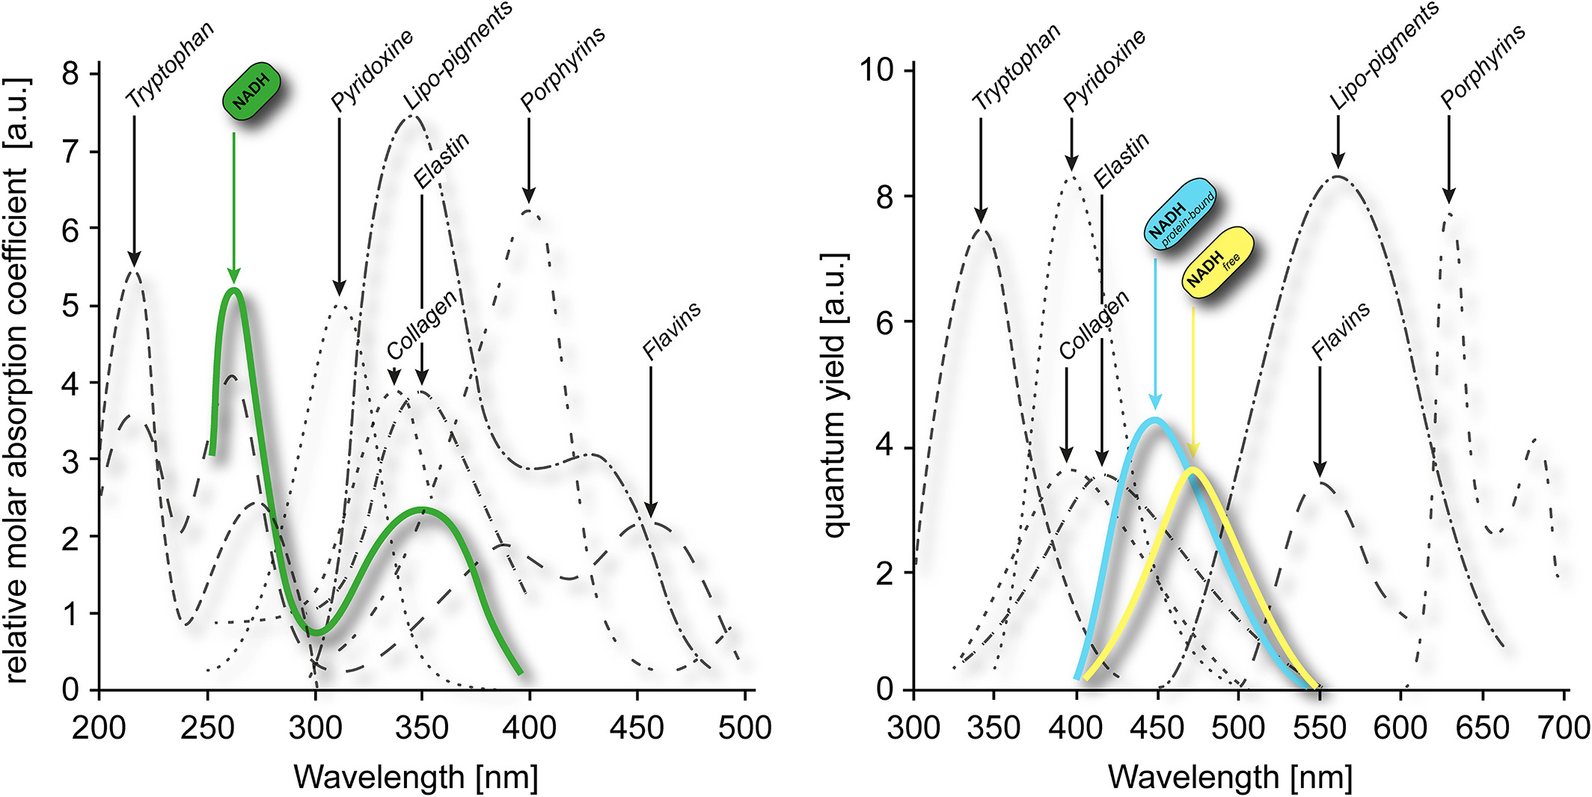
NADH Autofluorescence—A Marker on its Way to Boost Bioenergetic Research
Cytometry Pt A, Volume: 95, Issue: 1, Pages: 34-46, First published: 13 September 2018, DOI: (10.1002/cyto.a.23597)
Notes:
Cellular autofluorescence spectra. The left‐hand side shows the absorbance spectra of typical autofluorescent molecules with NADH highlighted in green. The right‐hand side displays the respective emission spectra. The height of the peaks indicates the relative molar absorption coefficient and the quantum yield, respectively; however, the abundance of the fluorophore in a cell is not accounted for, as this might vary from sample to sample. (Adapted from Wagnieres et al., ). [Color figure can be viewed at wieyonlinelibrary.com]
IF THIS IMAGE HAS BEEN PROVIDED BY OR IS OWNED BY A THIRD PARTY, AS INDICATED IN THE CAPTION LINE, THEN FURTHER PERMISSION MAY BE NEEDED BEFORE ANY FURTHER USE. PLEASE CONTACT WILEY'S PERMISSIONS DEPARTMENT ON PERMISSIONS@WILEY.COM OR USE THE RIGHTSLINK SERVICE BY CLICKING ON THE 'REQUEST PERMISSIONS' LINK ACCOMPANYING THIS ARTICLE. WILEY OR AUTHOR OWNED IMAGES MAY BE USED FOR NON-COMMERCIAL PURPOSES, SUBJECT TO PROPER CITATION OF THE ARTICLE, AUTHOR, AND PUBLISHER.

