Slide 1
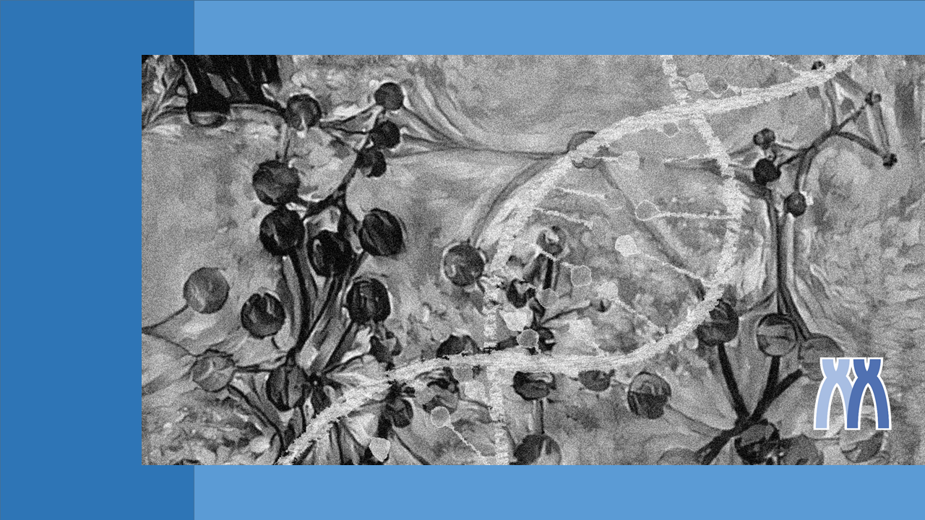
Gene List Analysis Report
Hint: Each slide has notes that explain the analysis!
http://metascape.org
Aug 2, 2021
Notes:
This report is automatically generated by metascape.org based on the gene lists you submitted and the analyses you specified.

Slide 2
Gene List Summary
You gene list contains 500 identifiers, 500 human Entrez Gene IDs.
Please check online Metascape User Manual for explanation of each annotation field.
Notes:
Metascape automatically first convert you input identifiers (Gene ID, RefSeq or Symbol) into Human Entrez Gene ID. Input identifiers can be from human, mouse or rat, ortholog mapping into human based on the latest NCBI Homologene database is automatically applied.

Slide 3
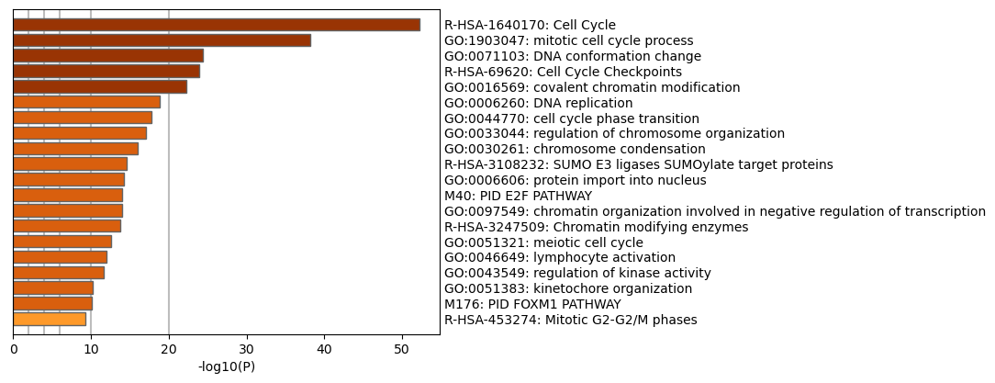
Enriched Ontology Clusters
Notes:
We first identified all statistically enriched terms (can be GO/KEGG terms, canonical pathways, hall mark gene sets, etc., based on what your choice during the analysis), accumulative hypergeometric p-values and enrichment factors were calculated and used for filtering. Remaining significant terms were then hierarchically clustered into a tree based on Kappa-statistical similarities among their gene memberships (similar to what is used in NCI DAVID site). Then 0.3 kappa score was applied as the threshold to cast the tree into term clusters. The terms within each cluster are exported in the Excel spreadsheet named “Enrichment Analysis”.
We then selected a subset of representative terms from this cluster and convert them into a network layout. More specifically, each term is represented by a circle node, where its size is proportional to the number of input genes fall into that term, and its color represent its cluster identity (i.e., nodes of the same color belong to the same cluster). Terms with a similarity score > 0.3 are linked by an edge (the thickness of the edge represents the similarity score). The network is visualized with Cytoscape (v3.1.2) with “force-directed” layout and with edge bundled for clarity. One term from each cluster is selected to have its term description shown as label.

Slide 4
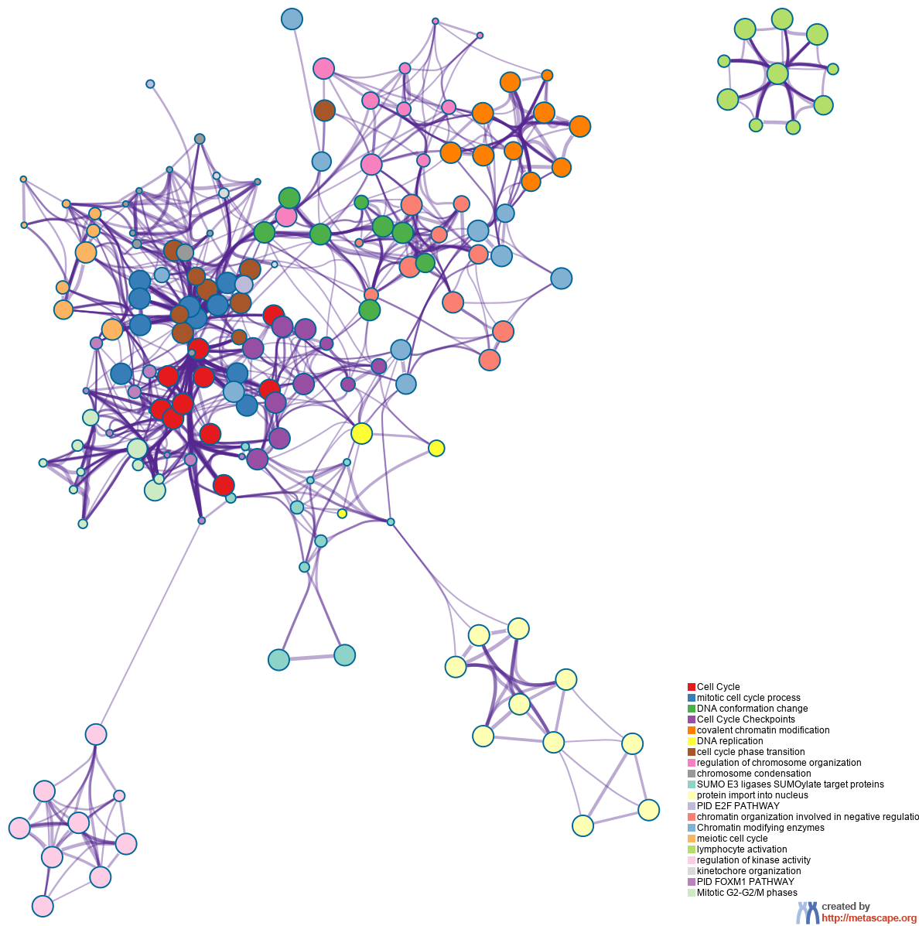
Enriched Ontology Clusters Colored by Cluster ID
Notes:
We first identified all statistically enriched terms (can be GO/KEGG terms, canonical pathways, hall mark gene sets, etc., based on what your choice during the analysis), accumulative hypergeometric p-values and enrichment factors were calculated and used for filtering. Remaining significant terms were then hierarchically clustered into a tree based on Kappa-statistical similarities among their gene memberships (similar to what is used in NCI DAVID site). Then 0.3 kappa score was applied as the threshold to cast the tree into term clusters. The terms within each cluster are exported in the Excel spreadsheet named “Enrichment Analysis”.
We then selected a subset of representative terms from this cluster and convert them into a network layout. More specifically, each term is represented by a circle node, where its size is proportional to the number of input genes fall into that term, and its color represent its cluster identity (i.e., nodes of the same color belong to the same cluster). Terms with a similarity score > 0.3 are linked by an edge (the thickness of the edge represents the similarity score). The network is visualized with Cytoscape (v3.1.2) with “force-directed” layout and with edge bundled for clarity. One term from each cluster is selected to have its term description shown as label.

Slide 5
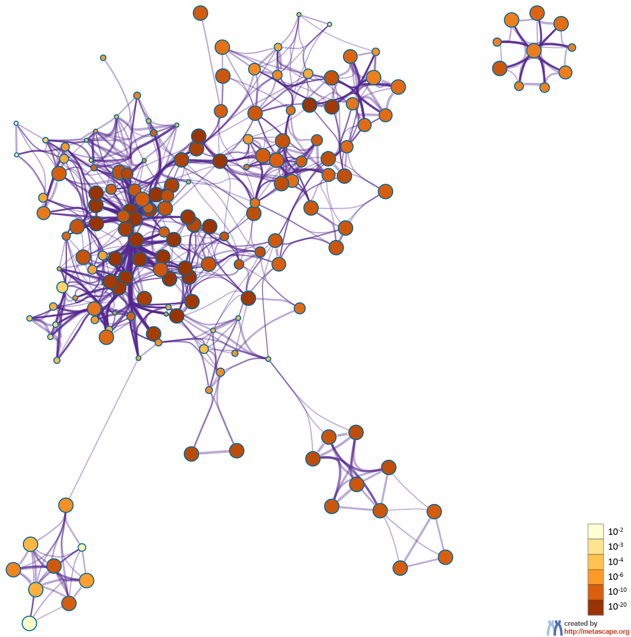
Enriched Ontology Clusters Colored by p-Value
Notes:
The same enrichment network has its nodes colored by p-value, as shown in the legend. The dark the color, the more statistically significant the node is (see legend for p-value ranges).

Slide 6
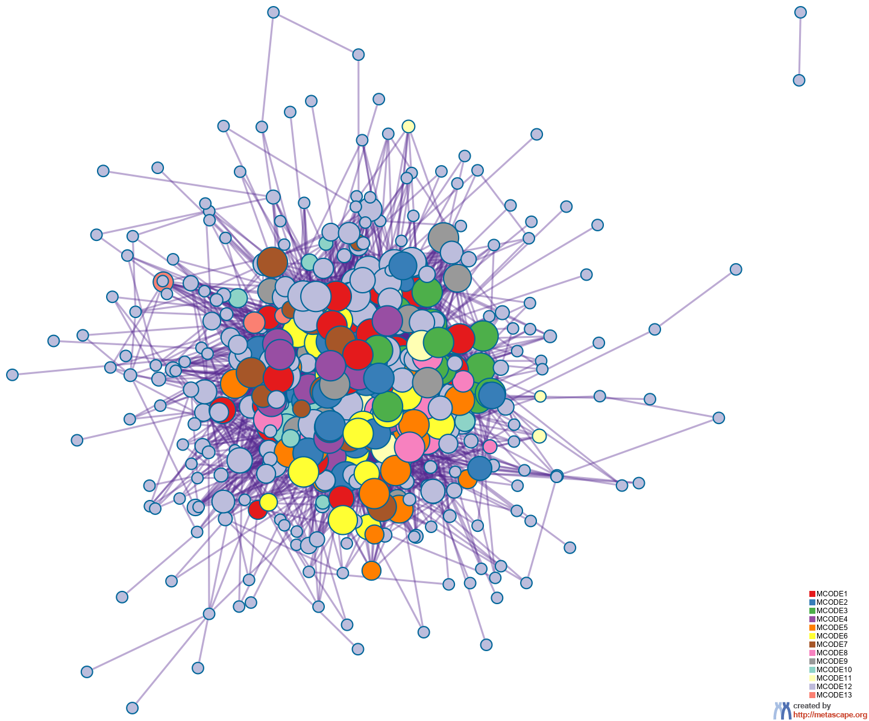
Protein-protein Interaction Network
Notes:
MCODE algorithm was then applied to this network to identify neighborhoods where proteins are densely connected. Each MCODE network is assigned a unique color. GO enrichment analysis was applied to each MCODE network to assign “meanings” to the network component.

Slide 7
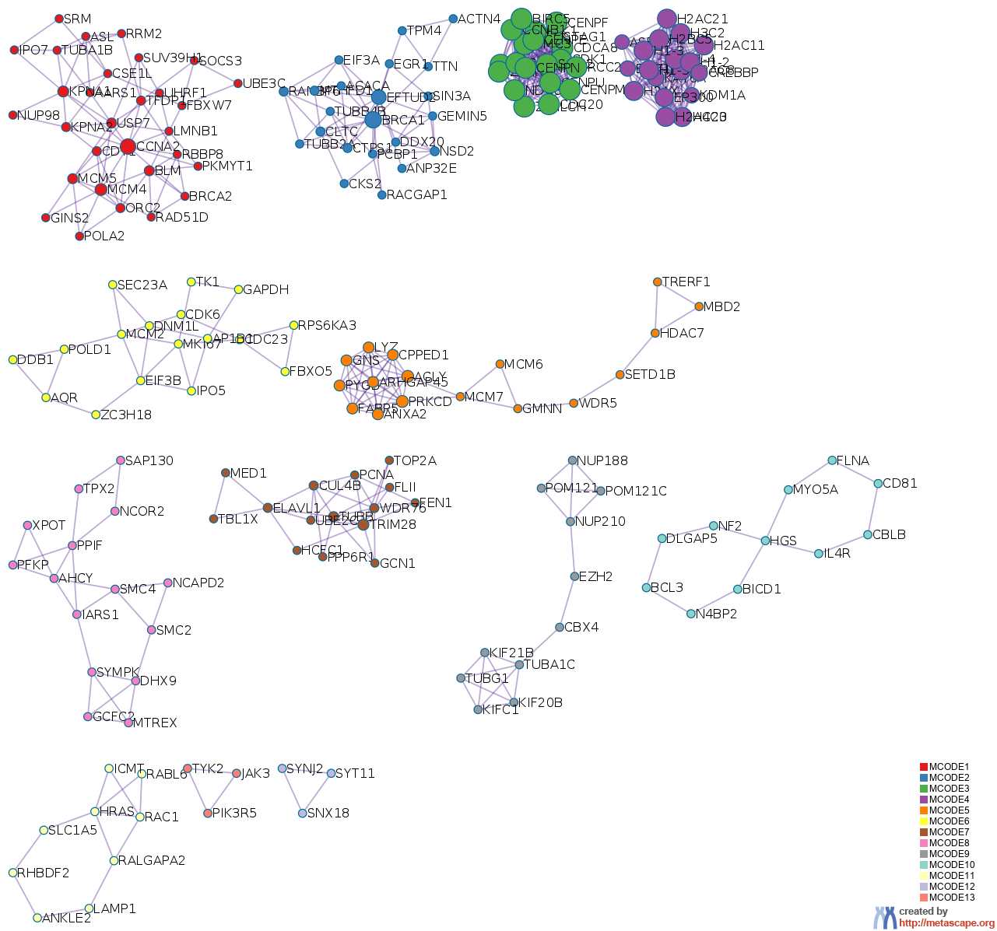
PPI MCODE Components
Notes:
MCODE algorithm was then applied to this network to identify neighborhoods where proteins are densely connected. Each MCODE network is assigned a unique color. GO enrichment analysis was applied to each MCODE network to assign “meanings” to the network component.

Slide 8
Biological Interpretation PPI Network & MCODE Components
Network | Annotation
MyList | R-HSA-1640170|Cell Cycle|-55.5;R-HSA-69278|Cell Cycle, Mitotic|-50.3;GO:1903047|mitotic cell cycle process|-40.8
MyList_MCODE_ALL | R-HSA-1640170|Cell Cycle|-63.5;R-HSA-69278|Cell Cycle, Mitotic|-62.6;R-HSA-68886|M Phase|-38.7
MyList_SUB1_MCODE_1 | R-HSA-1640170|Cell Cycle|-17.8;R-HSA-69278|Cell Cycle, Mitotic|-14.2;GO:0006260|DNA replication|-13.0
MyList_SUB1_MCODE_2 | R-HSA-2132295|MHC class II antigen presentation|-5.6;WP383|Striated muscle contraction pathway|-5.5;R-HSA-109582|Hemostasis|-5.2
MyList_SUB1_MCODE_3 | R-HSA-2500257|Resolution of Sister Chromatid Cohesion|-47.7;R-HSA-68877|Mitotic Prometaphase|-43.2;R-HSA-68882|Mitotic Anaphase|-41.9
MyList_SUB1_MCODE_4 | R-HSA-4839726|Chromatin organization|-20.0;R-HSA-3247509|Chromatin modifying enzymes|-20.0;GO:0006333|chromatin assembly or disassembly|-19.1
MyList_SUB1_MCODE_5 | R-HSA-6798695|Neutrophil degranulation|-11.6;GO:0016569|covalent chromatin modification|-6.6;R-HSA-68962|Activation of the pre-replicative complex|-6.0
MyList_SUB1_MCODE_6 | R-HSA-69278|Cell Cycle, Mitotic|-6.2;R-HSA-453279|Mitotic G1 phase and G1/S transition|-5.8;R-HSA-1640170|Cell Cycle|-5.7
MyList_SUB1_MCODE_7 | R-HSA-2151201|Transcriptional activation of mitochondrial biogenesis|-5.5;R-HSA-69278|Cell Cycle, Mitotic|-5.1;WP4016|DNA IR-damage and cellular response via ATR|-5.0
MyList_SUB1_MCODE_8 | CORUM:157|Condensin I complex|-8.9;CORUM:10|Condensin I complex|-8.9;CORUM:167|Condensin I complex|-8.9
MyList_SUB1_MCODE_9 | R-HSA-9609690|HCMV Early Events|-9.0;R-HSA-4570464|SUMOylation of RNA binding proteins|-8.7;R-HSA-9609646|HCMV Infection|-8.6
MyList_SUB1_MCODE_10 | GO:0046426|negative regulation of receptor signaling pathway via JAK-STAT|-6.8;GO:1904893|negative regulation of receptor signaling pathway via STAT|-6.6;GO:0046631|alpha-beta T cell activation|-6.5
MyList_SUB1_MCODE_11 | GO:0032940|secretion by cell|-4.1;GO:0051056|regulation of small GTPase mediated signal transduction|-4.0;R-HSA-5683057|MAPK family signaling cascades|-3.9
MyList_SUB1_MCODE_12 | R-HSA-8856828|Clathrin-mediated endocytosis|-6.9;R-HSA-199991|Membrane Trafficking|-4.9;GO:0006897|endocytosis|-4.9
Notes:
GO enrichment analysis was applied to each MCODE network to assign “meanings” to the network component, where top three best p-value terms were retained.

Slide 9
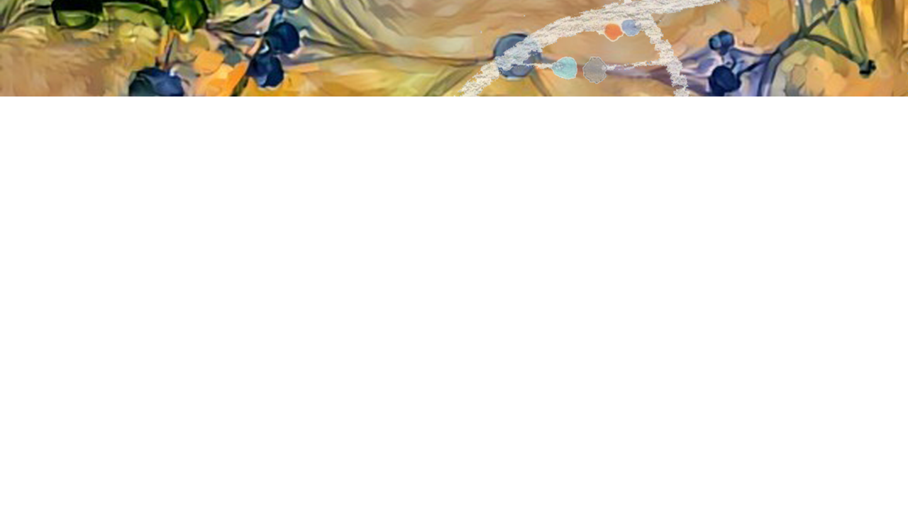

metascape.org
bioinformatics for biologists
Hint: If you have multiple related gene lists, upload them in one Excel file will trigger meta analyses.
Easy, Fresh & Free
Submit gene identifiers, one click on Expression Analysis. Done!
Interpretable results: visualizations, methods, pptx, xslx, zip
Best Practices for Gene List Analyses
Rich annotations for thousands of genes at once
Pathway & process enrichment analysis
Protein-protein interactome network analysis
Overlap analysis across multiple gene lists
Common and unique pathways across multiple studies
Support key model organisms
Notes:
Try metascape.org today!

