Slide 1

Blood vessel
Smooth muscle cells
Endothelial cells

Slide 2
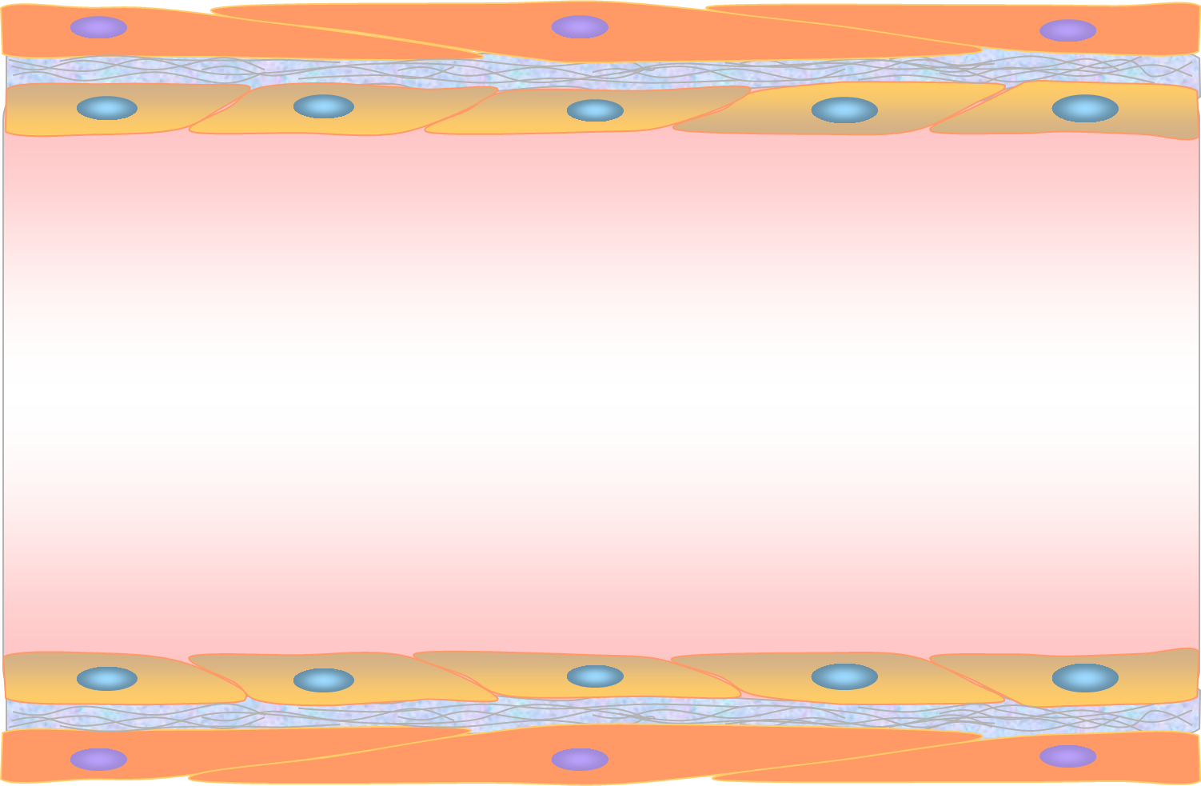
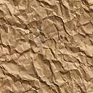
Smooth muscle cells
Endothelial cells
2
2
2
1
B cell
1
1
1
Monocyte
Dendritic cells
1
2
1
1
CCC within immune cells
T cell
2
CCC between immune cells and endothelial cells
2

Slide 3
Neutrophil Eosinophil Basophil
Monocyte
Macrophage
FcεRI
Mast
cell
Dendritic cells
FcεRI
T-cell
B-cell

