Slide 1
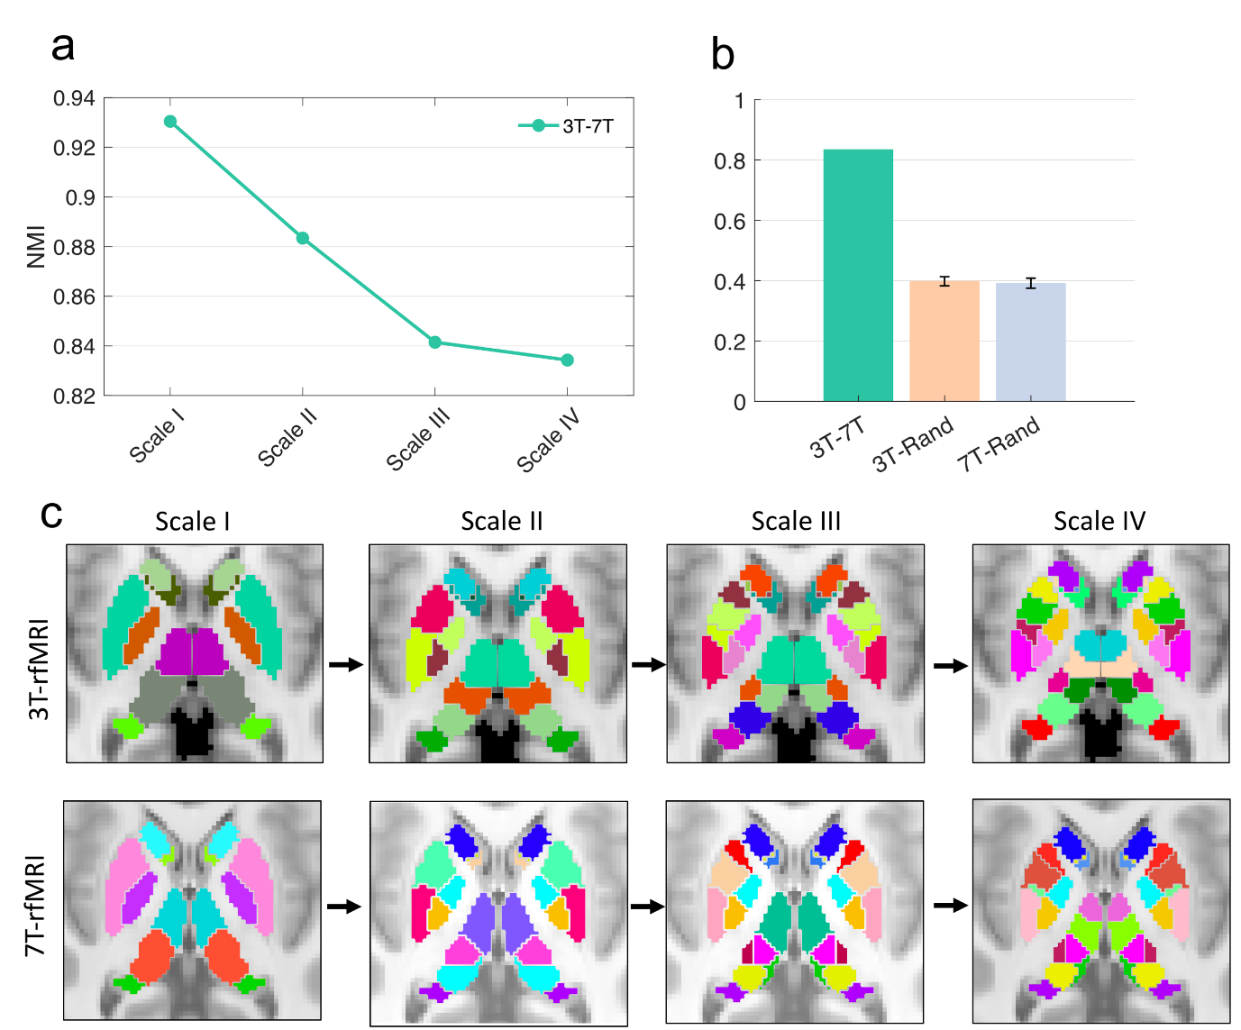
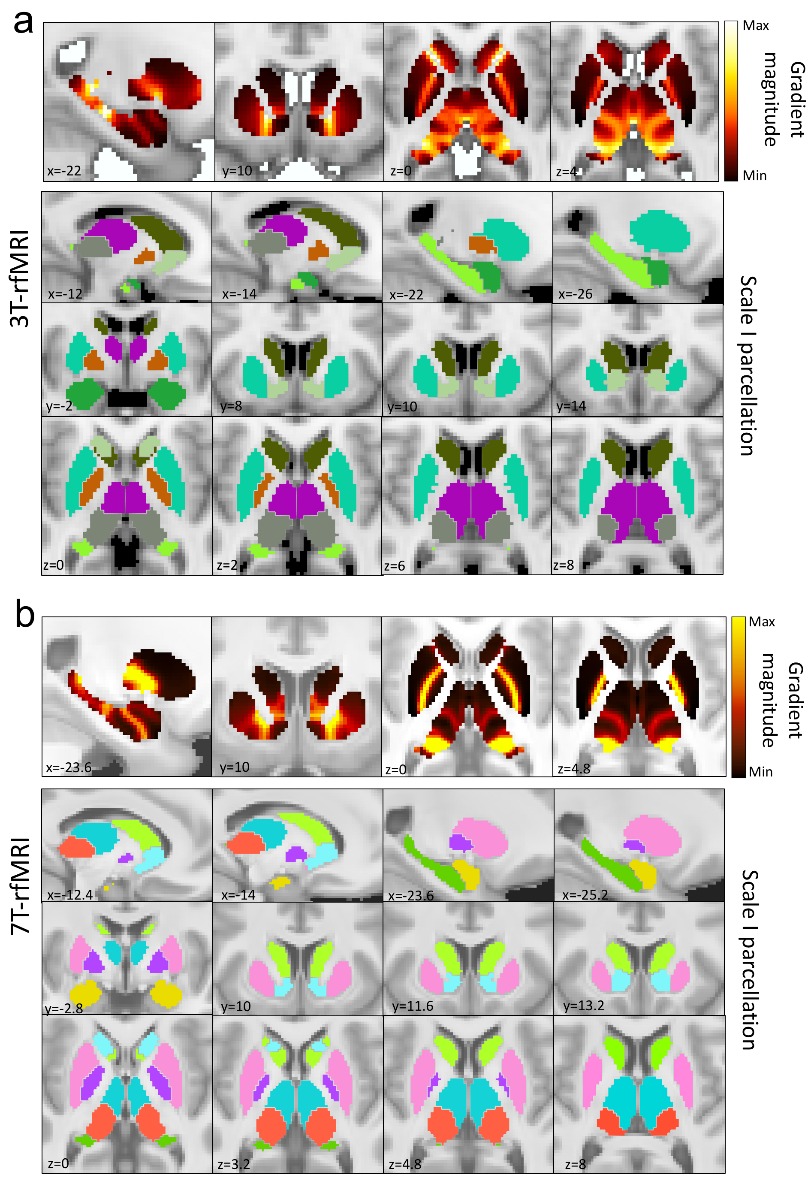
FC Gradient
Scale I
Scale II
Scale III
Scale IV

