Slide 1
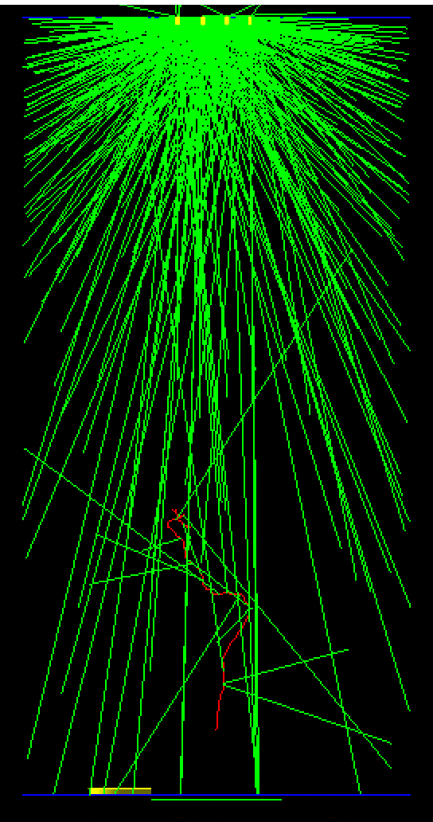
NEST+G4+Garfield/Magboltz simulation for CRAB
Eric, 12-July-2022

Slide 2
Synergies/Motivation
Exploring this, because we have a GXePC we’re interested in building at PNNL to do some radioxenon detection work.
Smaller than CRAB
No camera – at least not anytime soon
Will use a dense-ish tracking plane of SiPMs
This toolkit will allow to design an optimal detector
Voltages
LEM gap size
Gas pressure
SiPM size

Slide 3
Purpose of so many packages
Geant4
To allow to build common geometry and default propagation of particles
Magboltz
To calculate and store and provide-at-runtime the gas properties of an arbitrary gas mix at a particular E and p.
Garfield
To drift individual ionization electrons to the LEM region
Applying attachment, diffusion along the way
To provide the gas excitations in the high field LEM region
NEST
This takes over from G4 and provides the (hopefully) correct yield of ionization e’s and optical photons produced by whatever’s traversing the GXe.
Validated in LXe and recently in LAr and only a little in GXe

Slide 4
Why
Geant4 on its own gives a bunch of ionization e’s, many of which are not few-ish eV, but are hundreds to kilo-eV (though, Energy seems to be conserved)
Hence, NEST
gives the correct number of es/optphotons with small Fano factor.
Further, the e’s are not typically drifted one-by-one in the E-field in G4.
For example, simulations of LArTPCs usually apply a model, simply given the energy deposition of the primary particle, and clouds of e’s just appear at the anode.
For us, however, to preserve the whole purpose of the GXe detector – precise calorimetry! Limited diffusion! – we need the right number of thermalized e’s generated and tracked, and then we need the correct multiplication in the LEM.
Hence, Garfield

Slide 5
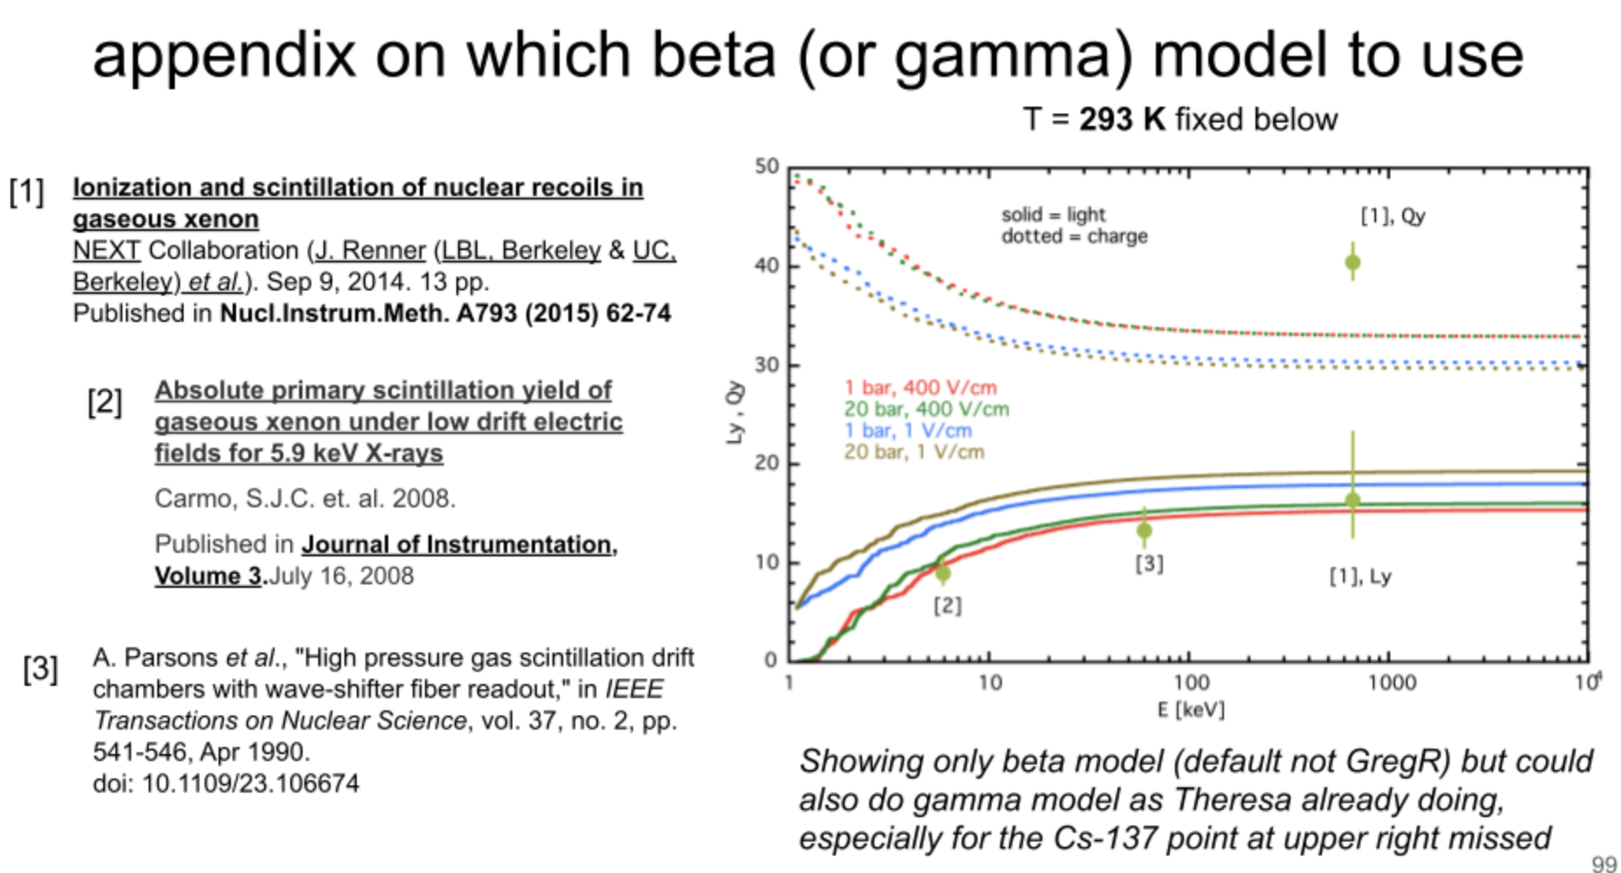
From Matthew Szydagis – main NEST author
per keV

Slide 6
Photon Look-Up Tables/Libraries
Yes, these can do the job eventually.
Given an energy deposition at x,y,z in the gas, what is N_{pe}/keV at SiPM or PMT i?
But that library is fixed, and once any parameter – radius, length, p, E, SiPM arrangement – is changed that library has to be re-generated.
They, themselves can be cumbersome for a fine-enough required spatial resolution.
Also, ray-tracing through the MgFl lens can not use this mechanism.
But, by all means, for eventual big production runs we can build a photon look-up table from this work.

Slide 7
What I’ve done
Simple cylinder geometry with settable (10 bar) pressure pure Xe.
60cm high, 15cm radius
All in C++, not gdml
A simple “camera”, at cathode that just “catches” optphotons
No focusing yet! Will get back to this.
There are 2 Settable E-fields
59.5 cm drift of exactly 1000 V/cm, transitioning abruptly to …
0.5 cm LEM of 10000 V/cm
No meshes in the geometry
Nothing like Maxwell,…, yet

Slide 8
2MeV electron
2 MeV electron launched upward (red)
S1 photons, x~1000 suppressed in number, shown emanating from the primary electron
S1 e-s not shown, highly suppressed in number (4), and drifted up by Garfield, where they hit the LEM region and create excitations (shown in yellow at top)
S2 photons, again highly suppressed, emanate isotropically from those excitations

Slide 9
S1
S1
58873 e’s
mm

Slide 10
6443507 opticalγ’s
S2
LEM gain = 6443507/58873 = 109.4
Adding time (y-axis)
S2
nsec

Slide 11
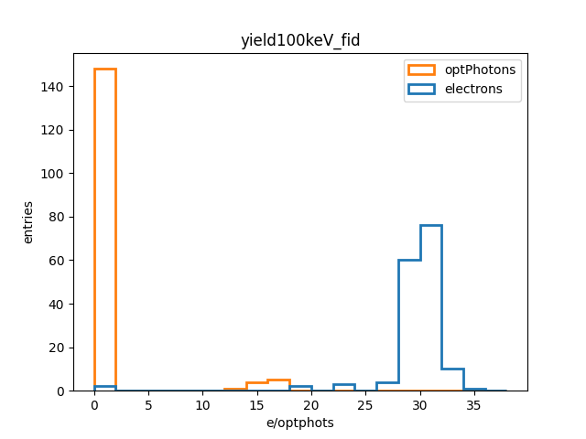
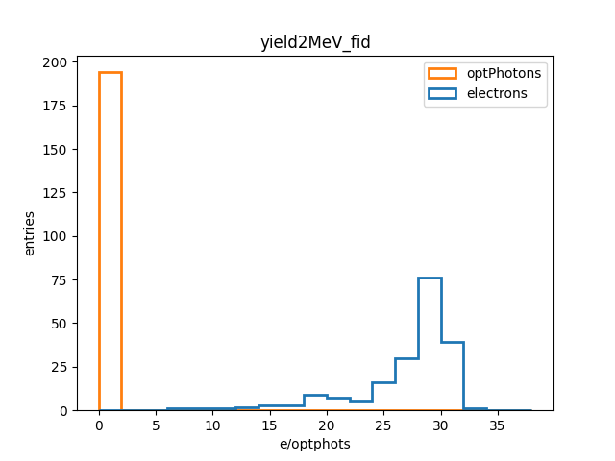
Primary Yield
Requiring all points of origin (primary e confinement) to be 1cm from walls
2 samples: 100 keV and 2 MeV both in 2bar Xe
/100
/2000
My bug defining S1 optphotons at TTree-filling time

Slide 12
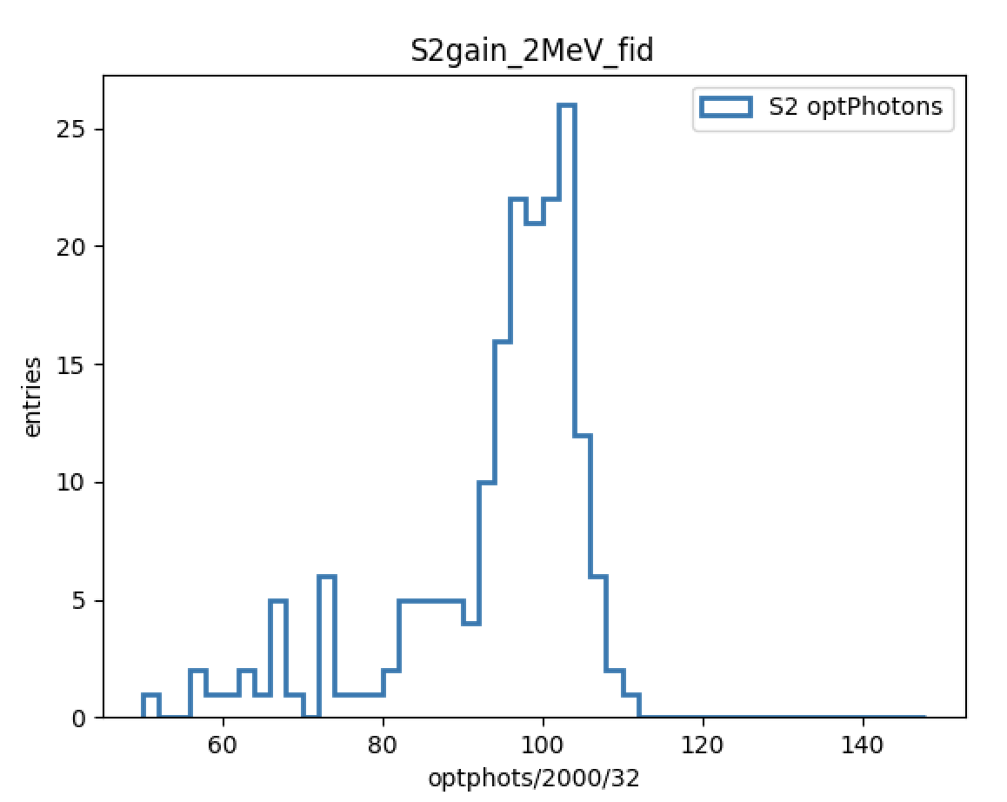
LEM gain
2 MeV isotropic e’s started at 0,30,0. (many of which are not fully contained).

Slide 13
How the code works
Geant4 starts the primary 2 MeV e’ that we launch in our .mac file.
NEST realizes it’s in xenon. It generates ~30k/keV ~few eV thermales and ~20k/keV 7.7 eV optphotons and puts em all on the G4 stack along the track.
The optphotons are left for G4 to propagate
Our G4 FastTracker sees the thermales, and we kill them as G4 tracks and hand ‘em to Garfield::AvalancheMC() through the drift region, then to Garfield::AvalancheMicro() in the LEM region.
G4 FastTracker places the LEM excitation photons onto the G4 stack

Slide 14
Technical points
Out-of-box, a 2MeV e in 10 bar in this geometry takes ~10 hours to run.
It is perhaps interesting that the single biggest offender is GarfieldAvalancheMicro().
This is the function that creates the N excitations in the LEM region.
After doing diffusion, Atomic shell choice, …
Replacing that function with a hand-created function of my own that merely creates N points of excitation along y (cylinder axis) in the LEM region, according to the well known formula, and with a ~0.5% gaussian fluctuation, gives a x100 speed-up.
A fully contained 2 MeV event now takes 6min
And is dominated by the optphoton tracking now.
=> This is now a usable tool.
YoverP = 105.*fieldLEM/(detCon-GetGasPressure()/torr) - 116.;
N = YoverP * detCon-GetGasPressure()/bar * gapLEM; // with P in bar this time.

Slide 15
Code – 3 repos
Currently have Garfield, NEST and gxsim up on PNNL internal sites
One needs Geant4/ROOT of course to be installed
The changes I’ve made to Garfield and NEST are mostly cout insertions, for helping me figure out what’s going on where. But not entirely: e.g., I made NEST produce .so’s instead of .a’s to make the linking work
gxsim OTH I could just put up on my github with a setup script and a README

Slide 16
Next steps
Put a MgFl lens in over the camera
Would be nice to confirm a focused image
https://github.com/ymei/G4QSim/geometry/lens.gdml
Put in proper wall/end-cap reflections
Is that image still somewhat clear?
By how much does the runtime go up?
What is correct λ_{atten} to use?
Perhaps run some few-hundred keV gammas to see what NEST does with those.
Might have to pull in Degrad to do the photoelectric effect properly
I have an example that does this. It would be unfortunate to have to do it.
Proper E-field modeling and meshes
Look into CHROMA
GPU propagation of optical photons
https://github.com/BenLand100/chroma, https://github.com/NuTufts/ChromaUBooNE

