Slide 1
Spark on Azure
@EugeneChuvyrov
Software Consultant @SlalomSV

Slide 2
Spark
“Open Source Framework that (1)combines engine for distributing programs across clusters of machines with an (2)elegant model for writing programs atop it.”
Advanced Analytics with Spark (O’Reilly)

Slide 3
Why Spark?
Short Version:
It’s faster than Hadoop
THE END

Slide 4
Why Spark?
Longer version:
Better programming model
In-memory processing
Interactivity
Increased analyst productivity: single environment, from preprocessing to evaluation

Slide 5
Spark vs Hadoop MapReduce
Spark - compatible with Hadoop
Cluster Managers
Hadoop YARN
Apache Mesos
Standalone
However, Spark can be thought of as a generation higher than MapReduce

Slide 6
Spark: not just for Machine Learning
MyFitnessPal
Using Spark to clean-up user entered food data using [..]

Slide 7
Spark on Azure
Very easy way to create a Spark cluster
Spark 1.3.1 (currently)
Anaconda. A collection of powerful packages for python.
Spark Job Server - submit jars or python scripts remotely.
Zeppelin Notebook for interactive querying.
Jupyter Notebook for interactive querying.
ODBC driver for connectivity from BI tools such as Microsoft Power BI and Tableau.
Integration with Azure storage (persistence)

Slide 8

Machine Learning Competitions
kaggle.com– platform to test your ML skills
A great place to start and enhance your ML journey
Titanic: Machine Learning from Disaster
https://www.kaggle.com/c/titanic/

Slide 9
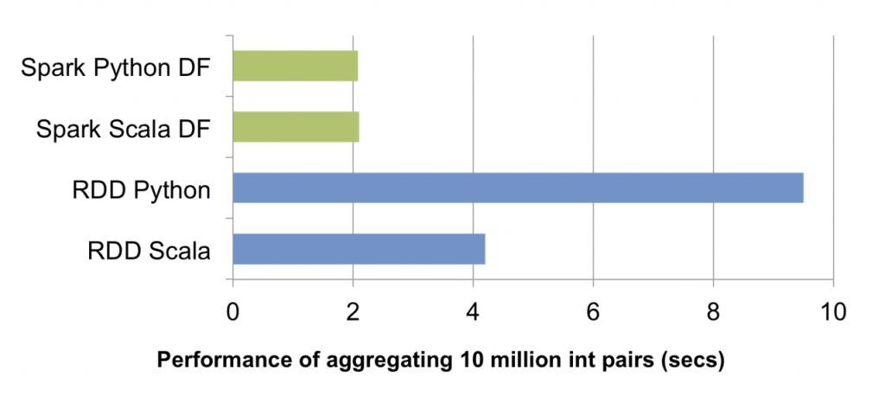
Spark SQL and DataFrames
It’s the future
Machine Learning Pipelines

Slide 10
#machinelearning
What is it?
Are we predicting the future?

Slide 11
#machinelearning
What is it?
Are we predicting the future?
Machine learning is a type of artificial intelligence (AI) that provides computers with the ability to learn without being explicitly programmed.

Slide 12
#machinelearning
Types of ML
Supervised
Regression
Classification
Unsupervised
Clustering

Slide 13
#machinelearning
General approach [to supervised learning]:
Train the model using known data
Test your model using known data
Use the model to “predict the future” on unknown data

Slide 14
Some sources of data for experiments
Lots of sample data inside ML Studio
kaggle.com, of course
UC Irvine ML Repo http://archive.ics.uci.edu/ml/
AWS Public Datasets http://aws.amazon.com/public-data-sets/

Slide 15
Q&A
Thank you!
@EugeneChuvyrov

