Slide 1
Team 2: Optimizing molecular diffusion and interaction simulations (“TurboReceptors”)
Team leads: Khuloud Jaqaman, Paniz Karbasi
Team members: Devin O’Kelly, Keith Nguyen, Teddy Hsieh, Uday Chintapula, Wei Guo
Goal: Optimize and speed up a code that simulates molecules diffusing and interacting

Slide 2
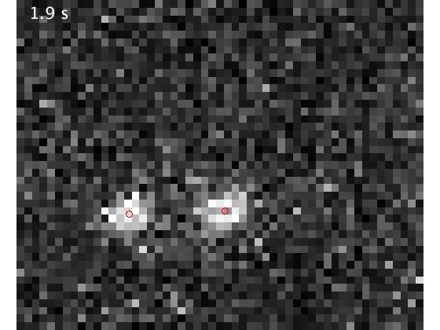
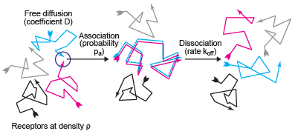
Why? We need simulations to compare simulated receptor trajectories and interactions with experimental data, in order to estimate in situ on and off rates for receptor interactions in their native environment.
Significance: Understanding receptor interactions opens avenues for drug development targeting these interactions.
Single-molecule data
Model

Slide 3
Simulation strategy
At t=0, place molecules randomly in simulation area
For t > 0
Dissociate oligomers based on dissociation rate
Move oligomers and receptors
Associate oligomers and receptors that are within the association distance
Note:
If you dissociate in this time point, you cannot re-associate
Association and dissociation is one receptor at a time

Slide 4
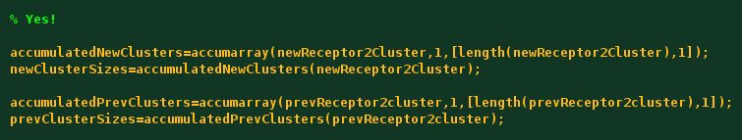
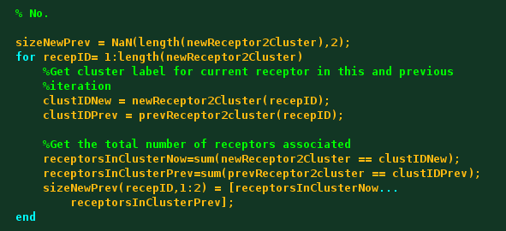
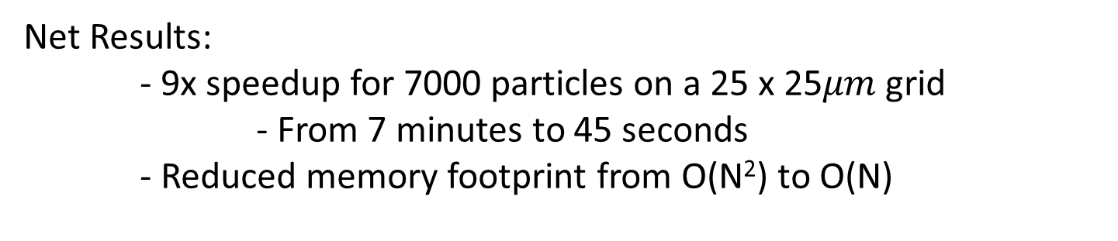
Strategy 1: Profile and optimize Matlab code
Identified CPU bottlenecks
For loops
Set comparison and difference
Identified excess memory usage
Replaced:
Loops with vectorized accumulation
Large pairwise distance matrix with local graph structure
Net Results:
- 9x speedup for 7000 particles on a 25 x 25$μm$ grid
- From 7 minutes to 45 seconds
- Reduced memory footprint from O(N²) to O(N)

Slide 5
Strategy 2: Rewrite to run on GPU instead of CPU
Develop spatial parallelization strategy
Special case of boundary particles (red)
First pass: non-boundary particles in parallel (1 thread per box)
Second pass: boundary particles
Write code in C/C++ (got backbone done)
Convert to CUDA C to run on GPU (got some done)

