Slide 1

Team: Coin Connoisseurs Project: TYME (Track Your Money Easily)
Members: Cinteza Emilian-Cosmin, Despina Cojocaru, Stan Anamaria Cristina, Dubina Jesica Denisa

Slide 2


Introduction
The goal of this project is to create a C# application that allows users to track their finances easily. The application will feature six main buttons on the home screen, each leading to a different section of the app.

Slide 3
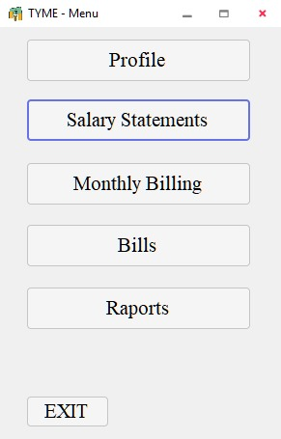
The menu
The User Interface has six buttons on the main screen: Profile, Salary Statements, Monthly Billing, Bills, Reports and Exit.

Slide 4
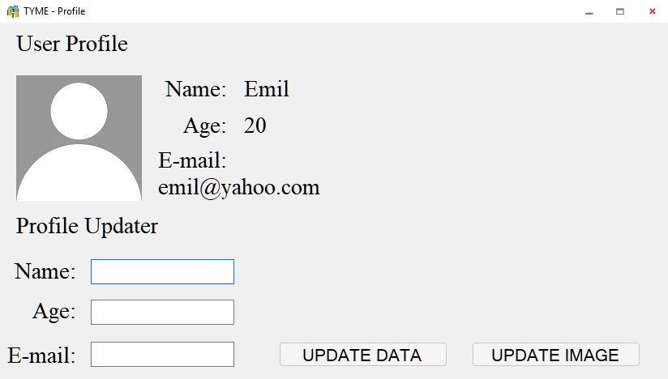
User Profile Module
The User Profile module will allow users to enter and update their personal information, such as name, age, email and profile picture.

Slide 5
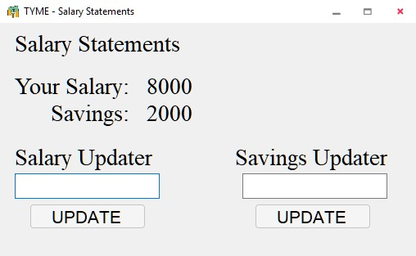
Salary Statements Module
The Salary Statements module will allow users to enter and track their income. Users can enter their salary and the amount of money they want to save each month. This module will be linked to other modules that require user data, such as the Reports module.

Slide 6
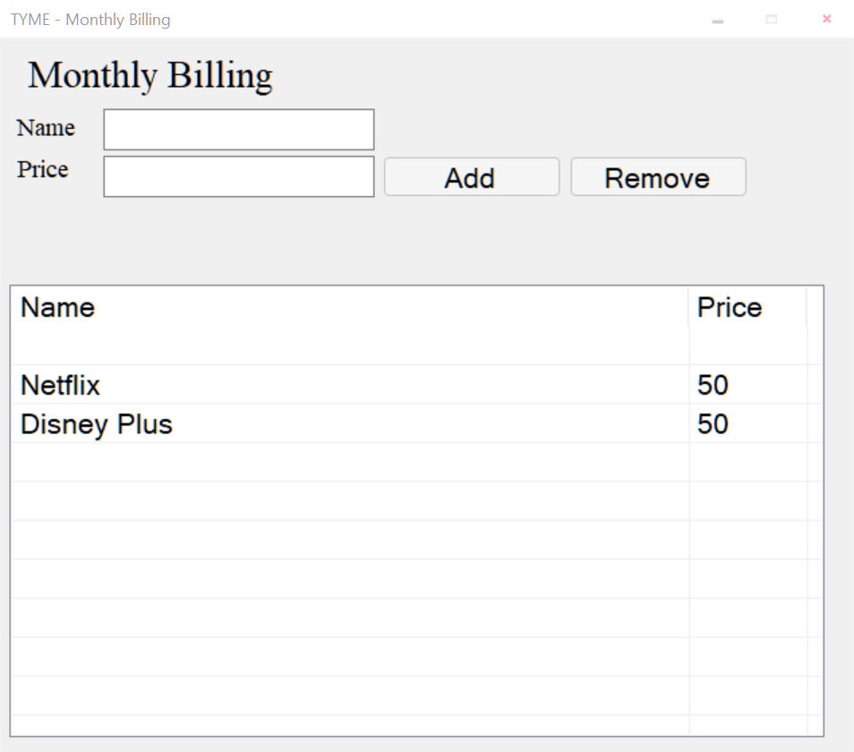
Monthly Billing Module
The Monthly Billing module will allow users to track their recurring monthly bills, such as Netflix or Hulu. Users can add, edit, and delete subscriptions as needed. This module will also provide a summary of total monthly expenses.

Slide 7
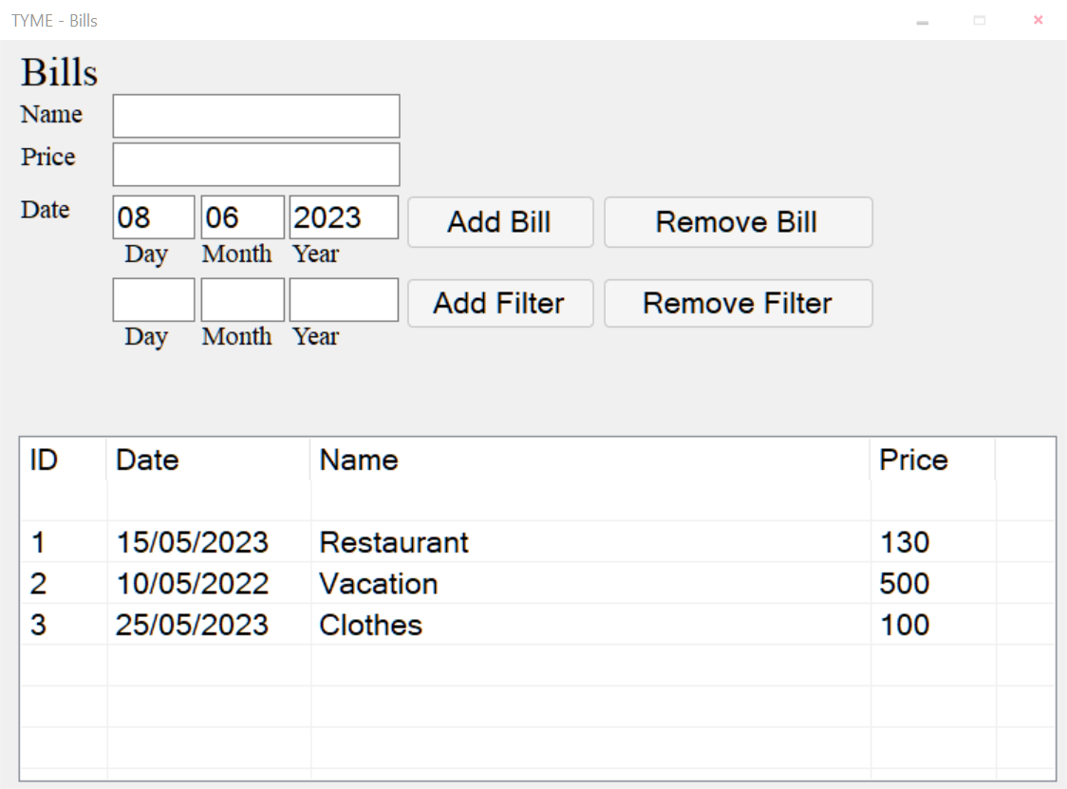
Bills Module
The Bills module will allow users to track their one-time expenses, such as grocery bills or restaurant receipts. Users can add, edit, and delete bills as needed. This module will also provide a summary of total expenses over time.

Slide 8
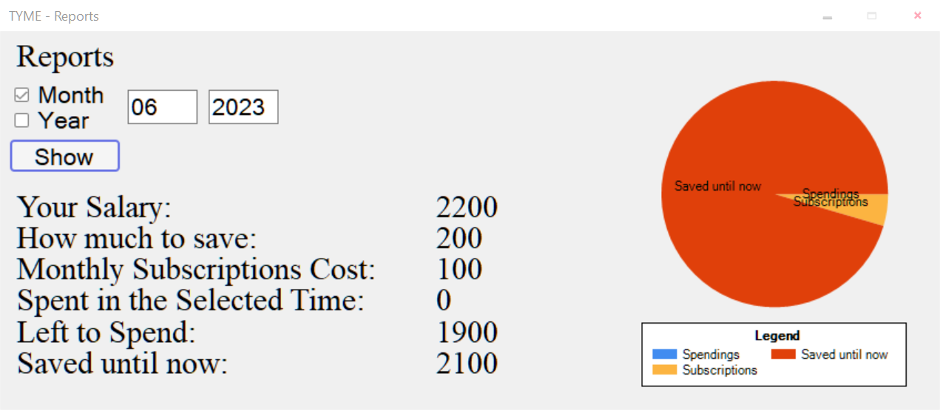
Reports Module
By pressing the Reports button, the User will view a detailed summary of his finances with a pie chart and the ability to choose a specific month or a specific year. If you choose the current year, it will only show available data until the current month.

Slide 9
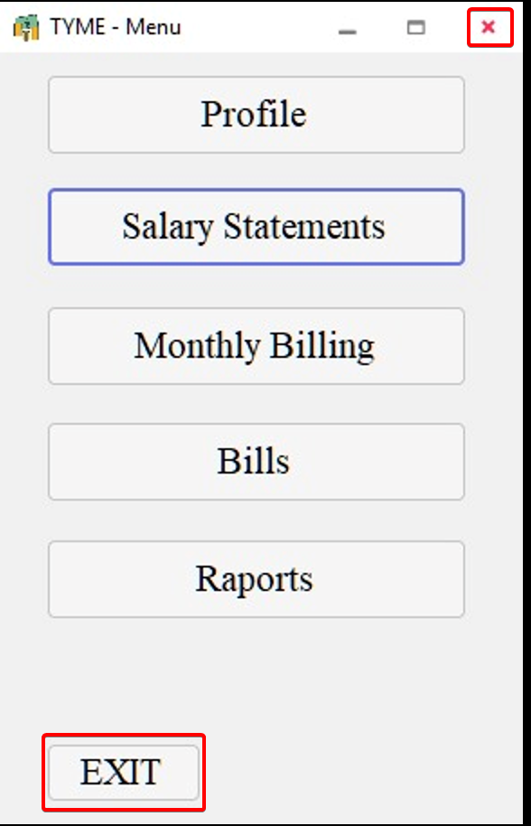
The Exit Module
In order to exit the app just exit the current tab (Profile, Salary Statements, Monthly Billing, Bills or Reports) and press the Exit button or the [X] button.

Slide 10
Thank you for your attention!

