Slide 1
BAEJ
Developed by Bailey Morgan, Alex Dripchak, Eric Tu, and Joshua Eckels

Slide 2
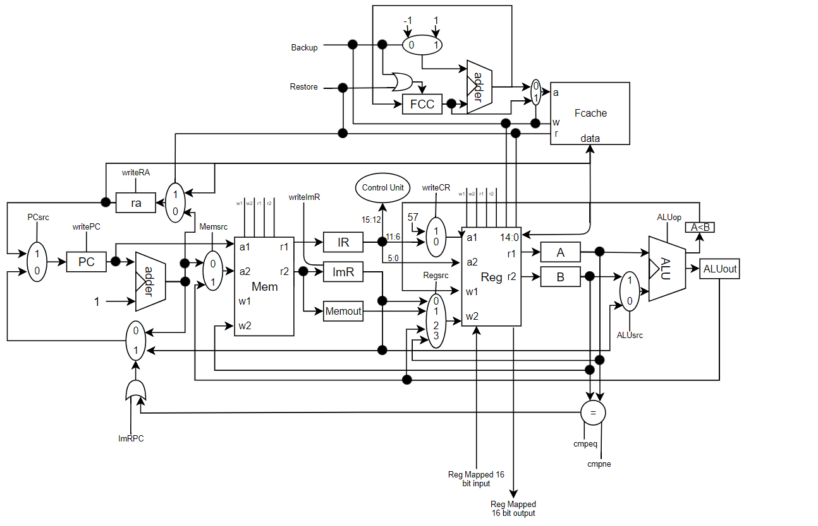
Overall Architecture
Load-Store / Accumulator
Multicycle
No stack

Slide 3
