Slide 1
TSP ∈ NP-Complete
Emre Can Kucukoglu
eckucukoglu@gmail.com
16.01.2016

Slide 2

Traveling Salesman Problem
Given n cities $c_{1},c_{2},c_{3}, …,c_{n}$ and integer distances $d_{c_{i},c_{j}}$ between any two cities $c_{i} and c_{j}$.
TSP asks for the total distance of the shortest tour of the cities.
Decision version of TSP asks if there is a tour with a total distance at most B, where B is an input.

Slide 3
TSP: formal description
TSP = {
<G, d, B> :
G=(V, E) is a complete undirected graph,
d is an edge cost function from VxV→Z+ ∪ {0},
B ∈ Z,
G has a Hamiltonian cycle with cost ≤ B
}

Slide 4

TSP ∈ NP-Complete ?
To prove that TSP ∈ NP-Complete,
First, we must show that there exists a nondeterministic algorithm in polynomial time that solves TSP.
TSP ∈ NP
Then, we will reduce the undirected Hamiltonian cycle, which is a known NP-complete problem, to TSP:
HAM-CYCLE ${\text{≤}}_{p}$ TSP

Slide 5
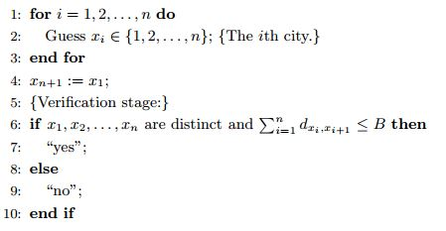
Nondeterministic algorithm for TSP
The following procedure is a polynomial time non-deterministic algorithm that terminates successfully iff an ordering of n-cities are distinct and sum of distances between pairs are less than or equal to B.
The complexity of this non-deterministic algorithm is O(n).
So that; TSP ∈ NP

Slide 6
Hamiltonian Circuit Problem
Find a tour of a given unweighted graph that simply starts at one vertex and goes through all the other vertices and ends at the starting vertex.
Note that the input graph G to a Hamiltonian Cycle problem need not be a complete graph connecting all vertices.
Hamiltonian circuit is a known NP-Complete problem.

Slide 7

HAM-CYCLE ${\text{≤}}_{p}$ TSP
To transform Hamiltonian circuit/cycle problem to TSP,
Create a graph G’ = (V, E’) from Hamiltonian cycle instance G = (V, E),
G’ is a complete graph,
Edges in E’ also in E have an edge cost 0,
All other edges in E’ have an edge cost 1.

Slide 8
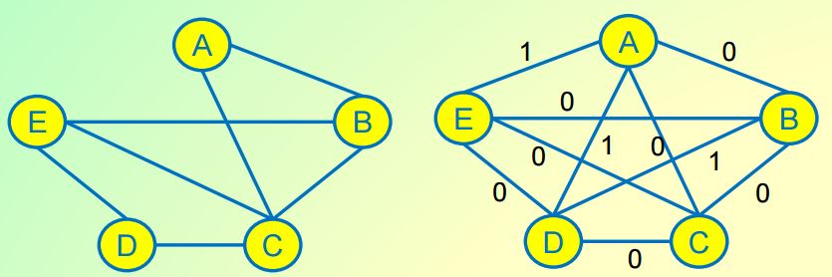



HAM-CYCLE ${\text{≤}}_{p}$ TSP
Take any instance G = (V, E) for the Hamiltonian cycle problem,
Convert it into an instance G′=(V, E′ = V×V, d), B = 0 of TSP,
$d_{c_{i},c_{j}}$ = { 0 if edge ($c_{i},c_{j}$) ∈ E,
1 otherwise }
Time complexity of reduction is O($n^{2}$) as there n(n-1)/2 edges on a complete graph.

Slide 9
HAM-CYCLE ${\text{≤}}_{p}$ TSP
Problem: Is there a TSP on G’ with total edge cost = 0 ?
If G has a Hamiltonian circuit, algorithm will return "yes" on input (G′, C),
If there is no Hamiltonian circuit in G, algorithm will return "no" on input (G′, C).
If G’ has a cycle with cost = 0, every edge of that cycle has a cost = 0, thus G has a Hamiltonian cycle.
If Hamiltonian cycle does not exist, then there is no simple cycle in G, that visits every vertex exactly once. Suppose that TSP has a “yes” answer. Then, there is a cycle that visits every vertex once with total cost = 0. Since negative distance cost is not possible, every edges have cost = 0, which implies that these edges are in the Hamiltonian Circuit graph. It is a contradiction.

Slide 10
TSP ∈ NP-Complete
It is well known that Hamiltonian Circuit is NP-Complete, every problem ß in NP reduces to Hamiltonian Circuit in polynomial time.
We have reduced Hamiltonian Circuit to TSP in polynomial time, it indicates that every problem ß in NP reduces to TSP is polynomial time, since the sum of two polynomials is also a polynomial.

Slide 11
References
http://www.csie.ntu.edu.tw/~lyuu/complexity/2004/c_20040929.pdf
http://web.calstatela.edu/faculty/jmiller6/2014spring-cs312/lectures/Lecture10.pdf
https://www.quora.com/Why-is-the-traveling-salesman-problem-NP-complete/answer/Luke-Benning

