Slide 1
NIDEC CORPORATION
Online MIS Request (User Account Request & Job Request)
Management Information System
Administration Division

Slide 2
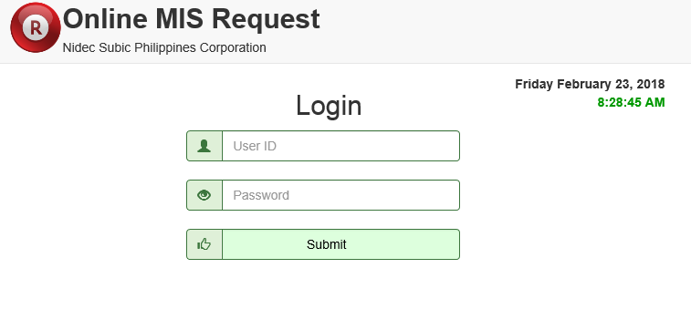
Online MIS Request Address
Type in Address Bar : http://nsweb/mis/
1
2
Input employee ID
3
Input assign password
4
Click here to login
Reminder : Default user ID and password is employee’s ID. You can change your password upon login.

Slide 3
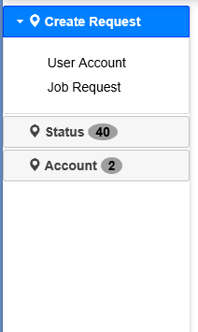
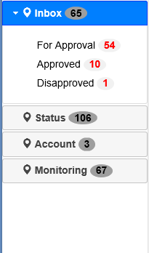
Account Type : Filler & Approver
Different between Filler and Approver account.
For filler, ‘Create Request’ will be display. They can create a user account or Job Request.
For approver, ‘Inbox’ will be display. They can view current request for approval and
previous request already approved and disapproved for backtracking.
Filler Display
Approver Display

Slide 4
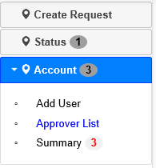
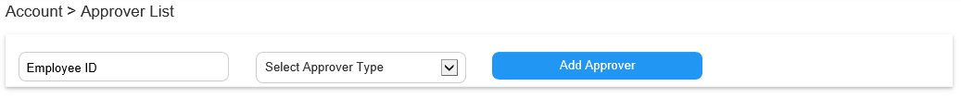
Add Approver
In ‘Account’ tab, click ‘Approver List’.
1
2
3
Follow this simple procedure… Step 1 : Input Employee ID of your approver.
Step 2 : Select signatory level. ‘s1’ for immediate superior and ‘s2’ for managerial level.
Step 3 : Click ‘Add Approver’ button to save. Then list of approver will display below automatically.

Slide 5
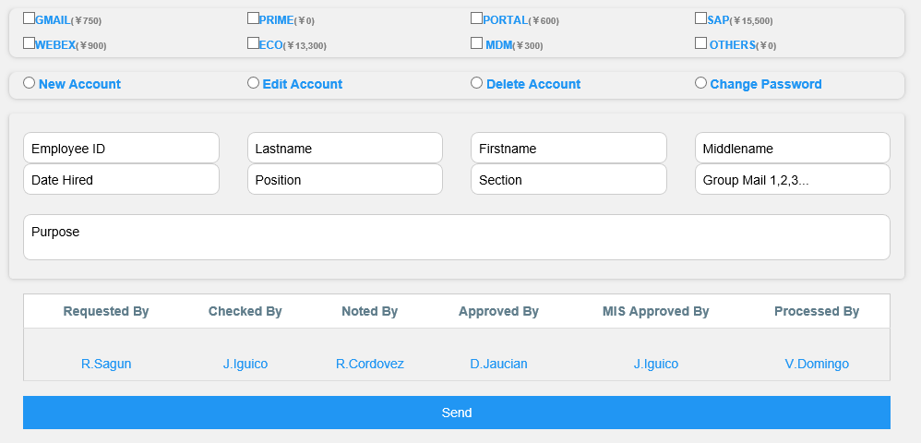
Filler Account
User Account Request
1
2
3
4
5
Follow this simple procedure… Step 1 : Select account request. Step 4 : Input purpose or description of your request. Step 2 : Choose account type. Step 5 : Click ‘Send’ button to submit your request. Step 3 : Input all fields needed.
Note : All signatories are subject to received a auto email once requestor was submitted.

Slide 6
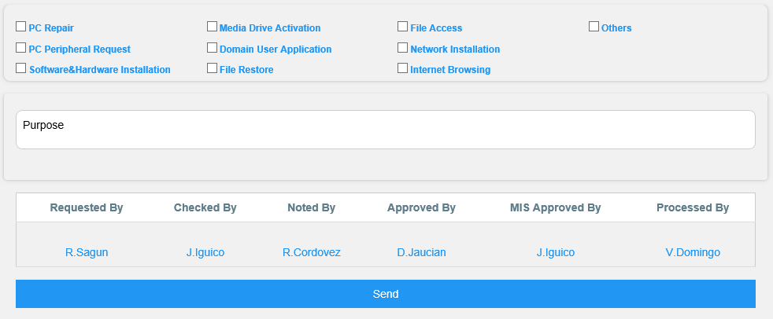
Filler Account
Job Request
1
2
3
Follow this simple procedure… Step 1 : Select job request type.
Step 2 : Input purpose or description of your request. Step 3 : Click ‘Send’ button to submit your request.
Note : All signatories are subject to received a auto email once requestor was submitted.

Slide 7
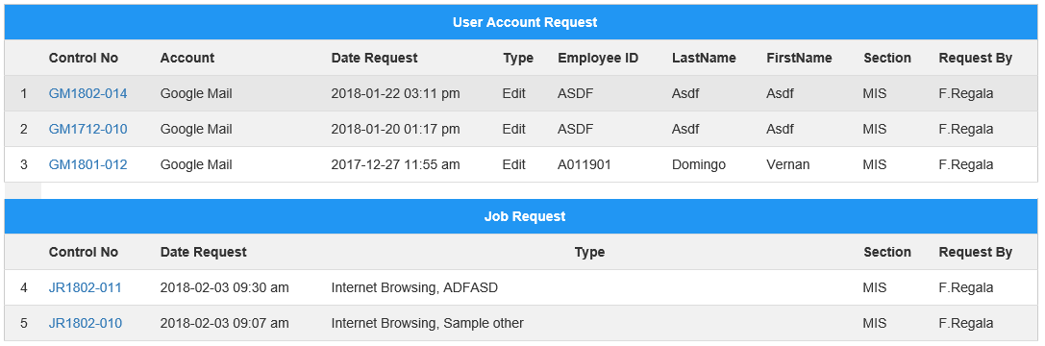
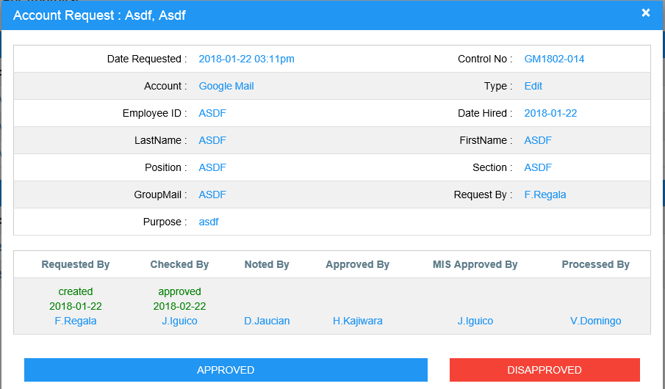
Approver Account
Inbox >> For Approval
1
2
Follow this simple procedure… Step 1 : Click control number to be sign.
Step 2 : After reviewing all request information, click ‘Approved’. If not correct, choose ‘Disapproved’ then input reason of disapproved and click ‘Submit’.
Note : This procedure was same with Job Request Approval.

Slide 8
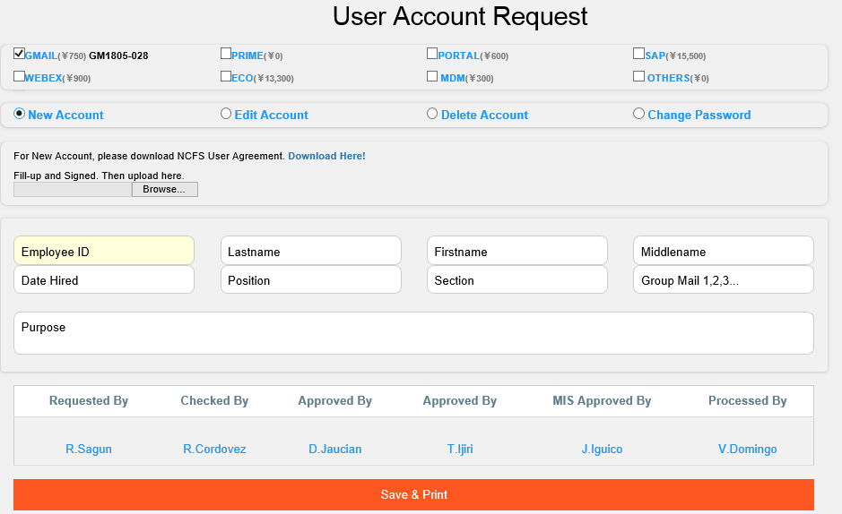
New Gmail Account Request Flow
First, click ‘GMAIL’
Second, click ‘NEW’
Fill-up all necessary fields
Click here to ‘Save & Print’
For New Gmail Account Request Flow
Step 1 : After fill-up all necessary fields @ USER ACCOUNT REQUEST module, click 'Save & Print' button.
Step 2 : PrintOut/HardCopy of your request will be signed by Immediate Superior, Manager
and Vice President thru hand written signature.
Step 3 : Then scan and save as PDF, upload your files @ Online MIS Request under 'Status' > 'On-Going' tab.
Step 4 : Auto email will notify MIS Manager for approval. Step 5 : Once approved, MIS Staff will process your request..

Slide 9
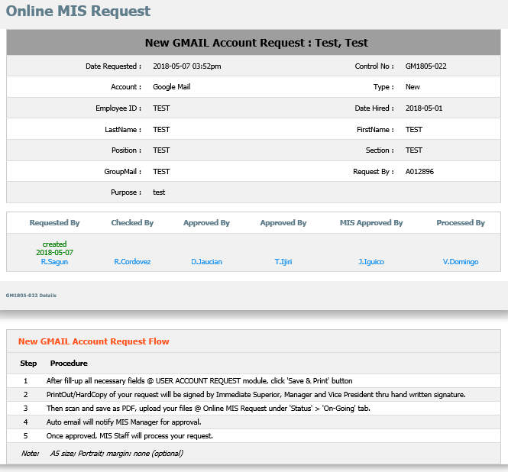
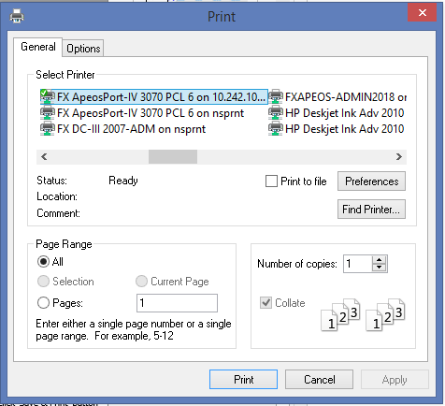
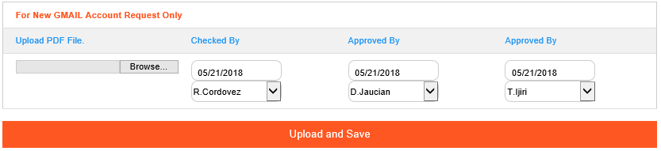
New Gmail Account Printing & Uploading
After clicking ‘Save & Print’, Printing option will popup. Recommended is A5 size; Portrait; margin: none (optional).
Then HardCopy will manually signed by Immediate superior, Manager and Vice President. After signing, scan and save as PDF file. Upload your file in system.
Please follow uploading procedure below.
1
2
3
4
In ‘Status’ tab, click ‘On-going’. Then click your request.
Follow this simple procedure… Step 1 : Browse your PDF files.
Step 2 : Change Immediate Superior date signed and name based on your hardcopy.
Step 3 : Change Manager date signed and name based on your hardcopy.
Step 4 : Change Vice President date signed and name based on your hardcopy.
Step 5 : Then click ‘Upload and Save’. If successfully uploaded, MIS Manager will alert thru email for approval.
Once approved, MIS Staff will process your request.
5

Slide 10
SAP and Other User Account Request Flow
For New SAP Account Request Flow
Step 1 : After fill-up all necessary fields @ USER ACCOUNT REQUEST module, click ‘Send' button.
Step 2 : Your request will be signed by Immediate Superior, Manager and Vice President thru online signature.
Step 3 : Auto email will notify MIS Manager for approval. Step 4 : Once approved, MIS Staff will process your request..
For Edit, Delete or Change Password Request Flow (regardless any account)
Step 1 : After fill-up all necessary fields @ USER ACCOUNT REQUEST module, click ‘Send' button.
Step 2 : Your request will be signed by Immediate Superior and Manager thru online signature.
Step 3 : Auto email will notify MIS Manager for approval. Step 4 : Once approved, MIS Staff will process your request..
Job Request Application Flow
For Job Request Application Flow
Step 1 : After fill-up all necessary fields @ Job Request module, click 'Save' button.
Step 2 : Your request will be signed by Immediate Superior and Manager thru online signature.
Step 3 : Auto email will notify MIS Manager for approval. Step 4 : Once approved, MIS Staff will process your request..

Slide 11
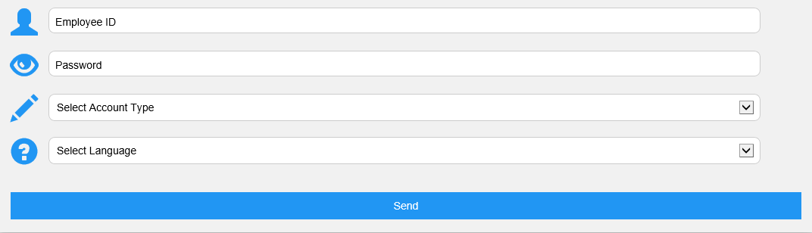
Account Tab
Account >> Additional User
1
2
3
4
5
Follow this simple procedure… Step 1 : Input unique Employee ID.
Step 2 : Input assign password.
Step 3 : Select account type. If ‘Approver’, then choose ‘Approver Type’ from ‘s1’, ‘s2’, ‘s3’.
Step 4 : Select language if ‘English’ or ‘Japanese’. Step 5 : Click ‘Send’ button to submit your request.

Slide 12
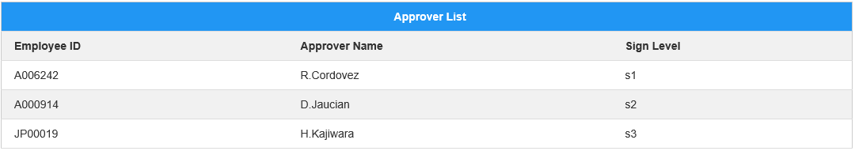
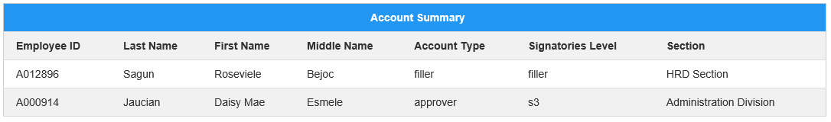
Approver List & Summary
Approver List : You can view signatories summary under your section.
Account Summary : You can monitoring with account under you section.

Slide 13
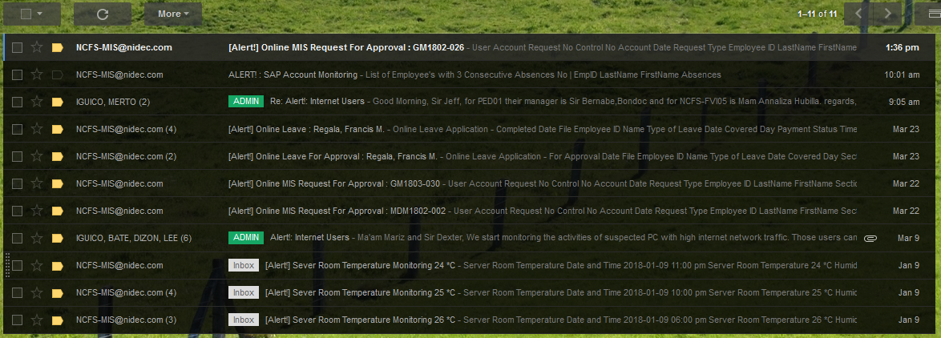
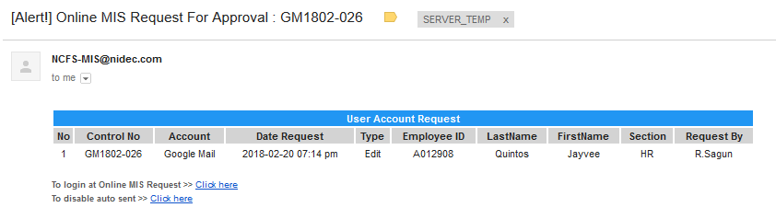
Auto Email
Approver can received a notification for every request for approval.
1
2
3

Slide 14
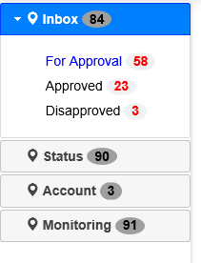

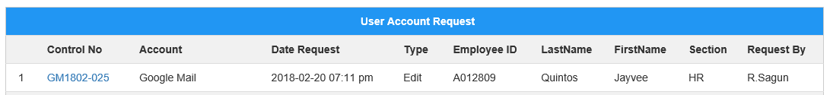
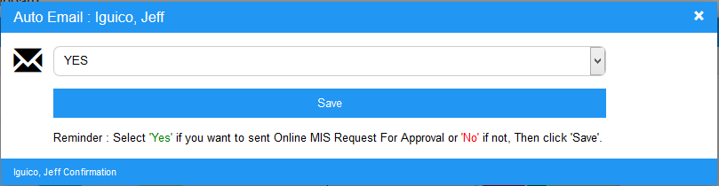
Auto Email
#1 : To view full details of request.
#2 : Click here to automatic login and approved all pending request
#3 : Approver have a option to sent automatically or not

