Slide 1
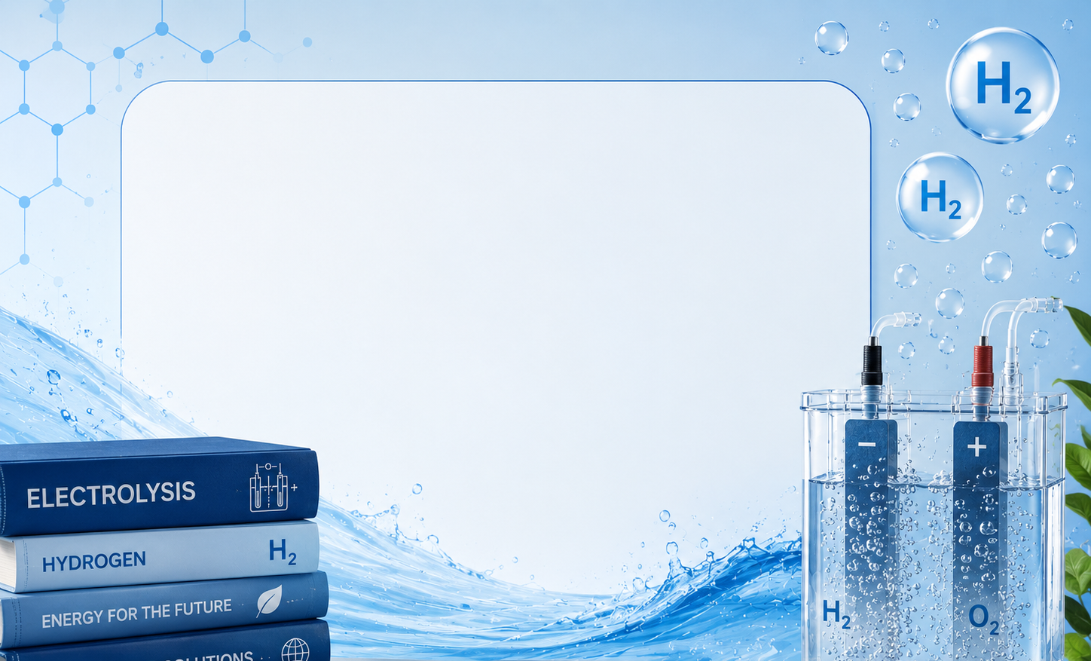
Everything you need to know about the water electrolyse - beginners

Slide 2
Everything you need to know about the water electrolyse - intermediate

Slide 3
Everything you need to know about the water electrolyse - expert

Slide 4
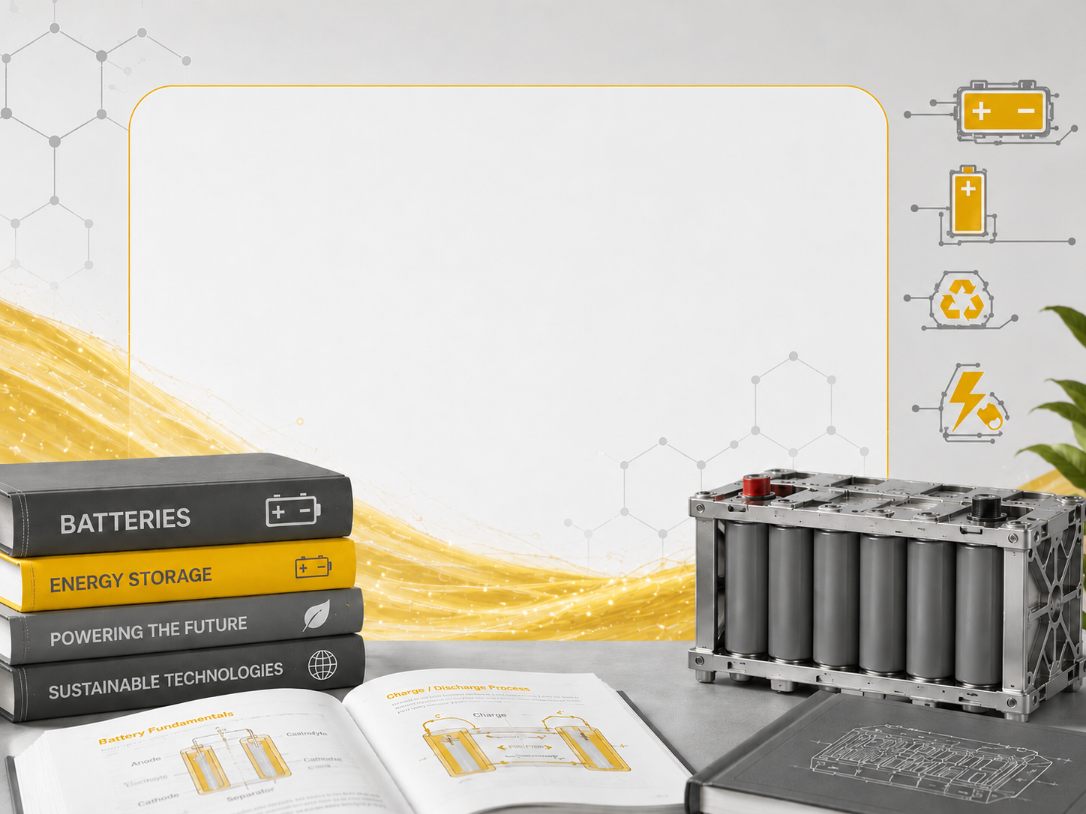
Everything you need to know about the batteries- beginners

Slide 5
Everything you need to know about the batteries - intermediate

Slide 6
Everything you need to know about the batteries- expert

