Slide 1



Slide 2
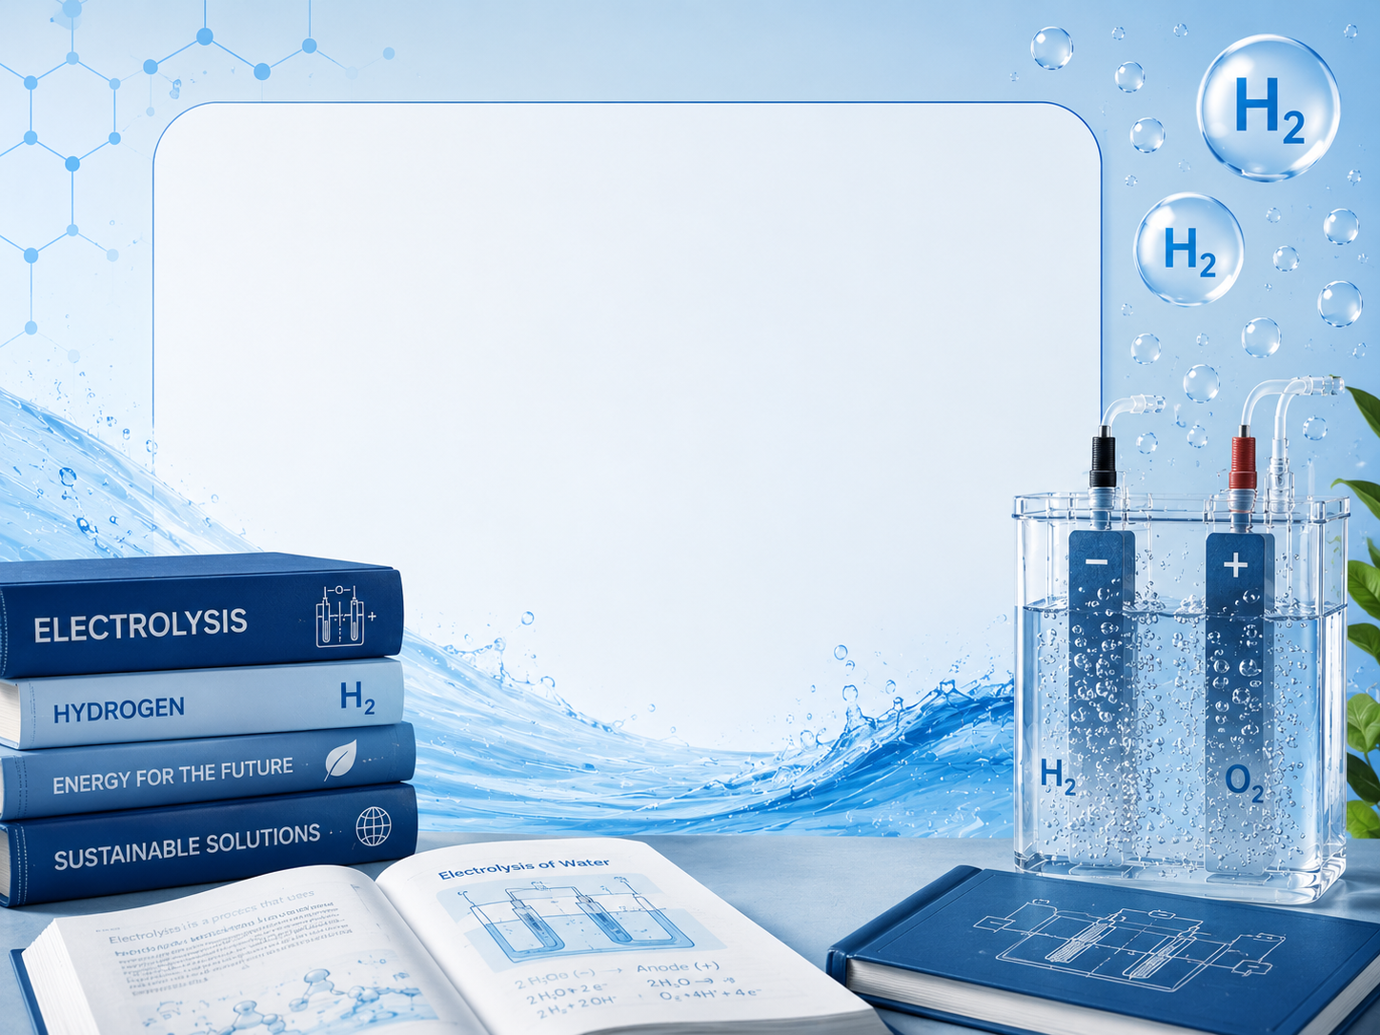
Everything you need to know about the water electrolysis –
beginner

Slide 3
Everything you need to know about the water electrolysis –
intermediate

Slide 4
Everything you need to know about the water electrolysis –
expert

Slide 5
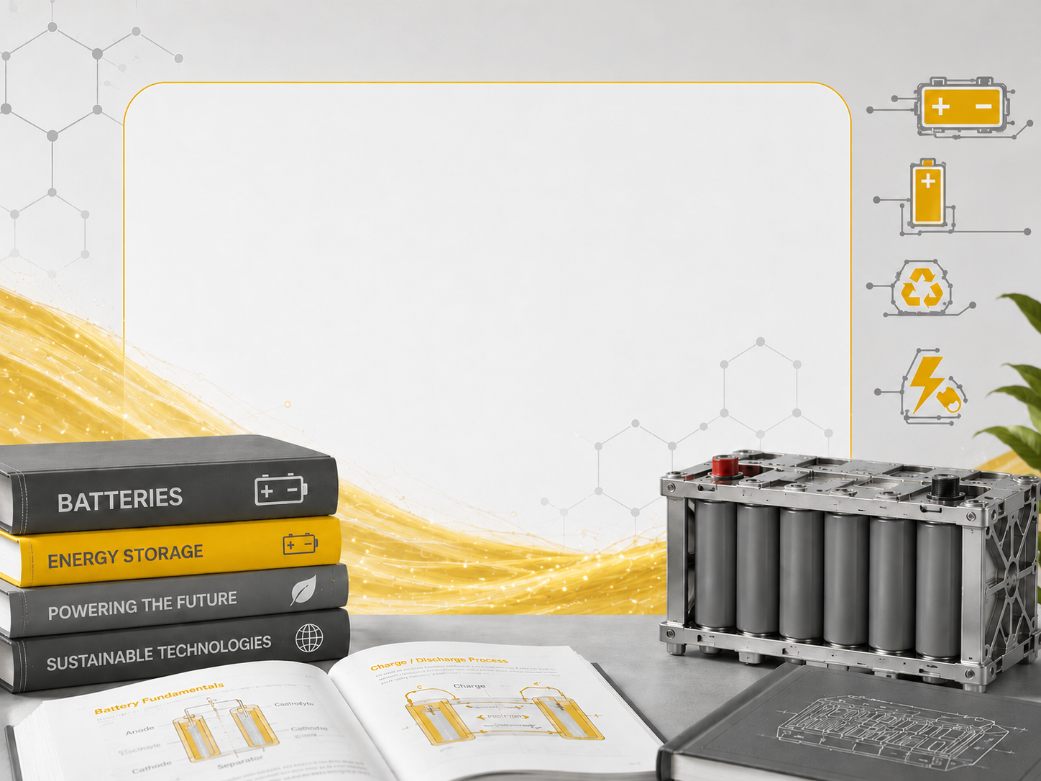
Everything you need to know about the batteries –
beginners

Slide 6
Everything you need to know about the batteries –
intermediate

Slide 7
Everything you need to know about the batteries –
expert

Slide 8
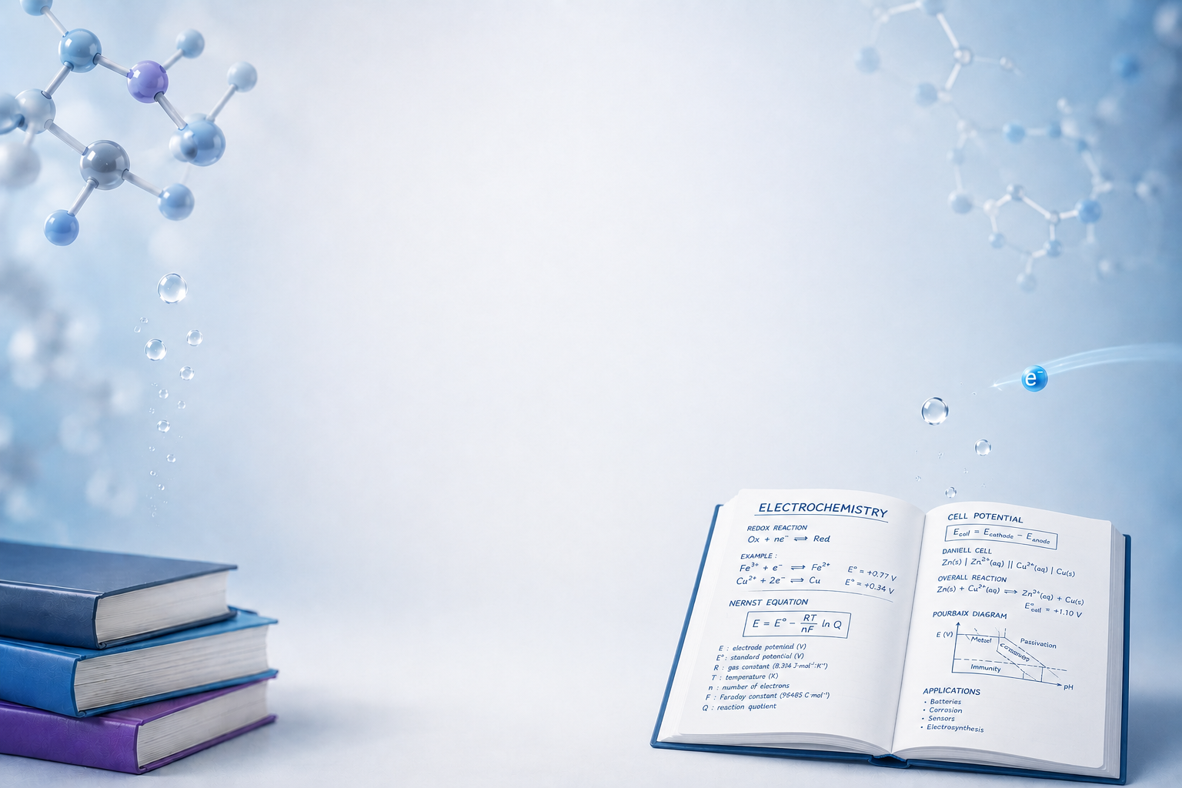
ECLAIR
educational
programmes

Slide 9
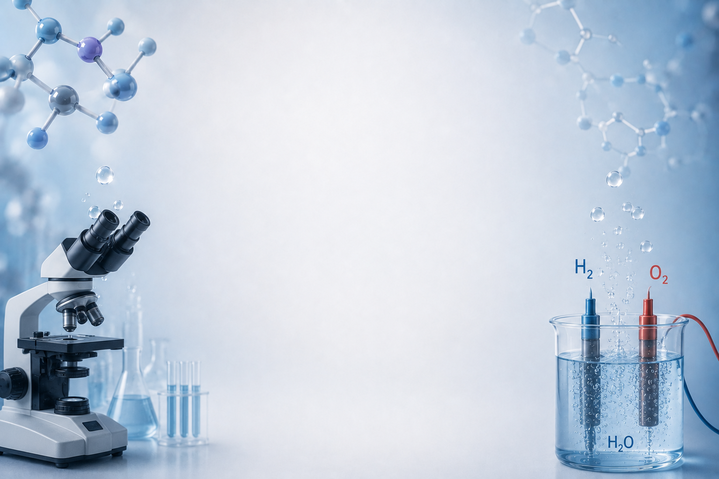
ECLAIR
research
programmes

