Slide 1
Genetic Scheduling
David Monteleone, Tomer Shemesh, Kelly Shiptoski

Slide 2
Problem Statement
Students at Drexel need a method for creating class schedules.
Needs to be accurate
Needs to be fast
We wanted a program that built a near optimal schedule for us.
Design and implement a program that can solve the problem for us!

Slide 3
Original Idea
Use a neural network
Wasn’t the easiest solution to get working
HW4 gave us a new insight to solving the problem with genetic algorithms.
Experimented with prompting the user on each generation for input to skew the results.
- Unnecessary and too slow!

Slide 4
Problem Solution
Use a genetic algorithm to determine a near optimal schedule.
Allow for a self learning scheduling application
Allow for user preferences to skew the scheduler
This is described in detail later in the presentation.

Slide 5
Our Approach
Utilize MATLAB for its rapid prototyping
Utilize a previously built Drexel WebTMS Ruby API (Just provides class info)
Made by Tomer
Use a specialized genetic algorithm approach:
Have user defined preferences (online, tightly packed, morning, days we want off)
Generate random permutations of user specified classes
Crossover the top 6 schedules to create 3 more schedules to add to the population
Get the fitness scores of the children and place them into the population (sorted)
Perform for 100 generations (For speed!)
The top scored fitness function at the end is the best schedule

Slide 6
Our Results
Excellent self learning scheduler!
Distinct schedules based on user defined preferences!
Let’s see some examples!

Slide 7
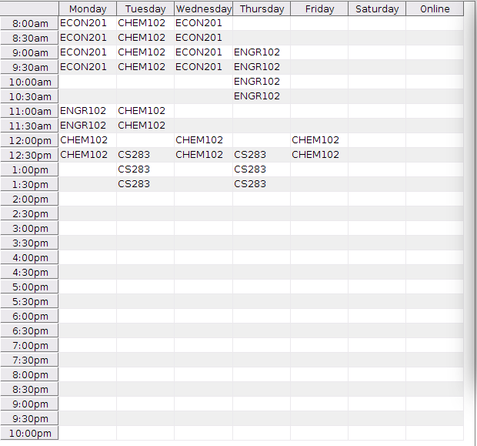


Slide 8
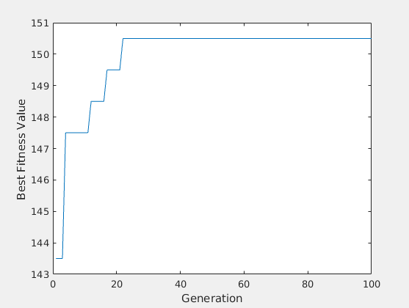

Slide 9
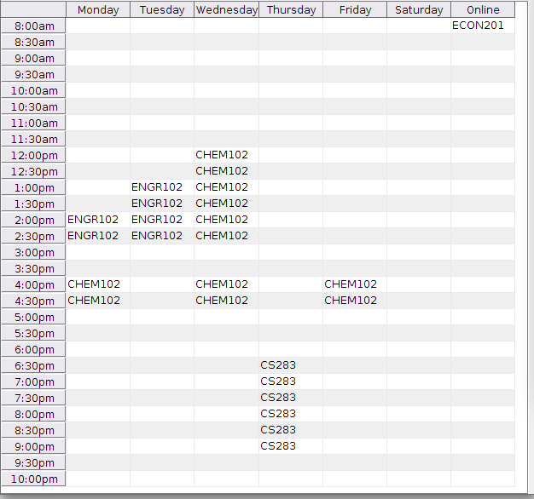


Slide 10
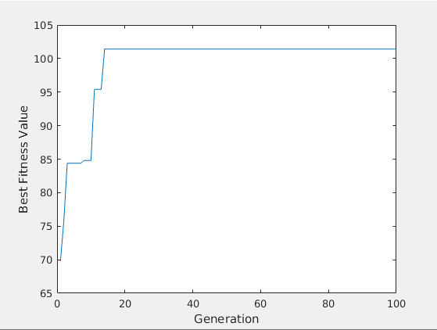

Slide 11
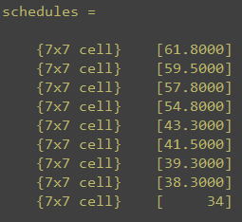
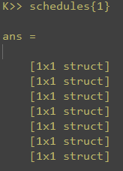
Problem Representation
MATLAB structs and cell arrays
Represent the population and list of current schedules

Slide 12
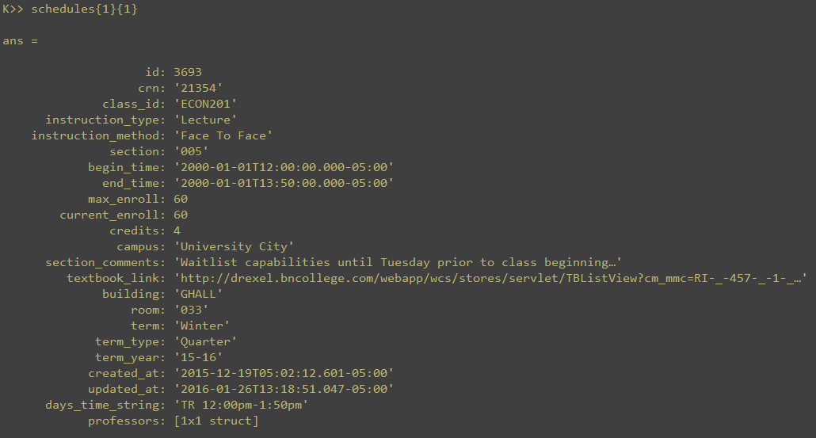
REST API Struct

Slide 13
Crossover
Each child must be a permutation of a combination of the parents
Defined as follows:
For each class position in the child:
Select one of two parents to copy that class position
Repeat for each class position
Give a random chance to mutate the child afterwards
Built off of the cryptograph crossover discussed in lecture
Other methods attempted:
Choose a random class in parent 1 and swap it with parent 2’s into the child (Slow!)
Random permutations (Incredibly slow and inefficient)

Slide 14
Mutation
33% chance at a random mutation
Selects a random class and replaces with another random section of that class
Higher rates resulted in:
Random schedules
Less stable ascent
Lower rates
Quicker plateauing of the best schedule.

Slide 15
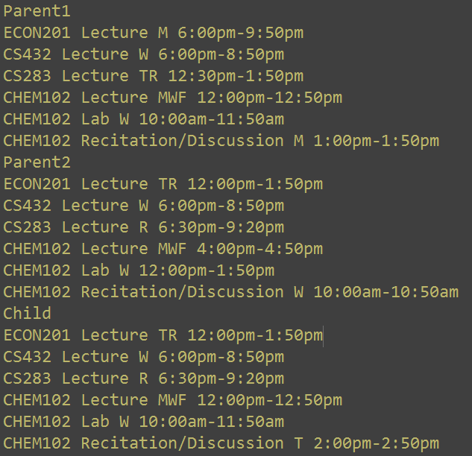

Slide 16
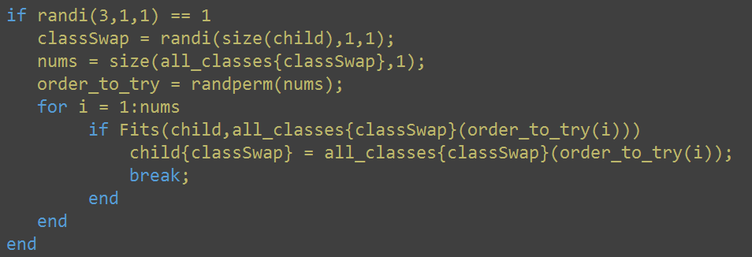

Slide 17
Fitness Function
User preference based!
Skews best schedules to morning, tightly compact, online, etc…
Schedules are awarded “points” for satisfying the defined preferences
Points are summed into a collective total score
F = F1 + F2 + F3 + … + Fn

Slide 18
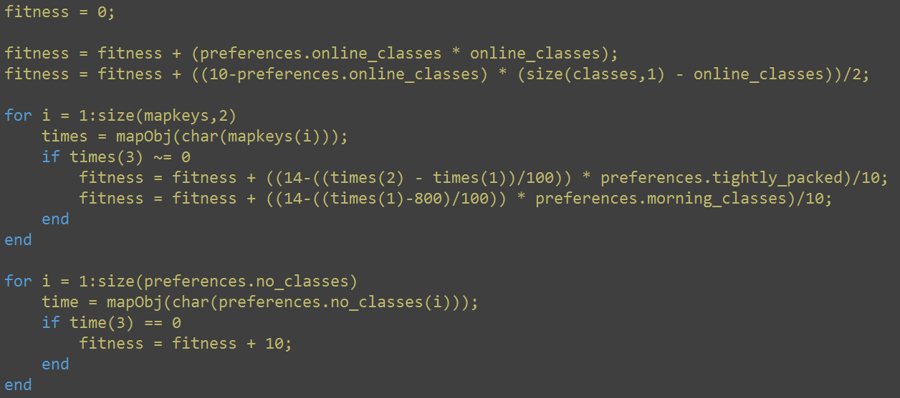

Slide 19
Live Demo

Slide 20
Comparison with Other Methods
Brute Force and Depth First Search
7 classes, all with 4-49 sections available
24,300,864 possible combinations of schedules
This would take weeks to find the best schedule:
Running at 1/10th a second per schedule
24,300,864 / 10 per second / 60 seconds / 60 minutes / 24 hours = 27.7 Days!
Ours finds a great suboptimal schedule within a minute

Slide 21
Uses in Other Applications
Scale up!
Airport scheduling
Train scheduling
Genetic algorithms have proved to be an effective way to get a favorable suboptimal answer to relatively small datasets.

Slide 22
Conclusion
This is an excellent method for creating student schedules.
Small scale experiments prove it to be effective.
Given more time we could build this into a mobile app. (lightweight!)
We’ve shown a method for letting a program solve the problem instead of the programmers solving the problem directly!

Slide 23
Questions

