Slide 1

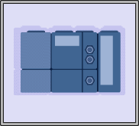
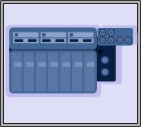

SIFB development approach to provide control and real time communications
Notes:
Good afternoon my name is Federico Perez and I am going to present the job entitled “Achieving Distributed Control Applications Using IEC 61499 and Communication Standard”
This job presents a methodology for developing SIFBs for Distributed Control Applications using actual standards. This work has been developed by automatic Control and System engineering department belonging to the university of the Basque Country.
The layout of my presentation is as follows:
First of all I will do a brief introduction in which I am going to talk about the field which paper is focussed on.
The next section describe the main elements of IEC 61499, the FBs, and their characteristics.
We are going to study with more detail the SIFBS.
The nest section presents the methodology for developing such type of FBs.
After that we are going to see how we have developed a set of SIFBs for accessing to OPC-DA servers.
These SIFBs are tested in a case study
And finally I’ll finish with some concluding remarks.

Slide 2

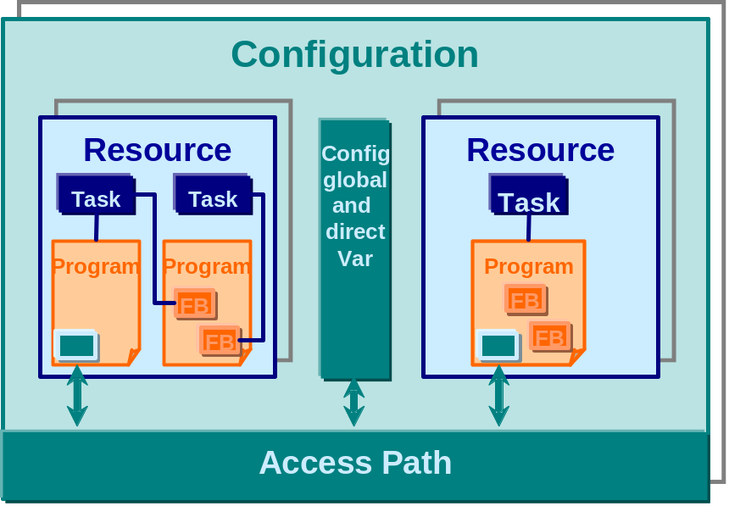
Introduction
Industrial Automation System
IEC 61499
Dedicated Control Equipment
Use of proven technologies
Propietary solutions
  “the facto” standards
  not completely open
Event flow
Application
=
Function
Block
Network
Data flow
IEC 61131
Communication network
System
=
Communication
Network
+
Devices
+
Process/Machines
Device 1
Device 2
Device 3
Device 4
Application A
Appl. C
Application B
Controlled process/machines
Notes:
Most of industrial sectors use the PLC controllers for control of their productive systems. Nowadays the technological advances in this devices allow controlling more complex automation,
But this field is characterized because :
It use a dedicated control equipment, such a Programmable Logic Controller
It is a conservative field, because it uses other serctors very proven technologies
There are great difficulties for integrating different manufacturers equipment. In fact, vendors proposed a standards that in many cases are not completely open
On the other hand, there are organization that promotes the use of standards. In fact one of the most vendor accepted standard is IEC 61131. This standard is composed by five parts. The part three standarizes programming languages, concretly it offers 5 programming languages from which 3 of them are graphical languages (FBD,LD, and SFC) and the other two are textual languages (ST and IL). This standard also provides a software model illustrated in the left part of the picture. Any automation project is composed at least by one configuration (PLC) within one or more resouces that acts as a CPU or virtual machine, modules which source code is going to be running on. The source code is programmed in modules called Program Organization Units which are programmed once and used whenever necessary. The IEC 61131-3 standard offers three type of POUs: Function (similiar to functions of the high level programming languages), FB and Programs which are similar to procedures of high level programming languages. Finally by means of access path and variables we can define the information that could be interchanged with othe PLCs. Neverthless, this standard does not explain nothing about how a communcation can be achieved. Vendors offer a propietary solutions (tools and protocols) for achieving the comunication among their own products.
On the other hand we have the IEC 61499 standard that is focussed on modelling distributed control system applications. To do this, it offers different elements and models that IEC 61131-3, even it redifines concepts. There are few vendors that support this standard, as far as authors know there are only three vendors e.g. IsaGRAF of Triplex. On the other hand there are many free tools for this standard and all of them have java as a runtime.
This paper is centred in this standard but making use of the free IEC 61499 environments.

Slide 3
Function Blocks Types
Basic FB type
Composite FB type
Service Interface FB type (SIFB)
EVENT
INIT
INITO
EVENT
EVENT
INIT
INITO
EVENT
EVENT
REQ
CNF
EVENT
EVENT
RSP
IND
EVENT
REQUESTER
RESPONDER
BOOL
QI
QO
BOOL
BOOL
QI
QO
BOOL
ANY
PARAMS
STATUS
ANY
ANY
PARAMS
STATUS
ANY
ANY
SD_1
RD_1
ANY
ANY
SD_1
RD_1
ANY
ANY
SD_m
RD_n
ANY
ANY
SD_m
RD_n
ANY
Normal_data_transfer
Normal_data_transfer
REQUESTER
RESPONDER
REQUESTER
RESPONDER
REQ+
IND+
CNF+
RSP+
Notes:
The last type of FB is the Services Interface Function Block or SIFB it is an special FB used for mapping the communication between resources and external elements.
The IEC 61499 standard defines two type of SIFBs: the requester and the responder. The first one is activated by the software application and the latter is activated by the hardware.
There are different kinds of requester and responders function blocks. The service of the SIFB is performed by a set of service primitives provided also by the IEC 61499 standard. In the lower part of the slide we can see two examples in a sequence diagram form. Service primitives shall be indicated by horizontal arrows as in ISO/IEC10731.

Slide 4
Methodology to Develop SIFBs
IEC 61499
JAVA based
Service identification
Event inputs
Event outputs
Data inputs
Data outputs
Service primitives specification
Java algorithms definition
C++ hardware access procedures
Notes:
We selected a IEC 61499 compliant tool that is based on java runtime, FBDK.
The SIFB programming is characterized by following steps:
First of all we need to identify the service on which this SIFB is responsible. After that we define the necessary input/output events and input/outpu data
In the same way the secuence of the involved service primitives are also known.
After that we need to develop the service via vendor provided functions. In this step there is a gap beacuse normally vendors offer their functions in C/C++ and initially we cannot invoke directly from java. So, we need something that allows us to invoke C/C++ functions from java. This step is implemented using the so called Java Native Interface (JNI).
So the first three step we can perform directly for instance in Function Block Development Kit tool an we can export the SIFB empty java structure. In a java programming tool ( in our case eclipse) we need add the declaraction of java native methods which are going to be programmed using vendor provided funcions an invoked directly in The SIFB.
In this part of the picture we can see an example of SIFB structre. The green part is obtained directly form FBDK environment. The blue part is the part modified by the user that includes the name of the service and the declaration on java native functions.
After that using javah a header file within the declaration of java native methods is obtained. An C/C++ environment gets this header and this native methods ara programed by means of vendor provided functions. With the source code a dynamic library is generated. In the java programming environment making use of system offered functions this library is loaded.
Finally, onces compiled the resulting code the SIFB is obtaned.
In this picture an example of services are presented. In fact the possible services related to INIT input event.
As I commented before this event could be used for requirement of services stablishment (INIT+) or for requirement of services finish.
The first one is represented by the first conditional part in which the corresponding qualifier es checked. If this value es TRUE is because INT+ has been happened. the user defined variable (status) checks that this service has been not requested before and only in this case the library is loaded , the java native method is invoked and the value of status variable es updated.
The second part is related to the service desconection requirement. In this part the corresponding java native method is invoked and status variable is set to false value.
Independently of the service executed at the end the output qualifier value es updated and the INTO service is invoked

Slide 5
Methodology to Develop SIFBs
IEC 61499
FORTE based
Service identification
Event inputs
Event outputs
Data inputs
Data outputs
Service primitives specification
C++ algorithms definition
and hardware access procedures
Notes:
We selected a IEC 61499 compliant tool that is based on java runtime, FBDK.
The SIFB programming is characterized by following steps:
First of all we need to identify the service on which this SIFB is responsible. After that we define the necessary input/output events and input/outpu data
In the same way the secuence of the involved service primitives are also known.
After that we need to develop the service via vendor provided functions. In this step there is a gap beacuse normally vendors offer their functions in C/C++ and initially we cannot invoke directly from java. So, we need something that allows us to invoke C/C++ functions from java. This step is implemented using the so called Java Native Interface (JNI).
So the first three step we can perform directly for instance in Function Block Development Kit tool an we can export the SIFB empty java structure. In a java programming tool ( in our case eclipse) we need add the declaraction of java native methods which are going to be programmed using vendor provided funcions an invoked directly in The SIFB.
In this part of the picture we can see an example of SIFB structre. The green part is obtained directly form FBDK environment. The blue part is the part modified by the user that includes the name of the service and the declaration on java native functions.
After that using javah a header file within the declaration of java native methods is obtained. An C/C++ environment gets this header and this native methods ara programed by means of vendor provided functions. With the source code a dynamic library is generated. In the java programming environment making use of system offered functions this library is loaded.
Finally, onces compiled the resulting code the SIFB is obtaned.
In this picture an example of services are presented. In fact the possible services related to INIT input event.
As I commented before this event could be used for requirement of services stablishment (INIT+) or for requirement of services finish.
The first one is represented by the first conditional part in which the corresponding qualifier es checked. If this value es TRUE is because INT+ has been happened. the user defined variable (status) checks that this service has been not requested before and only in this case the library is loaded , the java native method is invoked and the value of status variable es updated.
The second part is related to the service desconection requirement. In this part the corresponding java native method is invoked and status variable is set to false value.
Independently of the service executed at the end the output qualifier value es updated and the INTO service is invoked

Slide 6
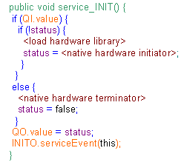
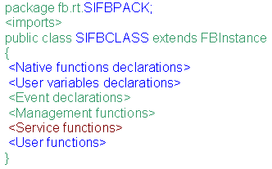
Methodology to Develop SIFBs
FBDK
.java
Eclipse
.h
C/C++
.class
SIFB
structure
Empty java structure
Native method algorithm
Header
.h JNI
Hardware access algorithm
javah
.c
.class
Acknowledgement library
.dll
Library
SIFB
Notes:
We selected a IEC 61499 compliant tool that is based on java runtime, FBDK.
The SIFB programming is characterized by following steps:
First of all we need to identify the service on which this SIFB is responsible. After that we define the necessary input/output events and input/outpu data
In the same way the secuence of the involved service primitives are also known.
After that we need to develop the service via vendor provided functions. In this step there is a gap beacuse normally vendors offer their functions in C/C++ and initially we cannot invoke directly from java. So, we need something that allows us to invoke C/C++ functions from java. This step is implemented using the so called Java Native Interface (JNI).
So the first three step we can perform directly for instance in Function Block Development Kit tool an we can export the SIFB empty java structure. In a java programming tool ( in our case eclipse) we need add the declaraction of java native methods which are going to be programmed using vendor provided funcions an invoked directly in The SIFB.
In this part of the picture we can see an example of SIFB structre. The green part is obtained directly form FBDK environment. The blue part is the part modified by the user that includes the name of the service and the declaration on java native functions.
After that using javah a header file within the declaration of java native methods is obtained. An C/C++ environment gets this header and this native methods ara programed by means of vendor provided functions. With the source code a dynamic library is generated. In the java programming environment making use of system offered functions this library is loaded.
Finally, onces compiled the resulting code the SIFB is obtaned.
In this picture an example of services are presented. In fact the possible services related to INIT input event.
As I commented before this event could be used for requirement of services stablishment (INIT+) or for requirement of services finish.
The first one is represented by the first conditional part in which the corresponding qualifier es checked. If this value es TRUE is because INT+ has been happened. the user defined variable (status) checks that this service has been not requested before and only in this case the library is loaded , the java native method is invoked and the value of status variable es updated.
The second part is related to the service desconection requirement. In this part the corresponding java native method is invoked and status variable is set to false value.
Independently of the service executed at the end the output qualifier value es updated and the INTO service is invoked

Slide 7
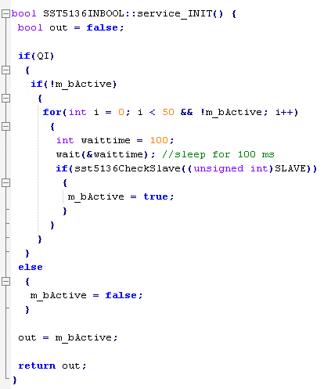
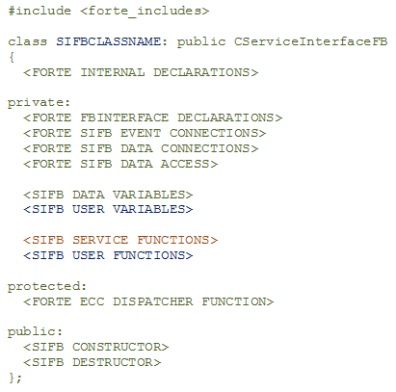
Methodology to Develop SIFBs
4DIAC
.cpp .h
Eclipse CDT
FORTE
source code
SIFB
interface
Empty C/C++ structure
FORTE with HW algorithm
HW code
HW Library
.cpp
App/System
GCC/LD
.exe
FORTE runtime with SIFBs
Runtime
Notes:
We selected a IEC 61499 compliant tool that is based on java runtime, FBDK.
The SIFB programming is characterized by following steps:
First of all we need to identify the service on which this SIFB is responsible. After that we define the necessary input/output events and input/outpu data
In the same way the secuence of the involved service primitives are also known.
After that we need to develop the service via vendor provided functions. In this step there is a gap beacuse normally vendors offer their functions in C/C++ and initially we cannot invoke directly from java. So, we need something that allows us to invoke C/C++ functions from java. This step is implemented using the so called Java Native Interface (JNI).
So the first three step we can perform directly for instance in Function Block Development Kit tool an we can export the SIFB empty java structure. In a java programming tool ( in our case eclipse) we need add the declaraction of java native methods which are going to be programmed using vendor provided funcions an invoked directly in The SIFB.
In this part of the picture we can see an example of SIFB structre. The green part is obtained directly form FBDK environment. The blue part is the part modified by the user that includes the name of the service and the declaration on java native functions.
After that using javah a header file within the declaration of java native methods is obtained. An C/C++ environment gets this header and this native methods ara programed by means of vendor provided functions. With the source code a dynamic library is generated. In the java programming environment making use of system offered functions this library is loaded.
Finally, onces compiled the resulting code the SIFB is obtaned.
In this picture an example of services are presented. In fact the possible services related to INIT input event.
As I commented before this event could be used for requirement of services stablishment (INIT+) or for requirement of services finish.
The first one is represented by the first conditional part in which the corresponding qualifier es checked. If this value es TRUE is because INT+ has been happened. the user defined variable (status) checks that this service has been not requested before and only in this case the library is loaded , the java native method is invoked and the value of status variable es updated.
The second part is related to the service desconection requirement. In this part the corresponding java native method is invoked and status variable is set to false value.
Independently of the service executed at the end the output qualifier value es updated and the INTO service is invoked

Slide 8
Components in IEC-61499
Components and reusability
Components in IEC-61499 as FBs
Hadware-specific interaction as components in SIFBs
Notes:
FBs are the main element in the IEC61699 standard. This standard provides three type of FBs:
Basic FB type
Composite FB type
Service Interface FB type (SIFB)

Slide 9
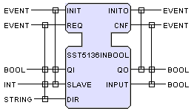
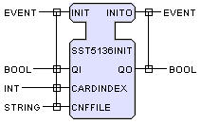
SIFBs set for PROFIBUS-DP
SIFB components PF-DP set
  Initialization
  Read/Write BOOL data types
  Read/Write BYTE data types
  Read/Write WORD data types
  Read/Write DWORD data types
Tested with SST-5136 and SST-PFB3 from Molex-Woodhead

Slide 10
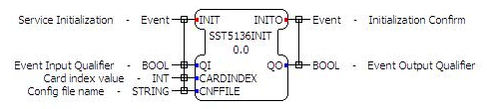
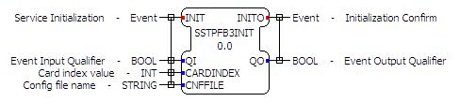
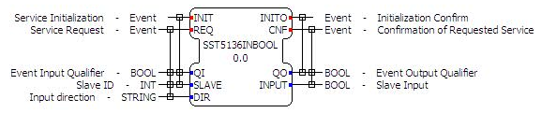
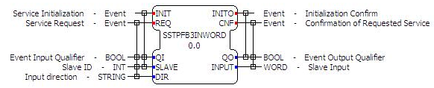
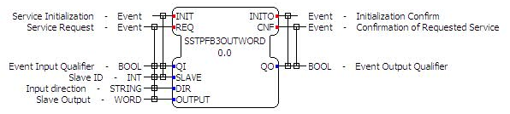
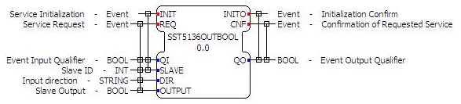
SIFBs set for PROFIBUS-DP
SIFB components PF-DP set
  Initialization
  Read real time data
  Write real time data
Tested with SST-5136 and SST-PFB3 from Molex-Woodhead

Slide 11
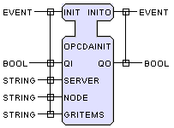
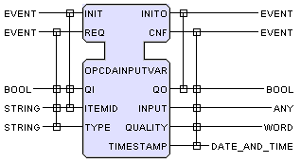
SIFBs set for OPC-DA
SIFB components OPC-DA set
  Initialization
  Read synchronous real time data
  Write synchronous real time data
Tested with SimaticNet and Matrikon OPC-DA servers
Notes:
In this job we present an implementation of the before methodology to OPC-DA environment. We have develop a set of SIFB for communicaiting with OPC-DA servers. We have develop several SIFBs for reading and writing boolean, byte, word, dword and real data.
In the left part of the picture we can see the interface for the initialization SIFB. As we can see, it only has one input and other output even with their corresponding qualifiers.
On the right part of the picture it is illustrated the structure of the SIFB for reading input real time data. To achive these there are necessary two input/output events and their corresponding qualifiers. Furthermore it is mandatory to indicate the address of the OPC-DA server from which the data is going to be read.

Slide 12
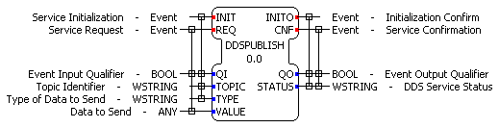
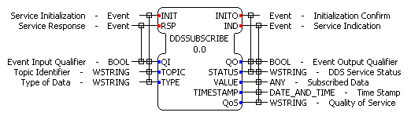
SIFBs set for DDS
SIFB components DDS set
  Publisher
  Subscriber

Slide 13
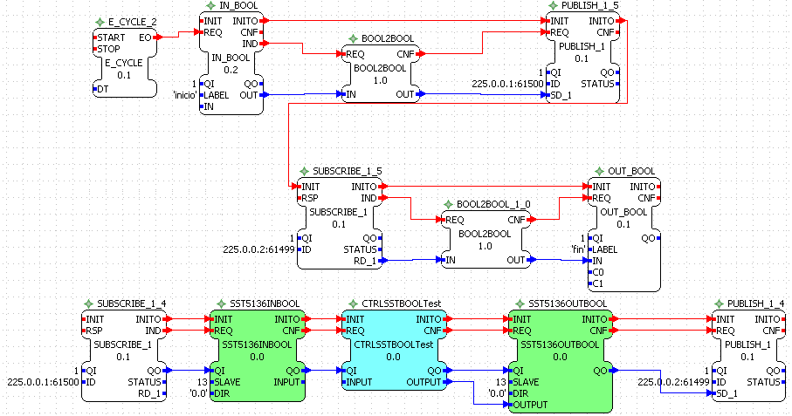
Application Architecture
Application system configuration
Notes:
In this slide is illustrated part of the FB network for one application.

Slide 14
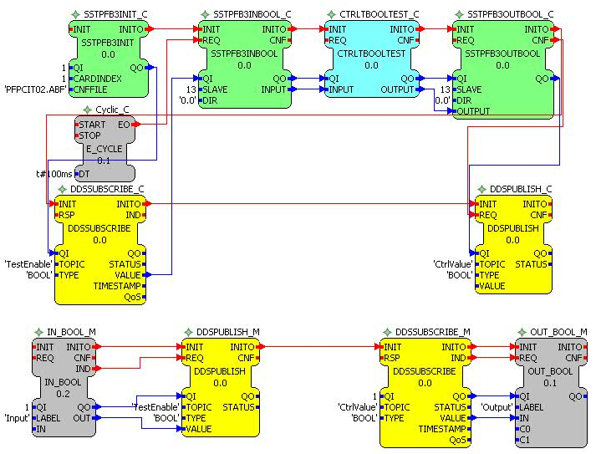
Application Architecture
Application system configuration
Notes:
In this slide is illustrated part of the FB network for one application.

Slide 15
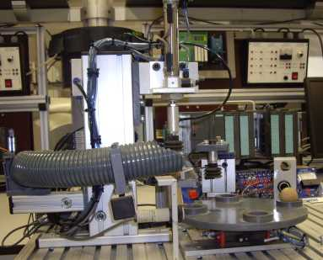
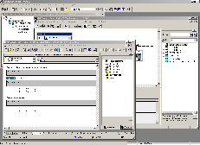

Case Study
Test platform
OPC Server
Dummy
Controller
DP-Master
PROFIBUS
Industrial
Ethernet
Controller
OPC Client
Distributed
Peripherals
DP-Slave
Notes:
This is the platform in which we have tested the SIFB commented before. It is an service quality controller. It is composed by 5 cilinders and each one have two positional sensors.
There are other two sensors: one for detecting if there is a piece and other for the color.
The outputs of the sensors and inputs of actuators are stored in an I/O device, in particular ET 200M from Siemens manufacturer. This IO devices acts as a profibus slave as well.
The control system is peformed in FBDK tool an it is running on a control computer.

Slide 16
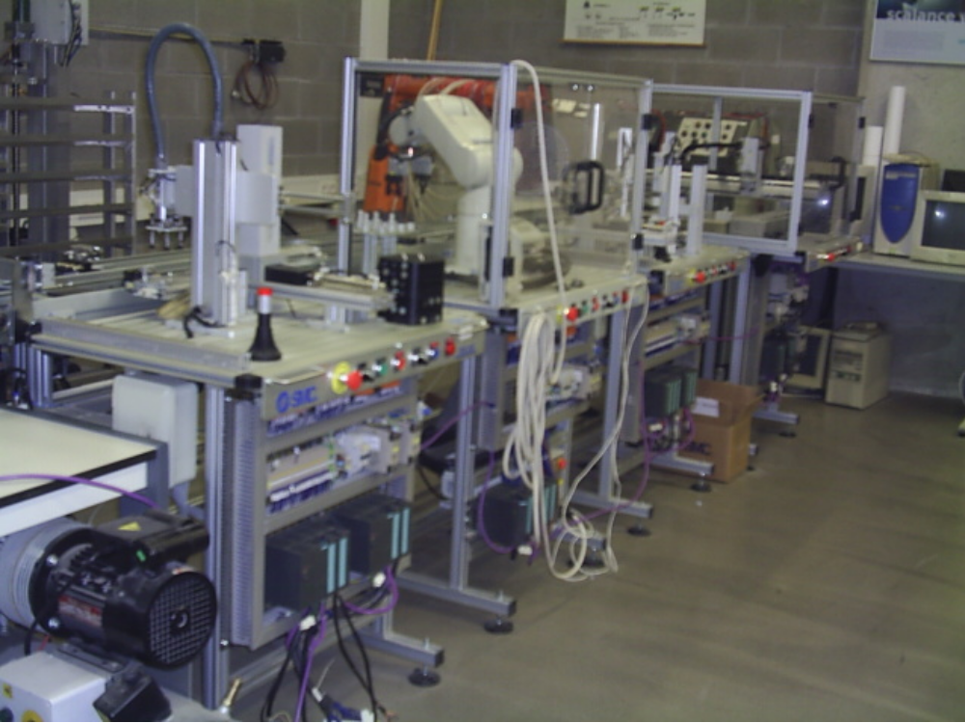
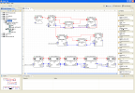
Case Study
Test platform
Supervisor
Industrial
Ethernet
Controller 1
Controller 2
PROFIBUS DP
Set base
Robot
Sealer
Storage cell
Conveyor belt
Notes:
This is the platform in which we have tested the SIFB commented before. It is an service quality controller. It is composed by 5 cilinders and each one have two positional sensors.
There are other two sensors: one for detecting if there is a piece and other for the color.
The outputs of the sensors and inputs of actuators are stored in an I/O device, in particular ET 200M from Siemens manufacturer. This IO devices acts as a profibus slave as well.
The control system is peformed in FBDK tool an it is running on a control computer.

Slide 17
Summary
IEC 61499 standard defines a generic architecture that provides a reference model to achieve the use of FBs in distributed control systems.
The use of IEC 61499 enables the integration into a distributed automation system and the use of the services of a component within the whole system.
The developed SIFBs set allows access to control and real process data using different technologies.
Notes:
The proposed methodology allows us to apply legacy systems and vendor provided drivers in an IEC 61499 applications.

Slide 18
SIFB development approach to provide control and real time communications

