Slide 1
Introduction to 4DIAC
The Open Source Initiative
for Distributed Industrial Automation and Control
4DIAC Users’ Meeting
ETFA , Bilbao, Spain
September 16, 2010
www.fordiac.org

Slide 2
Mission
The goal of the 4DIAC Initiative is to provide an open, IEC 61499 standard compliant foundation, that gives the opportunity to establish an automation and control environment, based on the targets
  portability,
  configurability and
  interoperability.
16.09.2010
4DIAC Users' Meeting - Introduction

Slide 3
Short History
Need for basic infrastructure in 2 research projects
Development of runtime environment and engineering tool
Provision of results as initial open source version in 4DIAC
  Consent of all involved project partners
  Common basis for development, industrial appliance and research of IEC 61499
  Leveraging the use of IEC 61499 within industry
Further development by initial committers:
PROFACTOR GmbH & Vienna University of Technology
Industrial/commercial usage by NXTcontrol
16.09.2010
4DIAC Users' Meeting - Introduction

Slide 4
Actual Projects
FORTE (4DIAC-RTE)
  IEC 61499 compliant run-time environment
  C++ implementation
  Portable to multiple platforms
4DIAC-IDE
  IEC 61499 compliant engineering environment
  Java-based implementation
  Implementation as Eclipse plug-ins
16.09.2010
4DIAC Users' Meeting - Introduction

Slide 5
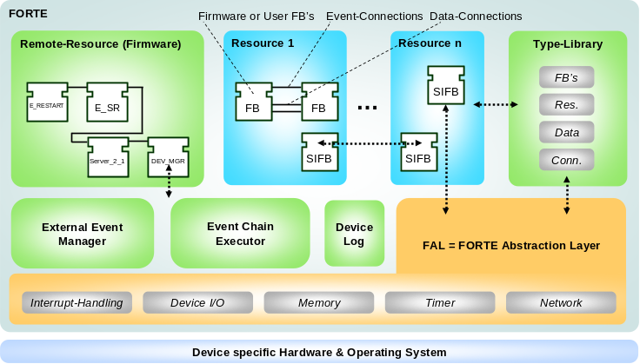


FORTE
Features
  Basic FB’s, Composite FB’s, SIFB’s, Adapters
  Elementary data-types according to IEC 61131-3
  Event & data connections
  Configuration commands (create, write,
  start … according to IEC 61499)
  Communication FB’s (Server/Client,
  Publish/Subscribe for Ethernet)
  Type-Library & Device Log
  RMT-Device, RMT- & EMB-Resource
  Real-time event FB’s
Platforms
  Posix (tested on: Cygwin, Linux (i386, PPC))
  Digi Connect ME (ARM7, ThreadX)
  eCos (ARM7, Lego Mindstorms NXT)
16.09.2010
4DIAC Users' Meeting - Introduction

Slide 6
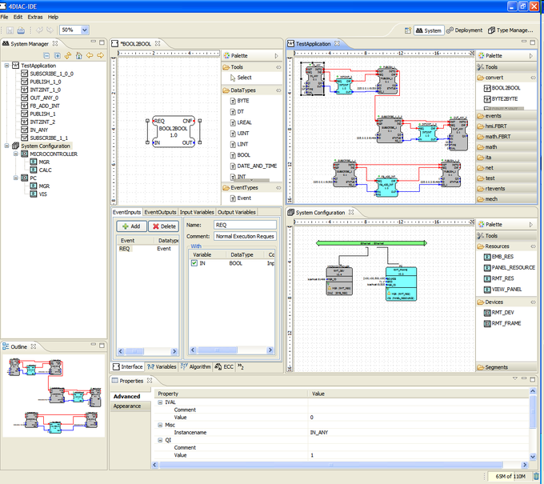
4DIAC-IDE
Features
Function Block Editor:
  Basic FB’s
  Composite FB’s
  SIFB’s
System Editor:
  support for sub-applications
  mapping
Deployment:
  support for different profiles
  separate deployment possible
Project Management
  project specific Type-Libraries
16.09.2010
4DIAC Users' Meeting - Introduction

Slide 7
Most recent changes
FORTE:
  Optimizations of performance & size
  New implementation communication interface
  Unit test integration
  Initial version STRUCT datatype
4DIAC-IDE:
  New routing algorithm
  Adapter editor
  Virtual DNS
  Online Edit
  Deployment perspective: clear resource/device
  Merge editor for C++ export
16.09.2010
4DIAC Users' Meeting - Introduction

Slide 8
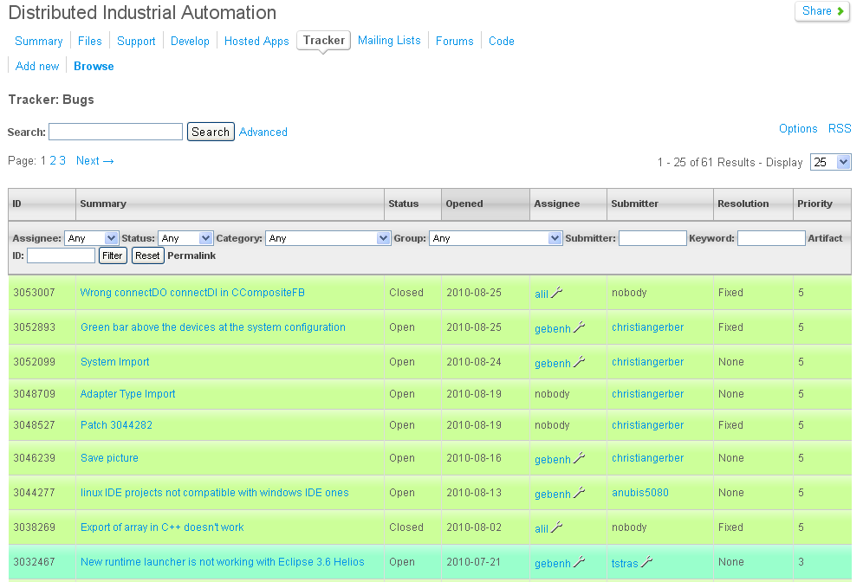
Interaction users-developers
Hosted on SourceForge-Platform
Bug-Tracker
Feature requests
Forum
PLEASE provide feedback, questions, etc. via the offered channels
Feedback helps to improve quality
16.09.2010
4DIAC Users' Meeting - Introduction

Slide 9
Involvement in development
Bug-list / feature-requests as starting point for involvement
Source code provided in distributed version control system “Mercurial”
Quality of source code shall be maintained/improved
  Towards test-driven development
  Patches of collaborators will be reviewed and applied
  Committer’s rights have to be earned
16.09.2010
4DIAC Users' Meeting - Introduction

Slide 10
Next steps
Roadmap
  Based on feature requests and discussions among developers and users
Marketing
General 61499 discussion forum
16.09.2010
4DIAC Users' Meeting - Introduction

Slide 11
Thank you for your attention!
Contact Speaker
Ingo Hegny
Vienna University of Technology, ACIN
Gußhausstraße 27-29 / E376
1040 Wien, AUSTRIA
+43 1 58801x37687
hegny@acin.tuwien.ac.at
www.acin.tuwien.ac.at

