Slide 1
Orion Project 0.5 Release Review

Slide 2
New Features
Navigation features:
  Improved in-page navigation and selection
  Selection model unified across pages
  Redesigned Navigator Page
Overall UI features:
  Re-branded look and feel
  Improved breadcrumbs and title area
  New Create Content area in Navigator
New Landing Page
  Auto-redirect to login landing page when not authenticated
Notes:
Committer info:
http://dash.eclipse.org/dash/commits/web-app/commit-count-loc.php?top=eclipse&range=1yr

Slide 3
New Features
Git improvements:
  Completely new Git Status page (flat UI)
  Improving Git performance
Console Page:
  Extendible console window for command line actions
  Implemented by use of Mozilla's GCLI
    https://wiki.mozilla.org/DevTools/Features/GCLI
Internationalization:
  i18N architecture for externalizing messages
  Plugin to assist with externalization
HTML5 File System Plugin
  Supported on Chrome allows completely local development
Notes:
Committer info:
http://dash.eclipse.org/dash/commits/web-app/commit-count-loc.php?top=eclipse&range=1yr

Slide 4
Non-Code Aspects
Orion User Guide and Orion Developer Guide included with release. Documentation developed using Mylyn WikiText
Developer Guide includes server administration guide that describes how to setup and manage the server
Public beta server hosted by Eclipse Foundation: orionhub.org
Blog for New and Noteworthy updates: planetorion.org
Community is very active
  Mailing list has steady activity
  Firefox 10 includes Orion editor for Scratchpad and now Style editor
  Firebug plugin for integrating with Orion
  Wiki content is growing
    http://wiki.eclipse.org/Orion
  Orion webinar: http://live.eclipse.org/node/1006

Slide 5
API
Orion has initial JavaScript API for client side services and components
HTTP API for accessing server functionality
No Java API on the server to allow for alternate server implementation languages and technologies
Client API documented using jsdoc
No APIs are final while Orion is incubating
List of API changes in 0.5 can be found here
  http://wiki.eclipse.org/Orion/Plugin_API_Changes/R0.5

Slide 6
Non-Code Aspects
Internationalization
  I18N localization is almost complete
  New architecture for allowing off site language packs
  Plugin/Page to assist with generating message bundles
  Editor is capable of displaying non-latin characters and supporting bidirectional text
  All existing pages have had strings externalized
  Working with Babel project for translations
Accessibility
  Devoted student time to accessibility through 1Q12
  Defects logged and being addressed by team
  Focus point in 0.5 and thru to next release

Slide 7
Architectural Issues
Strong architecture and modularity of Orion client
CommonJS module format used to facilitate client side reuse
JavaScript plugin architecture allows for integration via linking rather than a monolithic application: architecture designed for the web
Editor and “text view” components factored out with no external dependencies to enable reuse by other applications
Exploring how to make seamless tooling workflows across multiple web sites
  Enabling commands on links inbound to Orion ("Clone this repository", "Install this Plugin")
  Allowing Orion plugins to define outbound links to related content on other sites
Targeting modern HTML5-compliant browsers: Chrome, Firefox, Internet Explorer,Safari

Slide 8
Tool Usability

Slide 9
End of Life Issues
None.
High priority is landing experience for new Users
  Improved login/logout page
High priority was unification of pages for style and selection models
Unified settings page for plugins/profile/other settings
Much improved JavaScript outliners are now available as plugins
  Esprima parser now including in base Orion
Character level compare in differences views
Search highlights all matches
Addressing performance concerns with in-depth analysis to page and plugin load times
First time user presented with options to populate Navigator/Workspace

Slide 10
Bugzilla
Between Feb 14, 2011 and Jun 4, 2012 (RC1)
  644 reports were created
  324 were resolved/closed
Current state (RC1) is:
  0 blockers, 4 critical
  0 P1, 7 P2

Slide 11
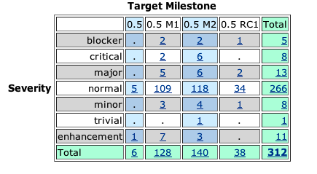
Bugs fixed during 0.5

Slide 12
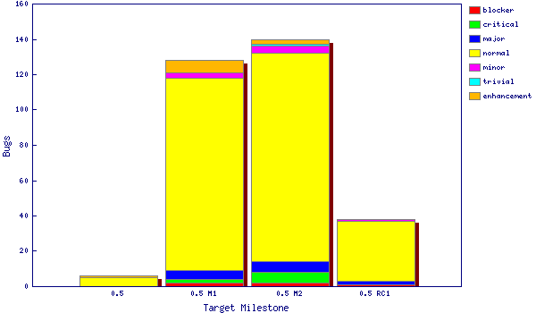
Fixed bugs – 0.5

Slide 13
Standards
Client components conforming to CommonJS Asynchronous Module Definition (AMD) format
HTML5 standard source code
URI Templates
  http://tools.ietf.org/html/draft-gregorio-uritemplate-08
Participating in specification of CrossFire browser debug protocol
  http://getfirebug.com/doc/crossfire/crossfire-splash-2011.pdf

Slide 14
UI Usability
In 0.5 the UI across the various Orion pages was a key focus
  Many pages had different looks, used check boxes vs. selection mode, displayed differing breadcrumbs as some examples
  A UX meeting was established to go over the various aspects of the UI and come to define standards for pages and their sections – these were implemented in 0.5 mostly through M2
The landing experience was greatly improved with a new login page vs. showing a random page or partially filled in Navigator
The getting started aspects of a New Workspace were moved to a side panel within the Navigator.
Much improvement in workflows and page layout
  http://wiki.eclipse.org/Orion/UX_Issues/R0.5

Slide 15
Schedule
Utilizing a web-scale release cycle
  Four month release cycle
  13 weeks development, 3 weeks end-game
Daily build and deployment to self-hosting server
Tracked schedule
  All milestones delivered as planned

Slide 16
Process
Orion is developed using an open, transparent, and inclusive process
Team relies on Bugzilla, mailing lists, forums, social media for input
Weekly planning calls conducted with all contributors welcome
Self-hosted development on http://orion.eclipse.org
  Meeting minutes posted to the orion-dev mailing list
Publicly available plan: http://wiki.eclipse.org/Orion/Plan

Slide 17
Community
Orion team members are active in Bugzilla, newsgroups, mailing lists, Eclipse forums and Twitter
http://wiki.eclipse.org/Orion/Buzz - Continuous press
Two Google Summer of Code Projects
  Improving Git forking from GitHub into multiple Orion destinations
  Google Chrome DevTools integration with Orion components
Blogs started by Orion committers are active:
  http://planetorion.org
  http://planeteclipse.org
  Team is using the eclipse-orion IRC channel
  irc.freenode.net#eclipse-orion
  also see: http://wiki.eclipse.org/index.php/IRC
The Orion team participates in code camps, conference presentations, and tutorials, including
  EclipseCon, What's Next Conference, jsconf, Eclipse Demo Camps
The Orion team interacts with other open source projects, standards bodies, and other projects on eclipse.org, including
  Mozilla, Dojo Foundation (Dojo framework, Maqetta), JGit, Mylyn, jsdoc, Firebug, CodeMirror, Esprima

Slide 18
IP Issues
All significant and third party contributions have been reviewed and approved by Eclipse legal.
About files and license files are complete and correct.
Client code (JavaScript) is dual-licensed with EPL and EDL
Approved 0.5 release log:
  http://www.eclipse.org/eclipse/development/project-log-files/eclipse-orion-0-5-log.html

Slide 19

Future Plans
Continue with 4 month release cycle to keep up with pace of development in the web community. For example with new browsers shipping every 3 months we can't ship Orion once a year and expect to be current
Aiming for a 1.0 release in November 2012
Focus on APIs, i18N, Accessibility, Cross-site workflows, User Interface, URI Templates, continued improvements to language support, Test Infrastructure, Git Workflows, Documentation, Performance, Security

