Slide 1
Orion Project 2.0 Release Review

Slide 2
New Features
Navigation features:
  Drag and drop from Desktop
  Selection model unified across pages
  Redesigned Navigator Page
Projects Work:
  Initial release of SFTP support
  Separate page for task focused drive and folder access
  Currently enabled by installing Projects plugin
Content Assist
  Improved content assist inferencing
Theming Improvements
  Themes apply to CSS/HTML editing, Customizable editor fonts
Notes:
Committer info:
http://dash.eclipse.org/dash/commits/web-app/commit-count-loc.php?top=eclipse&range=1yr

Slide 3
New Features
Shell improvements:
  Plugins command for working with Orion plugins
  Services listing plugin
  GCLI extensions for page parameters and return types
Console Page:
  Extendible console window for command line actions
  Implemented by use of Mozilla's GCLI
    https://wiki.mozilla.org/DevTools/Features/GCLI
Node.js Based Orion Server
  Written in JavaScript only leveraging Node libraries
  Installable via npm (npm install orion)
  Node application starting, debugging and npm support in console
Notes:
Committer info:
http://dash.eclipse.org/dash/commits/web-app/commit-count-loc.php?top=eclipse&range=1yr

Slide 4
Non-Code Aspects
Orion User Guide and Orion Developer Guide included with release. Documentation developed using Mylyn WikiText
Developer Guide includes server administration guide that describes how to setup and manage the server for both Java and Node.js versions
Library independence from specific DoJo version
Community is active
  Mailing list has steady activity
  Firefox including Orion editor for Scratchpad, Style editor and Debugger
  VMWare Scripted editor consuming from Orion and contributing back JavaScript tooling features
  Maqetta HTML5 Editor consuming all Orion server components

Slide 5
Non-Code Aspects
Internationalization
  Ongoing work to complete language packs
Accessibility
  Very difficult to complete, have another student engaged
  Continuing work

Slide 6
Architectural Issues
Now providing individual Editor builds
  Easier to consume for projects Firefox and Scripted
Node.js layout within Orion client
  Convenient for overall project but not for building NPM package, continuing work here

Slide 7
End of Life Issues
None.

Slide 8
Bugzilla
Between Oct 28, 2012 and Feb 19, 2013 (RC2)
  419 reports were created
  342 were resolved/closed
Current state (RC2) is:
  0 blockers, 0 critical
  0 P1, 0 P2

Slide 9
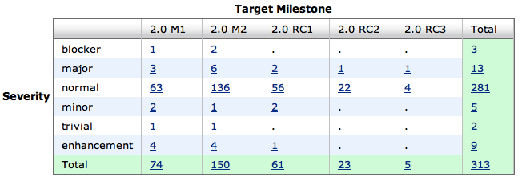
Bugs fixed during 0.5

Slide 10
Standards
Working with the community on
  Promises A+ (cancellation and progress)
  W3C URL
  W3C Web Components
  HTML Templates and Custom Elements
  Orion provides reference code and test suites

Slide 11
Community
Orion team members are active in Bugzilla, newsgroups, mailing lists, Eclipse forums and Twitter
http://wiki.eclipse.org/Orion/Buzz - Continuous press
Warsaw Student working group on Git for Node.js
Two UCOSP students working on Accessibility and Node.js language tools
Blogs started by Orion committers are active:
  http://planetorion.org
  http://planeteclipse.org
  Team is using the eclipse-orion IRC channel
  irc.freenode.net#eclipse-orion
  also see: http://wiki.eclipse.org/index.php/IRC
The Orion team participates in code camps, conference presentations, and tutorials, including
  EclipseCon EU, MLOC.JS, Ottawa JS Group
The Orion team interacts with other open source projects, standards bodies, and other projects on eclipse.org, including
  Mozilla, Dojo Foundation (Dojo framework, Maqetta), JGit, Mylyn, jsdoc, Firebug, CodeMirror, Esprima

Slide 12
Process
Orion is developed using an open, transparent, and inclusive process
Team relies on Bugzilla, mailing lists, forums, social media for input
Weekly planning calls conducted with all contributors welcome including a new User Experience Call
Self-hosted development on http://orion.eclipse.org
  Meeting minutes posted to the orion-dev mailing list
Publicly available plan: http://wiki.eclipse.org/Orion/Plan

Slide 13
IP Issues
All significant and third party contributions have been reviewed and approved by Eclipse legal.
About files and license files are complete and correct.
Client code as well as the Node.js Orion Server (JavaScript) is dual-licensed with EPL and EDL
Approved 1.0 release log:
  (waiting approval)

Slide 14

Future Plans
Continue with 4 month release cycle to keep up with pace of development in the web community.
3.0 release in June 2013
Continuing Focus on APIs, i18N, Accessibility, Cross-site workflows. Move to official support for the Projects page including sftp and other drive options. Support WAR file distribution of Java Server

