Slide 1
GitHub contribution
Szvetlin Tanyi szvetlin@aitia.ai

Slide 2
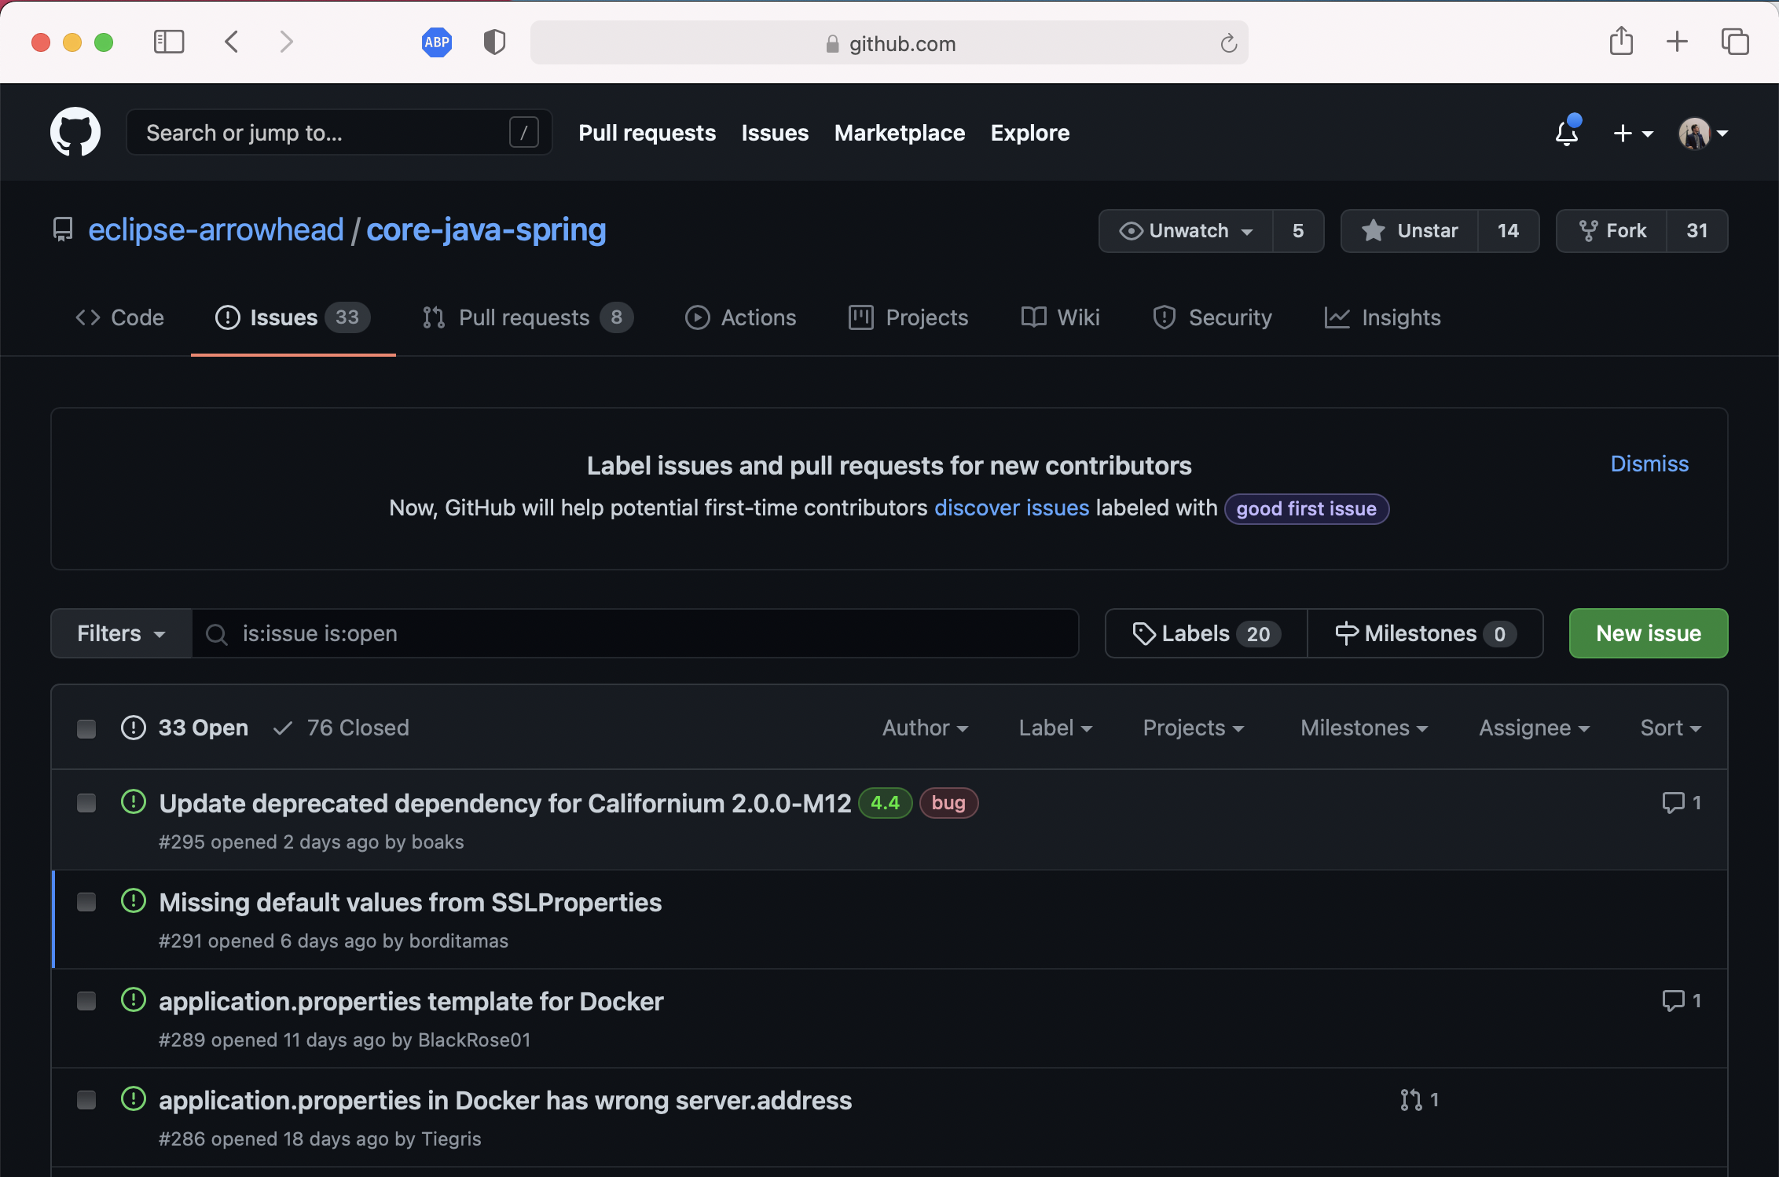
GitHub Issues

Slide 3
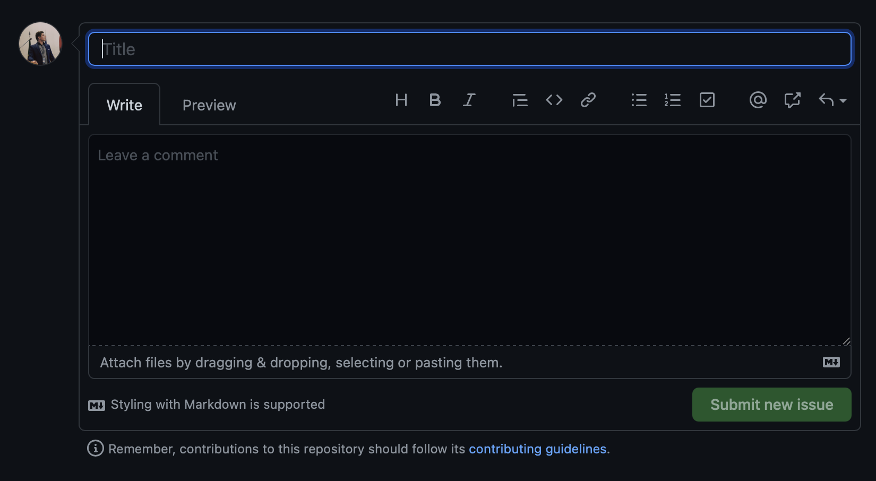
Filing a new issue
Descriptive Title
Description with explanation, proposal, images

Slide 4
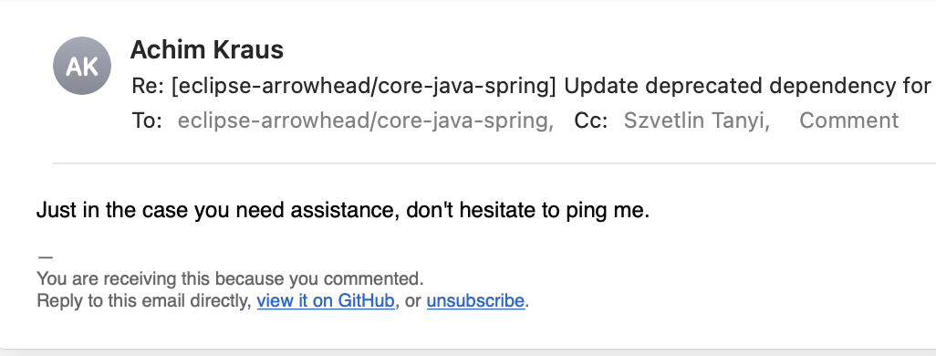
Replying to issues / pull requests
https://github.com/eclipse-arrowhead/core-java-spring/pull/290

Slide 5

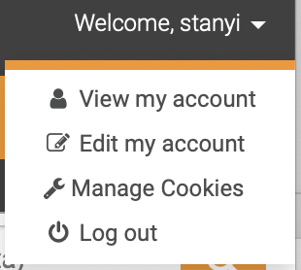
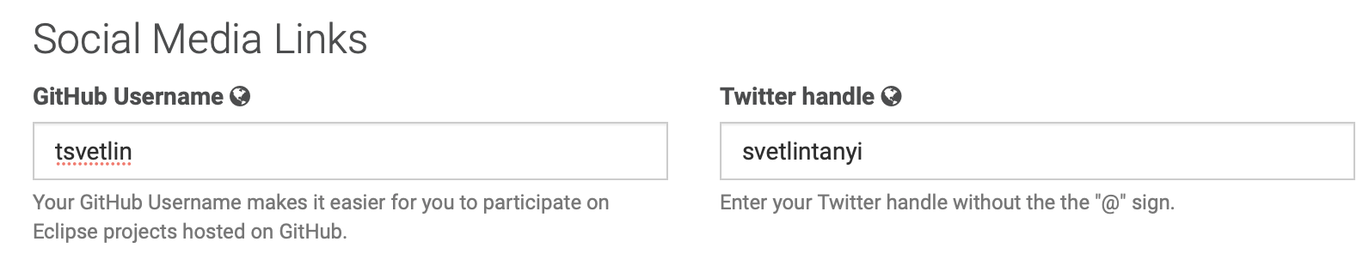
Contribution - Eclipse Committer
Fill out your GitHub ID on the website
Use the same email address to commit the changes on your machine

Slide 6
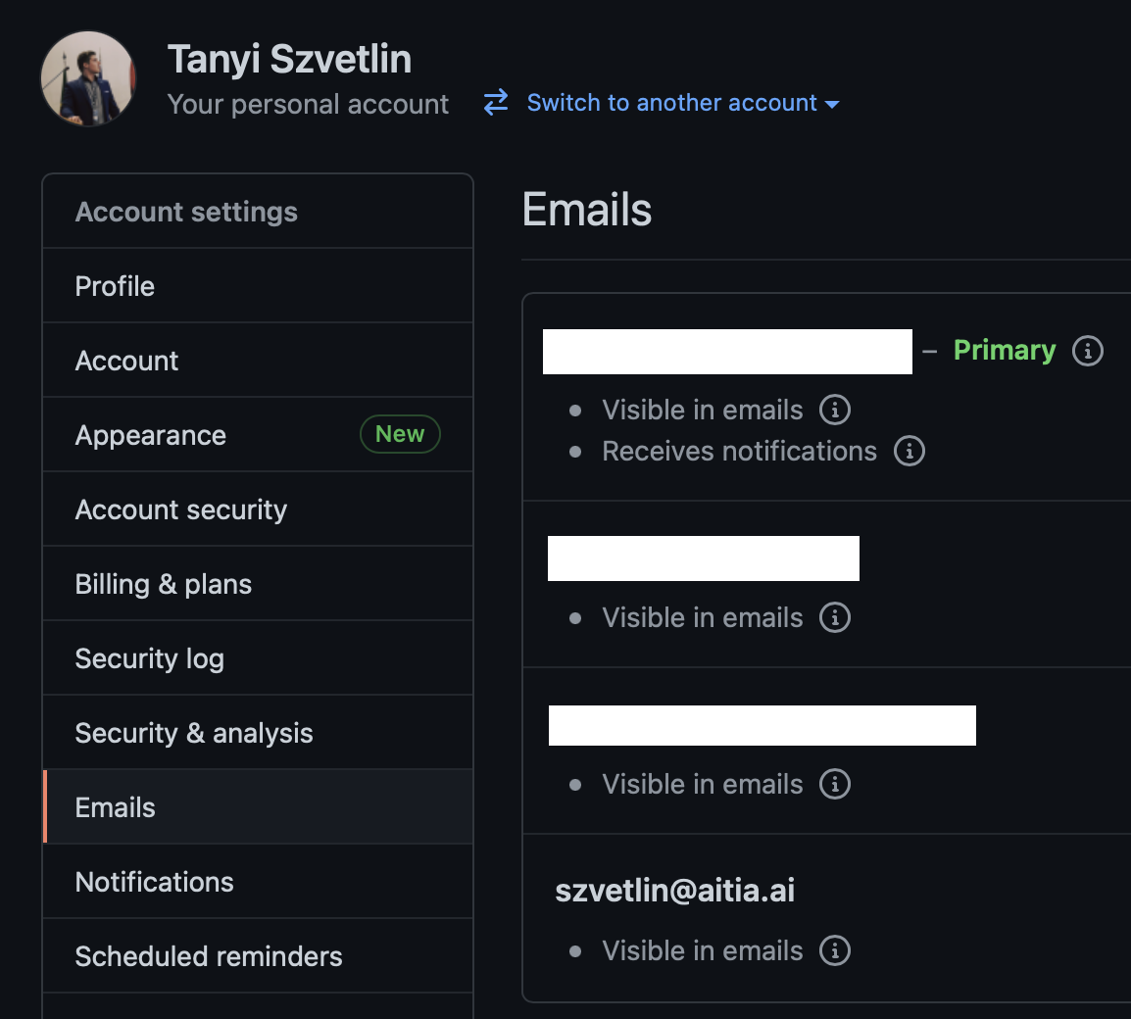

Slide 7
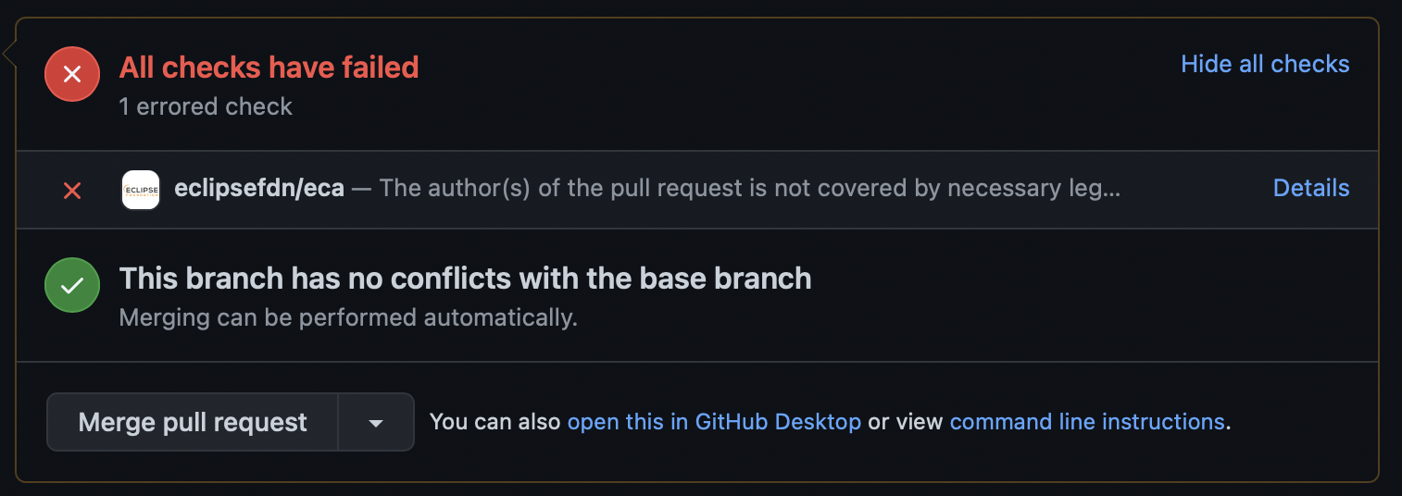
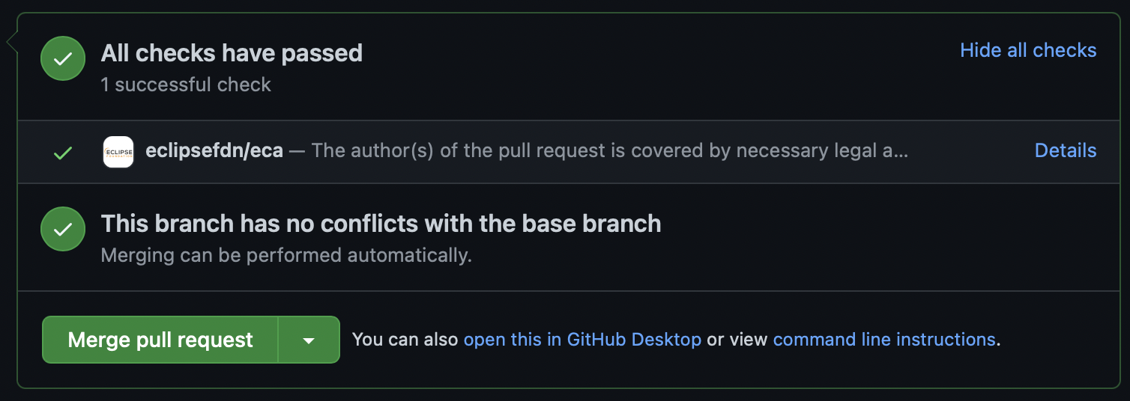
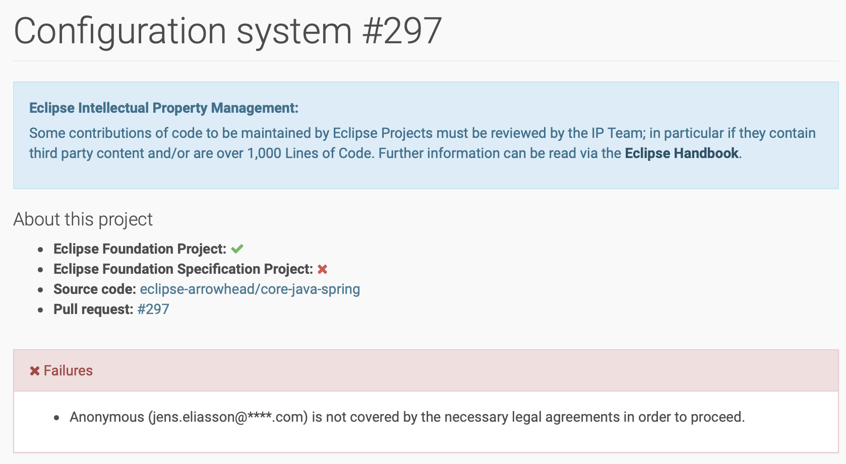
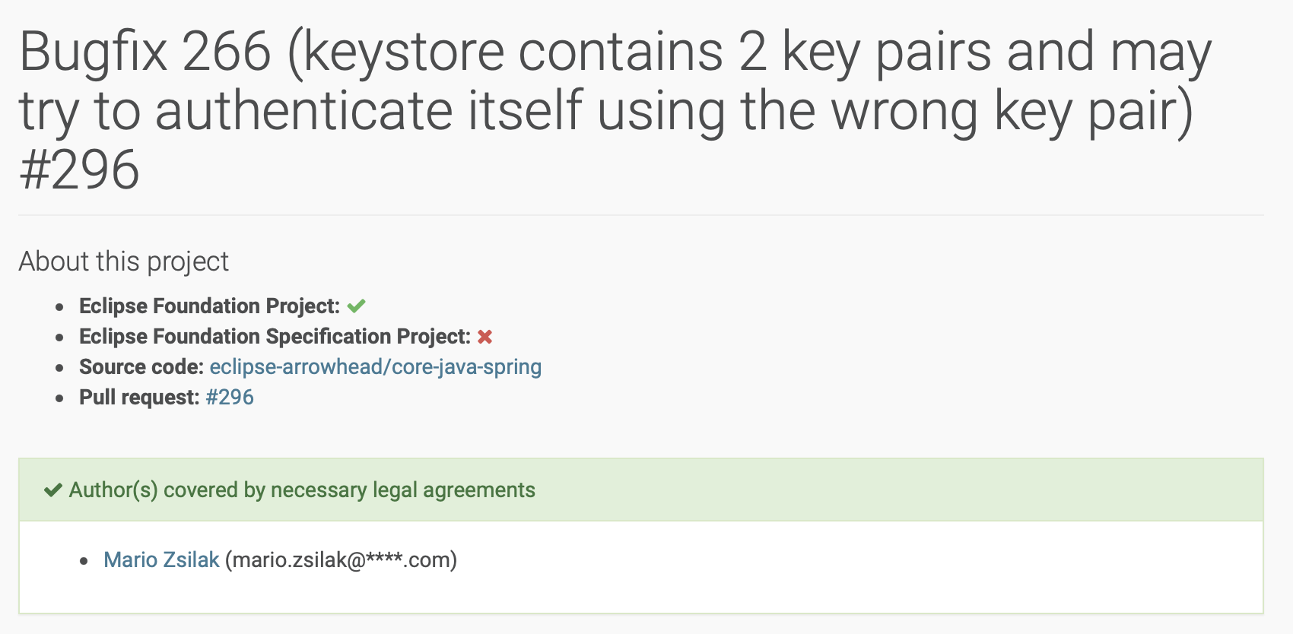
Don’t forget to add this line to your commit message: Signed-off-by: YOUR_NAME <your_email@address.com>

Slide 8
New Core Systems

Slide 9
New core system development
Contact Jerker and AITIA about the idea
Start a discussion, work out the details, make a proposal.
Database
API
JSON
Arrowhead WG Meeting: proposal review
Development process
Create a PR from your branch / fork to the “development” branch of the eclipse-arrowhead/core-java-spring repository.

Slide 10
CI/CD

Slide 11
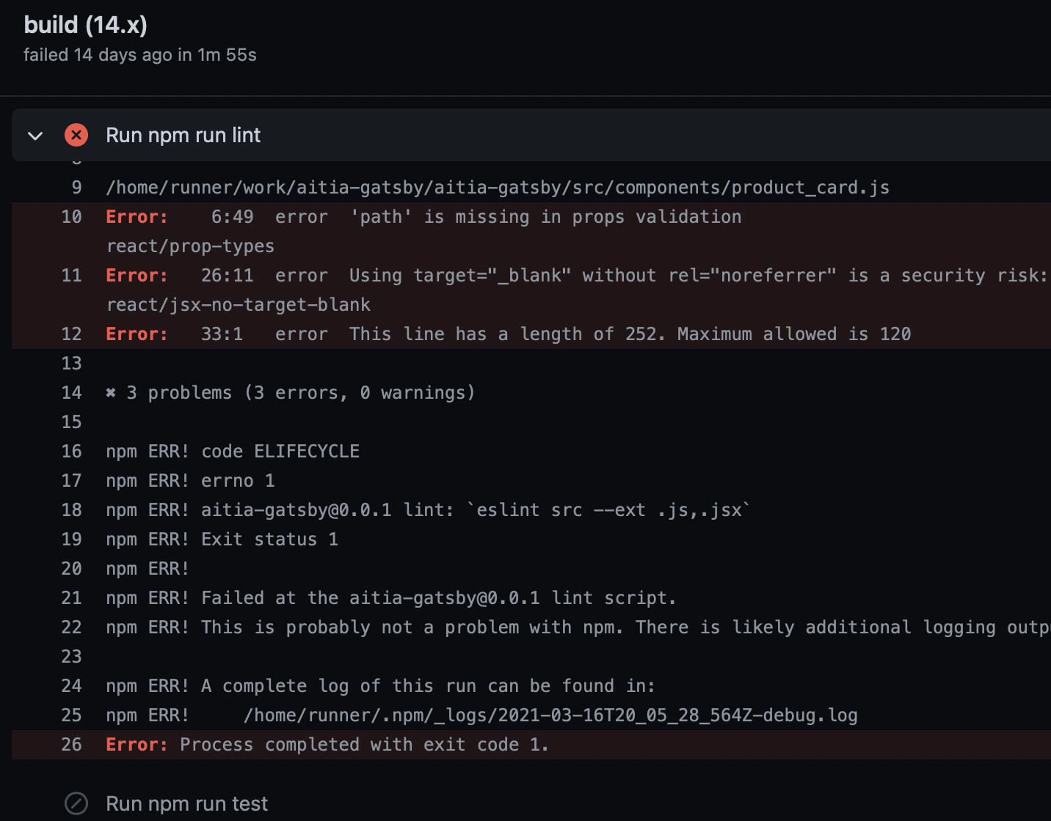
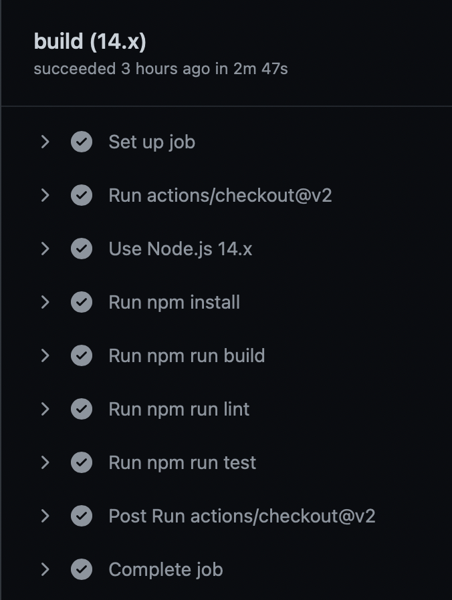
GitHub Actions
Automatic code check on every push
Code style enforcing (code style will be included in the project too)
Tries to build the project
Runs unit & integration test

Slide 12
Jenkins
Request an instance from Eclipse
It will build the Docker images and upload them do DockerHub.

Slide 13
Releases

Slide 14
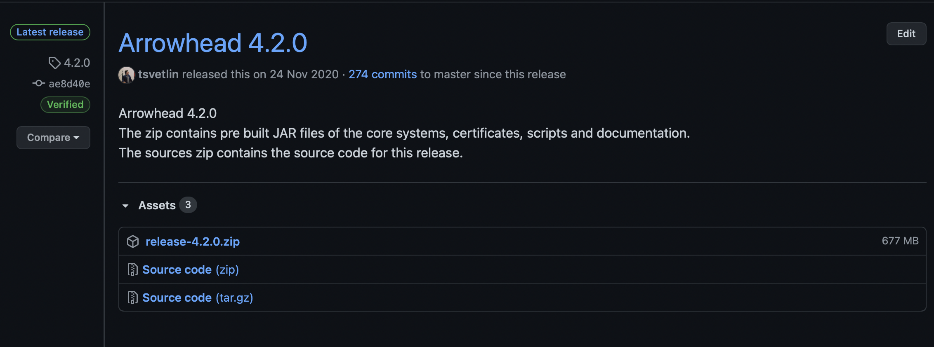
Releases
Source Code
JAR files
Documentation – PDF
https://github.com/eclipse-arrowhead/core-java-spring/releases

Slide 15
Questions

