Slide 1
Roadmap WG 221219

Slide 2
Agenda
1) Follow up on the discussion with preferable a decision on mandatory core systems
2) SoSD - updates, Per Olofsson
3) Microsystem fundamental properties, Jerker
4) Microservice fundamental properties, Jerker
5) SoS fundamental properties
6) Next step

Slide 3
3), 4), 5) Technology foundation
Microservice - microsystem paradigm
System of Systems paradigm

Slide 4
Key properties of Microservice SoS
SOA
Look-up
Late binding
Loose coupling

Slide 5
Key properties of Microservice SoS
Microsystem
A microsystem performs its function independently.
A microsystem can be
stateful and is then responsible for storing its own state; or
stateless.

Slide 6
Key properties of Microservice SoS
SoS
Operational independence/autonomy of the elements
Belonging
Connectivity
Diversity
Emergent behaviour
Managerial independence of the elements
Evolutionary development
Geographical distribution
Secure and safe
Competition
Business transaction

Slide 7
Key properties of Microservice SoS
SoS
Operational independence/autonomy of the elements The constituent systems can operate independently in a meaningful way and are useful in their own right.
Belonging The autonomous constituent systems choose to belong to the SoS because they see value for themselves to give up some of their autonomy to receive benefits.
Connectivity To let the constituent systems interact, they must be connected, and unless they provide sufficiently generic interfaces, they must be modified to provide such interoperability. Connectivity in an SoS is, thus, dynamic, with interfaces and links forming and vanishing as the need arises.
Diversity Whereas many other systems strive to minimize diversity to simplify the system, increased diversity in an SoS gives it the ability to better address unforeseen situations during its life-cycle.
Emergent behavior appears in any system, and in many systems, this is deliberately and intentionally designed in and tested. In an SoS, emergent behavior is not restricted to what can be foreseen. Instead, the system should have the capability to detect (in an early stage) and eliminate bad behavior that emerges.
Managerial independence of the elements The con- stituent systems not only can but do operate inde- pendently, even while being part of the SoS. Further, elements can be added individually to the SoS.
Evolutionary development The SoS does not appear fully formed, and functions and purposes are added based on experience.
Geographical distribution The constituent systems only exchange information and not substantial quantities of mass or energy.
Secure and safe Malicious behavior in an SoS and its constituent systems must be detected and mitigated to ensure information, system and SoS integrity.
Notes:
Operational independence/autonomy of the elements The constituent systems can operate independently in a meaningful way and are useful in their own right.
Belonging The autonomous constituent systems choose to belong to the SoS because they see value for themselves to give up some of their autonomy to receive benefits.
Connectivity To let the constituent systems interact, they must be connected, and unless they provide sufficiently generic interfaces, they must be modified to provide such interoperability. Connectivity in an SoS is, thus, dynamic, with interfaces and links forming and vanishing as the need arises.
Diversity Whereas many other systems strive to minimize diversity to simplify the system, increased diversity in an SoS gives it the ability to better address unforeseen situations during its life-cycle.
Emergent behavior appears in any system, and in many systems, this is deliberately and intentionally designed in and tested. In an SoS, emergent behavior is not restricted to what can be foreseen. Instead, the system should have the capability to detect (in an early stage) and eliminate bad behavior that emerges.
Managerial independence of the elements The con- stituent systems not only can but do operate inde- pendently, even while being part of the SoS. Further, elements can be added individually to the SoS.
Evolutionary development The SoS does not appear fully formed, and functions and purposes are added based on experience.
Geographical distribution The constituent systems only exchange information and not substantial quantities of mass or energy.
Secure and safe Malicious behavior in an SoS and its constituent systems must be detected and mitigated to ensure information, system and SoS integrity.

Slide 8
Architectural foundation

Slide 9
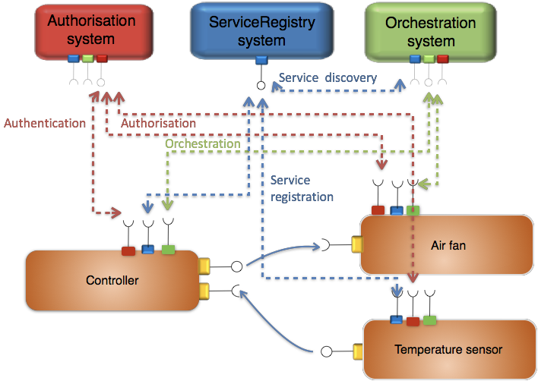
Foundational concept 1
Microservice based
Providing core SOA properties - control plane & data plane

Slide 10
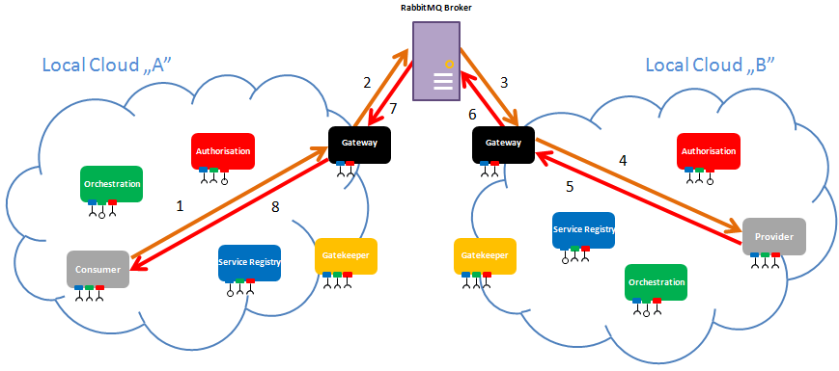
Foundational concept 2
Local clouds - “Micro clouds”
Enabling real time performance using Internet technologies
Provides improved Security
Supports engineering simplicity and scalability

