Slide 1

AspectJ
Development Tools
Mik Kersten
beatmik@acm.org
University of British Columbia
October 28, 2003

Slide 2
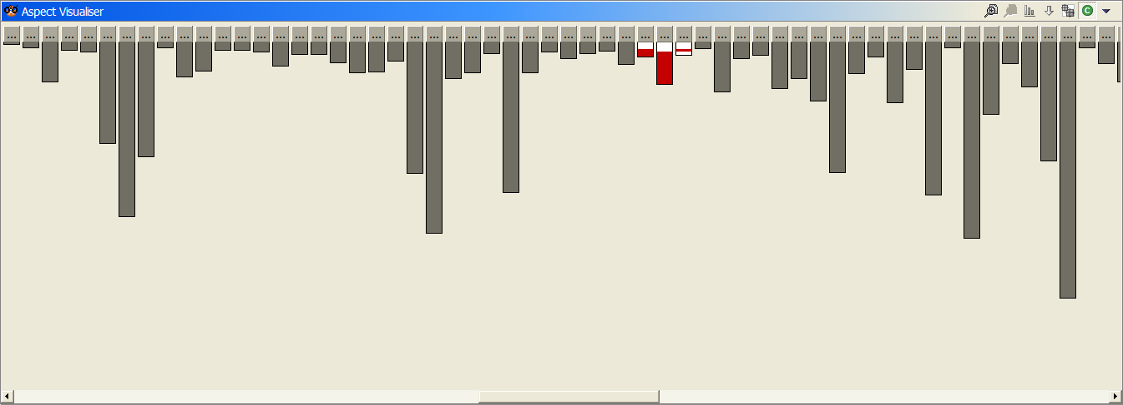
good modularity
socket creation in Tomcat
  colored lines show relevant lines of code
  fits nicely into one package (3 classes)

Slide 3
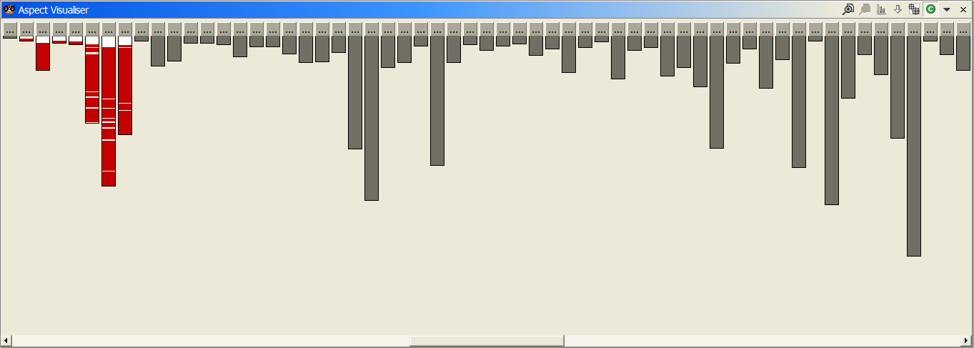
pretty good modularity
class loading in Tomcat
  colored lines show relevant lines of code
  mostly in one package (9 classes)

Slide 4
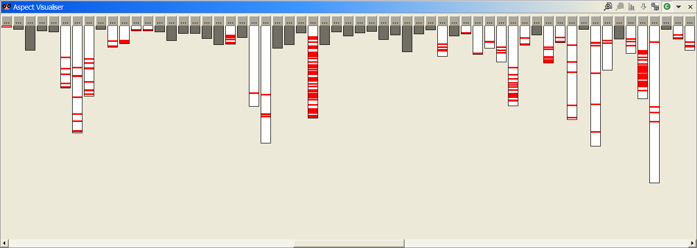
not so good modularity
logging in Tomcat
  scattered across the packages and classes
  error handling, security, business rules, …

Slide 5
the cost of tangled code
redundant code
  same fragment of code in many places
difficult to reason about
  non-explicit structure
  the big picture of the tangling isn’t clear
difficult to change
  have to find all the code involved
  and be sure to change it consistently
Notes:
this tangling is accidental
it isn’t stupidity or laziness!
there is something fundamentally hard to modularize using OOP going on here…

Slide 6
the aop idea
crosscutting is inherent in complex systems
crosscutting concerns
  have a clear purpose
  have a natural structure
so, let’s capture the structure of crosscutting concerns explicitly...
  in a modular way
  with linguistic and tool support
aspects are
  well-modularized crosscutting concerns
Notes:
here’s where we pick up the crystallization of style and analogy to OOP points
people know this, they deal with it a variety of ways, we can make that explicit
(1) It rests on an assumption that cross-cutting is inherent. That in any sufficiently complex system… I haven’t proven this assumption today, I’ve just reminded you about the problem. But I believe it, and we can talk an EXAMPLES HERE
(2) But that cross-cutting concerns are not random…

Slide 7
language overview
I

Slide 8
a simple figure editor
factory methods
Display
Figure
*
FigureElement
makePoint(..)
makeLine(..)
moveBy(int, int)
Point
2
Line
getX()
getY()
setX(int)
setY(int)
moveBy(int, int)
getP1()
getP2()
setP1(Point)
setP2(Point)
moveBy(int, int)
operations that move elements

Slide 9
join points
key points in the dynamic
call graph
imagine l.move(2, 2)
a Line
dispatch
a Point
a method execution
a method call
dispatch
returning or throwing
returning or throwing
a method execution
returning or throwing

Slide 10
join point terminology
a Line
dispatch
method execution join points
method call join points
several kinds of join points
  method & constructor execution
  method & constructor call
  field get & set
  exception handler execution
  static & dynamic initialization

Slide 11
pointcuts: naming join points
each execution of the
<void Line.setP1(Point)> or
<void Line.setP2(Point)> method
pointcut move():
execution(void Line.setP1(Point)) ||
execution(void Line.setP2(Point));
name and parameters
a “void Line.setP1(Point)” execution
or
a “void Line.setP2(Point)” execution

Slide 12
advice: action under joinpoints
after advice runs
“on the way back out”
a Line
pointcut move():
execution(void Line.setP1(Point)) ||
execution(void Line.setP2(Point));
after() returning: move() {
<code here runs after each move>
}

Slide 13
a simple aspect
an aspect defines a special class that can crosscut other classes
aspect HistoryUpdating {
pointcut move():
exucution(void Line.setP1(Point)) ||
execution(void Line.setP2(Point));
after() returning: move() {
<code here runs after each move>
}
}

Slide 14
demo: modularize concern

Slide 15
comparison
without AspectJ
  no locus of “history updating”
  evolution is cumbersome
  changes in all classes
  have to track & change all callers
with AspectJ
  clear “history updating” module
  all changes in single aspect
  evolution is modular

Slide 16
getting started
II

Slide 17
adoption curve
reusable libraries
aspects and
classes for:
development
infrastructure
business logic
beyond OO
AOP redefines
services,
middleware
benefit
security
domain aspects
persistence
feature
management
error handling
management
timing
caching
enforcement
testing
debugging
performance
time &
confidence
development time
infrastructure
AO architecture

Slide 18
logging (again)
logging in Catalina
  scattered across the packages and classes
  error handling, security, business rules, …

Slide 19
logging (again)
From ContextManager
public void service( Request rrequest, Response rresponse ) {
// log( "New request " + rrequest );
try {
// System.out.print("A");
rrequest.setContextManager( this );
rrequest.setResponse(rresponse);
rresponse.setRequest(rrequest);
// wront request - parsing error
int status=rresponse.getStatus();
if( status < 400 )
status= processRequest( rrequest );
if(status==0)
status=authenticate( rrequest, rresponse );
if(status == 0)
status=authorize( rrequest, rresponse );
if( status == 0 ) {
rrequest.getWrapper().handleRequest(rrequest,
rresponse);
} else {
// something went wrong
handleError( rrequest, rresponse, null, status );
}
} catch (Throwable t) {
handleError( rrequest, rresponse, t, 0 );
}
// System.out.print("B");
try {
rresponse.finish();
rrequest.recycle();
rresponse.recycle();
} catch( Throwable ex ) {
if(debug>0) log( "Error closing request " + ex);
}
// log( "Done with request " + rrequest );
// System.out.print("C");
return;
}
// log( "New request " + rrequest );
// System.out.print(“A”);
// System.out.print("B");
if(debug>0)
log("Error closing request " + ex);
// log("Done with request " + rrequest);
// System.out.print("C");

Slide 20
demo: development time aspects

Slide 21
crosscutting structure
III

Slide 22
aspects crosscut classes
aspect modularity cuts across class modularity
Display
Figure
*
FigureElement
makePoint(..)
makeLine(..)
moveBy(int, int)
Point
2
Line
getX()
getY()
setX(int)
setY(int)
moveBy(int, int)
getP1()
getP2()
setP1(Point)
setP2(Point)
moveBy(int, int)
HistoryUpdating
Notes:
One of the reasons that OO won was toll support – the tools shoed the structure of the system

Slide 23
showing crosscutting
motivation
  tool support helped OO win
  advice invocation is implicit
  difficult to infer structure from source alone
challenges
  compatibility with Eclipse
  not hierarchical
  global structure

Slide 24
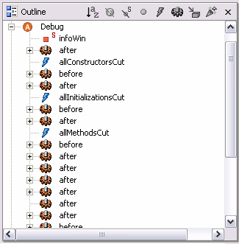
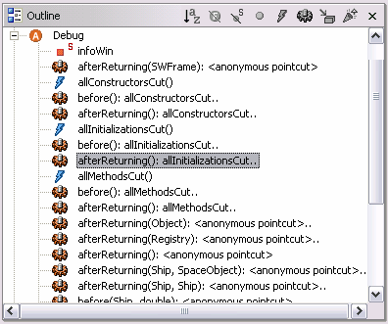
new declarations
ajdt 1.0
ajdt 1.1

Slide 25
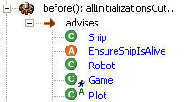
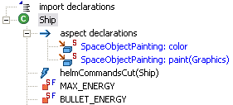
new relationships
pointcuts
  execution, call
  staticinitialization, initialization
  get, set
  handler, cflow, ..
inter-type declarations
  declare warning, error
  fields and methods
  declare parents
  declare precedence

Slide 26



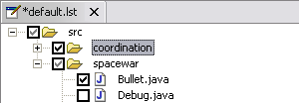
new views
tree view links (outline)
editor gutter annotations
documentation (ajdoc)
build configuration editor
aspect visualizer…

Slide 27
demo: aspect visualizer

Slide 28
tools suite
IV

Slide 29
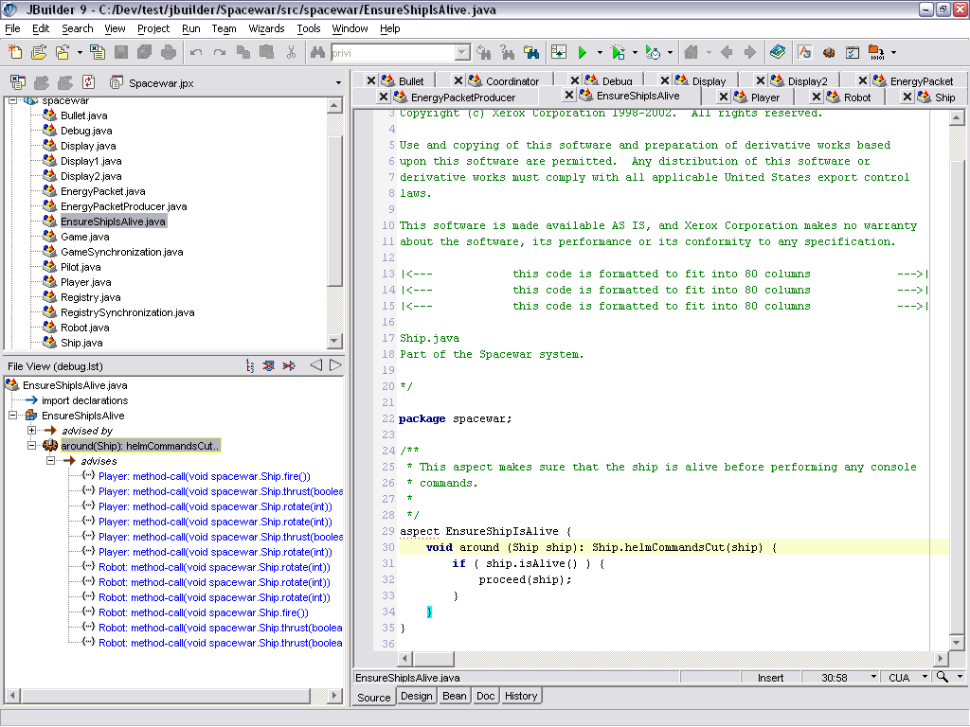
jbuilder screenshot…

Slide 30
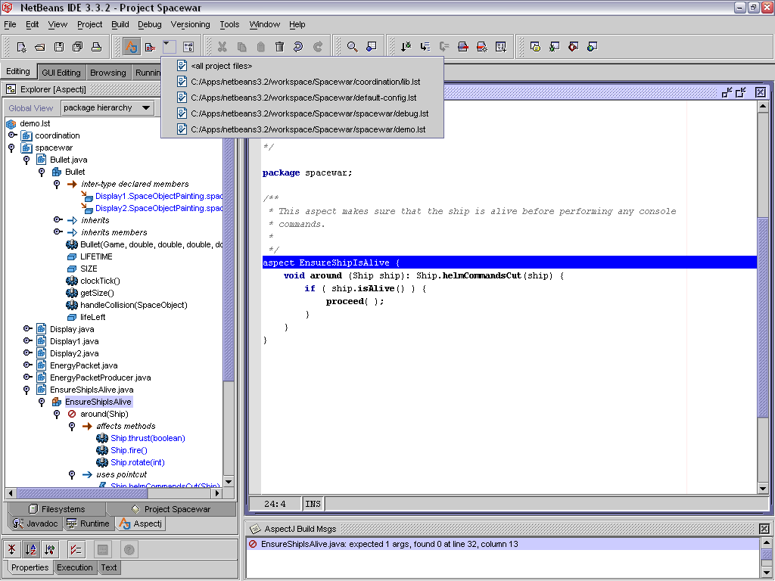
netbeans screenshot…

Slide 31
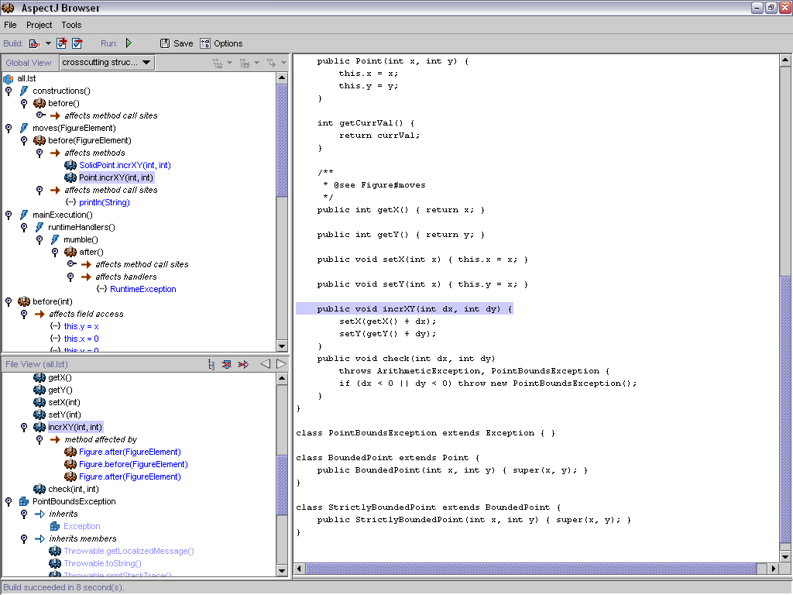
ajbrowser screenshot…

Slide 32
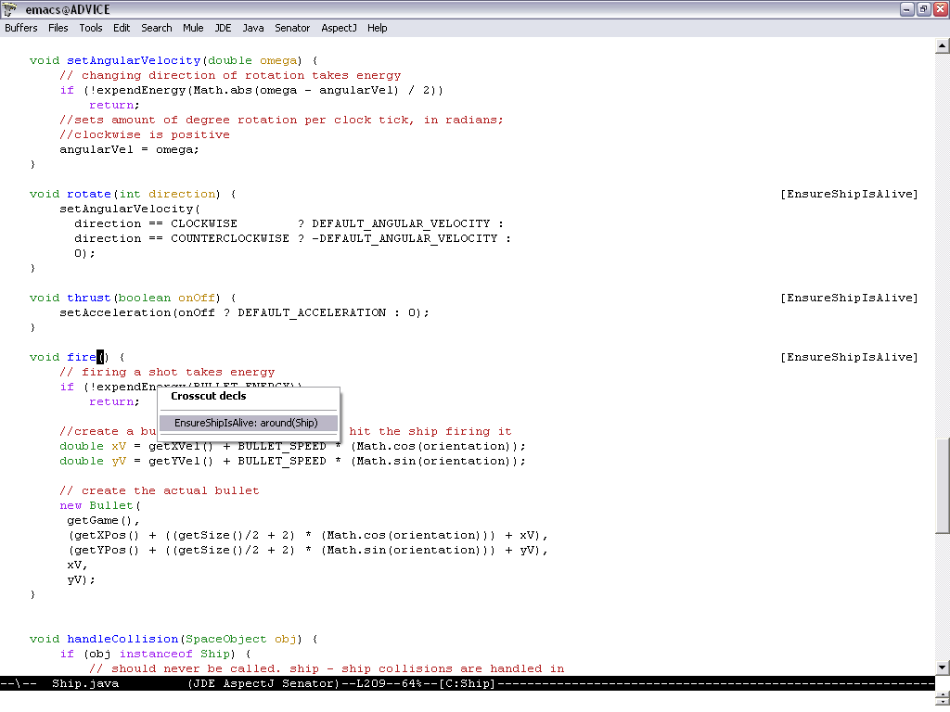
emacs

Slide 33
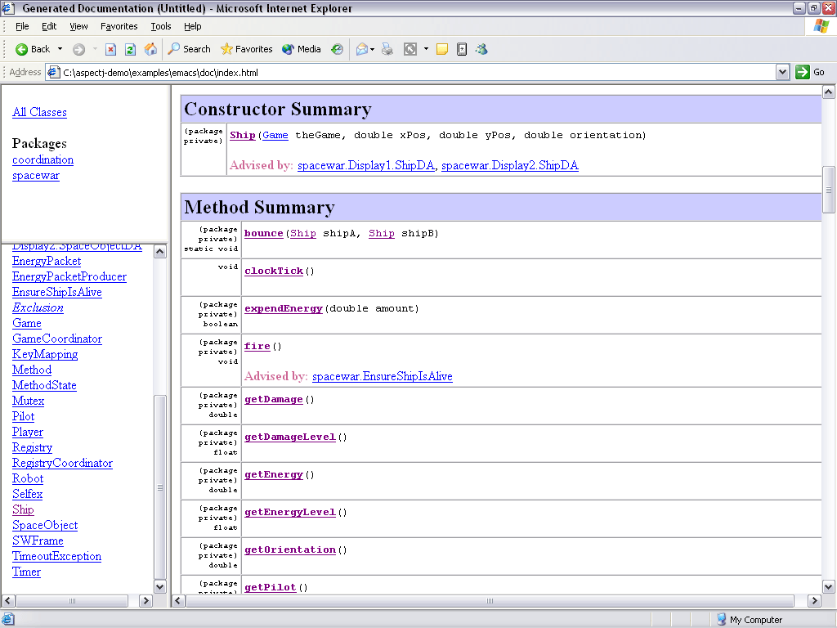
ajdoc

Slide 34
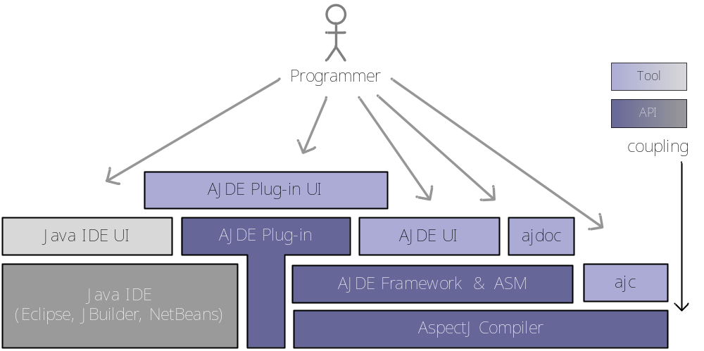
extensibility overview

Slide 35
engineering challenges
eclipse sets the bar high
  eager parsing and code assist
  refactoring
integration with the JDT
  java model is not inherently extensible
  structure searches don’t work for crosscutting
keeping up with the platforms
  eclipse versions
  jdk 1.5 generics and metadata

Slide 36
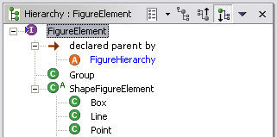
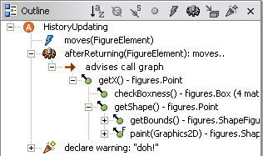
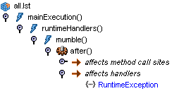
what’s next?
show inheritance
  abstract aspects
  declare parents
show dynamic info
  aspect precedence
  cflow call graphs
crosscutting
navigator

Slide 37
summary
aop
  same benefits of good modularity
  but for crosscutting concerns
aspectj
  join points, pointcuts, advice, …
  getting started with auxiliary aspects
tool support
  crosscutting structure is explicit

Slide 38
aspectj credits
eclipse.org Technology PMC project
versions 0.1-1.1 developed at Xerox PARC
aspectj team
  Adrian Colyer, Erik Hilsdale, Jim Hugunin,
  Wes Isberg and Mik Kersten
ajdt team
  Adrian Colyer, Andy Clement, Mik Kersten
  and Julie Waterhouse Park
http://eclipse.org/aspectj
http://aosd.net

