Slide 1
AJDT: AspectJ™ Development Tools for Eclipse
Mik Kersten
aspectj.org
Palo Alto Research Center
Notes:
benefits are the usual benefits of modularity, for a kind of concern that previously could not be
implemented in a modular way -- its critical to make it clear that its about modularity (and old and
general point) for a new kind of thing

Slide 2
what’s AspectJ?
an aspect-oriented extension to Java™ that supports general-purpose aspect programming
find out more at
  tutorial tomorrow
  demos thursday and friday
quick overview…

Slide 3
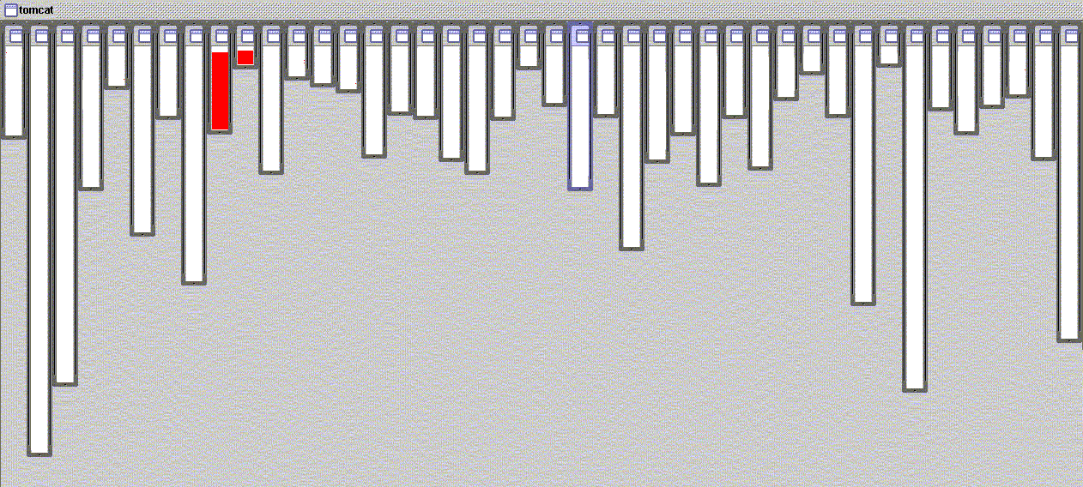
good modularity
URL pattern matching
URL pattern matching in org.apache.tomcat
  red shows relevant lines of code
  nicely fits in two boxes (using inheritance)

Slide 4
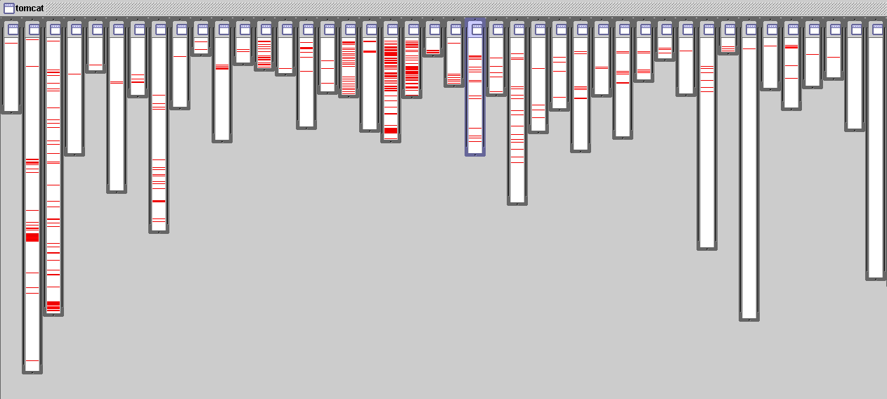
problems like…
logging is not modularized
logging in org.apache.tomcat
  red shows lines of code that handle logging
  not in just one place
  not even in a small number of places

Slide 5
the AOP idea
cost of crosscutting concerns in code
  redundant code
  difficult to reason about
  difficult to change
crosscutting is inherent in complex systems
crosscutting concerns
  have a clear purpose
  have a natural structure
so, let’s capture the structure of crosscutting concerns explicitly...
  in a modular way
  with linguistic and tool support
Notes:
this tangling is accidental
it isn’t stupidity or laziness!
there is something fundamentally hard to modularize using OOP going on here…

Slide 6
logging, zoomed in
//From ContextManager
public void service( Request rrequest, Response rresponse ) {
// log( "New request " + rrequest );
try {
// System.out.print("A");
rrequest.setContextManager( this );
rrequest.setResponse(rresponse);
rresponse.setRequest(rrequest);
// wront request - parsing error
int status=rresponse.getStatus();
if( status < 400 )
status= processRequest( rrequest );
if(status==0)
status=authenticate( rrequest, rresponse );
if(status == 0)
status=authorize( rrequest, rresponse );
if( status == 0 ) {
rrequest.getWrapper().handleRequest(rrequest,
rresponse);
} else {
// something went wrong
handleError( rrequest, rresponse, null, status );
}
} catch (Throwable t) {
handleError( rrequest, rresponse, t, 0 );
}
// System.out.print("B");
try {
rresponse.finish();
rrequest.recycle();
rresponse.recycle();
} catch( Throwable ex ) {
if(debug>0) log( "Error closing request " + ex);
}
// log( "Done with request " + rrequest );
// System.out.print("C");
return;
}
// log( "New request " + rrequest );
// System.out.print(“A”);
// System.out.print("B");
if(debug>0)
log("Error closing request " + ex);
// log("Done with request " + rrequest);
// System.out.print("C");

Slide 7
logging, modularized
aspect PublicErrorLogging {
Log log = new Log();
pointcut publicInterface ():
call(public * org.apache.tomcat..*.*(..));
after() throwing (Error e): publicInterface() {
log.write(e);
}
}
captures public interface of tomcat package
crosscutting concerns
  tangled implementation → complex, difficult to maintain
  modular implementation → can be clear, easy to maintain
crosscutting concerns per se not complicated!
Notes:
maintenance is always where better modularity pays off best

Slide 8
aspectj tools role
present crosscutting structure
  advice invocation is implicit
  hard to infer structure from source alone
consistently across multiple platforms
  already had JBuilder, NetBeans, Emacs
  noticed constant requests for an Eclipse plug-in after OOPSLA 2001

Slide 9
ajdt project
goal is seamless integration with Eclipse/JDT
  compiler integration
  editor support
  structure views
  crosscutting navigation
  resource creation wizards
  build configurations
  searching
  debugging

Slide 10
demo: aspectj development tools

Slide 11
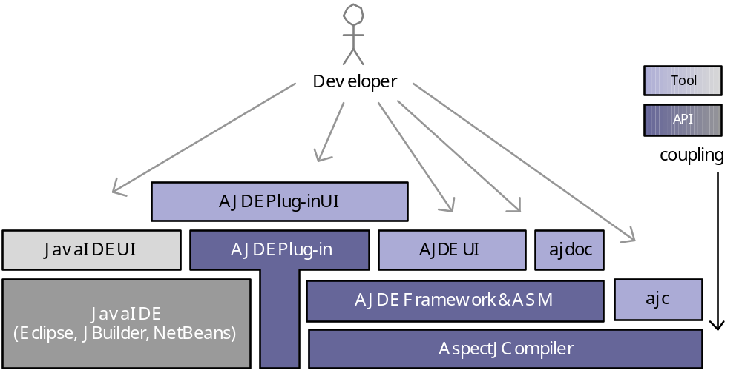
tools architecture overview

Slide 12
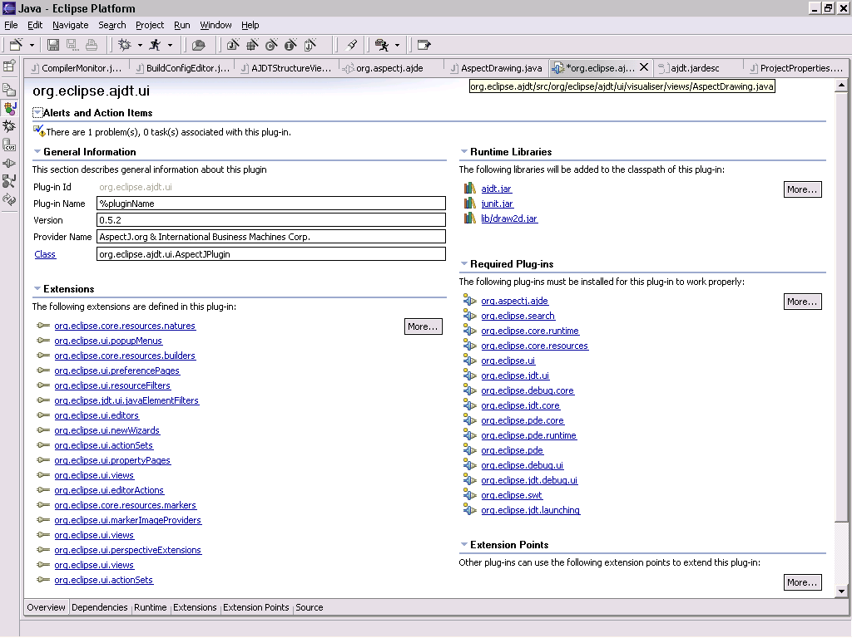
“

Slide 13
ajdt development timeline
3 part-time developers
started mid-January 2002
plug-in used by ~50 developers in workshop, end of February 2002
first public release June 2002
  delayed due to hosting, legal issues

Slide 14
what was easy
architecture
  plug-in model facilitated AspectJ/AJDT separation
  perspectives, views, and editors made the plug-in unobtrusive to Java projects
  rich OO UIs
development process
  examples to work from
  development infrastructure
  execution support

Slide 15
what was hard
need persistent model that understands global structure
JDT not designed with language extension in mind
  outline view is replicated
  use AspectJ model not extension Java model
  will get worse as we try to support more functionality (refactoring, code assist)

Slide 16
aspectj 1.1
incrmental compiler
  extends JDT’s compiler
eager parsing
extended, persistent model
once that’s done
  code assist
  refactoring
  structure mining
  navigator and global views
Notes:
these are all inter-dependent
runtime structure can leverage the joinpoint model
cross-resource structure is contains crosscutting
current refactoring is problematic because it doesn’t understand this structure
declarative transactions and security crosscut

Slide 17
logging (again)
logging in org.apache.tomcat
  red shows lines of code that handle logging
  not in just one place
  not even in a small number of places

Slide 18
demo: aspect visualizer

Slide 19
credits
team
  Adrian Colyer, IBM UK Ltd
  Mik Kersten, PARC
  Andy Clement, IBM UK Ltd
  Julie Waterhouse Park, IBM Canada
  contributors: Mathew Webster, Rory Slaney, Sian Whiting, Jonathan Davies, Nick Huismans
download the ajdt eclipse plug-in: http://eclipse.org/ajdt
download the tools and docs at: http://aspectj.org
find more information on AOP: http://aosd.net
demos: thursday 12-12:45pm, friday 1-1:45pm

