Slide 1
"Families to Persons"
A simple illustration of model-to-model transformation
Freddy Allilaire
Frédéric Jouault
ATLAS group, INRIA & University of Nantes, France

Slide 2

Context of this work
The present courseware has been elaborated in the context of the “Usine Logicielle” project (www.usine-logicielle.org) of the cluster System@tic Paris-Région with the support of the Direction Générale des Entreprises, Conseil Régional d‘Ile de France, Conseil Général des Yvelines, Conseil Général de l'Essonne, and Conseil Général des Hauts de Seine.
The MDD courseware provided here with the status of open source software is produced under the EPL 1.0 license.

Slide 3
Overview
This presentation describes a very simple model transformation example, some kind of ATL "hello world".
It is intended to be extended later.
The presentation is composed of the following parts:
  Prerequisites.
  Introduction.
  Metamodeling.
  Transformation.
  Conclusion.

Slide 4
Prerequisites
In the presentation we will not discuss the prerequisites.
The interested reader may look in another presentation to these prerequisites on:
  MDE (MOF, XMI, OCL).
  Eclipse/EMF (ECORE).
  AMMA/ATL.

Slide 5
Introduction
The goal is to present a use case of a model to model transformation written in ATL.
This use case is named: “Families to Persons”.
Initially we have a text describing a list of families.
We want to transform this into another text describing a list of persons.

Slide 6
Goal of the ATL transformation we are going to write
Transforming this …
… into this.
  …
  Family March
    Father: Jim
    Mother: Cindy
    Son: Brandon
    Daughter: Brenda
    … other Families
  …
  Mr. Jim March
  Mrs. Cindy March
  Mr. Brandon March
  Mrs. Brenda March
    … other Persons
Let's suppose these are not texts, but models
(we'll discuss the correspondence
between models and texts later).

Slide 7
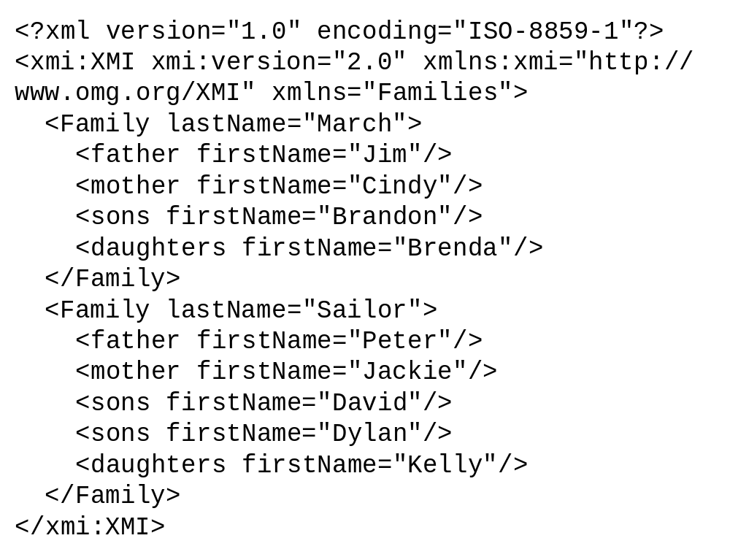
Input of the transformation is a model
  Family March
    Father: Jim
    Mother: Cindy
    Son: Brandon
    Daughter: Brenda
  Family Sailor
    Father: Peter
    Mother: Jackie
    Son: David
    Son: Dylan
    Daughter: Kelly
This is the text.
This is the corresponding model.
It is expressed in XMI,
a standard way to represent models.

Slide 8
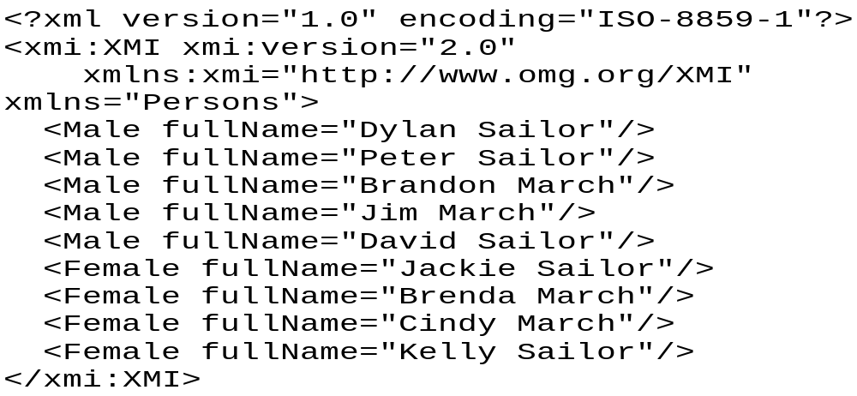
Output of the transformation should be a model
  Mr. Dylan Sailor
  Mr. Peter Sailor
  Mr. Brandon March
  Mr. Jim March
  Mr. David Sailor
  Mrs. Jackie Sailor
  Mrs. Brenda March
  Mrs. Cindy March
  Mrs. Kelly Sailor
This is the text.
This is the corresponding model
(The corresponding XMI file is named
"sample-Persons.ecore").

Slide 9
Each model conforms to a metamodel
Source metamodel
Target metamodel
conformsTo
conformsTo
Source model
"sample-Families.ecore"
Target model
"sample-Persons.ecore"

Slide 10
The general picture
conformsTo
Metametamodel (ECORE)
conformsTo
conformsTo
Source metamodel
Target metamodel
conformsTo
conformsTo
Source model
Target model

Slide 11
What we need to provide
In order to achieve the transformation, we need to provide:
  A source metamodel in KM3 ("Families").
  A source model (in XMI) conforming to "Families".
  A target metamodel in KM3 ("Persons").
  A transformation model in ATL ("Families2Persons").
When the ATL transformation is executed, we obtain:
  A target model (in XMI) conforming to "Persons".

Slide 12
Definition of the source metamodel "Families"
What is “Families”:
  A collection of families.
  Each family has a name and is composed of members:
    A father
    A mother
    Several sons
    Several daughters
  Each family member has a first name.
  Family March
    Father: Jim
    Mother: Cindy
    Son: Brandon
    Daughter: Brenda
  Family Sailor
    Father: Peter
    Mother: Jackie
    Sons: David, Dylan
    Daughter: Kelly
familyFather
father
Family
0..1
1
Member
familyMother
mother
lastName : String
0..1
1
firstName : String
familySon
sons
0..1
*
familyDaughter
daughters
0..1
*

Slide 13
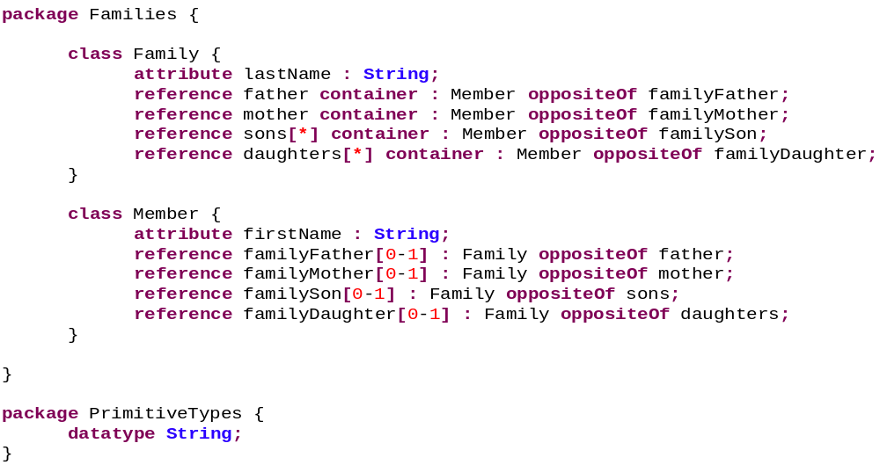
"Families" metamodel (visual presentation and KM3)
familyFather
father
Family
0..1
1
Member
familyMother
mother
lastName : String
0..1
1
firstName : String
familySon
sons
0..1
*
familyDaughter
daughters
0..1
*

Slide 14
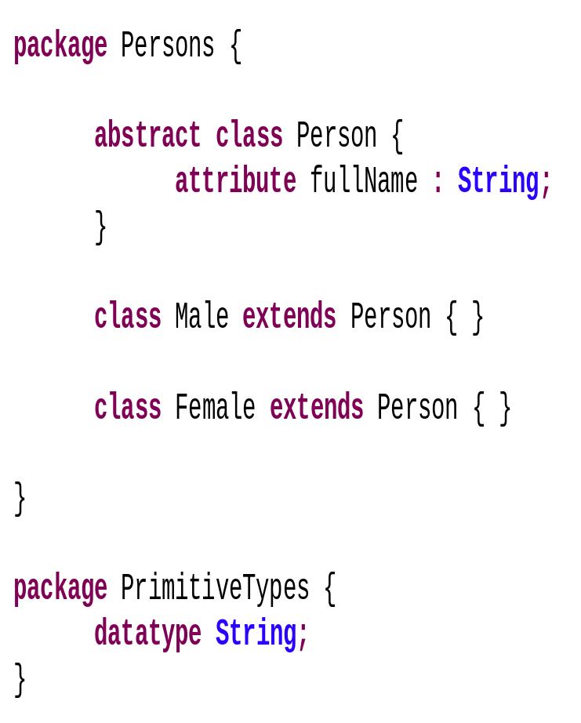
"Persons" metamodel (visual presentation and KM3)
Person
fullName
Male
Female

Slide 15
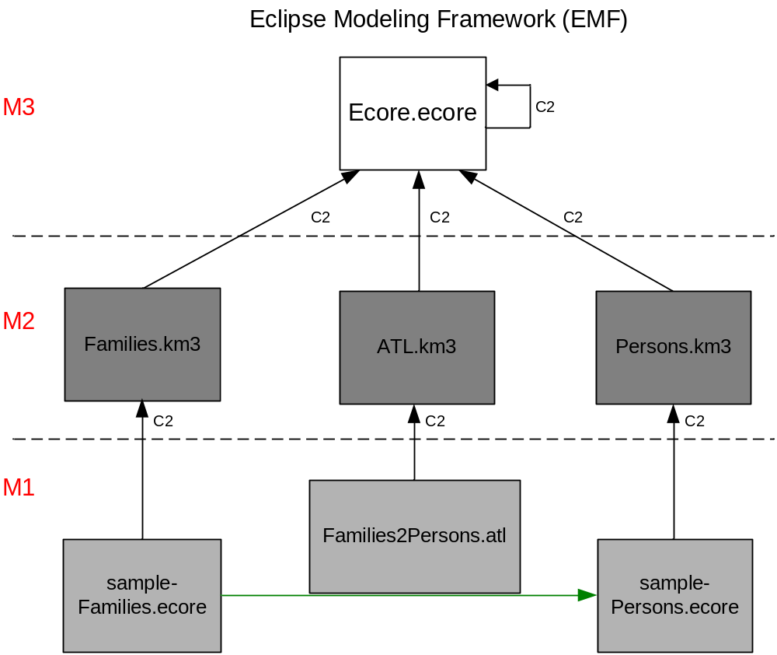
The big picture
Our goal in this mini-tutorial is to write the ATL transformation, stored in the "Families2Persons" file.
Prior to the execution of this transformation the resulting file "sample-Persons.ecore" does not exist. It is created by the transformation.
Before defining the transformation itself, we need to define the source and target metamodels ("Families.km3" and "Person.KM3").
We take for granted that the definition of the ATL language is available (supposedly in the "ATL.km3" file).
Similarly we take for granted that the environment provides the recursive definition of the metametamodel (supposedly in the "Ecore.ecore" file).

Slide 16
Families to Persons Architecture
Families and Persons metamodels have been created previously.
They have been written in the KM3 metamodel specification DSL (Domain Specific Language).

Slide 17
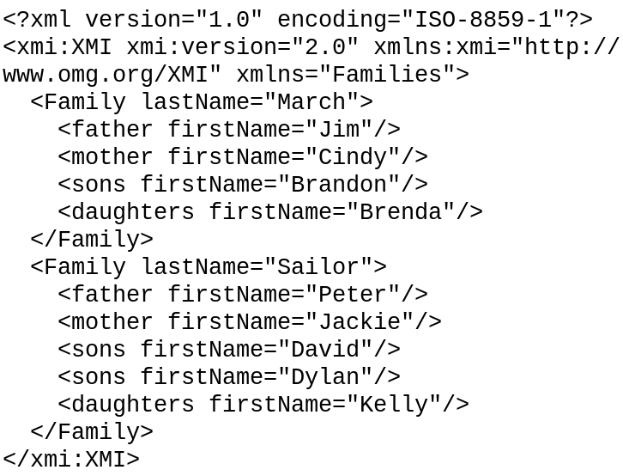
Families to Persons Architecture
The following file is the sample that we will use as source model in this use case:

Slide 18
Families to Persons Architecture
Now, let us start the creation of the ATL transformation Families2Persons.atl.
We suppose the ATL environment is already installed.
The creation of the ATL transformation will follow several steps as described in the next slides.

Slide 19
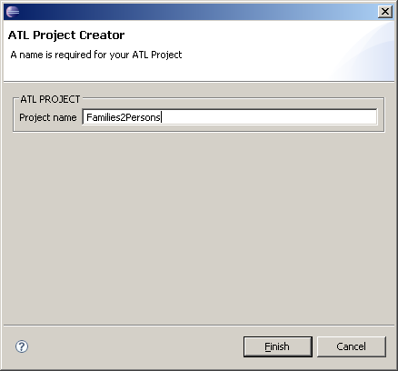
Families to Persons: project creation
First we create an ATL project by using the ATL Project Wizard.

Slide 20
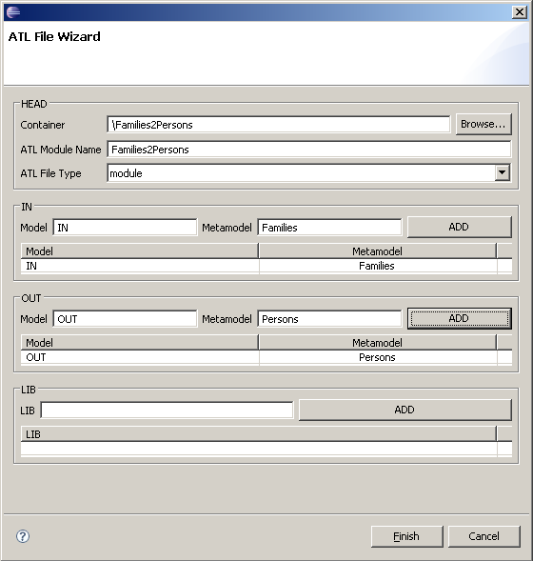
Families to Persons: ATL transformation creation
Next we create the ATL transformation. To do this, we use the ATL File Wizard. This will generate automatically the header section.
IN:
Name of the source model in the transformation
Families:
Name of the source metamodel in the transformation
OUT:
Name of the target model in the transformation
Persons:
Name of the target metamodel in the transformation

Slide 21
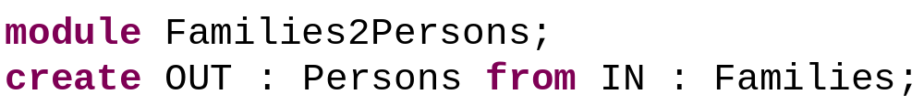
Families to Persons: header section
The header section names the transformation module and names the variables corresponding to the source and target models ("IN" and "OUT") together with their metamodels ("Persons" and "Families") acting as types. The header section of "Families2Persons" is:

Slide 22
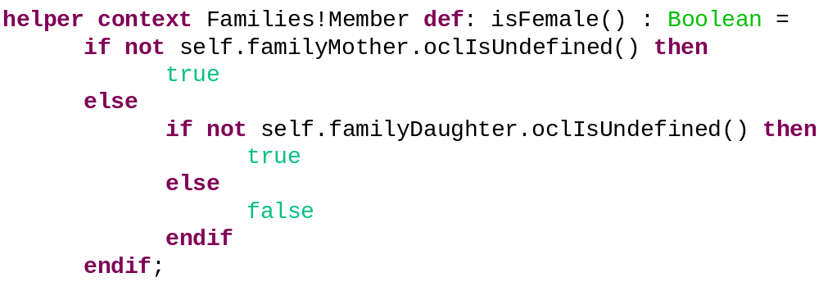
Families to Persons: helper "isFemale()"
A helper is an auxiliary function that computes a result needed in a rule.
The following helper "isFemale()" computes the gender of the current member:
Family
familyFather
father
Member
0..1
1
familyMother
mother
lastName : String
0..1
1
firstName : String
familySon
sons
0..1
*
familyDaughter
daughters
0..1
*

Slide 23
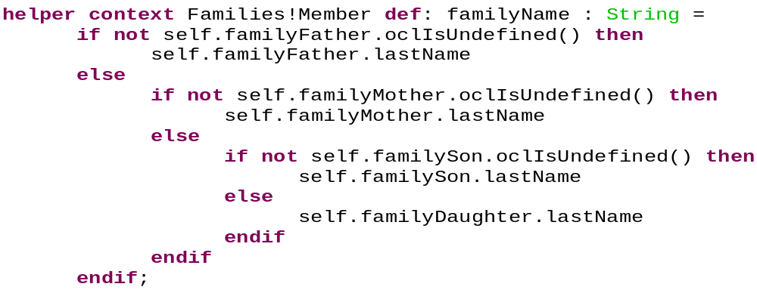
Families to Persons: helper "familyName"
The family name is not directly contained in class “Member”. The following helper returns the family name by navigating the relation between “Family” and “Member”:
Family
familyFather
father
Member
0..1
1
familyMother
mother
lastName : String
0..1
1
firstName : String
familySon
sons
0..1
*
familyDaughter
daughters
0..1
*

Slide 24
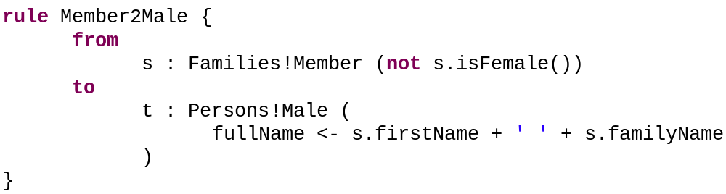
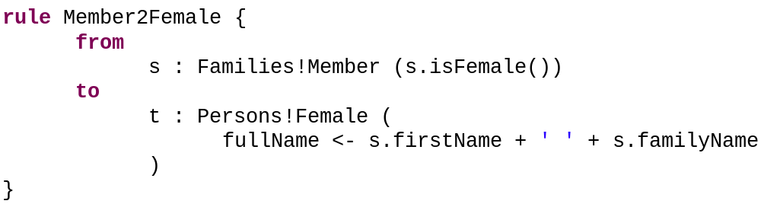
Families to Persons: writing the rules
After the helpers we now write the rules:
  Member to Male
  Member to Female

Slide 25
Summary of the Transformation
familyFather
father
For each instance of the class "Member" in the IN model, create an instance in the OUT model.
If the original "Member" instance is a "mother" or one of the "daughters" of a given "Family", then we create an instance of the "Female" class in the OUT model.
If the original "Member" instance is a "father" or one of the "sons" of a given "Family", then we create an instance of the "Male" class in the OUT model.
In both cases, the "fullname" of the created instance is the concatenation of the Member "firstName" and of the Family "lastName", separated by a blank.
Family
0..1
1
Member
familyMother
mother
lastName : String
0..1
1
firstName : String
familySon
sons
0..1
*
familyDaughter
daughters
0..1
*
+
If isFemale()
Female
Else
Male
Person
fullName : String
Male
Female

Slide 26
Families to Persons Architecture
Once the ATL transformation “Families2Persons” is created, we can execute it to build the OUT model.

Slide 27
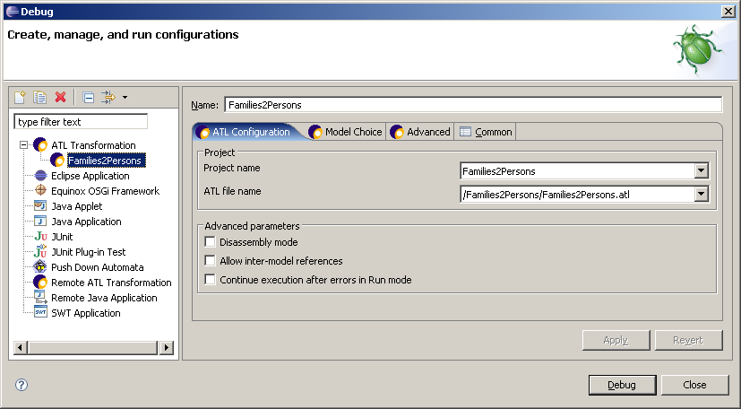
ATL Launch Configuration - 1

Slide 28
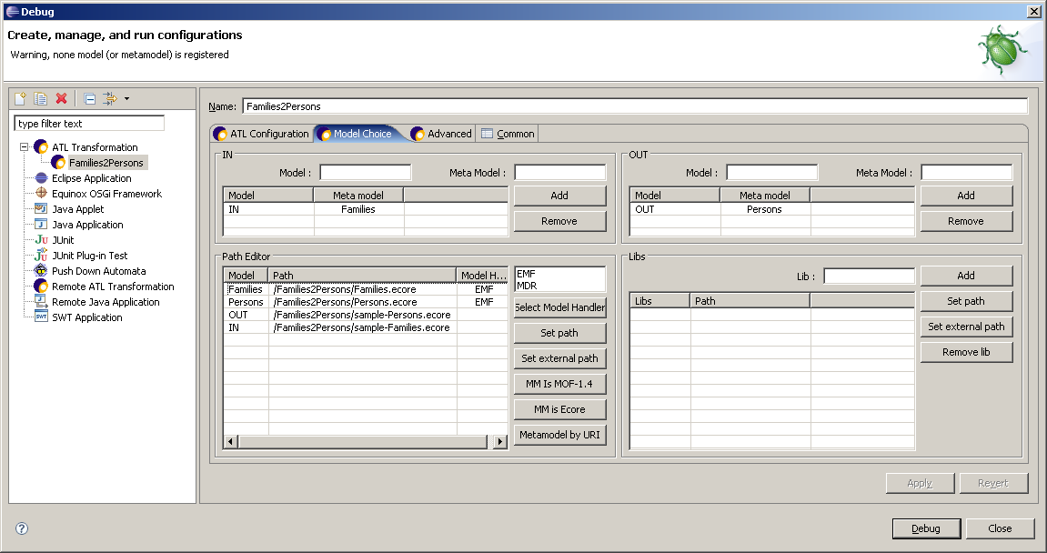
ATL Launch Configuration - 2

Slide 29
Summary
We have presented here a "hello world" level basic ATL transformation.
This is not a recommendation on how to program in ATL, just an initial example.
Several questions have not been answered
  Like how to transform a text into an XMI-encoded model.
  Or how to transform the XMI-encoded result into text.
For any further questions, see the documentation mentioned in the resource page (FAQ, Manual, Examples, etc.).

Slide 30
ATL Resource page
ATL Home page
  http://www.eclipse.org/m2m/atl/
ATL Documentation page
  http://www.eclipse.org/m2m/atl/doc/
ATL Newsgroup
  news://news.eclipse.org/eclipse.modeling.m2m
ATL Wiki
  http://wiki.eclipse.org/index.php/ATL

Slide 31
Working on the example
There are a lot of exercise questions that could be based on this simple example.
For example, modify the target metamodel as shown and compute the "grandParent" for any Person.
Person
fullName: String
grandParent
Male
Female

