Slide 1
CS793 Project:
Code Clones Visual Representation
Yu Sun, Frédéric Jouault
{yu.sun.cs, f.jouault}@gmail.com
12/5/2007

Slide 2
Goal
Realize an uniform visual representation for analysis results of different code clone detection tools by using Model-Driven Engineering

Slide 3
Sub-Objectives & Main Steps
Define specific DSLs for various kinds of code clone analysis results generated from different code clone detection tools, such as CCFinder, ClondDr, Simian, SimScan etc.
Define a generic DSL to represent code clones
Realize the transformation from specific code clone DSLs to the generic DSL
Transform the generic code clone DSL to Scalable Vector Graphics (SVG)

Slide 4
Step 1 - Preparation
Try some code clone detection tools to better understand this domain
Read a tutorial about SVG
Finish the project proposal

Slide 5
Step 2 – a DSL for a simple tool
Choose to first implement Simian
Understand the result
Define its KM3 Metamodel
Define its TCS syntax
Test Samples

Slide 6
Grammarware TS
Model-Driven Engineering (MDE)
Technical Space (TS)
M3
KM3
EBNF
M2
Output.g
Grammar
Clone Tools
Metamodel
M1
CloneTools
Output
Clone Tools
Model
Injection
M1 = terminal model level
M2 = metamodel level
M3 = meta-metamodel level

Slide 7
Step 3 – Define generic Code Clone DSL
Analyze the Simian and other tools again, get the generic concepts for the DSL
Define its KM3 metamodel

Slide 8
Grammarware TS
Model-Driven Engineering (MDE)
Technical Space (TS)
M3
KM3
EBNF
M2
Output.g
Grammar
Clone Tools
Metamodel
CodeClone
Metamodel
M1
CloneTools
Output
Clone Tools
Model
CodeClone
Model
Injection
M1 = terminal model level
M2 = metamodel level
M3 = meta-metamodel level

Slide 9
Step 4 – Transformation to generic DSL
Most of the mappings are very direct
Getting familiar with ATL and its debug

Slide 10
Grammarware TS
Model-Driven Engineering (MDE)
Technical Space (TS)
M3
KM3
EBNF
M2
Output.g
Grammar
Clone Tools
Metamodel
CodeClone
Metamodel
M1
CloneTools
Output
Clone Tools
Model
CodeClone
Model
Injection
Output2CdeClone
Transformation
M1 = terminal model level
M2 = metamodel level
M3 = meta-metamodel level

Slide 11
Step 5 – Understand later part transformation
Referred to two samples
  Table to SVGPieChart
  Table to SVGBarChart
http://www.eclipse.org/m2m/atl/atlTransformations/

Slide 12
Step 6 – Learning SVG and XML
Introduction to XML Doug Tidwell IBM
Some online tutorials about SVG and examples

Slide 13
Step 7 – Design my SVG representation for code clone
Try to make the representation concise and clear
Write the SVG code for a specific clone group
Calculate the location for each element

Slide 14
Step 8 – Define SVG
Define SVG KM3 Metamodel
An already defined metamodel in AM3 Zoo
But it is too big, not necessary
Define SVG metamodel by myself

Slide 15
Grammarware TS
Model-Driven Engineering (MDE)
Technical Space (TS)
M3
KM3
EBNF
M2
Output.g
Grammar
Clone Tools
Metamodel
CodeClone
Metamodel
SVG
Metamodel
M1
CloneTools
Output
Clone Tools
Model
CodeClone
Model
SVG
Model
Injection
Output2CodeClone
Transformation
M1 = terminal model level
M2 = metamodel level
M3 = meta-metamodel level

Slide 16
Step 9 – Transformation from CodeClone to SVG
Most difficult and time-consuming part of the project
Two different domains
Difficulties in using ATL
Referred to Table to SVG example
Problem: Total number of lines is not available

Slide 17
Grammarware TS
Model-Driven Engineering (MDE)
Technical Space (TS)
M3
KM3
EBNF
M2
Output.g
Grammar
Clone Tools
Metamodel
CodeClone
Metamodel
SVG
Metamodel
M1
CloneTools
Output
Clone Tools
Model
CodeClone
Model
SVG
Model
Injection
Output2CodeClone
Transformation
CodeClone2SVG
Transformation
M1 = terminal model level
M2 = metamodel level
M3 = meta-metamodel level

Slide 18
Step 10 – Transformation from SVG to XML
XML Metamodel is already available
Referred to an example SVG to XML

Slide 19
Grammarware TS
Model-Driven Engineering (MDE)
Technical Space (TS)
XML TS
M3
KM3
XSD.xsd
EBNF
M2
Output.g
Grammar
Clone Tools
Metamodel
CodeClone
Metamodel
SVG
Metamodel
XML
Metamodel
SVG.xsd
SVG Schema
M1
CloneTools
Output
Clone Tools
Model
CodeClone
Model
SVG
Model
XML
Model
Output.xml
SVG Code
Injection
Output2CodeClone
Transformation
CodeClone2SVG
Transformation
SVG2XML
Transformation
Extraction
M1 = terminal model level
M2 = metamodel level
M3 = meta-metamodel level

Slide 20
Step 11 – Test the whole process
Tried different input model to verify the correctness of transformations
Modified the positions of the elements in the final graph
Modified the Metamodel and TCS for Simian to add some file information in the end of the input

Slide 21
Step 12 – Adding FileInfo DSL
Define KM3 and TCS for FileInfo
Make Simian & FileInfo as the input to the CodeClone Transformation

Slide 22
Grammarware TS
Model-Driven Engineering (MDE)
Technical Space (TS)
XML TS
M3
KM3
XSD.xsd
EBNF
M2
Output.g
Grammar
FileInfo.g
Grammar
Clone Tools
Metamodel
FileInfo
Metamodel
CodeClone
Metamodel
SVG
Metamodel
XML
Metamodel
SVG.xsd
SVG Schema
M1
CloneTools
Output
File
Information
Clone Tools
Model
FileInfo
Model
CodeClone
Model
SVG
Model
XML
Model
Output.xml
SVG Code
Injection
Output2CodeClone
Transformation
CodeClone2SVG
Transformation
SVG2XML
Transformation
Extraction
M1 = terminal model level
M2 = metamodel level
M3 = meta-metamodel level

Slide 23
Step 13 – Support a new clone tool SimScan
Define the KM3 and TCS
Transformation to CodeClone
Test

Slide 24
Step 14 – Another kind of Representation
Design the graph and calculate the position
Write the ATL transformation CodeClone2SVG2

Slide 25
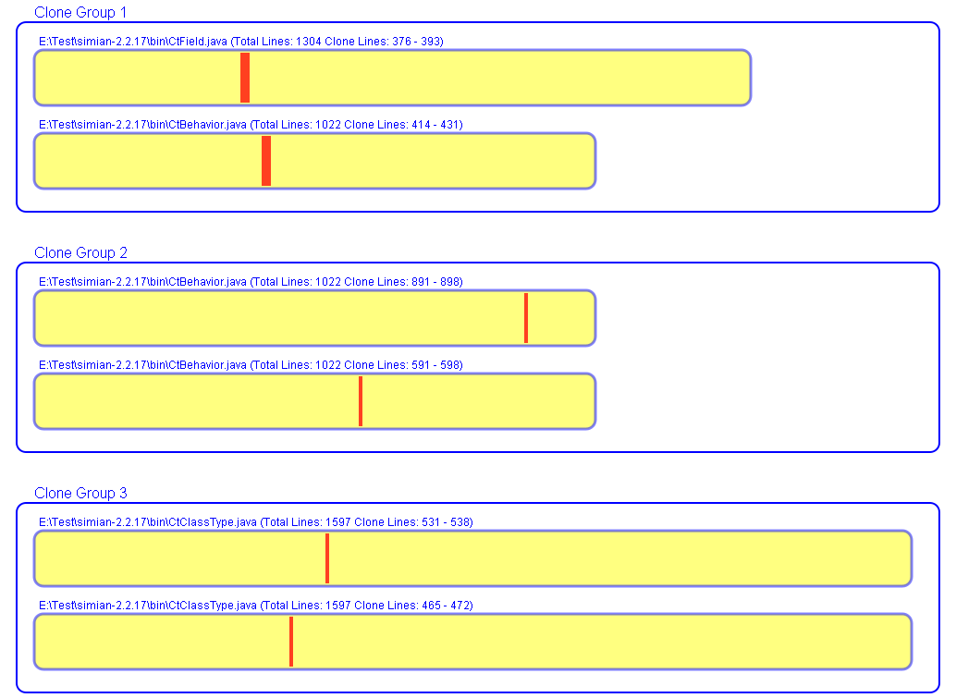

Slide 26
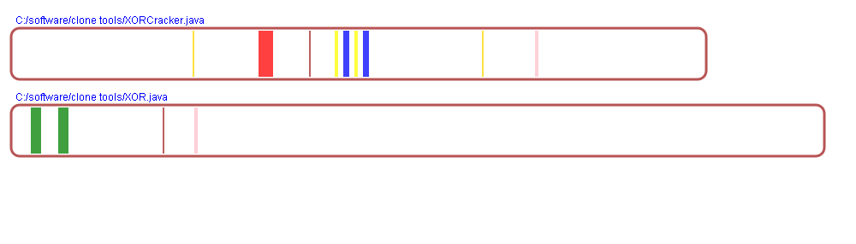

Slide 27
Step 15 – Megamodel Graph
Better understand the whole picture and structure

Slide 28
Grammarware TS
Model-Driven Engineering (MDE)
Technical Space (TS)
XML TS
M3
KM3
XSD.xsd
EBNF
M2
Output.g
Grammar
FileInfo.g
Grammar
Clone Tools
Metamodel
FileInfo
Metamodel
CodeClone
Metamodel
SVG
Metamodel
XML
Metamodel
SVG.xsd
SVG Schema
M1
CloneTools
Output
File
Information
Clone Tools
Model
FileInfo
Model
CodeClone
Model
SVG
Model
XML
Model
Output.xml
SVG Code
Injection
Output2CodeClone
Transformation
CodeClone2SVG
Transformatio
(Two Forms)
SVG2XML
Transformation
Extraction
M1 = terminal model level
M2 = metamodel level
M3 = meta-metamodel level

Slide 29
Step 16 – Ant scripts
Simian2Visual
SimScan2Visual

Slide 30
Step 17 – Support CloneDr
A new version of CloneDr offers a good output file for this project
Finished its KM3, TCS, ATL

Slide 31
Future work
Improve the parsing of the input result
  Some parts of the input is deleted
  Some inputs are too complex to parse
Improve the details of the visual representation
Step 19 – Write the paper

Slide 32
Thank you!!!

