Slide 1

The CDO Model Repository
Perfect for the Enterprise
Eike Stepper
stepper@esc-net.de
http://www.esc-net.de
http://thegordian.blogspot.com
Berlin, Germany
Enterprise Modeling Day, Zurich, October 28, 2010

Slide 2
EMF Application
Huge models require lots of smaller files
Partitioning must be done at design time
Saving changes is not transactional safe
Loading single objects is still impossible
Garbage collection of objects is impossible
Conflicts must be resolved in text form
No change notifications to other clients
The CDO Model Repository - Perfect for the Enterprise
© 2010 by Eike Stepper, Berlin, Germany. Made available under the EPL v1.0

Slide 3
EMF Application
Does not scale well
Not suitable for multi-user
The CDO Model Repository - Perfect for the Enterprise
© 2010 by Eike Stepper, Berlin, Germany. Made available under the EPL v1.0

Slide 4
EMF Application
EMF Application
EMF Application
Model Repository
The CDO Model Repository - Perfect for the Enterprise
© 2010 by Eike Stepper, Berlin, Germany. Made available under the EPL v1.0

Slide 5
Modify
EMF Application
EMF Application
EMF Application
Model Repository
The CDO Model Repository - Perfect for the Enterprise
© 2010 by Eike Stepper, Berlin, Germany. Made available under the EPL v1.0

Slide 6
EMF Application
Commit
EMF Application
EMF Application
Model Repository
The CDO Model Repository - Perfect for the Enterprise
© 2010 by Eike Stepper, Berlin, Germany. Made available under the EPL v1.0

Slide 7
EMF Application
EMF Application
EMF Application
Invalidate
Model Repository
The CDO Model Repository - Perfect for the Enterprise
© 2010 by Eike Stepper, Berlin, Germany. Made available under the EPL v1.0

Slide 8
EMF Application
EMF Application
EMF Application
Invalidate
Model Repository
The CDO Model Repository - Perfect for the Enterprise
© 2010 by Eike Stepper, Berlin, Germany. Made available under the EPL v1.0

Slide 9
EMF Application
EMF Application
EMF Application
Load
Model Repository
The CDO Model Repository - Perfect for the Enterprise
© 2010 by Eike Stepper, Berlin, Germany. Made available under the EPL v1.0

Slide 10
EMF Application
EMF Application
EMF Application
Load
Model Repository
The CDO Model Repository - Perfect for the Enterprise
© 2010 by Eike Stepper, Berlin, Germany. Made available under the EPL v1.0

Slide 11
Non Auditing
EMF Application
Auditing
Branching
EMF Application
EMF Application
Storage
Backend
Model Repository
The CDO Model Repository - Perfect for the Enterprise
© 2010 by Eike Stepper, Berlin, Germany. Made available under the EPL v1.0

Slide 12

BookImpl
Native
Models
String title
int pages
Category category
Writer author
String title
int pages
Category category
Writer author
Dynamic
Models
Legacy
Models
The CDO Model Repository - Perfect for the Enterprise
© 2010 by Eike Stepper, Berlin, Germany. Made available under the EPL v1.0

Slide 13
P E R S I S T E N T
attach to transaction
NEW
commit
commit
DIRTY
TRANSIENT
remote
invalidate
CLEAN
write
detach from transaction
remote
invalidate
read
PROXY
CONFLICT
rollback
The CDO Model Repository - Perfect for the Enterprise
© 2010 by Eike Stepper, Berlin, Germany. Made available under the EPL v1.0

Slide 14
Client / Server
Client
Application
Server
CDOSession
ISession
IRepository
IStore
DB
The CDO Model Repository - Perfect for the Enterprise
© 2010 by Eike Stepper, Berlin, Germany. Made available under the EPL v1.0

Slide 15
Embedded Repository
Client
Application
CDOSession
ISession
IRepository
IStore
DB
The CDO Model Repository - Perfect for the Enterprise
© 2010 by Eike Stepper, Berlin, Germany. Made available under the EPL v1.0

Slide 16
Embedded Session
Server
Logic
CDOSession
ISession
IRepository
IStore
DB
The CDO Model Repository - Perfect for the Enterprise
© 2010 by Eike Stepper, Berlin, Germany. Made available under the EPL v1.0

Slide 17
Offline Clone (Embedded)
Client
Application
CDOSession
ISession
OfflineClone
Synchronizer
Server
IStore
CDOSession
ISession
MasterRepository
DB
IStore
DB
The CDO Model Repository - Perfect for the Enterprise
© 2010 by Eike Stepper, Berlin, Germany. Made available under the EPL v1.0

Slide 18
Offline Clone (Group Server)
Client
Application
Clone Server
CDOSession
ISession
OfflineClone
Synchronizer
Master Server
IStore
CDOSession
ISession
MasterRepository
DB
IStore
DB
The CDO Model Repository - Perfect for the Enterprise
© 2010 by Eike Stepper, Berlin, Germany. Made available under the EPL v1.0

Slide 19
Fail-Over Monitor (1)
??? Server
??? Server
CDOSession
CDOSession
FO-Agent
FO-Agent
Repository
Repository
IStore
FO-Monitor
IStore
DB
DB
The CDO Model Repository - Perfect for the Enterprise
© 2010 by Eike Stepper, Berlin, Germany. Made available under the EPL v1.0

Slide 20
Fail-Over Monitor (2)
Master Server
Backup Server
CDOSession
CDOSession
FO-Agent
FO-Agent
Repository
Repository
IStore
FO-Monitor
IStore
DB
DB
The CDO Model Repository - Perfect for the Enterprise
© 2010 by Eike Stepper, Berlin, Germany. Made available under the EPL v1.0

Slide 21
Fail-Over Session
Client
Application
FO-Session
Master Server
Backup Server
CDOSession
CDOSession
FO-Agent
FO-Agent
Repository
Repository
IStore
FO-Monitor
IStore
DB
DB
The CDO Model Repository - Perfect for the Enterprise
© 2010 by Eike Stepper, Berlin, Germany. Made available under the EPL v1.0

Slide 22
Offline Workspace (Checkout)
Client
Application
CDOWorkspace
The CDO Model Repository - Perfect for the Enterprise
© 2010 by Eike Stepper, Berlin, Germany. Made available under the EPL v1.0

Slide 23
Offline Workspace (Checkout)
Client
Application
CDOWorkspace
Local Session
Local Repository
IStore
DB
The CDO Model Repository - Perfect for the Enterprise
© 2010 by Eike Stepper, Berlin, Germany. Made available under the EPL v1.0

Slide 24
Offline Workspace (Checkout)
Client
Application
Server
CDOWorkspace
Remote Session
ISession
Local Session
Remote Repository
Local Repository
IStore
IStore
DB
DB
The CDO Model Repository - Perfect for the Enterprise
© 2010 by Eike Stepper, Berlin, Germany. Made available under the EPL v1.0

Slide 25
CDO is a runtime technology.
People embed it into their products.
Persistent data must be kept safe and consistent.
All functionality must scale well with model size.
All components must be customizeable.
All default implementations should perform well.
The CDO Model Repository - Perfect for the Enterprise
© 2010 by Eike Stepper, Berlin, Germany. Made available under the EPL v1.0

Slide 26
CDO Core Features
The CDO Model Repository - Perfect for the Enterprise
© 2010 by Eike Stepper, Berlin, Germany. Made available under the EPL v1.0

Slide 27
Distribution
Various ways to set up an IRepository
  XML config file, programmatically, Spring, …
  OSGi, stand-alone, …
  All components customizeable
Various ways to open a CDOSession
  Net4j: TCP, HTTP, embedded, …
  CDO: embedded
  Other transports possible
Offline mode
  Cloned and sync’ed repository, normal sessions
The CDO Model Repository - Perfect for the Enterprise
© 2010 by Eike Stepper, Berlin, Germany. Made available under the EPL v1.0

Slide 28
Persistence
Pluggable storage backend adapters (IStores)
  DBStore (CDO’s own O/R mapper)
  HibernateStore / Teneo
  ObjectivityStore
  DB4OStore
  MEMStore
Changing the store type does not affect
client applications!
The CDO Model Repository - Perfect for the Enterprise
© 2010 by Eike Stepper, Berlin, Germany. Made available under the EPL v1.0

Slide 29
Resources
A CDOResource is an EObject
A repository contains CDOResourceNodes
  CDOResourceFolders
  CDOResources
  CDOTextResource (coming soon)
  CDOBinaryResource (coming soon)
The resource tree is
  Navigable through EMF
  Queryable through CDO
The CDO Model Repository - Perfect for the Enterprise
© 2010 by Eike Stepper, Berlin, Germany. Made available under the EPL v1.0

Slide 30
Versioning
CDO supports record temporality
  Must be supported by IStore
  Can be configured per IRepository
CDO supports branching
  Must be supported by IStore
  Can be configured per IRepository
A CDOView provides consistent graphs
  From a particular branch
  From a particular point in time
The CDO Model Repository - Perfect for the Enterprise
© 2010 by Eike Stepper, Berlin, Germany. Made available under the EPL v1.0

Slide 31
Scalability
Lazy loading at object granule
Lazy loading without container object
Partial collection loading, chunking
Adaptive prefetching
Manual prefetching
Automatic unloading at object granule
On demand streaming of large objects
The CDO Model Repository - Perfect for the Enterprise
© 2010 by Eike Stepper, Berlin, Germany. Made available under the EPL v1.0

Slide 32
Queries
CDO includes a generic query framework
  Supports any query language
  Supports named parameters
  Supports synchronous execution
  Supports asynchronous execution
Query language handlers can be
  plugged into an IRepository
  implemented by an IStore (SQL, HQL, custom, …)
Handlers provided for OCL and XRefs
The CDO Model Repository - Perfect for the Enterprise
© 2010 by Eike Stepper, Berlin, Germany. Made available under the EPL v1.0

Slide 33
Transactionality
Strong transactional safety at model-level
Multiple transactions per session
Multiple save points per transaction
Rollback to any save point
Commit with progress monitoring
Hooks for custom transaction handlers
Conflict detection and fail-early-transactions
Pluggable conflict resolvers
Explicit read/write locking on object granule
XA transactions to multiple repositories
The CDO Model Repository - Perfect for the Enterprise
© 2010 by Eike Stepper, Berlin, Germany. Made available under the EPL v1.0

Slide 34
Collaboration
Passive Updates
  Asynchronous commit notifications
  Invalidation of objects, lazy reload if needed
  Can be switched off per session
Change subscriptions
  Asynchronous change delta delivery
  Registration with repository per object/adapter
  Automated through pluggable adapter policies
Remote session manager
  Notifies about state of other sessions
  Supports sending/receiving of arbitrary messages
The CDO Model Repository - Perfect for the Enterprise
© 2010 by Eike Stepper, Berlin, Germany. Made available under the EPL v1.0

Slide 35
Integration
Integrates with EMF at the model level,
not at the edit- or UI-level.
Uninvasive to the .ecore file.
Best results with regenerated models (native)
Regeneration not needed (legacy mode)
Dynamic models supported
Multiple repositories per ResourceSet
External references
The CDO Model Repository - Perfect for the Enterprise
© 2010 by Eike Stepper, Berlin, Germany. Made available under the EPL v1.0

Slide 36
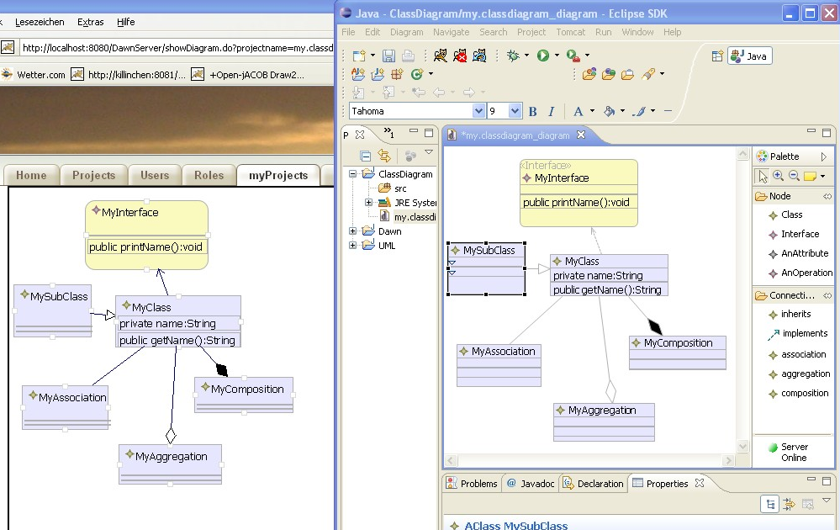
Dawn – Rise of Graphical Collaboration
The CDO Model Repository - Perfect for the Enterprise
© 2010 by Eike Stepper, Berlin, Germany. Made available under the EPL v1.0

Slide 37
Dawn – Rise of Graphical Collaboration
  Conflict handling
    Dawn provides detection and handling mechanisms for conflicts
    It will build on the CDO conflict mechanisms and provide flexible and intuitive UI to handle conflicts
    Conflicts are displayed inside the diagram editor. Conflicts that cannot be visualized inside the editor will be show in a special view (Dawn Conflict View)
  Locking
    Dawn will support locking on different hierarchy levels in the GMF diagram
    Locked objects are marked with special visualisations
  WebViewer/WebEditor
    Dawn provides a web viewer to view changes in the diagram while they are processed in Eclipse
    It also will support changing the diagram (adding/deleting/manipulating) in a browser
    Allows editing GMF-diagrams on mobile devices even if no Java platform is installed
The CDO Model Repository - Perfect for the Enterprise
© 2010 by Eike Stepper, Berlin, Germany. Made available under the EPL v1.0

Slide 38
Dawn – Rise of Graphical Collaboration
  Do not change existing code
    A dynamic design and a flexible generator will make it possible to “collaborate” existing GMF editors even if the source is
    Existing editor do not need to modified
  Firewall transparency mode
    Allows to operate from within restricted networks
    This mode will use a web-based protocol on CDO
  Network independence (Offline Mode)
    Using one of the latest CDO features (offline support) Dawn will allow modifying GMF diagrams without a repository connection.
  Authentication/Authorization
    Providing access rights on diagram level will allow to protect your model data
    Additionally the use of the diagram (show, modify, view) will be restrictable. Locking behaviour can also be influenced.
The CDO Model Repository - Perfect for the Enterprise
© 2010 by Eike Stepper, Berlin, Germany. Made available under the EPL v1.0

