Slide 1
CDO Model Repository
A Model Repository for EMF
A Framework for Distributed Shared Models

Slide 2
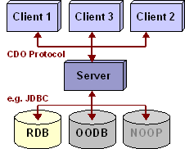
CDO Model Repository | © 2008 by Eike Stepper, Berlin, Germany | Made available under the EPL v1.0

Slide 3



Application
EStore
EObject
CDOView
CDORevision
CDOSession
strong ref
soft/weak ref
Repository
foreign key
CDO Model Repository | © 2008 by Eike Stepper, Berlin, Germany | Made available under the EPL v1.0

Slide 4


PERSISTENT
TRANSIENT
attach
NEW
commit
commit
DIRTY
detach
CLEAN
write
invalidate
invalidate
read
PROXY
CONFLICT
reload
CDO Model Repository | © 2008 by Eike Stepper, Berlin, Germany | Made available under the EPL v1.0

