Slide 1
CDO Model Repository
A Model Repository for EMF
A Framework for Distributed Shared Models

Slide 2
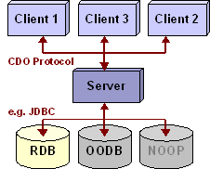

Slide 3
Application
EStore
EObject
CDOView
CDORevision
CDOSession
strong ref
Repository
soft/weak ref
foreign key

Slide 4
PERSISTENT
TRANSIENT
attach
NEW
commit
commit
DIRTY
detach
CLEAN
write
invalidate
invalidate
read
PROXY
CONFLICT
reload

