Slide 1
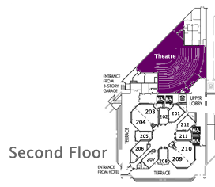

Connected Data Objects (CDO)
The EMF Model Repository

Slide 2
Agenda
Introduction
Live Demonstrations
Detailed Architecture
Programming Examples
Advanced Features
Open Discussion
≤ 5 minutes
≤ 15 minutes
≤ 5 minutes
≤ 10 minutes
≤ 5 minutes
≥ 10 minutes
______________
~ 50 minutes

Slide 3
Introduction
≤ 5 minutes
About the Author
EMF Intro
EMF Persistence Framework
Issues with XML Files
Distributed Shared Models
What is CDO About?

Slide 4
About the Author
Introduction
Eike Stepper, Germany, Berlin
Born in 1970
Started programming in 1983
Studied mathematics and computer science
Founded first company ES-Computersysteme in 1991
Consulting in dozens of IT projects
First orthogonally persistent system in 2000 (C++)
First version of CDO in 2003
Contribution of CDO to Eclipse.org in 2004
Complete rewrite with new design in 2007

Slide 5
EMF Intro
Introduction
With EMF you can (out of the box)
Create Ecore models
Configure generator models
Generate Java code for
Your Ecore model
Command framework
Eclipse UI (creation wizard and model editor)
Use the EMF persistence framework to
Serialize model instances to XML files
Deserialize model instances from XML files
Resolve model references across files
And many, many other things…

Slide 6
EMF Persistence Framework
Introduction
Resource
A named container for model instances
URI + Contents
Resource.Factory
Creates specialized resource instances
Default is XML / XMI
ResourceSet
Container for a set of resource instances
Package registry for resolving model references
URI converter for resolving resource URIs

Slide 7
Issues with XML Files
Introduction
Limited resource size
No lazy loading of instances
No lazy loading of lists
No unloading of instances
Bad influence on garbage collection
Influence on model design (containment)
No concurrent modification of resources
No fine grained locking
No transactions
No remote update notification
Just don’t behave like multi user databases

Slide 8
Distributed Shared Models
Introduction
Central persistent model repository
Contains all models (packages and classes)
Contains all instances (resources and regular objects)
Represents a potentially huge object graph in form of containment trees scattered across resources
Manages remote client sessions
Multiple remote clients share a common view of the central persistent models and instances
Represent partial views of the overall object graph
Concurrently alter the state of the object graph
Are immediately notified about modifications that happened in the context of other sessions

Slide 9
What is CDO About?
Introduction
Overcomes all the issues with XML files
Provides distributed shared models for EMF
Integrates with the EMF persistence framework
Uses Net4j to implement a network protocol
Configures multiple repositories on the server
Connects with heterogeneous back ends
Uses OSGi at client and server side
By the way
“Connected” indicates that objects in a client session always stay connected with their repository pendants

Slide 10
Live Demonstrations
≤ 15 minutes
Developing a CDO Model
Setting Up a CDO Server
Using the CDO Client

Slide 11
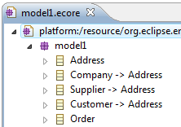
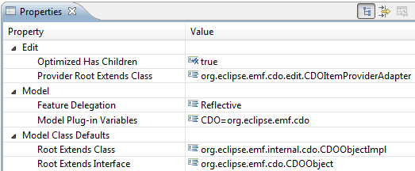
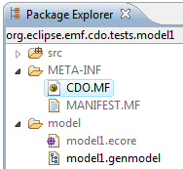
Developing a CDO Model
Live Demonstrations
Create an Ecore model
Just as you are used to it
No additional expenses to be met
Derive a generator model
Use the CDO Importer or the CDO Migrator
Do it manually

Slide 12
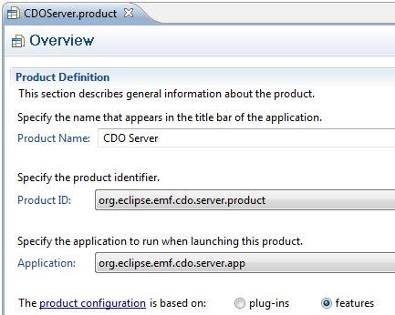
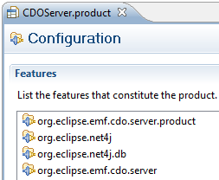
Setting Up a CDO Server
Live Demonstrations

Slide 13
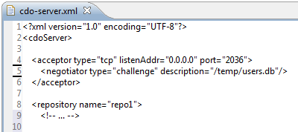
Setting Up a CDO Server
Live Demonstrations

Slide 14
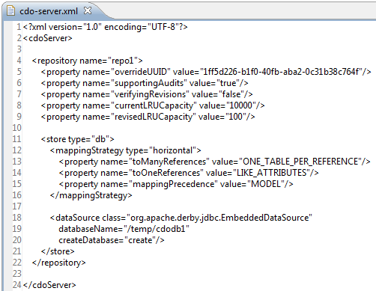
Setting Up a CDO Server
Live Demonstrations

Slide 15
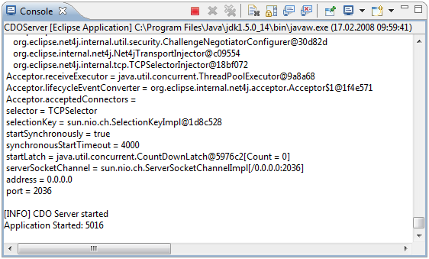
Setting Up a CDO Server
Live Demonstrations

Slide 16
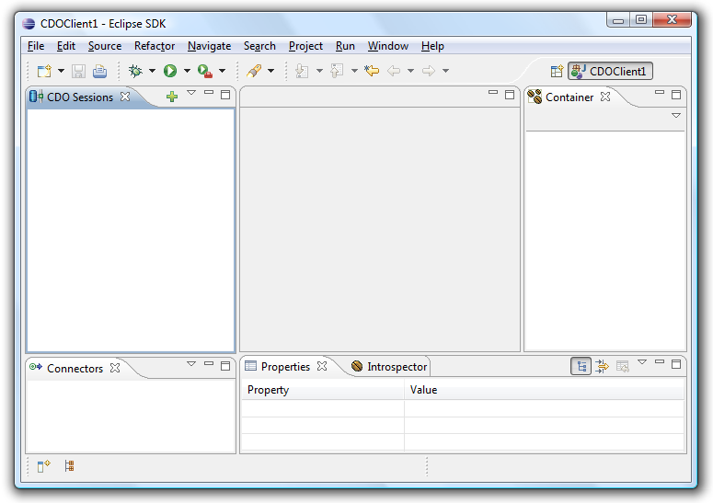
Using the CDO Client
Live Demonstrations

Slide 17
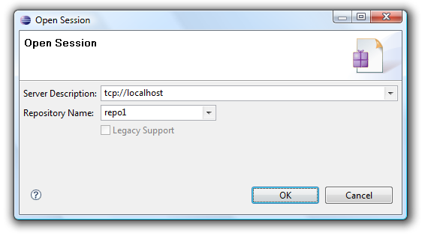
Using the CDO Client
Live Demonstrations

Slide 18
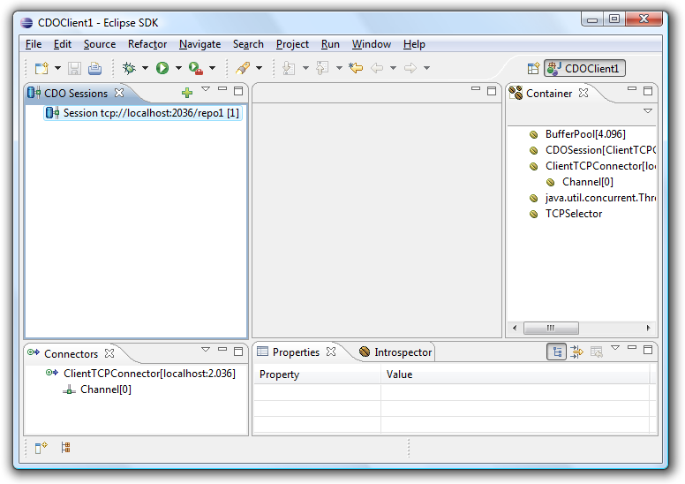
Using the CDO Client
Live Demonstrations

Slide 19
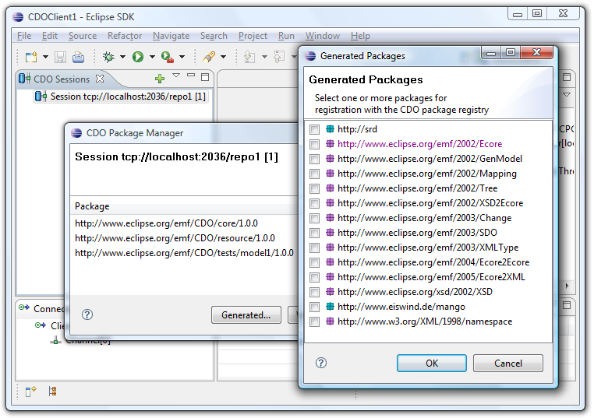
Using the CDO Client
Live Demonstrations

Slide 20
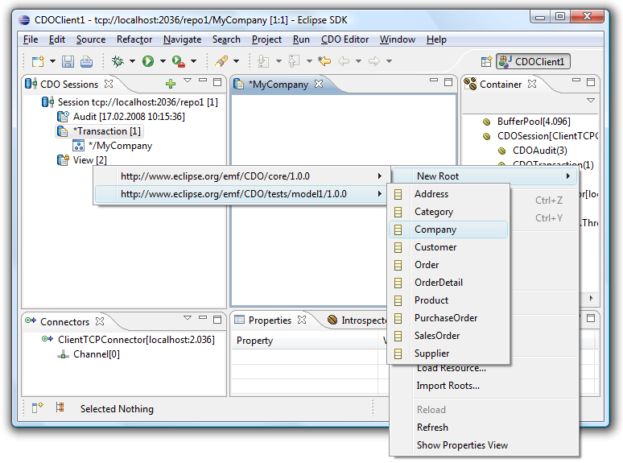
Using the CDO Client
Live Demonstrations

Slide 21
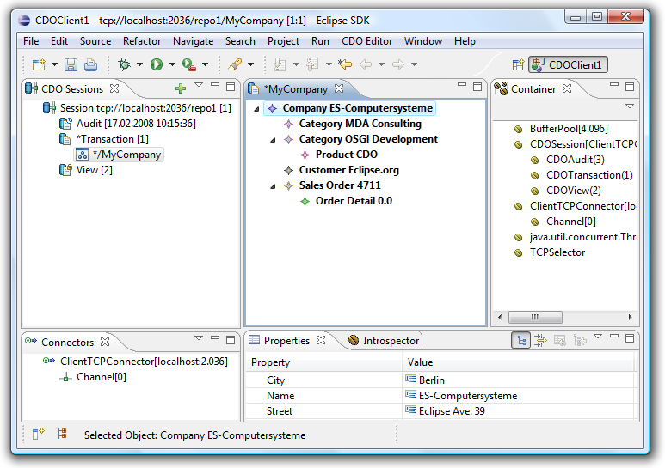
Using the CDO Client
Live Demonstrations

Slide 22
Detailed Architecture
≤ 5 minutes
Deployment Options
Networked Remote Server
Embedded Server
Static Decomposition
Server Components
Client Components
Component Interaction
Committing a Transaction
Demand Loading Objects

Slide 23
Deployment Options - Networked
Detailed Architecture
Client Applications
CDO Store
CDO Client
CDO Server
CDO Protocol
CDO Protocol
Generated Models
EMF
Net4j TCP
Net4j TCP
Backend
Net4j
Net4j
OSGi / Eclipse
OSGi / Eclipse

Slide 24
Deployment Options - Embedded
Detailed Architecture
Client Applications
CDO Store
CDO Client
CDO Server
CDO Protocol
Generated Models
EMF
Net4j JVM
Backend
Net4j
OSGi / Eclipse

Slide 25
Static Decomposition - Server
Detailed Architecture
IRepository
IStore
creates
IStoreAccessors
IPackageManager
CDOPackages
IRevisionManager
CDORevisions
IResourceManager
Path Mappings
ISessionManager
ISessions

Slide 26
Static Decomposition: Client
Detailed Architecture
CDOSession
CDOPackageManager
CDOPackages
CDORevisionManager
CDORevisions
CDOViews
CDOObjects
extends
CDOTransactions
Deltas

Slide 27
Component Interaction – CDOStateMachine (1)
Detailed Architecture
PERSISTENT
TRANSIENT
attach
NEW
commit
DIRTY
detach
CLEAN
write
read
PROXY
CONFLICT
invalidate
reload

Slide 28
Component Interaction – CDOStateMachine (2)
Detailed Architecture
PERSISTENT
TRANSIENT
attach
NEW
With Temp CDOID
detach
No CDOID
No CDOView
No CDORevision (state is in object)
With CDOID
With CDOView
With CDORevision (state is in revision)

Slide 29
Component Interaction - Committing
Detailed Architecture
Client
Client adds/modifies CDOObjects
Client transaction creates temporary IDs for new objects and records change deltas
Commit() sends new packages, new revisions and revision deltas to the server
Server passes data to the configured store
Store remaps temporary IDs and persists the data
Server sends back ID mappings
Server notifies other sessions about invalidations
Client transaction applies ID mappings
Server
Client

Slide 30
Component Interaction – Demand Loading
Detailed Architecture
Client
Client accesses an EReference
CDORevision delivers target CDOID
CDOView looks up target CDOObject
Found → Finished
CDORevisionManager looks up CDORevision
Found → Creates new CDOObject, links it with revision, finished
CDORevisionManager sends LoadRevisionRequest
IRevisionManager looks up CDORevision
If not found → Loads CDORevision from IStore and caches it
IRevisionManager sends back CDORevision to client
CDORevisionManager caches CDORevision
Creates new CDOObject, links it with revision, finished
Server
Client

Slide 31
Programming
≤ 10 minutes
Using a Managed Container
Using the Server API
Using the Client API

Slide 32
Using a Managed Container (1)
Programming
public interface IManagedContainer extends IContainer<Object>
{
public IRegistry<IFactoryKey, IFactory> getFactoryRegistry();
public IManagedContainer registerFactory(IFactory factory);
public List<IElementProcessor> getPostProcessors();
public void addPostProcessor(IElementProcessor postProcessor, boolean processExistingElements);
public void addPostProcessor(IElementProcessor postProcessor);
public void removePostProcessor(IElementProcessor postProcessor);
public Set<String> getProductGroups();
public Set<String> getFactoryTypes(String productGroup);
public IFactory getFactory(String productGroup, String factoryType);
public Object putElement(String productGroup, String factoryType, String description, Object element);
public Object removeElement(String productGroup, String factoryType, String description);
public Object getElement(String productGroup, String factoryType, String description);
public Object[] getElements(String productGroup, String factoryType);
public Object[] getElements(String productGroup);
public String[] getElementKey(Object element);
public void clearElements();
public void loadElements(InputStream stream) throws IOException;
public void saveElements(OutputStream stream) throws IOException;
}

Slide 33
Using a Managed Container (2)
Programming
<plugin>
<extension
point="org.eclipse.net4j.util.factories">
<factory
class="org.eclipse.net4j.internal.tcp.TCPAcceptorFactory"
productGroup="org.eclipse.net4j.acceptors"
type="tcp"/>
<factory
class="org.eclipse.net4j.internal.tcp.TCPConnectorFactory"
productGroup="org.eclipse.net4j.connectors"
type="tcp"/>
<factory
class="org.eclipse.net4j.internal.tcp.TCPSelectorFactory"
productGroup="org.eclipse.net4j.selectors"
type="tcp"/>
</extension>
<extension
point="org.eclipse.net4j.util.elementProcessors">
<elementProcessor
class="org.eclipse.net4j.internal.tcp.TCPSelectorInjector">
</elementProcessor>
</extension>
</plugin>

Slide 34
Using a Managed Container (3)
Programming
1 IManagedContainer container = IPluginContainer.INSTANCE;
2
3 IConnector connector = (IConnector)container.getElement(
4 “org.eclipse.net4j.connectors”,
5 “tcp”,
6 “localhost:2036”);
> TCPSelector [debug.lifecycle.dump] DUMP TCPClientConnector@8
> Connector.userID = null
> Connector.negotiator = null
> Connector.negotiationContext = null
> Connector.bufferProvider = BufferPool[4.096]
> Connector.receiveExecutor = java.util.concurrent.ThreadPoolExecutor@dd7404
> Connector.nextChannelID = 1
> Connector.connectorState = CONNECTED
> TCPConnector.selector = TCPSelector
> TCPConnector.controlChannel = Channel[Control]
> TCPConnector.host = localhost
> TCPConnector.port = 2036

Slide 35
Using a Managed Container (4)
Programming
// Turn on tracing
OMPlatform.INSTANCE.setDebugging(true);
// Prepare the standalone infra structure
// Not needed when running inside Eclipse
IManagedContainer container = ContainerUtil.createContainer();
Net4jUtil.prepareContainer(container); // Prepare the Net4j kernel
JVMUtil.prepareContainer(container); // Prepare the JVM transport
CDOServerUtil.prepareContainer(container); // Prepare the CDO server
CDOUtil.prepareContainer(container, false); // Prepare the CDO client
// Start the JVM transport
IAcceptor acceptor = JVMUtil.getAcceptor(container, "default");
// Open a JVM connection
IConnector connector = JVMUtil.getConnector(container, "default");

Slide 36
Using the Server API
Programming
// Prepare store parameters
IMappingStrategy strategy = CDODBUtil.createMappingStrategy("horizontal");
IDBAdapter adapter = DBUtil.getDBAdapter("mysql");
IConnectionProvider provider = DBUtil.createConnectionProvider(dataSource);
// Create a DBStore
IStore store = CDODBUtil.createStore(strategy, adapter, provider);
// Create a repository
Map<String, String> props = new HashMap<String, String>();
props.put(Props.PROP_SUPPORTING_REVISION_DELTAS, "true");
props.put(Props.PROP_CURRENT_LRU_CAPACITY, "10000");
props.put(Props.PROP_REVISED_LRU_CAPACITY, "10000");
IRepository repository = CDOServerUtil.createRepository("repo", store, props);
// Start the repository
CDOServerUtil.addRepository(container, repository);

Slide 37
Using the Client API
Programming
// Open an embedded connection
IConnector connector = JVMUtil.getConnector(container, "default");
// Open a session and register the model
CDOSession session = CDOUtil.openSession(connector, “repo", true);
session.getPackageRegistry().putEPackage(Model1Package.eINSTANCE);
// Start a transaction and create a resource
CDOTransaction transaction = session.openTransaction();
Resource resource = transaction.createResource("/my/big/resource");
// Work normally with the EMF resource
resource.getContents().add(getInputModel());
transaction.commit();
// Cleanup
session.close();
connector.disconnect();

Slide 38
Advanced Features
≤ 5 minutes
Models
Optimizations
Network Protocol
Server Side
DB Store

Slide 39
Models
Advanced Features
Support for dynamic models
just load .ecore file and commit to repository
Support for legacy models
for compiled models without access to .genmodel

Slide 40
Optimizations
Advanced Features
Sharing of objects between views/transactions
Modeled state resides in the session
Demand loading and unloading of objects
Containment does not prevent laziness
Transmission of only change deltas
Currently from client to server
Partial collection loading (chunking)
Adaptable object pre-fetching
Configurable per view
Intelligent model usage analyzers
Optionally done in background

Slide 41
Network Protocol
Advanced Features
Net4j based binary application protocol
Buffered, non-blocking, asynchronous
Pluggable transport layer
NIO socket transport
JVM embedded transport
Pluggable fail over support
Pluggable authentication
Challenge/response negotiation
Multiple acceptors per server

Slide 42
Server Side
Advanced Features
Multiple repositories per server
Configurable storage adapter per repository
Shipped with JDBC based O/R mapping adapter
Known to work with an Objectivity OODB adapter
Work on a Hibernate adapter is underway
Configurable caching per repository
Supported Environments
OSGi and Eclipse
Standalone applications

Slide 43
DB Store
Advanced Features
Supports the auditing mode of the repository
Pluggable mapping strategies
Horizontal mappings
Vertical mappings
Different mapping modes for collections
Pluggable SQL dialect adapters
Derby adapter
Mysql adapter
Hsqldb adapter

Slide 44
Open Discussion
Thank you for listening!
http://wiki.eclipse.org/CDO
http://wiki.eclipse.org/Net4j
Questions?
Comments?
Suggestions?

