Slide 1
CDO Model Repository
A Model Repository for EMF
A Framework for Distributed Shared Models

Slide 2
Agenda
EMF basics
EMF persistence framework
XML file persistence
CDO client overview
Distributed shared models
Detailed design review
CDO server overview
Brief design introduction

Slide 3
Application
Off
On

Slide 4
Application
On

Slide 5
Application
On
File1.xml
File2.xml

Slide 6
Application
On
File1.xml
File2.xml

Slide 7
Application
On

Slide 8
Application
On
File1.xml
File2.xml

Slide 9
Application
On
Off
File1.xml
File2.xml

Slide 10
Application
On
Off
File1.xml
File2.xml

Slide 11
Application
On
File1.xml
File2.xml

Slide 12
Recall: With EMF you can…
Create Ecore models
Configure generator models
Generate Java code for
Your Ecore model
Command framework
Eclipse UI
Use the EMF persistence framework
Save and load XML files
Resolve cross references across files

Slide 13
With XML files you can NOT…
Load single instances lazily
Resource size is limited
Load collections partially
Collection size is limited
Unload single instances transparently
Bad influence on footprint (garbage collection)
Bad influence on model design (containment)
Work concurrently
No transactions
No fine grained locking
No remote update notification
They just don’t behave like multi-user databases

Slide 14
Application

Slide 15

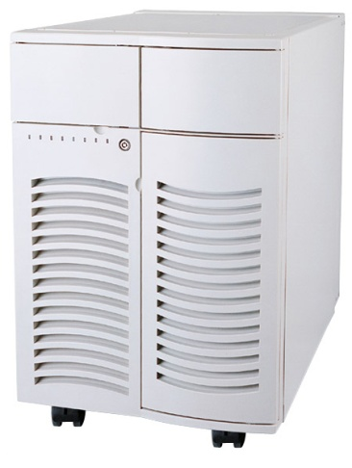
Application
Application
Application
Application

Slide 16


Slide 18
Multiple Clients
Model
Repository
Database

Slide 19
Model Repository =
Models +
Resources +
Objects
Multiple Clients
Model
Repository
Database

Slide 20
With CDO you can…
Maintain a central model repository
Store models in arbitrary backends
Cache models in server memory
Connect from multiple clients
Manage sessions
Manage views and transactions
Work with a distributed shared model
Distribute change notifications
Present hot data

Slide 21
CDO supports…
Multiple sessions on a single client
TCP connections
HTTP connections
JVM connections
Pluggable connection security
Challenge/Response negotiation
Pluggable fail-over strategies

Slide 22
CDO supports…
Multiple views per session
Read-only views
Transactions and save points
Audit views (time machine)
Local sharing across all views
Potentially huge object graphs
Transparent loading/unloading on demand
Partial collections
Intelligent prefetching

Slide 23
How does all this work?
?

Slide 24
Application

Slide 25
Book
State
ID
Title
Pages
Authors

Slide 26
Book
State
ID
Title
Pages
Authors

Slide 27
PERSISTENT
TRANSIENT
attach
NEW
commit
commit
DIRTY
detach
CLEAN
write
Book
read
invalidate
PROXY
CONFLICT
invalidate
State
reset
ID
Title
Pages
Authors

Slide 28
PERSISTENT
TRANSIENT
attach
NEW
commit
commit
DIRTY
detach
CLEAN
write
Book
read
invalidate
PROXY
CONFLICT
invalidate
State
reset
ID
Title
Pages
Authors
Revision

Slide 29
TRANSIENT
attach
NEW
Book
State
ID
Revision
ID
Version
Title
Pages
Authors
Title
Pages
Authors

Slide 30
TRANSIENT
attach
NEW
commit
CLEAN
Book
State
ID
Revision
Revision
ID
Version
Temporary ID
Version -1
Title
Pages
Authors

Slide 31
NEW
commit
DIRTY
CLEAN
write
Book
State
ID
Revision
Revision
Temporary ID
Version -1
Persistent ID
Version 1
Title
Pages
Authors

Slide 32
DIRTY
CLEAN
write
Book
State
ID
Revision
Revision
Persistent ID
Version 1
Title
Pages
Authors

Slide 33
DIRTY
CLEAN
write
Book
State
ID
Revision
Revision
Revision
Persistent ID
Version -1
Persistent ID
Version 1
Title
Pages
Authors
Title
Pages
Authors

Slide 34
commit
DIRTY
CLEAN
write
Book
State
ID
Revision
Revision
Revision
Persistent ID
Version -1
Persistent ID
Version 2
Persistent ID
Version 1
Title
Pages
Authors
Title
Pages
Authors

Slide 35
commit
DIRTY
CLEAN
Book
State
ID
Revision
Revision
Revision
Persistent ID
Version 2
Persistent ID
Version 1
Title
Pages
Authors
Title
Pages
Authors

Slide 36
Book
State
ID
Revision
Revision
Revision
Revision
Persistent ID
Version 3
Persistent ID
Version 2
Persistent ID
Version 1
Title
Pages
Authors
Title
Pages
Authors
Title
Pages
Authors

Slide 37
CDOStateMachine
PERSISTENT
TRANSIENT
attach
NEW
commit
DIRTY
detach
CLEAN
write
read
invalidate
PROXY
CONFLICT
reload

Slide 38
CDORevision
id:
version:
class:
created:
revised:
resourceID:
containerID:
containingFeatureID:
values:
CDOID
int
CDOClass
long
long
CDOID
CDOID
int
Object[]

Slide 39
CDORevision
Repository
CDOSession
id:
version:
class:
created:
revised:
resourceID:
containerID:
containingFeatureID:
values:
CDORevisionManager
CDOID
int
CDOClass
long
long
CDOID
CDOID
int
Object[]
id:
version:
class:
created:
revised:
resourceID:
containerID:
containingFeatureID:
values:
CDOID
int
CDOClass
long
long
CDOID
CDOID
int
Object[]
id:
version:
class:
created:
revised:
resourceID:
containerID:
containingFeatureID:
values:
CDOID
int
CDOClass
long
long
CDOID
CDOID
int
Object[]
id:
version:
class:
created:
revised:
resourceID:
containerID:
containingFeatureID:
values:
CDOID
int
CDOClass
long
long
CDOID
CDOID
int
Object[]

Slide 40
CDOObject
id:
state:
resource:
revision:
view:
CDOID
CDOState
CDOResource
CDORevision
CDOView

Slide 41
CDOObject
CDOSession
CDORevisionManager
id:
state:
resource:
revision:
view:
CDOID
CDOState
CDOResource
CDORevision
CDOView
id:
version:
class:
created:
revised:
resourceID:
containerID:
containingFeatureID:
values:
CDOID
int
CDOClass
long
long
CDOID
CDOID
int
Object[]
id:
version:
class:
created:
revised:
resourceID:
containerID:
containingFeatureID:
values:
CDOID
int
CDOClass
long
long
CDOID
CDOID
int
Object[]
id:
version:
class:
created:
revised:
resourceID:
containerID:
containingFeatureID:
values:
CDOID
int
CDOClass
long
long
CDOID
CDOID
int
Object[]
CDOView
id:
state:
resource:
revision:
view:
CDOID
CDOState
CDOResource
CDORevision
CDOView
id:
state:
resource:
revision:
view:
CDOID
CDOState
CDOResource
CDORevision
CDOView
id:
state:
resource:
revision:
view:
CDOID
CDOState
CDOResource
CDORevision
CDOView

Slide 42
CDOObject
CDOSession
CDORevisionManager
id:
state:
resource:
revision:
view:
CDOID
CDOState
CDOResource
CDORevision
CDOView
id:
version:
class:
created:
revised:
resourceID:
containerID:
containingFeatureID:
values:
CDOID
int
CDOClass
long
long
CDOID
CDOID
int
Object[]
id:
version:
class:
created:
revised:
resourceID:
containerID:
containingFeatureID:
values:
CDOID
int
CDOClass
long
long
CDOID
CDOID
int
Object[]
id:
version:
class:
created:
revised:
resourceID:
containerID:
containingFeatureID:
values:
CDOID
int
CDOClass
long
long
CDOID
CDOID
int
Object[]
CDOView
id:
state:
resource:
revision:
view:
CDOID
CDOState
CDOResource
CDORevision
CDOView
id:
state:
resource:
revision:
view:
CDOID
CDOState
CDOResource
CDORevision
CDOView
id:
state:
resource:
revision:
view:
CDOID
CDOState
CDOResource
CDORevision
CDOView
How does it integrate with EMF?

Slide 43
CDOObject
Application
id:
state:
resource:
revision:
view:
CDOID
CDOState
CDOResource
CDORevision
CDOView
How does it integrate with EMF?

Slide 44
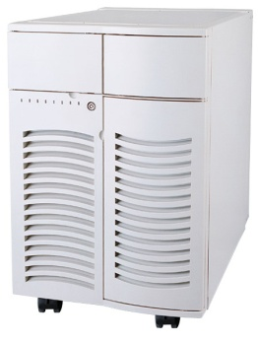
Application
CDOSession
CDOView
CDOStore
CDOStateMachine

Slide 45
Application
CDOSession
CDOView
CDOStore
CDOStateMachine

Slide 46
Application
CDOObject
EObject
CDOObjectImpl
InternalCDOObject
CDOStateMachine

Slide 47
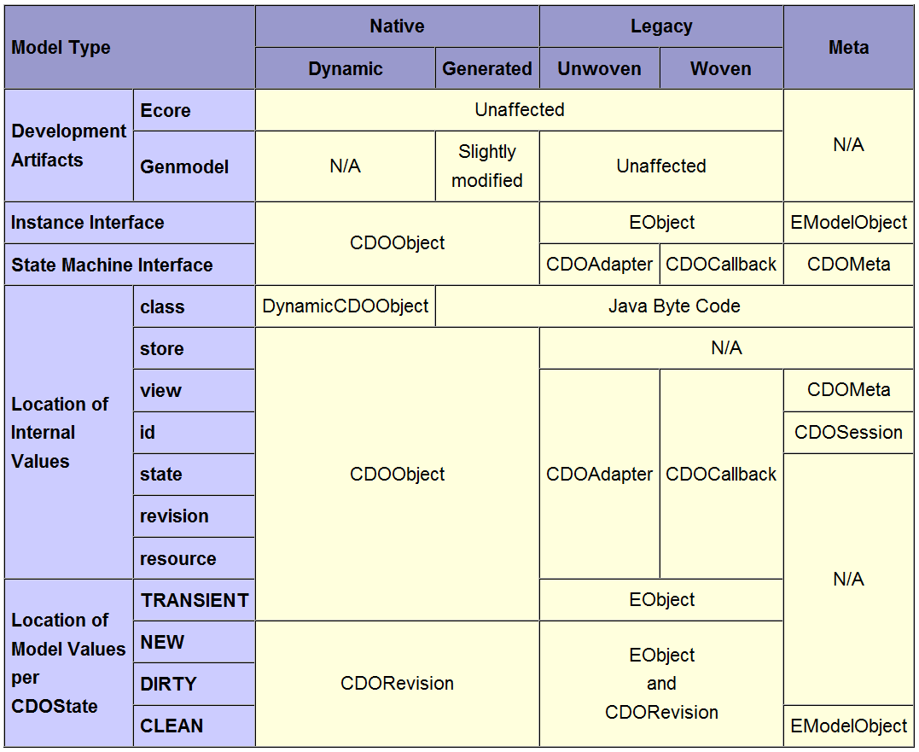

Slide 48
Application
CDOSession
Net4j
Protocol
?

Slide 49
CDO Server-Side
IRepository
IStore
creates
IStoreAccessor
IPackageManager
CDOPackage
IRevisionManager
CDORevision
IResourceManager
Path Mappings
ISessionManager
ISession

Slide 50
CDO Server-Side
IRepository
IStore
creates
IStoreAccessor
IStoreReader
MEMStore
DBStore
HibernateStore
ObjectivityStore
IStoreWriter
creates
creates
creates
creates
MEMStoreReader
DBStoreReader
HibernateStoreReader
ObjectivityStoreReader
MEMStoreWriter
DBStoreWriter
HibernateStoreWriter
ObjectivityStoreWriter

Slide 51
How to continue the tutorial?
Questions regarding the slides
Switch desktop sharing to Eike
Live Demonstration
CDO server application
CDO user interface
Open discussion + code walk-through

