Slide 1

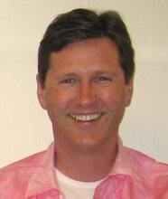
Scale, Share and Store your Models with CDO 2.0
Eclipse Live Webinar, January 29, 2009
Eike Stepper
stepper@esc-net.de
http://www.esc-net.de
http://thegordian.blogspot.com
Berlin, Germany
Ed Merks
Ed.Merks@gmail.com
http://www.macromodeling.com
http://ed-merks.blogspot.com
Ballantrae, Ontario, Canada

Slide 2

Agenda
Eike | Ed
 | Typical Application
answers questions | The Wonder of EMF
 | EMF Snippet
Typical CDO Deployment
Typical CDO Application | answers questions
Typical CDO Server
Live Demonstration
Live Discussion
(CDO Snippets)
(Next Steps)
Scale, Share and Store your Models with CDO 2.0
© 2009 by Eike Stepper, Berlin, Germany. Made available under the EPL v1.0

Slide 3
Typical Application
Business Logic
Persistence Logic
Input
Output
Business Objects
.xml
.dat
RDB
Scale, Share and Store your Models with CDO 2.0
© 2009 by Eike Stepper, Berlin, Germany. Made available under the EPL v1.0

Slide 4
Cross References by EMF
Business Logic
Persistence Logic
Input
Output
Business Objects
ResourceSet
.xml
.dat
RDB
Scale, Share and Store your Models with CDO 2.0
© 2009 by Eike Stepper, Berlin, Germany. Made available under the EPL v1.0

Slide 5
Model View Controller by EMF
Business Logic
Persistence Logic
Input
Output
Business Objects
ResourceSet
.xml
.dat
RDB
Scale, Share and Store your Models with CDO 2.0
© 2009 by Eike Stepper, Berlin, Germany. Made available under the EPL v1.0

Slide 6
Business Logic is Yours
Business Logic
Persistence Logic
Business Objects
ResourceSet
Resource
.xml
Resource
.dat
Resource
RDB
Scale, Share and Store your Models with CDO 2.0
© 2009 by Eike Stepper, Berlin, Germany. Made available under the EPL v1.0

Slide 7
Models Generated by EMF
Persistence Logic
Business Objects
ResourceSet
.xml
.dat
RDB
Scale, Share and Store your Models with CDO 2.0
© 2009 by Eike Stepper, Berlin, Germany. Made available under the EPL v1.0

Slide 8
Persistence Handled by EMF
Persistence Logic
ResourceSet
.xml
.dat
RDB
Scale, Share and Store your Models with CDO 2.0
© 2009 by Eike Stepper, Berlin, Germany. Made available under the EPL v1.0

Slide 9
Default Serialization by EMF
XMLResource
.xml
BinaryResource
.dat
?
RDB
Scale, Share and Store your Models with CDO 2.0
© 2009 by Eike Stepper, Berlin, Germany. Made available under the EPL v1.0

Slide 10
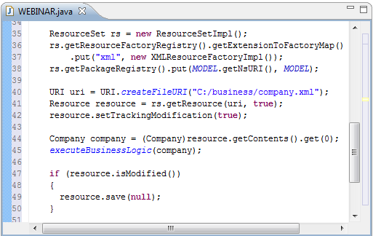
EMF Snippet
Scale, Share and Store your Models with CDO 2.0
© 2009 by Eike Stepper, Berlin, Germany. Made available under the EPL v1.0

Slide 11
Typical CDO Deployment
Client 1
Client 2
Client 3
Server
Model
Repository
RDB
Scale, Share and Store your Models with CDO 2.0
© 2009 by Eike Stepper, Berlin, Germany. Made available under the EPL v1.0

Slide 12
Multiple Repositories
Client 1
Client 2
Client 3
Model
Repository
Model
Repository
RDB
Scale, Share and Store your Models with CDO 2.0
© 2009 by Eike Stepper, Berlin, Germany. Made available under the EPL v1.0

Slide 13
Typical CDO Application
View
Audit
Transaction
Session
ResourceSet
CDOResource
Model
Repository
CDOResource
View
Audit
Transaction
Session
CDOResource
Model
Repository
Scale, Share and Store your Models with CDO 2.0
© 2009 by Eike Stepper, Berlin, Germany. Made available under the EPL v1.0

Slide 14
Integration with ResourceSet
View
Audit
Transaction
Session
ResourceSet
XATransaction
Model
Repository
ViewSet
View
Audit
Transaction
Session
Model
Repository
Scale, Share and Store your Models with CDO 2.0
© 2009 by Eike Stepper, Berlin, Germany. Made available under the EPL v1.0

Slide 15
Each Repository Once per ViewSet
View
Audit
Transaction
Session
ResourceSet
XATransaction
Model
Repository
ViewSet
View
Audit
Transaction
Session
Scale, Share and Store your Models with CDO 2.0
© 2009 by Eike Stepper, Berlin, Germany. Made available under the EPL v1.0

Slide 16
Multiple Views per Session
Audit
Session
View
Model
Repository
Transaction
ViewSet
Each Repository Once per ViewSet
Scale, Share and Store your Models with CDO 2.0
© 2009 by Eike Stepper, Berlin, Germany. Made available under the EPL v1.0

Slide 17
Scalability through Revisions
View
Session
Object
Cached Revisions
7
7 v1:
13
13, 263, 94
94
7 v2:
13, 263
82
7 v3:
263
82, 263
Scale, Share and Store your Models with CDO 2.0
© 2009 by Eike Stepper, Berlin, Germany. Made available under the EPL v1.0

Slide 18
Views are Revision Selectors
View
Session
Object
Cached Revisions
7
7 v1:
13, 263, 94
7 v2:
13, 263
7 v3:
82, 263
Transaction
Audit
Dirty Object
Local Revision
Historical Object
7 v-1:
7
7
263, 13
Scale, Share and Store your Models with CDO 2.0
© 2009 by Eike Stepper, Berlin, Germany. Made available under the EPL v1.0

Slide 19
Object State Machine
P E R S I S T E N T
attach to view
NEW
commit
commit
DIRTY
TRANSIENT
remote
invalidate
CLEAN
write
detach from view
remote
invalidate
read
PROXY
CONFLICT
reload
Scale, Share and Store your Models with CDO 2.0
© 2009 by Eike Stepper, Berlin, Germany. Made available under the EPL v1.0

Slide 20
Typical CDO Server
Server
TCPAcceptor
Model Repository
ODB
ObjectivityStore
HTTPAcceptor
Model Repository
JVMAcceptor
HibernateStore
RDB
…
…
Hibernate
Model Repository
Session
Management
Package
Management
Revision
Caching
DBStore
RDB
Scale, Share and Store your Models with CDO 2.0
© 2009 by Eike Stepper, Berlin, Germany. Made available under the EPL v1.0

Slide 21
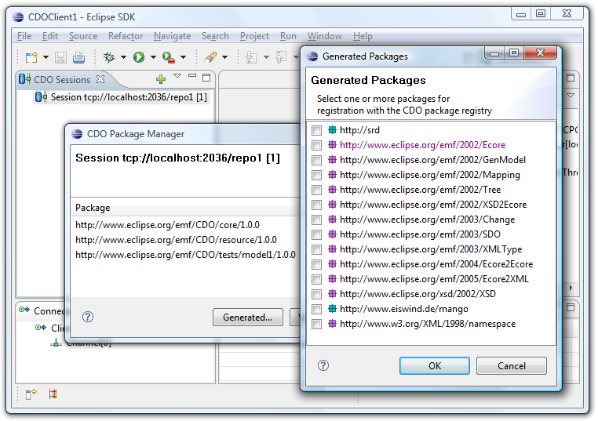
Live Demonstration
Scale, Share and Store your Models with CDO 2.0
© 2009 by Eike Stepper, Berlin, Germany. Made available under the EPL v1.0

Slide 22
Opening a Session
public CDOSession openSession()
{
// Create TCP connector through wiring container
IConnector connector = (IConnector)IPluginContainer.INSTANCE
.getElement("org.eclipse.net4j.connectors", "tcp", "dev.foo.com:2036");
// Create CDO session configuration
CDOSessionConfiguration config = CDONet4jUtil.createSessionConfiguration();
config.setConnector(connector);
config.setRepositoryName("repo1");
config.setLazyPackageRegistry();
// Open CDO session
return config.openSession();
}
Scale, Share and Store your Models with CDO 2.0
© 2009 by Eike Stepper, Berlin, Germany. Made available under the EPL v1.0

Slide 23
Opening Views, Audits and Transactions
CDOSession session = openSession();
// Open multiple views on a session
CDOView view = session.openView();
CDOAudit audit = session.openAudit(new Date("2009-01-19").getTime());
CDOTransaction transaction= session.openTransaction();
// Use own ResourceSet
ResourceSet resourceSet = new ResourceSetImpl();
CDOTransaction transaction2= session.openTransaction(resourceSet);
// Associate transactions with a distributed transaction
CDOXATransaction xa = CDOUtil.createXATransaction();
xa.add(transaction.getViewSet());
xa.add(transaction2.getViewSet());
Scale, Share and Store your Models with CDO 2.0
© 2009 by Eike Stepper, Berlin, Germany. Made available under the EPL v1.0

Slide 24
Structured Resources / Queries
// Open CDO session and view
CDOSession session = openSession();
CDOView view = session.openView();
// Navigate through the resource folder structure
for (CDOResourceNode node : view.queryResources(null, "business", false))
{
if (node instanceof CDOResourceFolder)
{
EList<CDOResourceNode> subNodes = ((CDOResourceFolder)node).getNodes();
}
else
{
EList<EObject> contents = ((CDOResource)node).getContents();
}
}
// Close the session when done
session.close();
Scale, Share and Store your Models with CDO 2.0
© 2009 by Eike Stepper, Berlin, Germany. Made available under the EPL v1.0

Slide 25
Explicit Locking
CDOSession session = openSession();
CDOTransaction transaction = session.openTransaction();
transaction.setAutoReleaseLocksEnabled(true);
// Lock a single object for writing
CDOResource resource = transaction.getResource("/my/resource");
resource.cdoWriteLock().lock();
// Modify that object
resource.getContents().add(new Company());
resource.getContents().add(new Company());
resource.getContents().add(new Company());
// Commit atomically and release all locks
transaction.commit();
session.close();
Scale, Share and Store your Models with CDO 2.0
© 2009 by Eike Stepper, Berlin, Germany. Made available under the EPL v1.0

Slide 26
Save Points
CDOSession session = openSession();
CDOTransaction transaction = session.openTransaction();
// Create and populate a resource
CDOResource resource = transaction.getOrCreateResource("/my/resource");
resource.getContents().add(new Customer());
resource.getContents().add(new Customer());
// Set save point, modify and rollback
CDOSavepoint savepoint = transaction.setSavepoint();
resource.getContents().add(new Supplier());
resource.getContents().add(new Supplier());
transaction.rollback(savepoint);
// Commit only the first changes (customers)
transaction.commit();
session.close();
Scale, Share and Store your Models with CDO 2.0
© 2009 by Eike Stepper, Berlin, Germany. Made available under the EPL v1.0

Slide 27
Passive Updates
CDOSession session = openSession();
CDOView view = session.openView();
CDOResource resource = view.getResource("/my/resource");
// Decouple from passive updates
session.options().setPassiveUpdateEnabled(false);
for (EObject object : resource.getContents())
{
Company company = (Company)object;
// Work with local model…
}
session.refresh();
// Work with refreshed model…
// Stay in sync from here
session.options().setPassiveUpdateEnabled(true);
Scale, Share and Store your Models with CDO 2.0
© 2009 by Eike Stepper, Berlin, Germany. Made available under the EPL v1.0

Slide 28
Change Subscriptions
CDOSession session = openSession();
CDOView view = session.openView();
// Subscribe to repository for CDO adapters
view.options().setChangeSubscriptionPolicy(CDOAdapterPolicy.CDO);
// Define your CDO adapter
class MyAdapter extends AdapterImpl implements CDOAdapter
{
@Override
public void notifyChanged(Notification msg)
{
System.out.println("Modified remotely: " + msg.getNotifier());
}
}
// Attach your adapter to any object to trigger a particular subscription
CDOResource resource = view.getResource("/my/resource");
resource.eAdapters().add(new MyAdapter());
Scale, Share and Store your Models with CDO 2.0
© 2009 by Eike Stepper, Berlin, Germany. Made available under the EPL v1.0

Slide 29
Query Framework
CDOSession session = openSession();
CDOView view = session.openView();
// Create query
CDOQuery query = view.createQuery("SQL",
"SELECT cdoid FROM Company WHERE name LIKE ${name}");
query.setParameter("name", "Foo%");
query.setMaxResults(35);
// Send query to server and iterate the result asynchronously
for (Iterator<Company> it = query.getResultAsync(Company.class); it.hasNext())
{
Company company = it.next();
System.out.println(company);
}
// Closing the view closes all open queries
session.close();
Scale, Share and Store your Models with CDO 2.0
© 2009 by Eike Stepper, Berlin, Germany. Made available under the EPL v1.0

Slide 30


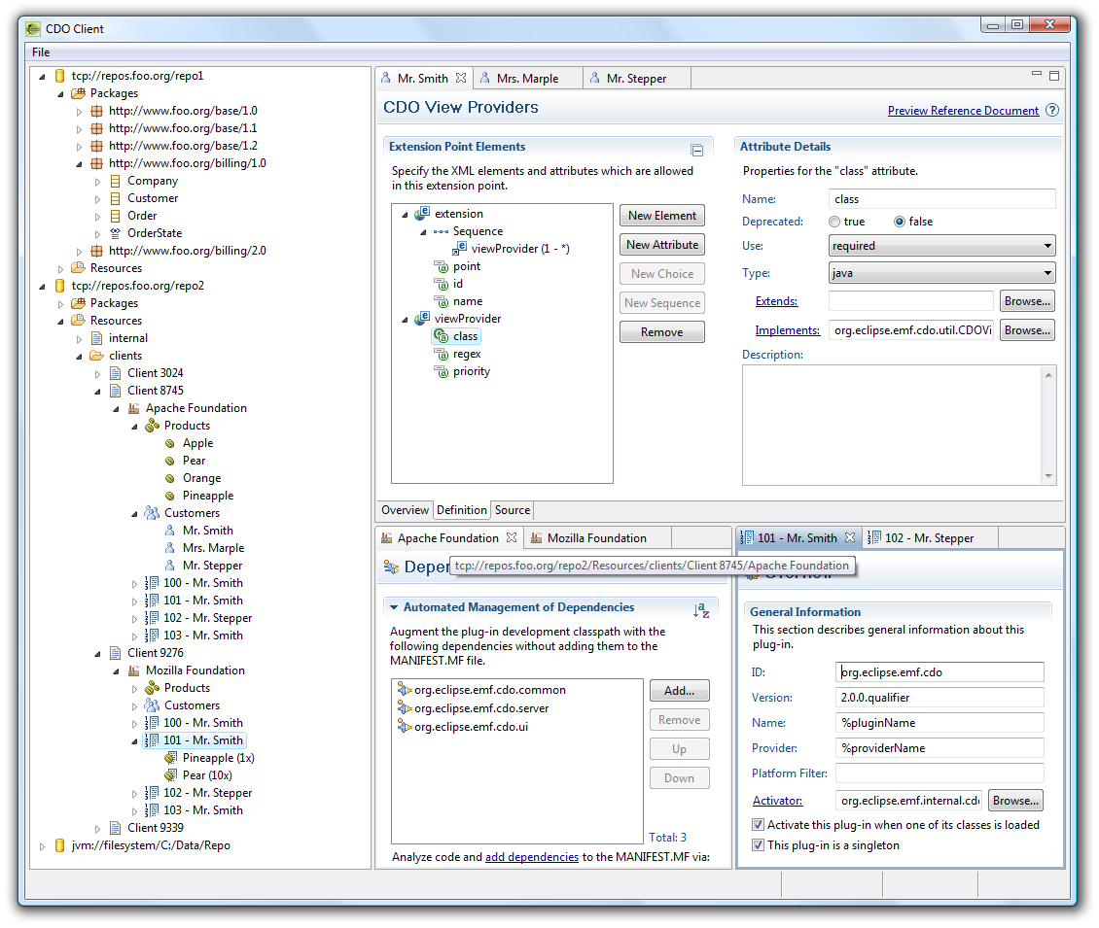
Offline mode
  Checkout
  Re-sync
Legacy model support
  Ecore
  UML
  3rd party models
OCL server-side
  As common query language
  For commit validation
Model code server-side
  Custom data types (persistence)
  Operations (e.g. in OCL)
Integration
  GMF integration
  Workspace integration
  Team integration
  CDO Explorer
Scale, Share and Store your Models with CDO 2.0
© 2009 by Eike Stepper, Berlin, Germany. Made available under the EPL v1.0

