Slide 1


Scale, Share and Store your Models with CDO 2.0
Eclipse Live Webinar, January 29, 2009
Eike Stepper
stepper@esc-net.de
http://www.esc-net.de
http://thegordian.blogspot.com
Berlin, Germany
Ed Merks
Ed.Merks@gmail.com
http://www.macromodeling.com
http://ed-merks.blogspot.com
Ballantrae, Ontario, Canada

Slide 2

Agenda
Eike | Ed
 | Typical Application
answers questions | The Wonder of EMF
 | EMF Snippet
Typical CDO Deployment
Typical CDO Application | answers questions
Typical CDO Server
Live Demonstration
Live Discussion
(CDO Snippets)
(Next Steps)

Slide 3
Typical Application
Business Logic
Persistence Logic
Input
Output
Business Objects
.xml
.dat
RDB

Slide 4
Cross References by EMF
Business Logic
Persistence Logic
Input
Output
Business Objects
ResourceSet
.xml
.dat
RDB

Slide 5
Model View Controller by EMF
Business Logic
Persistence Logic
Input
Output
Business Objects
ResourceSet
.xml
.dat
RDB

Slide 6
Business Logic is Yours
Business Logic
Persistence Logic
Business Objects
ResourceSet
Resource
.xml
Resource
.dat
Resource
RDB

Slide 7
Models Generated by EMF
Persistence Logic
Business Objects
ResourceSet
.xml
.dat
RDB

Slide 8
Persistence Handled by EMF
Persistence Logic
ResourceSet
.xml
.dat
RDB

Slide 9
Default Serialization by EMF
XMLResource
.xml
BinaryResource
.dat
?
RDB

Slide 10
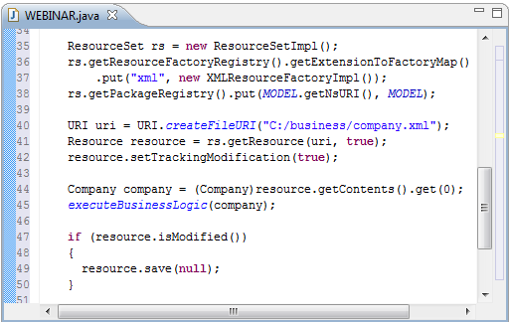
EMF Snippet

Slide 11
Typical CDO Deployment
Client 1
Client 2
Client 3
Server
Model
Repository
RDB

Slide 12
Multiple Repositories
Client 1
Client 2
Client 3
Model
Repository
Model
Repository
RDB

Slide 13
Typical CDO Application
View
Audit
Transaction
Session
ResourceSet
CDOResource
Model
Repository
CDOResource
View
Audit
Transaction
Session
CDOResource
Model
Repository

Slide 14
Integration with ResourceSet
View
Audit
Transaction
Session
ResourceSet
XATransaction
Model
Repository
ViewSet
View
Audit
Transaction
Session
Model
Repository

Slide 15
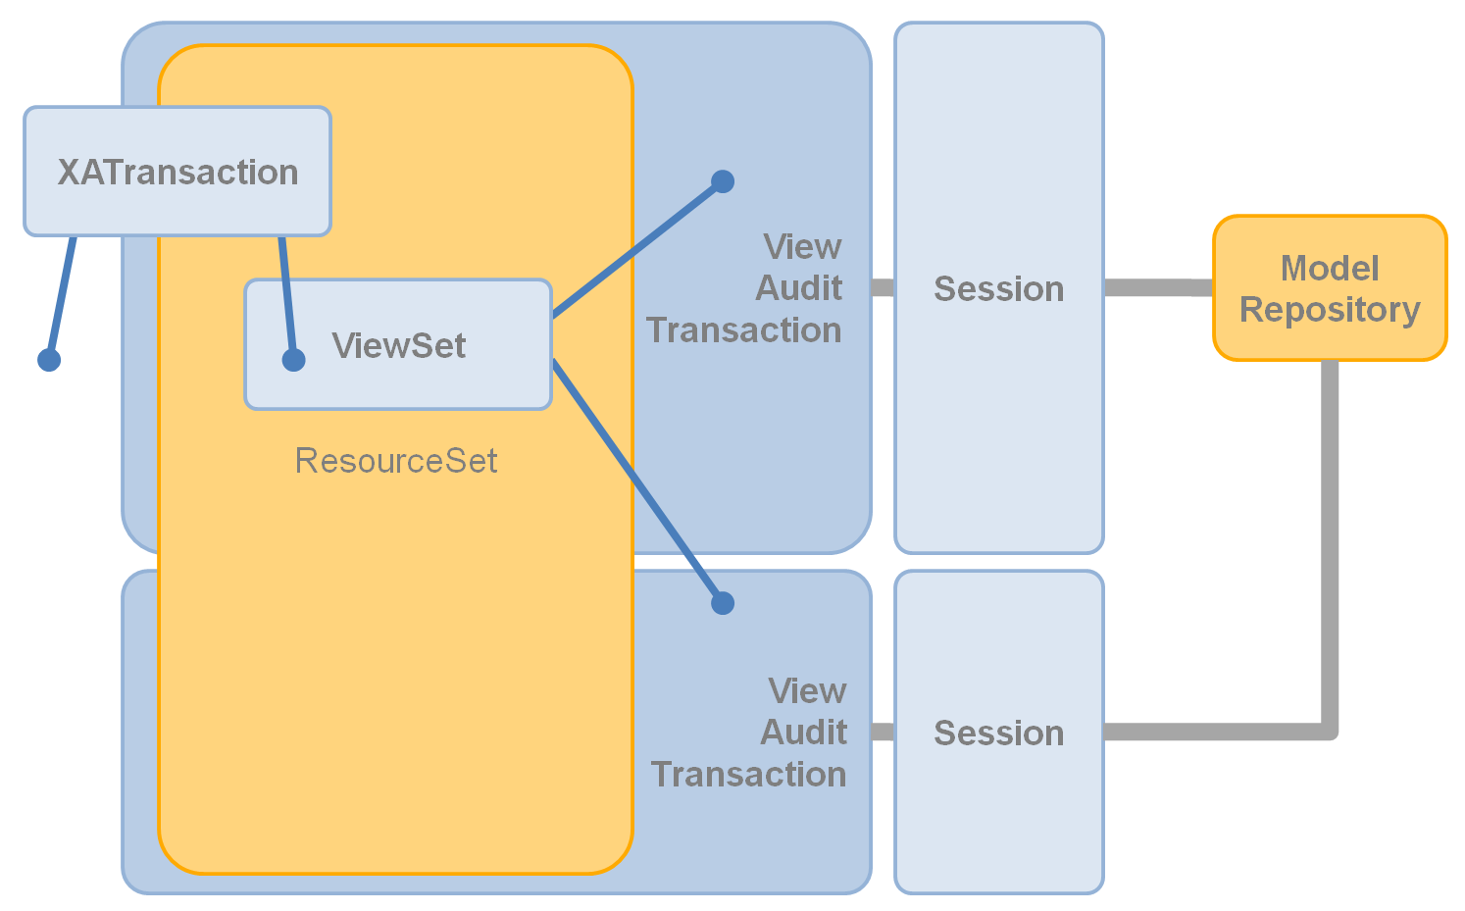
Each Repository Once per ViewSet

Slide 16
Multiple Views per Session
Audit
Session
View
Model
Repository
Transaction
ViewSet
Each Repository Once per ViewSet

Slide 17
Scalability through Revisions
View
Session
Object
Cached Revisions
7
7 v1:
13
13, 263, 94
94
7 v2:
13, 263
82
7 v3:
263
82, 263

Slide 18
Views are Revision Selectors
View
Session
Object
Cached Revisions
7
7 v1:
13, 263, 94
7 v2:
13, 263
7 v3:
82, 263
Transaction
Audit
Dirty Object
Local Revision
Historical Object
7 v-1:
7
7
263, 13

Slide 19
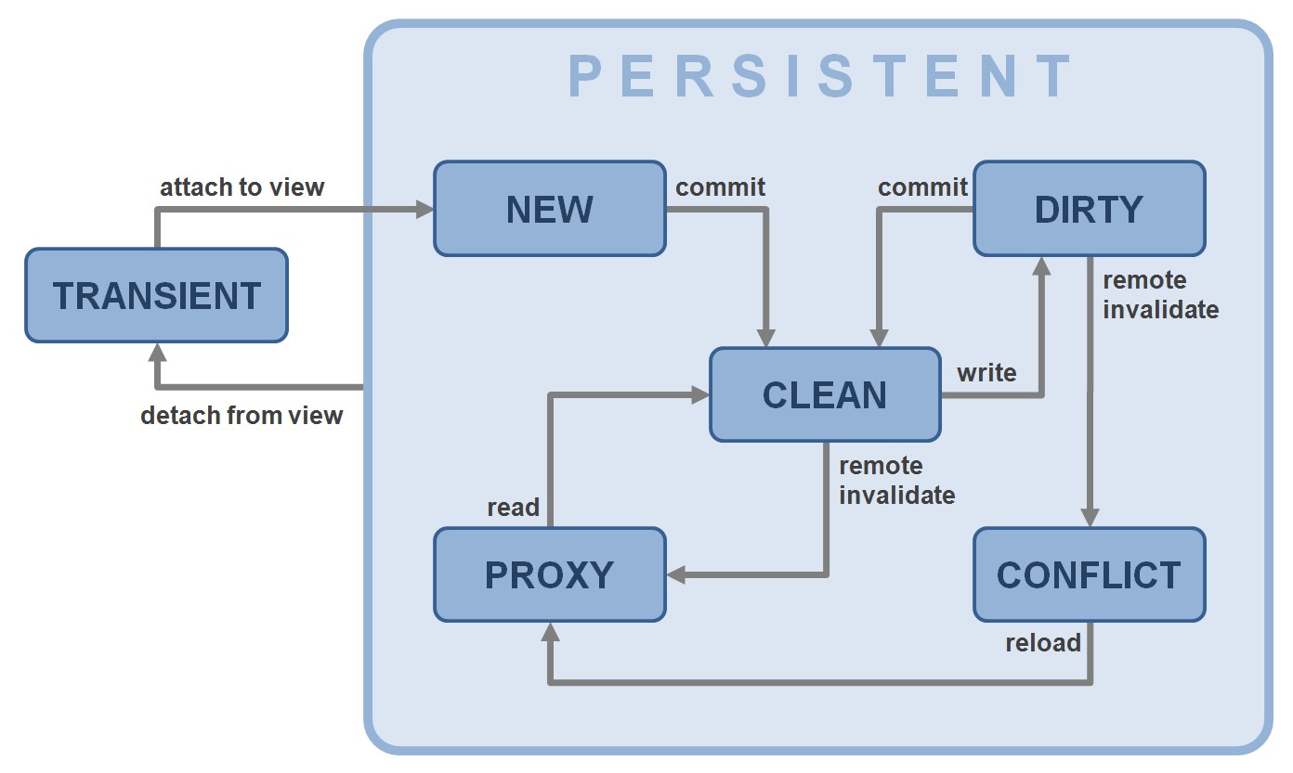
Object State Machine

Slide 20
Typical CDO Server
Server
TCPAcceptor
Model Repository
ODB
ObjectivityStore
HTTPAcceptor
Model Repository
JVMAcceptor
HibernateStore
RDB
…
…
Hibernate
Model Repository
Session
Management
Package
Management
Revision
Caching
DBStore
RDB

Slide 21
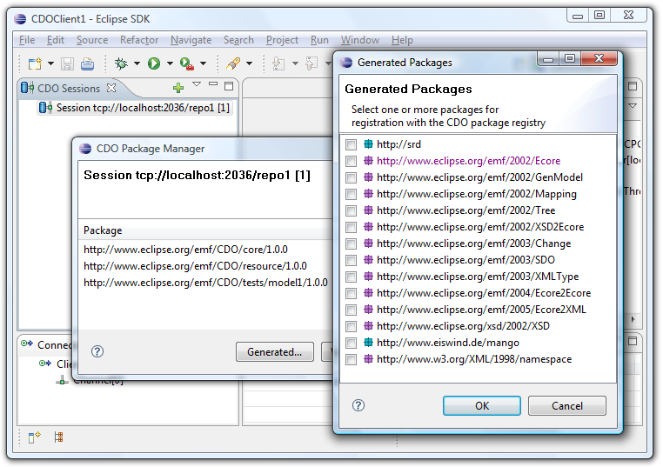
Live Demonstration

Slide 22
Opening a Session
public CDOSession openSession() {
// Create TCP connector through wiring container IConnector connector = (IConnector)IPluginContainer.INSTANCE .getElement("org.eclipse.net4j.connectors", "tcp", "dev.foo.com:2036"); // Create CDO session configuration CDOSessionConfiguration config = CDONet4jUtil.createSessionConfiguration(); config.setConnector(connector); config.setRepositoryName("repo1"); config.setLazyPackageRegistry(); // Open CDO session return config.openSession(); }

Slide 23
Opening Views, Audits and Transactions
CDOSession session = openSession();
// Open multiple views on a session CDOView view = session.openView();
CDOAudit audit = session.openAudit(new Date("2009-01-19").getTime());
CDOTransaction transaction= session.openTransaction();
// Use own ResourceSet
ResourceSet resourceSet = new ResourceSetImpl();
CDOTransaction transaction2= session.openTransaction(resourceSet);
// Associate transactions with a distributed transaction
CDOXATransaction xa = CDOUtil.createXATransaction();
xa.add(transaction.getViewSet());
xa.add(transaction2.getViewSet());

Slide 24
Structured Resources / Queries
// Open CDO session and view
CDOSession session = openSession(); CDOView view = session.openView(); // Navigate through the resource folder structure for (CDOResourceNode node : view.queryResources(null, "business", false)) { if (node instanceof CDOResourceFolder) { EList<CDOResourceNode> subNodes = ((CDOResourceFolder)node).getNodes(); } else { EList<EObject> contents = ((CDOResource)node).getContents(); } } // Close the session when done
session.close();

Slide 25
Explicit Locking
CDOSession session = openSession(); CDOTransaction transaction = session.openTransaction();
transaction.setAutoReleaseLocksEnabled(true);
// Lock a single object for writing CDOResource resource = transaction.getResource("/my/resource"); resource.cdoWriteLock().lock();
// Modify that object resource.getContents().add(new Company()); resource.getContents().add(new Company()); resource.getContents().add(new Company());
// Commit atomically and release all locks transaction.commit(); session.close();

Slide 26
Save Points
CDOSession session = openSession(); CDOTransaction transaction = session.openTransaction();
// Create and populate a resource
CDOResource resource = transaction.getOrCreateResource("/my/resource"); resource.getContents().add(new Customer()); resource.getContents().add(new Customer());
// Set save point, modify and rollback CDOSavepoint savepoint = transaction.setSavepoint(); resource.getContents().add(new Supplier()); resource.getContents().add(new Supplier()); transaction.rollback(savepoint);
// Commit only the first changes (customers) transaction.commit(); session.close();

Slide 27
Passive Updates
CDOSession session = openSession(); CDOView view = session.openView(); CDOResource resource = view.getResource("/my/resource"); // Decouple from passive updates
session.options().setPassiveUpdateEnabled(false); for (EObject object : resource.getContents()) { Company company = (Company)object;
// Work with local model… } session.refresh(); // Work with refreshed model…
// Stay in sync from here session.options().setPassiveUpdateEnabled(true);

Slide 28
Change Subscriptions
CDOSession session = openSession(); CDOView view = session.openView();
// Subscribe to repository for CDO adapters view.options().setChangeSubscriptionPolicy(CDOAdapterPolicy.CDO);
// Define your CDO adapter class MyAdapter extends AdapterImpl implements CDOAdapter { @Override public void notifyChanged(Notification msg) { System.out.println("Modified remotely: " + msg.getNotifier()); } }
// Attach your adapter to any object to trigger a particular subscription CDOResource resource = view.getResource("/my/resource"); resource.eAdapters().add(new MyAdapter());

Slide 29
Query Framework
CDOSession session = openSession(); CDOView view = session.openView();
// Create query CDOQuery query = view.createQuery("SQL",
"SELECT cdoid FROM Company WHERE name LIKE ${name}"); query.setParameter("name", "Foo%"); query.setMaxResults(35);
// Send query to server and iterate the result asynchronously for (Iterator<Company> it = query.getResultAsync(Company.class); it.hasNext()) { Company company = it.next(); System.out.println(company); }
// Closing the view closes all open queries session.close();

Slide 30
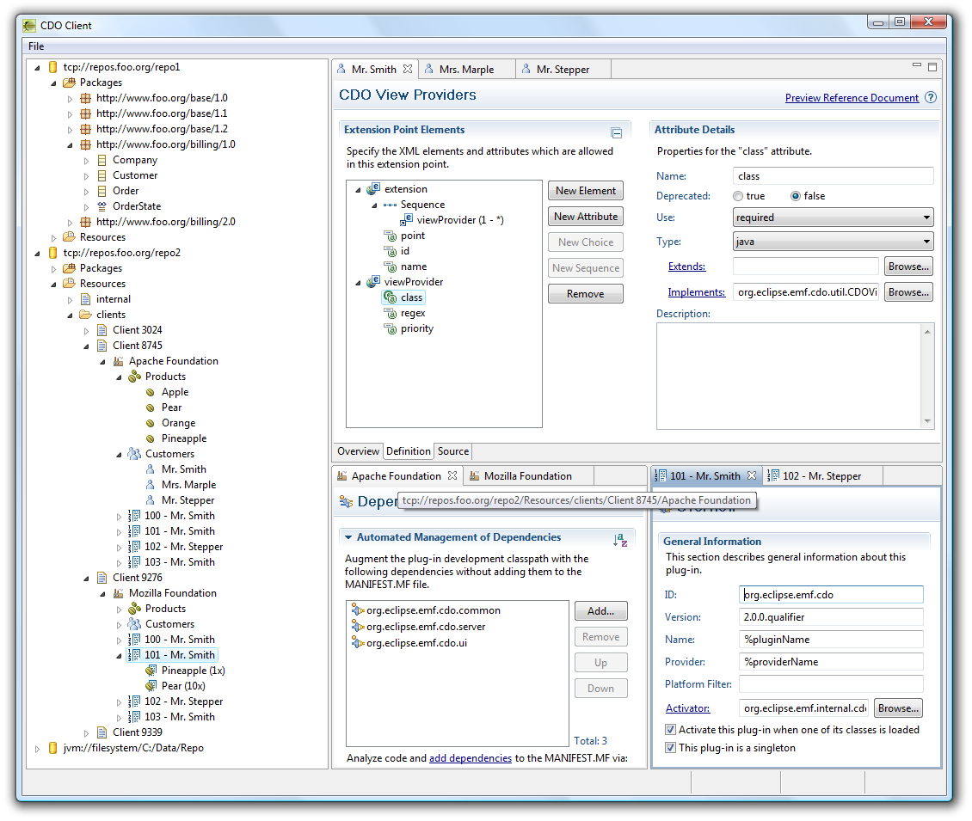
NEXT
Offline mode
Checkout
Re-sync
Legacy model support
Ecore
UML
3rd party models
OCL server-side
As common query language
For commit validation
Model code server-side
Custom data types (persistence)
Operations (e.g. in OCL)
Integration
GMF integration
Workspace integration
Team integration
CDO Explorer
STEPS

