Slide 1
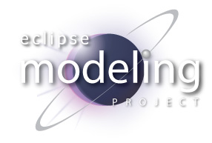

CDO
Orthogonal Aspects of Models
Eike Stepper
stepper@esc-net.de
http://www.esc-net.de
http://thegordian.blogspot.com
Berlin, Germany
EclipseCon Europe, November 2, 2011
Notes:
CDO is a Runtime Platform for Models
with a Focus on Non-Business Aspects
Like Distribution, Persistence, Transactionality
In the following I will outline some of them
And finally show some real life use cases

Slide 2
Distribution
EMF Application
EMF Application
EMF Application
Repository
CDO - Orthogonal Aspects of Models
© 2011 by Eike Stepper, Berlin, Germany. Made available under the EPL v1.0
Notes:
Models and Meta Models are Committed to a Central Server
They‘re Automatically Distributed to Other Clients in the Network

Slide 3
Persistence
EMF Application
EMF Application
EMF Application
Repository
JDBC
Hibernate
Objectivity
MongoDB
DB4O
MEM
CDO - Orthogonal Aspects of Models
© 2011 by Eike Stepper, Berlin, Germany. Made available under the EPL v1.0
Notes:
The Storage Layer of CDO is Pluggable and very Flexible
We already ship with 6 completely different backend Stores
And you can easily develop an integration with your own data layer.

Slide 4
Lazy Loading
EMF Application
CDO Application
Resource Set
Resource Set
CDO - Orthogonal Aspects of Models
© 2011 by Eike Stepper, Berlin, Germany. Made available under the EPL v1.0
Notes:
Lazy Loading in EMF happens in terms of whole Resources
Whereas CDO loads single objects only when they‘re needed.
Different forms of Prefetching are also supported

Slide 5
Automatic Unloading
EMF Application
CDO Application
Resource Set
Resource Set
CDO - Orthogonal Aspects of Models
© 2011 by Eike Stepper, Berlin, Germany. Made available under the EPL v1.0
Notes:
CDO comes with automatic and transparent Memory Management
Objects are garbage collected when they‘re no longer needed
While in EMF the Resources even grow when you unload them!

Slide 6
Read-Only Views
CDO Application
Resource Set
View
Session
shared
shared
shared
CDO - Orthogonal Aspects of Models
© 2011 by Eike Stepper, Berlin, Germany. Made available under the EPL v1.0
Notes:
In a CDO Application you can open multiple views on your model
All views opened from the same session share the underlying model data
We distinguish between read-only views and transactional views

Slide 7
Transactions and Save Points
CDO Application
Resource Set
Resource Set
Transaction
View
Session
shared
shared
shared
CDO - Orthogonal Aspects of Models
© 2011 by Eike Stepper, Berlin, Germany. Made available under the EPL v1.0
Notes:
In Multi Threaded Applications you can render the entire UI with a single read-only view.
Each User Action opens a new transaction that can be safely executed in a background job.

Slide 8
Concurrency and Integrity
Default Locking Strategy
  Optimistic write locks during commit
Optional Explicit Locking
  Pessimistic read and write locks
  Lock escalation
  Long lasting write reservations
Referential Integrity
  Stale reference prevention
  Containment cycle prevention
CDO - Orthogonal Aspects of Models
© 2011 by Eike Stepper, Berlin, Germany. Made available under the EPL v1.0
Notes:
CDO supports Optimistic and Pessimistic Locking with Lock Escalation
In addition a CDO Server can run multiple levels of Integrity Checks on each commit

Slide 9
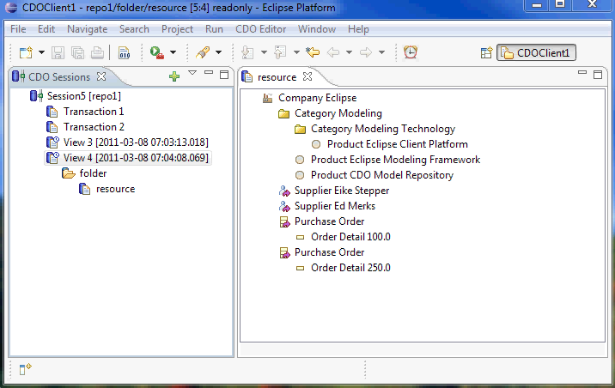
Auditing
CDO - Orthogonal Aspects of Models
© 2011 by Eike Stepper, Berlin, Germany. Made available under the EPL v1.0
Notes:
With Read-only views you can easily travel back and forth in time.
That makes Auditing a snap!

Slide 10
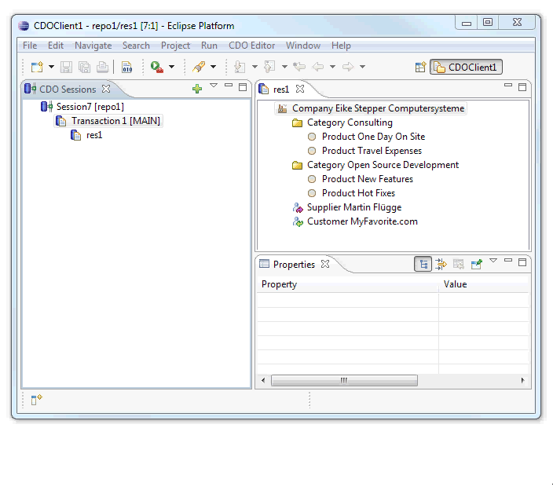
Branching
CDO - Orthogonal Aspects of Models
© 2011 by Eike Stepper, Berlin, Germany. Made available under the EPL v1.0
Notes:
In a similar way you can switch between separate branches of development.
Branches are layed out in a hierarchical namespace.

Slide 11
Merging
CDOBranch branch = branchManager.getBranch("MAIN/team1");
CDOTransaction tx = session.openTransaction();
tx.merge(branch.getHead(),
new DefaultCDOMerger());
tx.commit();
CDO - Orthogonal Aspects of Models
© 2011 by Eike Stepper, Berlin, Germany. Made available under the EPL v1.0
Notes:
CDO is a runtime technology with a focus on sophisticated APIs.
This is an example of opening a transaction on the MAIN branch,
Merging changes from a team branch
And finally committing the result.

Slide 12
Querying
CDOView view = session.openView();
CDOQuery query = view.createQuery("ocl",
"self.books->collect(b : Book | b.category"));
Iterator<String> iterator = query.getResultAsync(String.class);
EMF Application
self.books->collect(b : Book | b.category
Repository
Science Fiction, Poetry, Biography
CDO - Orthogonal Aspects of Models
© 2011 by Eike Stepper, Berlin, Germany. Made available under the EPL v1.0
Notes:
This example shows how to query the repository with OCL.
Here the results are asynchronously delivered to the client.

Slide 13


Failover Cluster
Failover
Monitor
master
Repository
backup
Repository
backup
EMF Application
Repository
master
CDO - Orthogonal Aspects of Models
© 2011 by Eike Stepper, Berlin, Germany. Made available under the EPL v1.0
Notes:
CDO can be operated in different deployment scenarios.
Here you see a fail-over cluster
where clients are shielded from the potential failure
of the active master server

Slide 14

Offline Replication
Repository
Repository
master
clone
EMF Application
CDO - Orthogonal Aspects of Models
© 2011 by Eike Stepper, Berlin, Germany. Made available under the EPL v1.0
Notes:
This setup involves the replication of the master repository
To a number of offline servers
Each of which can serve multiple clients in turn.
This can also be combined with fail-over clusters

Slide 15
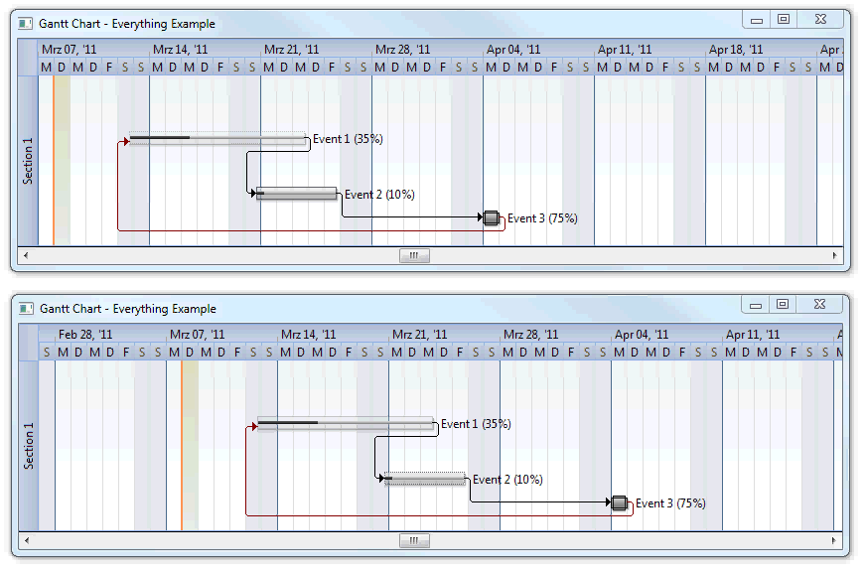
NASA: Distributed Plan Editing
CDO - Orthogonal Aspects of Models
© 2011 by Eike Stepper, Berlin, Germany. Made available under the EPL v1.0
Notes:
Now some examples:
The NASA uses CDO for their distributed project management of the next Mars Mission.
Each engineer sees immediately what the rest of the team is doing.

Slide 16



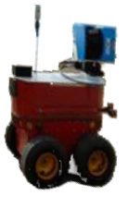

CSA: Autonomous Mobile Robots
Photos taken from http://www.asc-csa.gc.ca/eng/sciences/avatar.asp
CDO - Orthogonal Aspects of Models
© 2011 by Eike Stepper, Berlin, Germany. Made available under the EPL v1.0
Notes:
The Canadian Space Agency deploys CDO to a crowd of mobile Robots
that commit their sensor data into a central repository.
Effectively they all share sort of a common experience.

Slide 17
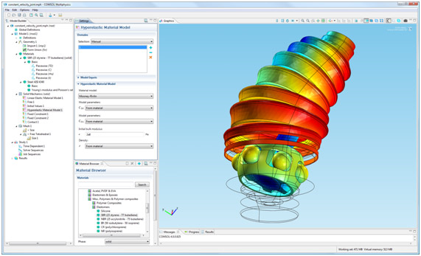
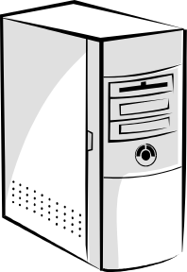
Comsol: Multiphysics Simulation
Authoring
Solving
Photos taken from http://www.comsol.de/press/news/article/648
CDO - Orthogonal Aspects of Models
© 2011 by Eike Stepper, Berlin, Germany. Made available under the EPL v1.0
Notes:
A swedish company offers a tool for complex physical simulations.
They can author a problem in collaboration.
And send it through a CDO repository to a computation farm.

Slide 18
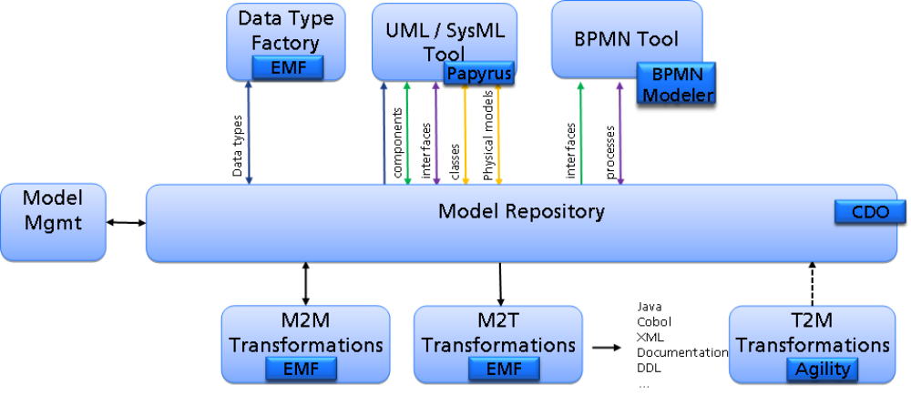
UBS: Tool Landscape Vision
CDO - Orthogonal Aspects of Models
© 2011 by Eike Stepper, Berlin, Germany. Made available under the EPL v1.0
Notes:
The UBS bank is currently realizing their vision of an integrated tool chain
They preserve the enterprise knowledge
and make it available to the technical projects
Through a model bus - implemented with CDO.

Slide 19
More Success Stories
RUAG: Homeland Security
Thales: Systems Engineering Modeler
Obeo: Obeo Designer
NoMagic: MagicDraw + Team Server
Paranor: Xtext Builder Optimization
Benchmark Consulting: Software Modernization
Open Canarias: Transforms of Cobol ASTs
RBCCM: Software Provisioning
WIPFLi: Product Model Workbench
Bombardier: Railway Station Designer
MobilePeople: Search Services
CDO - Orthogonal Aspects of Models
© 2011 by Eike Stepper, Berlin, Germany. Made available under the EPL v1.0
Notes:
Here are some more examples of successful CDO usages,
partly taken from my own customer history.

Slide 20
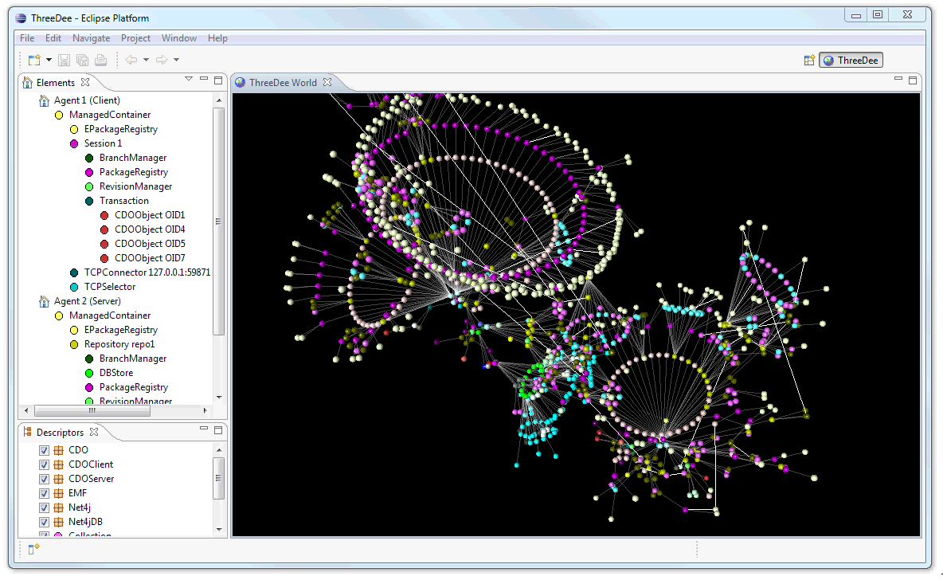
CDO 3D
See you Friday
11:30 - 12:00
Room: Theater
Thank You
CDO - Orthogonal Aspects of Models
© 2011 by Eike Stepper, Berlin, Germany. Made available under the EPL v1.0
Notes:
If you‘re interested in how CDO can do all this
I invite you to watch my show on Friday morning,
I‘ll take you on a realtime 3D trip into the world of CDO
where you‘ll be able to actually watch all the objects
calling methods on other objects
or sending network signals around.
I thank you for now!

