Slide 1

How Scalable Are My Models?
Eike Stepper
stepper@esc-net.de
http://www.esc-net.de
http://thegordian.blogspot.com
Löhne, Germany
BigMDE, 21.07.2017, Marburg

Slide 2
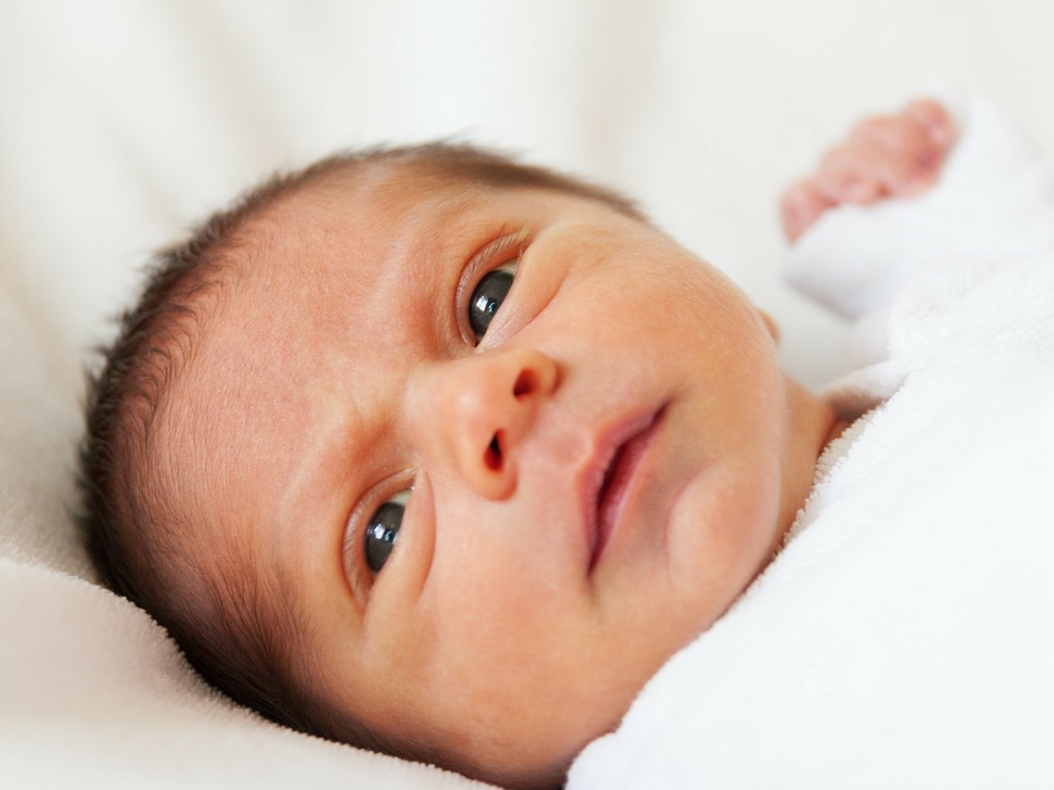
Locking
Persistence
Fail-Over Servers
Merging
Branching
Transactions
SQL
Querying
Auditing
+
Conflict Resolvers
Lazy Loading
Durable Locks
Thread Safety
Compare
Save Points
OCL
Offline Clones
Garbage Collection
=
Change Notifications
Versioning
Offline Checkouts
Scalability
Collaboration
NO-SQL
Optimistic / Pessimistic
Adaptive Prefetching

Slide 3
Loading With EMF
EMF Application
Resource Set
Notes:
Lazy Loading in EMF happens in terms of whole Resources
Whereas CDO loads single objects only when they‘re needed.
Different forms of Prefetching are also supported

Slide 4
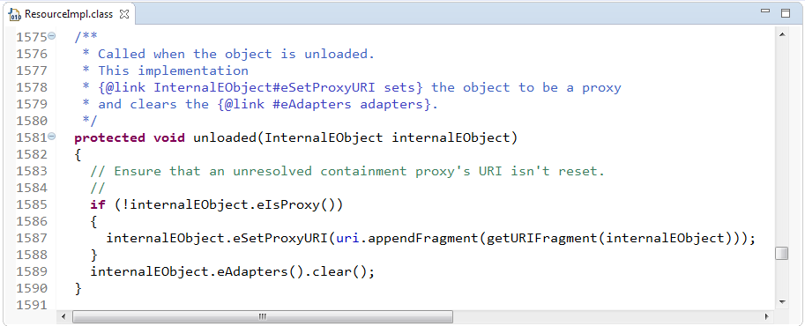
Unloading With EMF
EMF Application
Resource Set
resource.unload();
Notes:
Lazy Loading in EMF happens in terms of whole Resources
Whereas CDO loads single objects only when they‘re needed.
Different forms of Prefetching are also supported

Slide 5
Loading With CDO
CDO Application
Resource Set
Notes:
Lazy Loading in EMF happens in terms of whole Resources
Whereas CDO loads single objects only when they‘re needed.
Different forms of Prefetching are also supported

Slide 6
Unloading With CDO
CDO Application
Resource Set
Notes:
Lazy Loading in EMF happens in terms of whole Resources
Whereas CDO loads single objects only when they‘re needed.
Different forms of Prefetching are also supported

Slide 7
CDO Application
CDO Application
CDO Application
Model Repository

Slide 8
Modify
CDO Application
CDO Application
CDO Application
Model Repository

Slide 9
CDO Application
Commit
CDO Application
CDO Application
Model Repository

Slide 10
CDO Application
CDO Application
CDO Application
Invalidate
Model Repository

Slide 11
CDO Application
CDO Application
CDO Application
Invalidate
Model Repository

Slide 12
CDO Application
CDO Application
CDO Application
Load
Model Repository

Slide 13
CDO Application
CDO Application
CDO Application
Load
Model Repository

Slide 14
CDO Application
Model Repository

Slide 15
CDO Application
Model Repository
v1
v1
v1

Slide 16
CDO Application
Model Repository
v1
v1
v1
v1
v1
v1

Slide 17
CDO Application
Model Repository
v1
v2
v1
v2
v1
v1

Slide 18
CDO Application
Model Repository
v1
v3
v2
v3
v2
v1

Slide 19
CDO Application
Model Repository
v2
v4
v3
v4
v2
v1

Slide 20
CDO Application
Auditing
Model Repository

Slide 21
CDO Application
Auditing
Model Repository
v1
v1
v1

Slide 22
CDO Application
Auditing
Model Repository
v1
v1
v1
v1
v1
v1

Slide 23
CDO Application
Auditing
Model Repository
v2
v2
v1
v1
v1
v1
v1
v1

Slide 24
CDO Application
Auditing
Model Repository
v3
v3
v2
v2
v2
v2
v1
v1
v1
v1
v1
v1

Slide 25
CDO Application
Auditing
Model Repository
v4
v4
v3
v3
v3
v2
v2
v2
v2
v2
v1
v1
v1
v1
v1
v1

Slide 26
CDO Application
Auditing
Branching
Model Repository
v4
v4
v3
v3
v3
v2
v2
v2
v2
v2
v1
v1
v1
v1
v1
v1

Slide 27
CDO Application
Auditing
Branching
Model Repository
v4
v4
v4
v4
v3
v3
v3
v3
v3
v3
v2
v2
v2
v2
v2
v2
v2
v2
v2
v2
v1
v1
v1
v1
v1
v1
v1
v1
v1
v1
v1
v1

Slide 28
CDO Application
Auditing
Branching
Model Repository
v4
v4
v4
v4
v4
v4
v4
v4
v3
v3
v3
v3
v3
v3
v3
v3
v3
v3
v3
v3
v2
v2
v2
v2
v2
v2
v2
v2
v2
v2
v2
v2
v2
v2
v2
v2
v2
v2
v2
v2
v1
v1
v1
v1
v1
v1
v1
v1
v1
v1
v1
v1
v1
v1
v1
v1
v1
v1
v1
v1
v1
v1
v1
v1

Slide 29
CDO Application
Auditing
Branching
Model Repository
v4
v4
v4
v4
v4
v4
v4
v4
v4
v4
v4
v4
v3
v3
v3
v3
v3
v3
v3
v3
v3
v3
v3
v3
v3
v3
v3
v3
v3
v3
v2
v2
v2
v2
v2
v2
v2
v2
v2
v2
v2
v2
v2
v2
v2
v2
v2
v2
v2
v2
v2
v2
v2
v2
v2
v2
v2
v2
v2
v2
v1
v1
v1
v1
v1
v1
v1
v1
v1
v1
v1
v1
v1
v1
v1
v1
v1
v1
v1
v1
v1
v1
v1
v1
v1
v1
v1
v1
v1
v1
v1
v1
v1
v1
v1
v1

Slide 30
CDORevision
Revision Data
EClass
CDOID
CDOBranch
int
long
long
eClass
id
branch
version
created
revised
CDOID resourceID
CDOID containerID
int containerFeature
Object[] values
v4

Slide 31
Session
View
Audit
Transaction
View
Audit
Transaction
View
Audit
Transaction
1
1
1
v4
Package Registry
Revision Manager
1
Package Unit
1
1
2
2
3
3
4
v3
4
v3
v3
v3
v3
v3
Package Unit
v2
v2
v2
v2
v2
v2
v2
v2
v2
Package Unit
v1
v1
v1
v1
v1
v1
v1
v1
Package Unit
Protocol
1100101001110111010010011110101110101

Slide 32
BookImpl
1
Reflective Delegation
String title
int pages
Category category
Writer author
String title
int pages
Category category
Writer author
Root Extends Class

Slide 33
EObjectImpl
BookImpl
CDOObjectImpl

Slide 34
CDOObjectImpl
CDOID
CDORevision
CDOState
CDOView

Slide 35
P E R S I S T E N T
attach to TX
NEW
commit
commit
DIRTY
TRANSIENT
remote
invalidate
CLEAN
write
detach from TX
remote
invalidate
read
PROXY
CONFLICT
resolve
conflicts
rollback

Slide 36
InternalEObject
P E R S I S T E N T
InternalCDOObject
attach to view
NEW
commit
commit
DIRTY
TRANSIENT
remote
invalidate
CLEAN
write
detach from view
CDOObjectImpl
CDOLegacyAdapter
remote
invalidate
read
PROXY
CONFLICT
rollback
DynamicCDOObject
Generated Classes
Generated Classes

Slide 37
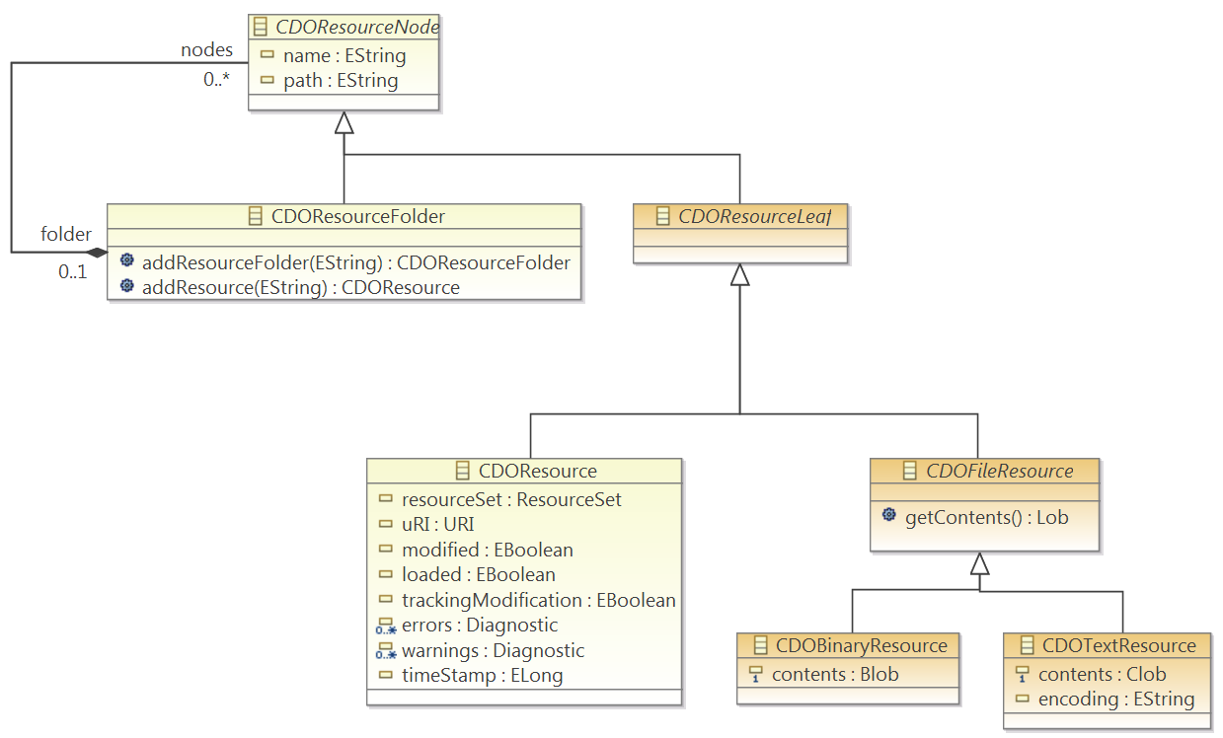

Slide 38
CDOSession session = openSession()
CDOTransaction tx = session.openTransaction()
Resource res = tx.createResource("model.uml")
Package p = (Package)res.getContents().get(0)
p.setName("MyPackage")
tx.commit()
session.close()

Slide 39
CDOView view = session.openView()
CDOQuery query = view.createQuery("ocl", "self.books->collect(b : Book | b.category"))
Iterator<Book> it = query.getResult (Book.class)
while (it.hasNext())
Book book = it.next()

Slide 40
CDOBranch branch = branchManager.getBranch("MAIN/team1")
CDOTransaction tx = session.openTransaction()
tx.merge(branch.getHead(), new DefaultCDOMerger())
tx.commit()

Slide 41
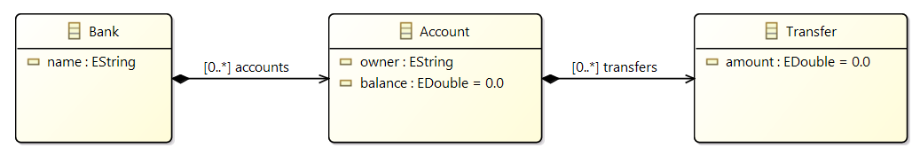
Demo Time

Slide 42
Eike Stepper
stepper@esc-net.de
http://www.esc-net.de
http://thegordian.blogspot.com
Löhne, Germany
Thank You
BigMDE, 21.07.2017, Marburg

