Slide 1



Scale, Share and Store your Models with CDO
Martin Flügge
martin.fluegge@mftech.org
http://www.mftech.org
http://www.mftech.org/blog
Berlin, Germany
Eike Stepper
stepper@esc-net.de
http://www.esc-net.de
http://thegordian.blogspot.com
Berlin, Germany
Eclipse Summit Europe, November 3, 2010

Slide 2
EMF Application
Huge models require lots of smaller files
Partitioning must be done at design time
Saving changes is not transactional safe
Loading single objects is still impossible
Garbage collection of objects is impossible
Conflicts must be resolved in text form
No change notifications to other clients

Slide 3
EMF Application
Does not scale well
Not suitable for multi-user

Slide 4
EMF Application
EMF Application
EMF Application
Model Repository

Slide 5
Modify
EMF Application
EMF Application
EMF Application
Model Repository

Slide 6
EMF Application
Commit
EMF Application
EMF Application
Model Repository

Slide 7
EMF Application
EMF Application
EMF Application
Invalidate
Model Repository

Slide 8
EMF Application
EMF Application
EMF Application
Invalidate
Model Repository

Slide 9
EMF Application
EMF Application
EMF Application
Load
Model Repository

Slide 10
EMF Application
EMF Application
EMF Application
Load
Model Repository

Slide 11
Non Auditing
EMF Application
Auditing
Branching
EMF Application
EMF Application
Storage
Backend
Model Repository

Slide 12
????
ObjectivityStore
DB4OStore
HibernateStore
MEMStore
DBStore
Storage
Backend
Model Repository

Slide 13
Session
View
Audit
Transaction
View
Audit
Transaction
View
Audit
Transaction
1
1
1
v4
Package Registry
Revision Manager
1
Package Unit
1
1
2
2
3
3
4
v3
4
v3
v3
v3
v3
v3
Package Unit
v2
v2
v2
v2
v2
v2
v2
v2
v2
Package Unit
v1
v1
v1
v1
v1
v1
v1
v1
Package Unit
Protocol
1100101001110111010010011110101110101

Slide 14
BookImpl
1
Reflective Delegation
String title
int pages
Category category
Writer author
String title
int pages
Category category
Writer author
Root Extends Class

Slide 15
EObjectImpl
BookImpl
CDOObjectImpl

Slide 16
CDOObjectImpl
CDOID
CDORevision
CDOState
CDOView
Native
Models
Dynamic
Models
Legacy
Models

Slide 17
P E R S I S T E N T
attach to transaction
NEW
commit
commit
DIRTY
TRANSIENT
remote
invalidate
CLEAN
write
detach from transaction
remote
invalidate
read
PROXY
CONFLICT
rollback

Slide 18
Demo Time

Slide 19
But what about your user interfaces?
?
?
?
?
CDO
?
?
?

Slide 20
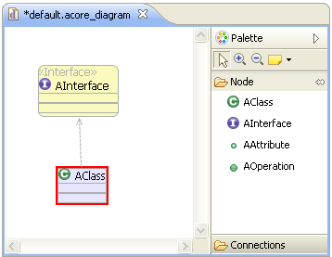
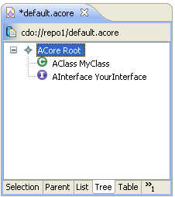
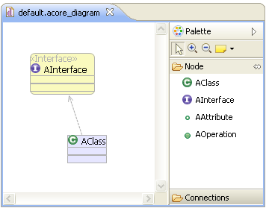
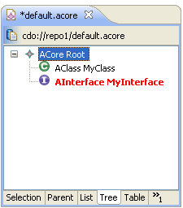
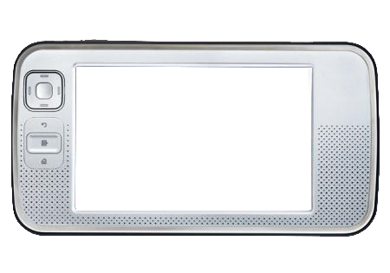
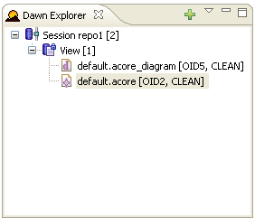
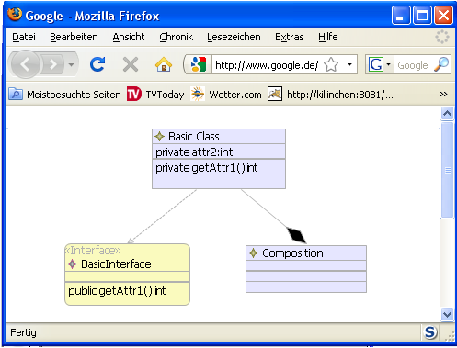
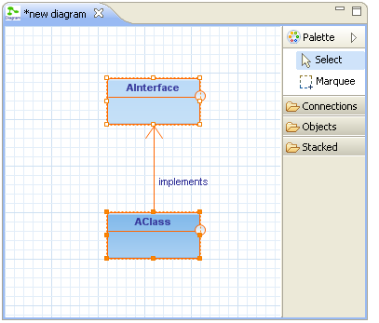
But what about your user interfaces?
?
?
?
?
CDO
?
?
?

Slide 21


Slide 22
Generate your extension
my.gmfgen
my.genmodel
my.diagram
my.editor
Dawn GenModel
my.diagram.dawn
Web Project
my.editor.dawn

Slide 23
Demo Time

Slide 24
Client / Server
Client
Application
Server
CDOSession
ISession
IRepository
IStore
DB

Slide 25
Embedded Repository
Client
Application
CDOSession
ISession
IRepository
IStore
DB

Slide 26
Embedded Session
Server
Logic
CDOSession
ISession
IRepository
IStore
DB

Slide 27
Offline Clone (Embedded)
Client
Application
CDOSession
ISession
OfflineClone
Synchronizer
Server
IStore
CDOSession
ISession
MasterRepository
DB
IStore
DB

Slide 28
Offline Clone (Group Server)
Client
Application
Clone Server
CDOSession
ISession
OfflineClone
Synchronizer
Master Server
IStore
CDOSession
ISession
MasterRepository
DB
IStore
DB

Slide 29
Fail-Over Monitor (1)
??? Server
??? Server
CDOSession
CDOSession
FO-Agent
FO-Agent
Repository
Repository
IStore
FO-Monitor
IStore
DB
DB

Slide 30
Fail-Over Monitor (2)
Master Server
Backup Server
CDOSession
CDOSession
FO-Agent
FO-Agent
Repository
Repository
IStore
FO-Monitor
IStore
DB
DB

Slide 31
Fail-Over Session
Client
Application
FO-Session
Master Server
Backup Server
CDOSession
CDOSession
FO-Agent
FO-Agent
Repository
Repository
IStore
FO-Monitor
IStore
DB
DB

Slide 32
Offline Workspace (Checkout)
Client
Application
CDOWorkspace

Slide 33
Offline Workspace (Checkout)
Client
Application
CDOWorkspace
Local Session
Local Repository
IStore
DB

Slide 34
Offline Workspace (Checkout)
Client
Application
Server
CDOWorkspace
Remote Session
ISession
Local Session
Remote Repository
Local Repository
IStore
IStore
DB
DB

Slide 35
CDO is a runtime technology. People embed it into their products.
Persistent data must be kept safe and consistent.
All functionality must scale well with model size.
All components must be customizeable.
All default implementations should perform well.

Slide 36
API Demo

Slide 37

CDO - On the Road to Indigo
Helios
EObjects on the Server
OCL on the Server
XRefs on the Server
Referential Integrity
Large Object Streaming
Text and Binary Resources
Model Evolution Support …
Indigo

Slide 38
Dawn - On the Road to Indigo
Helios
Integration of GMF editor
Integration of EMF (tree) editors
Web Viewer/Editor for Diagram editors
Integration Graphiti
UI Locking Support
UI Access Control Support
Property View Integration ...
Indigo

Slide 39
CDO Core Features

Slide 40
Distribution
Various ways to set up an IRepository
XML config file, programmatically, Spring, …
OSGi, stand-alone, …
All components customizeable
Various ways to open a CDOSession
Net4j: TCP, HTTP, embedded, …
CDO: embedded
Other transports possible
Offline mode
Cloned and sync’ed repository, normal sessions

Slide 41
Persistence
Pluggable storage backend adapters (IStores)
DBStore (CDO’s own O/R mapper)
HibernateStore / Teneo
ObjectivityStore
DB4OStore
MEMStore
Changing the store type does not affect client applications!

Slide 42
Resources
A CDOResource is an EObject
A repository contains CDOResourceNodes
CDOResourceFolders
CDOResources
CDOTextResource (coming soon)
CDOBinaryResource (coming soon)
The resource tree is
Navigable through EMF
Queryable through CDO

Slide 43
Versioning
CDO supports record temporality
Must be supported by IStore
Can be configured per IRepository
CDO supports branching
Must be supported by IStore
Can be configured per IRepository
A CDOView provides consistent graphs
From a particular branch
From a particular point in time

Slide 44
Scalability
Lazy loading at object granule
Lazy loading without container object
Partial collection loading, chunking
Adaptive prefetching
Manual prefetching
Automatic unloading at object granule
On demand streaming of large objects

Slide 45
Queries
CDO includes a generic query framework
Supports any query language
Supports named parameters
Supports synchronous execution
Supports asynchronous execution
Query language handlers can be
plugged into an IRepository
implemented by an IStore (SQL, HQL, custom, …)
Handlers provided for OCL and XRefs

Slide 46
Transactionality
Strong transactional safety at model-level
Multiple transactions per session
Multiple save points per transaction
Rollback to any save point
Commit with progress monitoring
Hooks for custom transaction handlers
Conflict detection and fail-early-transactions
Pluggable conflict resolvers
Explicit read/write locking on object granule
XA transactions to multiple repositories

Slide 47
Collaboration
Passive Updates
Asynchronous commit notifications
Invalidation of objects, lazy reload if needed
Can be switched off per session
Change subscriptions
Asynchronous change delta delivery
Registration with repository per object/adapter
Automated through pluggable adapter policies
Remote session manager
Notifies about state of other sessions
Supports sending/receiving of arbitrary messages

Slide 48
Integration
Integrates with EMF at the model level, not at the edit- or UI-level.
Uninvasive to the .ecore file.
Best results with regenerated models (native)
Regeneration not needed (legacy mode)
Dynamic models supported
Multiple repositories per ResourceSet
External references

Slide 49
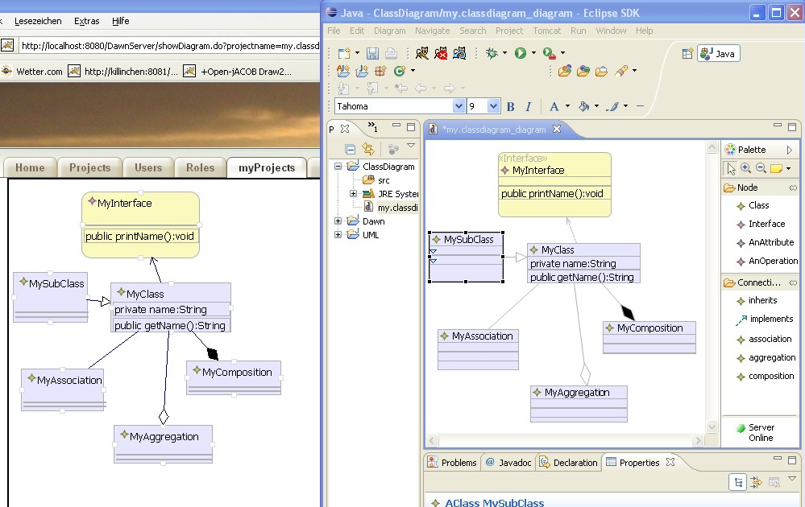
Dawn – Rise of Graphical Collaboration

Slide 50
Dawn – Rise of Graphical Collaboration
Conflict handling
Dawn provides detection and handling mechanisms for conflicts
It will build on the CDO conflict mechanisms and provide flexible and intuitive UI to handle conflicts
Conflicts are displayed inside the diagram editor. Conflicts that cannot be visualized inside the editor will be show in a special view (Dawn Conflict View)
Locking
Dawn will support locking on different hierarchy levels in the GMF diagram
Locked objects are marked with special visualisations
WebViewer/WebEditor
Dawn provides a web viewer to view changes in the diagram while they are processed in Eclipse
It also will support changing the diagram (adding/deleting/manipulating) in a browser
Allows editing GMF-diagrams on mobile devices even if no Java platform is installed

Slide 51
Dawn – Rise of Graphical Collaboration
Do not change existing code
A dynamic design and a flexible generator will make it possible to “collaborate” existing GMF editors even if the source is
Existing editor do not need to modified
Firewall transparency mode
Allows to operate from within restricted networks
This mode will use a web-based protocol on CDO
Network independence (Offline Mode)
Using one of the latest CDO features (offline support) Dawn will allow modifying GMF diagrams without a repository connection.
Authentication/Authorization
Providing access rights on diagram level will allow to protect your model data
Additionally the use of the diagram (show, modify, view) will be restrictable. Locking behaviour can also be influenced.

