Slide 1

Dawn Rise of the Collaborative UI
Martin Flügge
martin.fluegge@mftech.org
http://www.mftech.org
http://www.mftech.org/blog
Berlin, Germany
EclipseCon Santa Clara, March 24, 2010

Slide 2
one repository for huge models
transactional commit
offline support
notification to other clients
authentication and authorization
CDO
conflict detection and merging
failover and load balancing
object locking
versioning/ branching
scaleable

Slide 3
But what about your user interfaces?
?
?
?
?
CDO
?
?
?

Slide 4
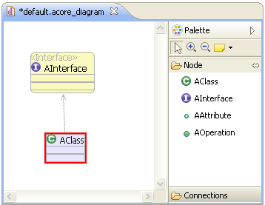
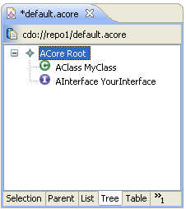
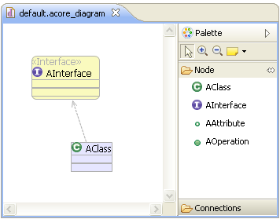
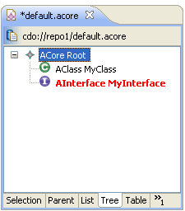
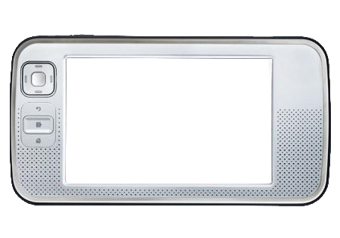
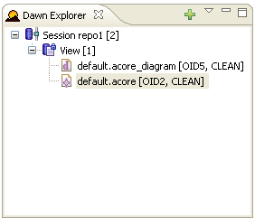
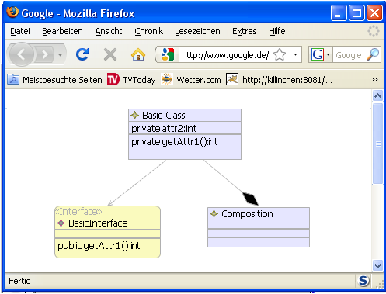
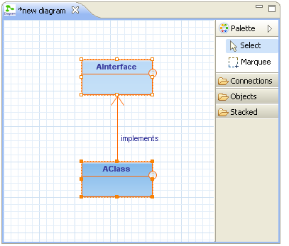
But what about your user interfaces?
?
?
?
?
CDO
?
?
?

Slide 5


Slide 6
How does it work?
CDO Model Repository
Dawn Runtime
GMF Extension
EMF Extension
Your GMF Editor
Your EMF Editor

Slide 7
Demo Time

Slide 8

Dawn - On the Road to Indigo
Helios
Integration of GMF editor
Integration of EMF (tree) editors
Web Viewer/Editor for Diagram editors
Integration of Graphiti
UI Locking Support
UI Access Control Support
Property View Integration ...
Indigo

Slide 9
Thank you for your attention!

