Slide 1


The Net4j Signalling Platform
Developing Pluggable Client/Server Applications
Eike Stepper
stepper@esc-net.de
http://www.esc-net.de
http://thegordian.blogspot.com
Berlin, Germany

Slide 2

Agenda
Requirements
Architecture
  Buffers
  Channels
  Connectors
  Acceptors
  Protocols
  Signals
Examples
FileShare Demo

Slide 3
Requirements
High performance
  java.nio.DirectByteBuffer, zero copying
Good scalability
  java.nio.channels.Selector, single I/O thread possible
Multiple transports
  Shipped with TCP, HTTP and JVM transports
Pluggable protocols
  Independent of chosen transport
Server-initiated push services (agent paradigm)
  Asynchronous and synchronous requests towards the client
OSGi™ and stand-alone modes

Slide 4

Architecture
TCP
JVM
App1
App2
Acceptors
Signals
Connectors
Protocols
Channels
Buffers
Utils
OSGi / Eclipse

Slide 5

Buffers
BufferState
IBufferHandler
handles
IBuffer
IBufferProvider
extends
BufferInputStream
reads
IBufferPool
BufferOutputStream
writes

Slide 6
Channels
IChannelMultiplexer
IBufferHandler
receiveHandler
IChannel
BufferInputStream
extends
ChannelInputStream
reads
BufferOutputStream
extends
ChannelOutputStream
writes

Slide 7

Connectors
ConnectorLocation
ConnectorState
IChannelMultiplexer
extends
IConnector
implements
TCPConnector
creates
JVMConnector
IBufferHandler
IChannel

Slide 8
Acceptors
JVMAcceptor
implements
IAcceptor
implements
TCPAcceptor
creates
accepts
creates
JVMConnector
implements
IConnector
implements
TCPConnector

Slide 9

Protocols
IBufferHandler
extends
IProtocol
uses
IChannel
IProtocolProvider
provides client protocol
provides server protocol

Slide 10

Signals
creates
SignalProtocol
implements
IProtocol
Signal
Thread
extends
extends
SignalActor
SignalReactor
runs in
extends
extends
extends
extends
Request
RequestWithConfirmation
Indication
IndicationWithResponse

Slide 11

Examples
public class JMSLogonRequest extends RequestWithConfirmation<Boolean> {
private String userName;
private String password;
public JMSLogonRequest(IChannel channel, String userName, String password) {
super(channel);
this.userName = userName;
this.password = password;
}
@Override
protected short getSignalID() { return JMSProtocolConstants.SIGNAL_LOGON; }
@Override
protected void requesting(ExtendedDataOutputStream out) throws IOException {
out.writeString(userName);
out.writeString(password);
}
@Override
protected Boolean confirming(ExtendedDataInputStream in) throws IOException {
return in.readBoolean();
}
}

Slide 12
Examples
public class JMSLogonIndication extends IndicationWithResponse
{
private boolean ok;
@Override
protected short getSignalID()
{
return JMSProtocolConstants.SIGNAL_LOGON;
}
@Override
protected void indicating(ExtendedDataInputStream in) throws IOException
{
String userName = in.readString();
String password = in.readString();
ok = JMSServer.INSTANCE.logon(userName, password);
}
@Override
protected void responding(ExtendedDataOutputStream out) throws IOException
{
out.writeBoolean(ok);
}
}

Slide 13
Examples
public class JMSServerProtocol extends SignalProtocol
{
public String getType()
{
return JMSProtocolConstants.PROTOCOL_NAME;
}
@Override
protected SignalReactor doCreateSignalReactor(short signalID)
{
switch (signalID)
{
case JMSProtocolConstants.SIGNAL_SYNC:
return new JMSSyncIndication();
case JMSProtocolConstants.SIGNAL_LOGON:
return new JMSLogonIndication();
}
return null;
}
}

Slide 14
Examples
// Start a TCP acceptor that is configured through extension points
IAcceptor acceptor = TCPUtil.getAcceptor(IPluginContainer.INSTANCE, "0.0.0.0:2036");
// Open a TCP connection that is configured through extension points
IConnector connector = TCPUtil.getConnector(IPluginContainer.INSTANCE, "localhost:2036");
// Open a channel with the JMS protocol
IChannel channel = connector.openChannel(JMSProtocolConstants.PROTOCOL_NAME);
try
{
// Create a logon request and send it through the channel
JMSLogonRequest request = new JMSLogonRequest(channel, "stepper", "secret");
boolean ok = request.send();
}
catch (Exception ex)
{
OM.LOG.error("Problem during logon", ex);
}
finally
{
channel.close();
}

Slide 15
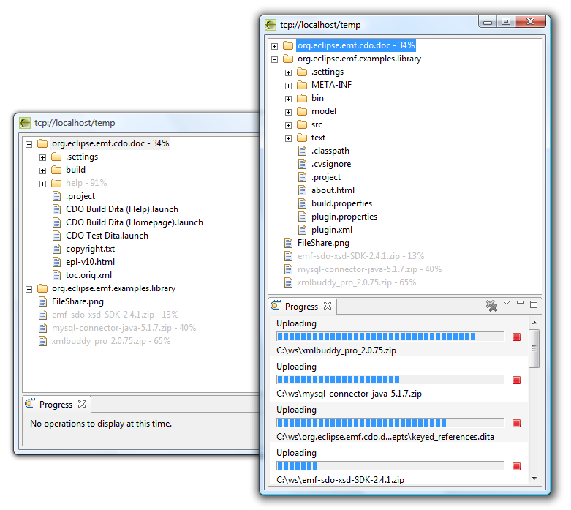

FileShare Demo

