Slide 1

Now that I've Got a Model
Eike Stepper
stepper@esc-net.de
http://www.esc-net.de
http://thegordian.blogspot.com
Berlin, Germany
Where's My Application?
EclipseCon Europe 2012
25.10.2012, Ludwigsburg

Slide 2
Now I've got a model !
But where's my application?
Now that I've Got a Model – Where's My Application?
© 2012 by Eike Stepper, Berlin, Germany. Made available under the EPL v1.0

Slide 3
User Interface
Storage Layer
Now that I've Got a Model – Where's My Application?
© 2012 by Eike Stepper, Berlin, Germany. Made available under the EPL v1.0

Slide 4

User Interface
interface Resource.Factory
{
Resource createResource(URI uri);
}
Resource
Resource
Storage Layer
Resource Set
Now that I've Got a Model – Where's My Application?
© 2012 by Eike Stepper, Berlin, Germany. Made available under the EPL v1.0

Slide 5
User Interface
Resource
Resource
Storage Layer
Resource Set
Now that I've Got a Model – Where's My Application?
© 2012 by Eike Stepper, Berlin, Germany. Made available under the EPL v1.0

Slide 6

User Interface
Storage Layer
Resource Set
Now that I've Got a Model – Where's My Application?
© 2012 by Eike Stepper, Berlin, Germany. Made available under the EPL v1.0

Slide 7
User Interface
Resource
Resource
Storage Layer
Resource Set
Now that I've Got a Model – Where's My Application?
© 2012 by Eike Stepper, Berlin, Germany. Made available under the EPL v1.0

Slide 8
Issues
URIs are quite general / need central setup
No overall dirty state
No commit / rollback (ACID)
No lifecycle / missing dispose()
Resource Set
Now that I've Got a Model – Where's My Application?
© 2012 by Eike Stepper, Berlin, Germany. Made available under the EPL v1.0

Slide 9
Data Volumes
Type | Instances
Classifications | 12
Products | 88
Components | 470
Versions | 1079
Myzillas | 27259
Comments | 35799
Total Objects | 64707
Resource Set
Now that I've Got a Model – Where's My Application?
© 2012 by Eike Stepper, Berlin, Germany. Made available under the EPL v1.0

Slide 10
User Interface
Storage Layer
Now that I've Got a Model – Where's My Application?
© 2012 by Eike Stepper, Berlin, Germany. Made available under the EPL v1.0

Slide 11

User Interface
Storage Layer
Now that I've Got a Model – Where's My Application?
© 2012 by Eike Stepper, Berlin, Germany. Made available under the EPL v1.0

Slide 12
User Interface
Storage Layer
Now that I've Got a Model – Where's My Application?
© 2012 by Eike Stepper, Berlin, Germany. Made available under the EPL v1.0

Slide 13
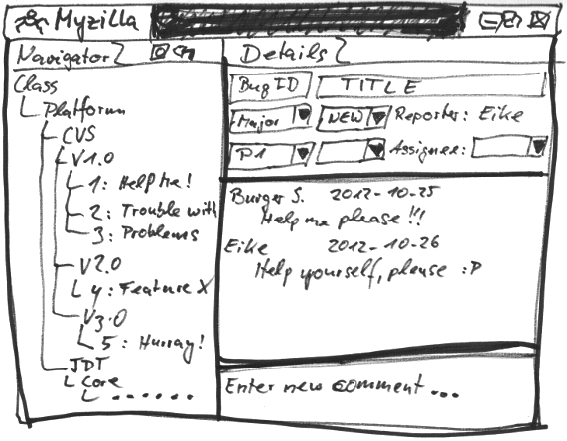
Now that I've Got a Model – Where's My Application?
© 2012 by Eike Stepper, Berlin, Germany. Made available under the EPL v1.0

Slide 14
Model Repository
Branch Manager
Session Manager
Session 1
Session 2
Session 3
Notification Manager
Commit Manager
Read / Write Access Handlers
Lock Manager
Query Manager / Handlers
Package Registry
Revision Manager
Store
Database
Now that I've Got a Model – Where's My Application?
© 2012 by Eike Stepper, Berlin, Germany. Made available under the EPL v1.0

Slide 15
Model Repository
LissomeStore
Custom…
HibernateStore
MongoStore
MEMStore
DB4OStore
DBStore
ObjectivityStore
Store
Database
Now that I've Got a Model – Where's My Application?
© 2012 by Eike Stepper, Berlin, Germany. Made available under the EPL v1.0

Slide 16
EMF Application
EMF Application
EMF Application
Model Repository
Now that I've Got a Model – Where's My Application?
© 2012 by Eike Stepper, Berlin, Germany. Made available under the EPL v1.0

Slide 17
Modify
EMF Application
EMF Application
EMF Application
Model Repository
Now that I've Got a Model – Where's My Application?
© 2012 by Eike Stepper, Berlin, Germany. Made available under the EPL v1.0

Slide 18
EMF Application
Commit
EMF Application
EMF Application
Model Repository
Now that I've Got a Model – Where's My Application?
© 2012 by Eike Stepper, Berlin, Germany. Made available under the EPL v1.0

Slide 19
EMF Application
EMF Application
EMF Application
Invalidate
Model Repository
Now that I've Got a Model – Where's My Application?
© 2012 by Eike Stepper, Berlin, Germany. Made available under the EPL v1.0

Slide 20
EMF Application
EMF Application
EMF Application
Invalidate
Model Repository
Now that I've Got a Model – Where's My Application?
© 2012 by Eike Stepper, Berlin, Germany. Made available under the EPL v1.0

Slide 21
EMF Application
EMF Application
EMF Application
Load
Model Repository
Now that I've Got a Model – Where's My Application?
© 2012 by Eike Stepper, Berlin, Germany. Made available under the EPL v1.0

Slide 22
EMF Application
EMF Application
EMF Application
Load
Model Repository
Now that I've Got a Model – Where's My Application?
© 2012 by Eike Stepper, Berlin, Germany. Made available under the EPL v1.0

Slide 23
EMF Application
Model Repository
Now that I've Got a Model – Where's My Application?
© 2012 by Eike Stepper, Berlin, Germany. Made available under the EPL v1.0

Slide 24
EMF Application
Model Repository
v1
v1
v1
Now that I've Got a Model – Where's My Application?
© 2012 by Eike Stepper, Berlin, Germany. Made available under the EPL v1.0

Slide 25
EMF Application
Model Repository
v1
v1
v1
v1
v1
v1
Now that I've Got a Model – Where's My Application?
© 2012 by Eike Stepper, Berlin, Germany. Made available under the EPL v1.0

Slide 26
EMF Application
Model Repository
v1
v2
v1
v2
v1
v1
Now that I've Got a Model – Where's My Application?
© 2012 by Eike Stepper, Berlin, Germany. Made available under the EPL v1.0

Slide 27
EMF Application
Model Repository
v1
v3
v2
v3
v2
v1
Now that I've Got a Model – Where's My Application?
© 2012 by Eike Stepper, Berlin, Germany. Made available under the EPL v1.0

Slide 28
EMF Application
Model Repository
v2
v4
v3
v4
v2
v1
Now that I've Got a Model – Where's My Application?
© 2012 by Eike Stepper, Berlin, Germany. Made available under the EPL v1.0

Slide 29
EMF Application
Auditing
Model Repository
Now that I've Got a Model – Where's My Application?
© 2012 by Eike Stepper, Berlin, Germany. Made available under the EPL v1.0

Slide 30
EMF Application
Auditing
Model Repository
v1
v1
v1
Now that I've Got a Model – Where's My Application?
© 2012 by Eike Stepper, Berlin, Germany. Made available under the EPL v1.0

Slide 31
EMF Application
Auditing
Model Repository
v1
v1
v1
v1
v1
v1
Now that I've Got a Model – Where's My Application?
© 2012 by Eike Stepper, Berlin, Germany. Made available under the EPL v1.0

Slide 32
EMF Application
Auditing
Model Repository
v2
v2
v1
v1
v1
v1
v1
v1
Now that I've Got a Model – Where's My Application?
© 2012 by Eike Stepper, Berlin, Germany. Made available under the EPL v1.0

Slide 33
EMF Application
Auditing
Model Repository
v3
v3
v2
v2
v2
v2
v1
v1
v1
v1
v1
v1
Now that I've Got a Model – Where's My Application?
© 2012 by Eike Stepper, Berlin, Germany. Made available under the EPL v1.0

Slide 34
EMF Application
Auditing
Model Repository
v4
v4
v3
v3
v3
v2
v2
v2
v2
v2
v1
v1
v1
v1
v1
v1
Now that I've Got a Model – Where's My Application?
© 2012 by Eike Stepper, Berlin, Germany. Made available under the EPL v1.0

Slide 35
EMF Application
Auditing
Branching
Model Repository
v4
v4
v3
v3
v3
v2
v2
v2
v2
v2
v1
v1
v1
v1
v1
v1
Now that I've Got a Model – Where's My Application?
© 2012 by Eike Stepper, Berlin, Germany. Made available under the EPL v1.0

Slide 36
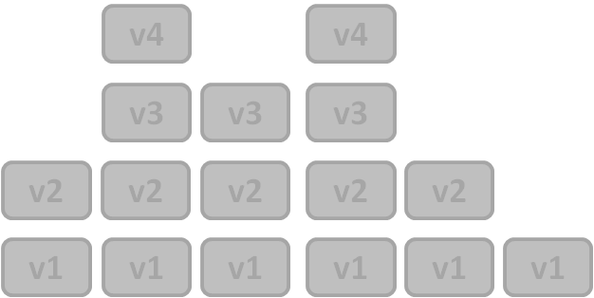
EMF Application
Auditing
Branching
Model Repository
v4
v4
v3
v3
v3
v2
v2
v2
v2
v2
v1
v1
v1
v1
v1
v1
Now that I've Got a Model – Where's My Application?
© 2012 by Eike Stepper, Berlin, Germany. Made available under the EPL v1.0

Slide 37
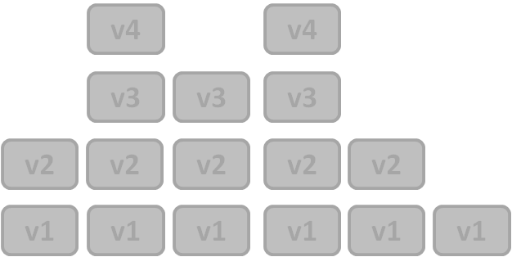
EMF Application
Auditing
Branching
Model Repository
v4
v4
v4
v4
v3
v3
v3
v3
v3
v3
v2
v2
v2
v2
v2
v2
v2
v2
v2
v2
v1
v1
v1
v1
v1
v1
v1
v1
v1
v1
v1
v1
Now that I've Got a Model – Where's My Application?
© 2012 by Eike Stepper, Berlin, Germany. Made available under the EPL v1.0

Slide 38

EMF Application
Auditing
Branching
Model Repository
v4
v4
v4
v4
v4
v4
v3
v3
v3
v3
v3
v3
v3
v3
v3
v2
v2
v2
v2
v2
v2
v2
v2
v2
v2
v2
v2
v2
v2
v2
v1
v1
v1
v1
v1
v1
v1
v1
v1
v1
v1
v1
v1
v1
v1
v1
v1
v1
Now that I've Got a Model – Where's My Application?
© 2012 by Eike Stepper, Berlin, Germany. Made available under the EPL v1.0

Slide 39
CDORevision
Revision Data
EClass
CDOID
CDOBranch
int
long
long
eClass
id
branch
version
created
revised
CDOID resourceID
CDOID containerID
int containerFeature
Object[] values
v4
Now that I've Got a Model – Where's My Application?
© 2012 by Eike Stepper, Berlin, Germany. Made available under the EPL v1.0

Slide 40
Session
View
Audit
Transaction
View
Audit
Transaction
View
Audit
Transaction
1
1
1
v4
Package Registry
Revision Manager
1
Package Unit
1
1
2
2
3
3
4
v3
4
v3
v3
v3
v3
v3
Package Unit
v2
v2
v2
v2
v2
v2
v2
v2
v2
Package Unit
v1
v1
v1
v1
v1
v1
v1
v1
Package Unit
Protocol
1100101001110111010010011110101110101
Now that I've Got a Model – Where's My Application?
© 2012 by Eike Stepper, Berlin, Germany. Made available under the EPL v1.0

Slide 41

BookImpl
1
Reflective Delegation
String title
int pages
Category category
Writer author
String title
int pages
Category category
Writer author
Root Extends Class
Now that I've Got a Model – Where's My Application?
© 2012 by Eike Stepper, Berlin, Germany. Made available under the EPL v1.0

Slide 42
EObjectImpl
BookImpl
CDOObjectImpl
Now that I've Got a Model – Where's My Application?
© 2012 by Eike Stepper, Berlin, Germany. Made available under the EPL v1.0

Slide 43
CDOObjectImpl
CDOID
CDORevision
CDOState
CDOView
Now that I've Got a Model – Where's My Application?
© 2012 by Eike Stepper, Berlin, Germany. Made available under the EPL v1.0

Slide 44
P E R S I S T E N T
attach to view
NEW
commit
commit
DIRTY
TRANSIENT
remote
invalidate
CLEAN
write
detach from view
remote
invalidate
read
PROXY
CONFLICT
rollback
Now that I've Got a Model – Where's My Application?
© 2012 by Eike Stepper, Berlin, Germany. Made available under the EPL v1.0

Slide 45
InternalEObject
P E R S I S T E N T
InternalCDOObject
attach to view
NEW
commit
commit
DIRTY
TRANSIENT
remote
invalidate
CLEAN
write
detach from view
CDOObjectImpl
CDOLegacyAdapter
remote
invalidate
read
PROXY
CONFLICT
rollback
DynamicCDOObject
Generated Classes
Generated Classes
Now that I've Got a Model – Where's My Application?
© 2012 by Eike Stepper, Berlin, Germany. Made available under the EPL v1.0

Slide 46
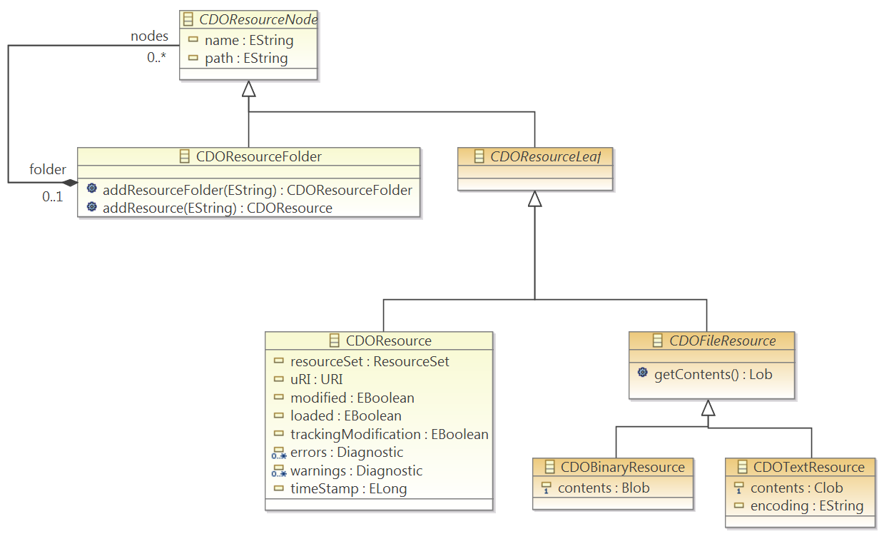
Now that I've Got a Model – Where's My Application?
© 2012 by Eike Stepper, Berlin, Germany. Made available under the EPL v1.0

Slide 47
Thank You
Please evaluate this session…
Now that I've Got a Model – Where's My Application?
© 2012 by Eike Stepper, Berlin, Germany. Made available under the EPL v1.0

