Slide 1

Scale, Share and Store your Models with CDO
Eike Stepper
stepper@esc-net.de
http://www.esc-net.de
http://thegordian.blogspot.com
Berlin, Germany
Eclipse Banking Day, June 1, 2010
IBM Danmark , Copenhagen

Slide 2
EMF Application
A.xml
A.xml
B.xml
B.xml
C.xml
C.xml
D.xml
D.xml
E.xml
E.xml
SCM

Slide 3
EMF Application
Huge models require lots of smaller files
Partitioning must be done at design time
Saving changes is not transactional safe
Loading single objects is still impossible
Garbage collection of objects is impossible
Conflicts must be resolved in text form
No change notifications to other clients

Slide 4
EMF Application
Does not scale well
Not well-suited for multi-user

Slide 5
EMF Application
EMF Application
EMF Application
Model Repository

Slide 6
Modify
EMF Application
EMF Application
EMF Application
Model Repository

Slide 7
EMF Application
Commit
EMF Application
EMF Application
Model Repository

Slide 8
EMF Application
EMF Application
EMF Application
Invalidate
Model Repository

Slide 9
EMF Application
EMF Application
EMF Application
Invalidate
Model Repository

Slide 10
EMF Application
EMF Application
EMF Application
Load
Model Repository

Slide 11
EMF Application
EMF Application
EMF Application
Load
Model Repository

Slide 12
EMF Application
Model Repository

Slide 13
EMF Application
Model Repository
v1
v1
v1

Slide 14
EMF Application
Model Repository
v1
v1
v1
v1
v1
v1

Slide 15
EMF Application
Model Repository
v1
v2
v1
v2
v1
v1

Slide 16
EMF Application
Model Repository
v1
v3
v2
v3
v2
v1

Slide 17
EMF Application
Model Repository
v2
v4
v3
v4
v2
v1

Slide 18
EMF Application
Auditing
Model Repository

Slide 19
EMF Application
Auditing
Model Repository
v1
v1
v1

Slide 20
EMF Application
Auditing
Model Repository
v1
v1
v1
v1
v1
v1

Slide 21
EMF Application
Auditing
Model Repository
v2
v2
v1
v1
v1
v1
v1
v1

Slide 22
EMF Application
Auditing
Model Repository
v3
v3
v2
v2
v2
v2
v1
v1
v1
v1
v1
v1

Slide 23
EMF Application
Auditing
Model Repository
v4
v4
v3
v3
v3
v2
v2
v2
v2
v2
v1
v1
v1
v1
v1
v1

Slide 24
EMF Application
Auditing
Branching
Model Repository
v4
v4
v3
v3
v3
v2
v2
v2
v2
v2
v1
v1
v1
v1
v1
v1

Slide 25
EMF Application
Auditing
Branching
Model Repository
v4
v4
v4
v4
v3
v3
v3
v3
v3
v3
v2
v2
v2
v2
v2
v2
v2
v2
v2
v2
v1
v1
v1
v1
v1
v1
v1
v1
v1
v1
v1
v1

Slide 26
EMF Application
Auditing
Branching
Model Repository
v4
v4
v4
v4
v4
v4
v4
v4
v3
v3
v3
v3
v3
v3
v3
v3
v3
v3
v3
v3
v2
v2
v2
v2
v2
v2
v2
v2
v2
v2
v2
v2
v2
v2
v2
v2
v2
v2
v2
v2
v1
v1
v1
v1
v1
v1
v1
v1
v1
v1
v1
v1
v1
v1
v1
v1
v1
v1
v1
v1
v1
v1
v1
v1

Slide 27
EMF Application
Auditing
Branching
Model Repository
v4
v4
v4
v4
v4
v4
v4
v4
v4
v4
v4
v4
v3
v3
v3
v3
v3
v3
v3
v3
v3
v3
v3
v3
v3
v3
v3
v3
v3
v3
v2
v2
v2
v2
v2
v2
v2
v2
v2
v2
v2
v2
v2
v2
v2
v2
v2
v2
v2
v2
v2
v2
v2
v2
v2
v2
v2
v2
v2
v2
v1
v1
v1
v1
v1
v1
v1
v1
v1
v1
v1
v1
v1
v1
v1
v1
v1
v1
v1
v1
v1
v1
v1
v1
v1
v1
v1
v1
v1
v1
v1
v1
v1
v1
v1
v1

Slide 28
CDORevision
Revision Data
EClass
CDOID
CDOBranch
int
long
long
eClass
id
branch
version
created
revised
CDOID resourceID
CDOID containerID
int containerFeature
Object[] values
v4

Slide 29
Session
View
Audit
Transaction
View
Audit
Transaction
View
Audit
Transaction
1
1
1
v4
Package Registry
Revision Manager
1
Package Unit
1
1
2
2
3
3
4
v3
4
v3
v3
v3
v3
v3
Package Unit
v2
v2
v2
v2
v2
v2
v2
v2
v2
Package Unit
v1
v1
v1
v1
v1
v1
v1
v1
Package Unit
Protocol
1100101001110111010010011110101110101

Slide 30
BookImpl
1
Reflective Delegation
String title
int pages
Category category
Writer author
String title
int pages
Category category
Writer author
Root Extends Class

Slide 31
EObjectImpl
BookImpl
CDOObjectImpl

Slide 32
CDOObjectImpl
CDOID
CDOView
CDORevision
CDOState

Slide 33
P E R S I S T E N T
attach to view
NEW
commit
commit
DIRTY
TRANSIENT
remote
invalidate
CLEAN
write
detach from view
remote
invalidate
read
PROXY
CONFLICT
rollback

Slide 34
InternalEObject
P E R S I S T E N T
InternalCDOObject
attach to view
NEW
commit
commit
DIRTY
TRANSIENT
remote
invalidate
CLEAN
write
detach from view
CDOObjectImpl
CDOLegacyAdapter
remote
invalidate
read
PROXY
CONFLICT
rollback
DynamicCDOObject
Generated Classes
Generated Classes

Slide 35
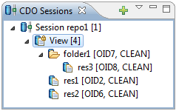
CDOResourceNode
CDOResource
CDOResourceFolder
CDOObjectImpl
Generated Classes

Slide 36
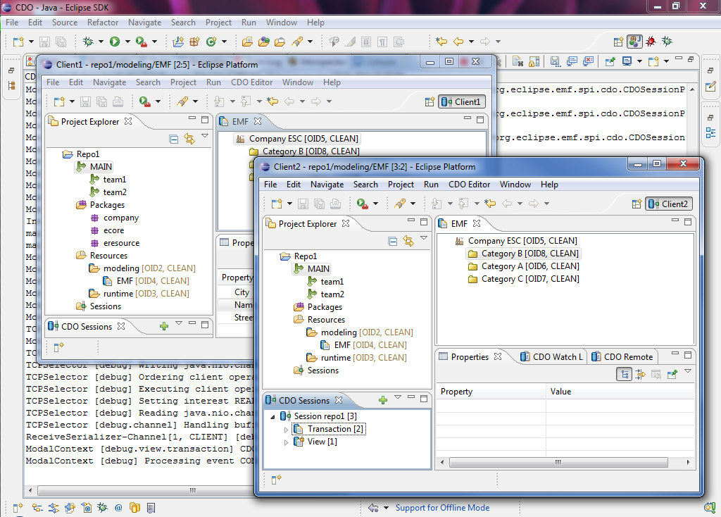

Slide 37
EMF Application
EMF Application
EMF Application
EMF Application
EMF Application
EMF Application
Clone Repository
Model Repository
Master Repository

Slide 38
EMF Application
EMF Application
EMF Application
Clone Repository
ONLINE
Master Repository

Slide 39
EMF Application
EMF Application
EMF Application
Clone Repository
OFFLINE
ONLINE
Master Repository

Slide 40
EMF Application
EMF Application
EMF Application
Clone Repository
OFFLINE
SYNCING
Master Repository

Slide 41
EMF Application
EMF Application
EMF Application
Clone Repository
ONLINE
Master Repository

Slide 42
Model Repository
Branch Manager
Session Manager
Session 1
Session 2
Session 3
Notifcation Manager
Commit Manager
Read / Write Access Handlers
Lock Manager
Query Manager / Handlers
Package Registry
Revision Manager
Store
Database

Slide 43
Model Repository
????
ObjectivityStore
DB4OStore
HibernateStore
MEMStore
DBStore
Database

Slide 44
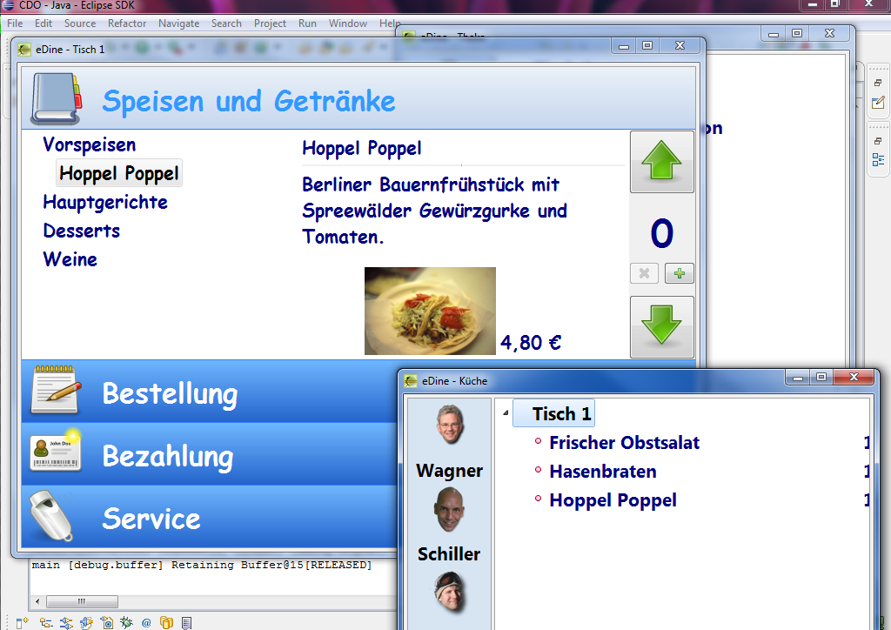

Slide 45
CDO Core Features

Slide 46
Distribution
Various ways to set up an IRepository
XML config file, programmatically, Spring, …
OSGi, stand-alone, …
All components customizeable
Various ways to open a CDOSession
Net4j: TCP, HTTP, embedded, …
CDO: embedded
Other transports possible
Offline mode coming soons
Cloned and sync’ed repository, normal sessions

Slide 47
Persistence
Pluggable storage backend adapters (IStores)
DBStore (CDO’s own O/R mapper)
HibernateStore / Teneo
ObjectivityStore
DB4OStore
MEMStore
Changing the store type does not affect client applications!

Slide 48
Resources
A CDOResource is an EObject
A repository contains CDOResourceNodes
CDOResourceFolders
CDOResources
The resource tree is
Navigable through EMF
Queryable through CDO

Slide 49
Versioning
CDO supports record temporality
Must be supported by IStore
Can be configured per IRepository
CDO supports branching
Must be supported by IStore
Can be configured per IRepository
A CDOView provides consistent graphs
From a particular branch
From a particular point in time

Slide 50
Scalability
Lazy loading at object granule
Lazy loading without container object
Partial collection loading, chunking
Adaptive prefetching
Manual prefetching
Automatic unloading at object granule

Slide 51
Queries
CDO includes a generic query framework
Supports any query language
Supports named parameters
Supports synchronous execution
Supports asynchronous execution
Query language handlers can be
plugged into an IRepository (OCL?, EMF-Q?, …)
implemented by an IStore (SQL, HQL, custom, …)

Slide 52
Transactionality
Strong transactional safety at model-level
Multiple transactions per session
Multiple save points per transaction
Rollback to any save point
Commit with progress monitoring
Hooks for custom transaction handlers
Conflict detection and fail-early-transactions
Pluggable conflict resolvers
Explicit read/write locking on object granule
XA transactions to multiple repositories

Slide 53
Collaboration
Passive Updates
Asynchronous commit notifications
Invalidation of objects, lazy reload if needed
Can be switched off per session
Change subscriptions
Asynchronous change delta delivery
Registration with repository per object
Automated through pluggable adapter policies
Remote session manager
Notifies about state of other sessions
Supports sending/receiving of arbitrary messages

Slide 54
Integration
Integrates with EMF at the model level, not at the edit- or UI-level.
Uninvasive to the .ecore file.
Best results with regenerated models (native)
Regeneration not needed (legacy)
Dynamic models supported
Multiple repositories per ResourceSet
External references

Slide 55
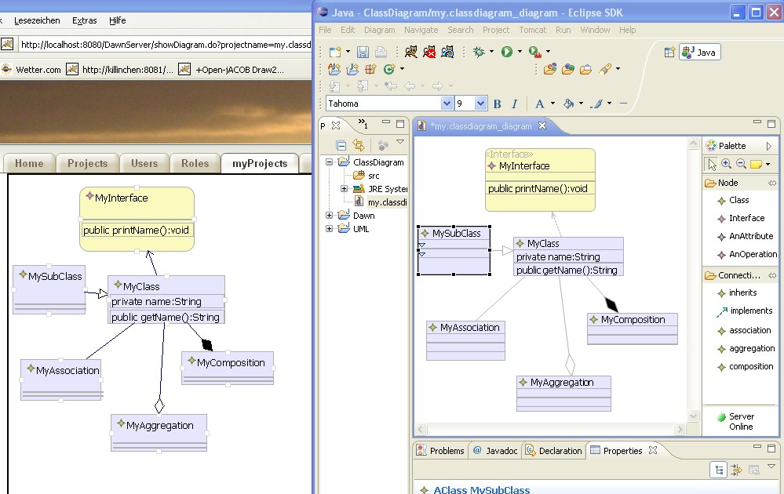
Dawn – Rise of Graphical Collaboration

Slide 56
Dawn – Rise of Graphical Collaboration
Conflict handling
Dawn provides detection and handling mechanisms for conflicts
It will build on the CDO conflict mechanisms and provide flexible and intuitive UI to handle conflicts
Conflicts are displayed inside the diagram editor. Conflicts that cannot be visualized inside the editor will be show in a special view (Dawn Conflict View)
Locking
Dawn will support locking on different hierarchy levels in the GMF diagram
Locked objects are marked with special visualisations
WebViewer/WebEditor
Dawn provides a web viewer to view changes in the diagram while they are processed in Eclipse
It also will support changing the diagram (adding/deleting/manipulating) in a browser
Allows editing GMF-diagrams on mobile devices even if no Java platform is installed

Slide 57
Dawn – Rise of Graphical Collaboration
Do not change existing code
A dynamic design and a flexible generator will make it possible to “collaborate” existing GMF editors even if the source is
Existing editor do not need to modified
Firewall transparency mode
Allows to operate from within restricted networks
This mode will use a web-based protocol on CDO
Network independence (Offline Mode)
Using one of the latest CDO features (offline support) Dawn will allow modifying GMF diagrams without a repository connection.
Authentication/Authorization
Providing access rights on diagram level will allow to protect your model data
Additionally the use of the diagram (show, modify, view) will be restrictable. Locking behaviour can also be influenced.

