Slide 1
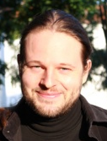
Let the sunshine in!
News from the Dawn side of life
Martin Flügge
martin.fluegge@mftech.org
http://www.mftech.org
http://www.mftech.org/blog
Berlin, Germany
EclipseCon Europe
Ludwigsburg, November 4, 2011

Slide 2





What is Dawn?
CDO
file://
Customized User Interfaces
Let the sunshine in! - News from the Dawn side of life
© 2011 by Martin Flügge, Berlin, Germany. Made available under the EPL v1.0

Slide 3

Let the sunshine in! - News from the Dawn side of life
© 2011 by Martin Flügge, Berlin, Germany. Made available under the EPL v1.0

Slide 4
Runtime
Collaborative UI extensions
Generators
Conflict Handling
Programming interfaces
Locking
Real-Time Shared Editing
Authentication/ Authorization
Let the sunshine in! - News from the Dawn side of life
© 2011 by Martin Flügge, Berlin, Germany. Made available under the EPL v1.0

Slide 5
How does it work?
CDO Model Repository
Dawn Runtime
GMF UI Extension
(generated Fragment)
EMF UI Extension
(generated Fragment)
Your GMF Editor
Your EMF Editor
Let the sunshine in! - News from the Dawn side of life
© 2011 by Martin Flügge, Berlin, Germany. Made available under the EPL v1.0

Slide 6
Internally
Dawn Runtime
IDawnUIElement
IDawnListener
IDawnEditingSupport
Extended UI
Dawn Runtime Extension
XYZEditor
DawnXYZListener
Dawn XYZEditor
DawnXYZEditingSupport
Dawn - Rise of the Collaborative UI
© 2011 by Martin Flügge, Berlin, Germany. Made available under the EPL v1.0

Slide 7
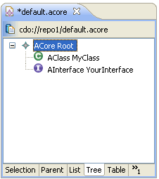
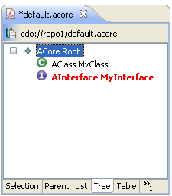
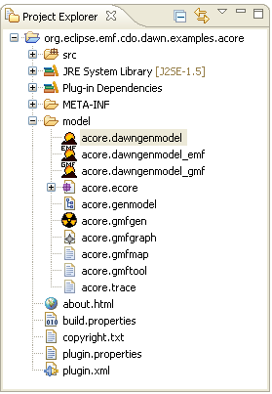
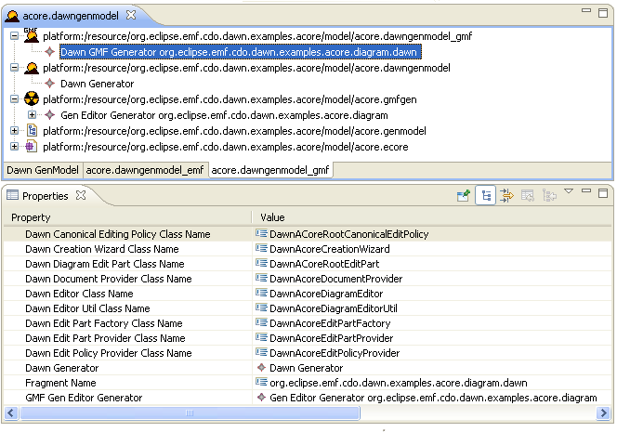
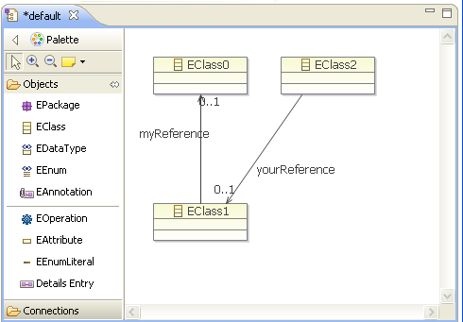
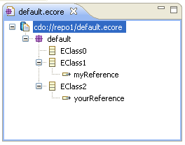
Dawn 1.0
EMF editor integration
Dawn-GenModel spit up
Ecore Tools Editor und Ecore Editor extension
Let the sunshine in! - News from the Dawn side of life
© 2011 by Martin Flügge, Berlin, Germany. Made available under the EPL v1.0

Slide 8
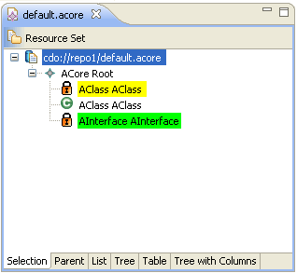
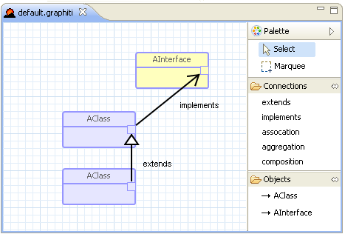
Dawn 2.0 …
Locking for all editors
Visualization of local/remote locks
Locking Strategies
No generation needed
Generic Editor and Wizard
Custom editor and Wizard
No Legacy Mode required
Let the sunshine in! - News from the Dawn side of life
© 2011 by Martin Flügge, Berlin, Germany. Made available under the EPL v1.0

Slide 9
Demo Time
Dawn - Rise of the Collaborative UI
© 2011 by Martin Flügge, Berlin, Germany. Made available under the EPL v1.0

Slide 10

Dawn - On the Road to Indigo
Indigo
Runtime Extension (split up) (done)
Integration of Graphiti (work in progress)
UI Locking Support (work in progress)
Property View Integration
UI Access Control Support
Web Portal
...
Juno
Dawn - Rise of the Collaborative UI
© 2011 by Martin Flügge, Berlin, Germany. Made available under the EPL v1.0

Slide 11
Thank you for your attention!
http://wiki.eclipse.org/Dawn
martin.fluegge@mftech.org
Let the sunshine in! - News from the Dawn side of life
© 2010 by Martin Flügge, Berlin, Germany. Made available under the EPL v1.0

